Slide 1
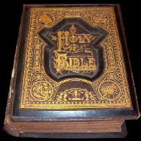
John 9:1-6 (約翰福音9:1-6)
As he went along, he saw a man blind from birth. His disciples asked him, “Rabbi, who sinned, this man or his parents, that he was born blind?”
“Neither this man nor his parents sinned,” said Jesus, “but this happened so that the works of God might be displayed in him. ….”
After saying this, he spit on the ground, made some mud with the saliva, and put it on the man’s eyes. “Go,” he told him, “wash in the Pool of Siloam” (this word means “Sent”). So the man went and washed, and came home seeing.
耶稣过去的时候，看见一个人生来是瞎眼的。门徒问耶稣说：拉比，这人生来是瞎眼的，是谁犯了罪？是这人呢？是他父母呢？
耶稣回答说：也不是这人犯了罪，也不是他父母犯了罪，是要在他身上显出神的作为来。。。”
耶稣说了这话，就吐唾沫在地上，用唾沫和泥抹在瞎子的眼睛上，对他说：你往西罗亚池子里去洗。他去一洗，回头就看见了。

Slide 2
Act 1: Preparation (制备)
1961年

Slide 3
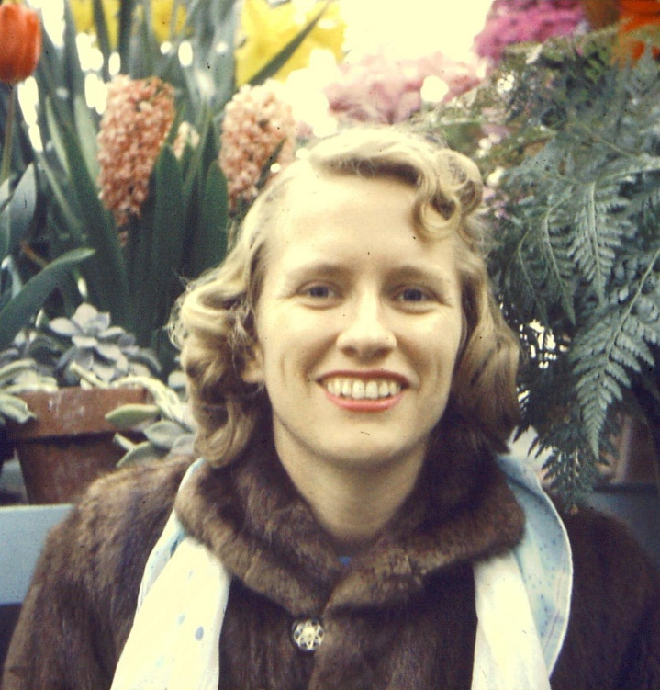
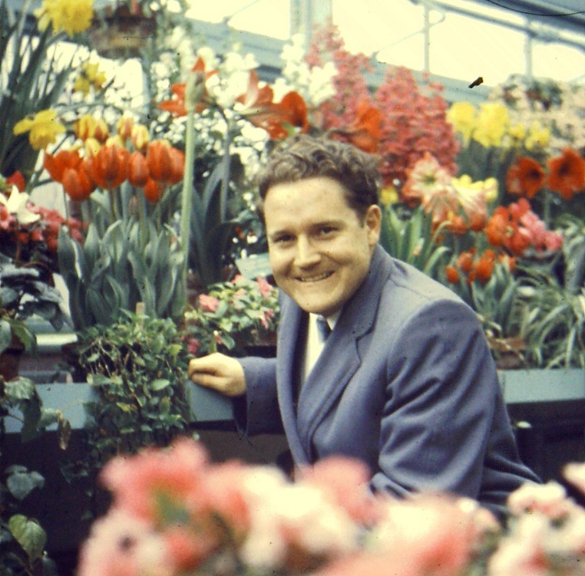
1957 Oakville, ON, Canada
体育老师 Physical Education Teacher
青年基督徒的领袖Christian Youth Leader
气喘 Asthma (Serious) →活不久 Short Life

Slide 4
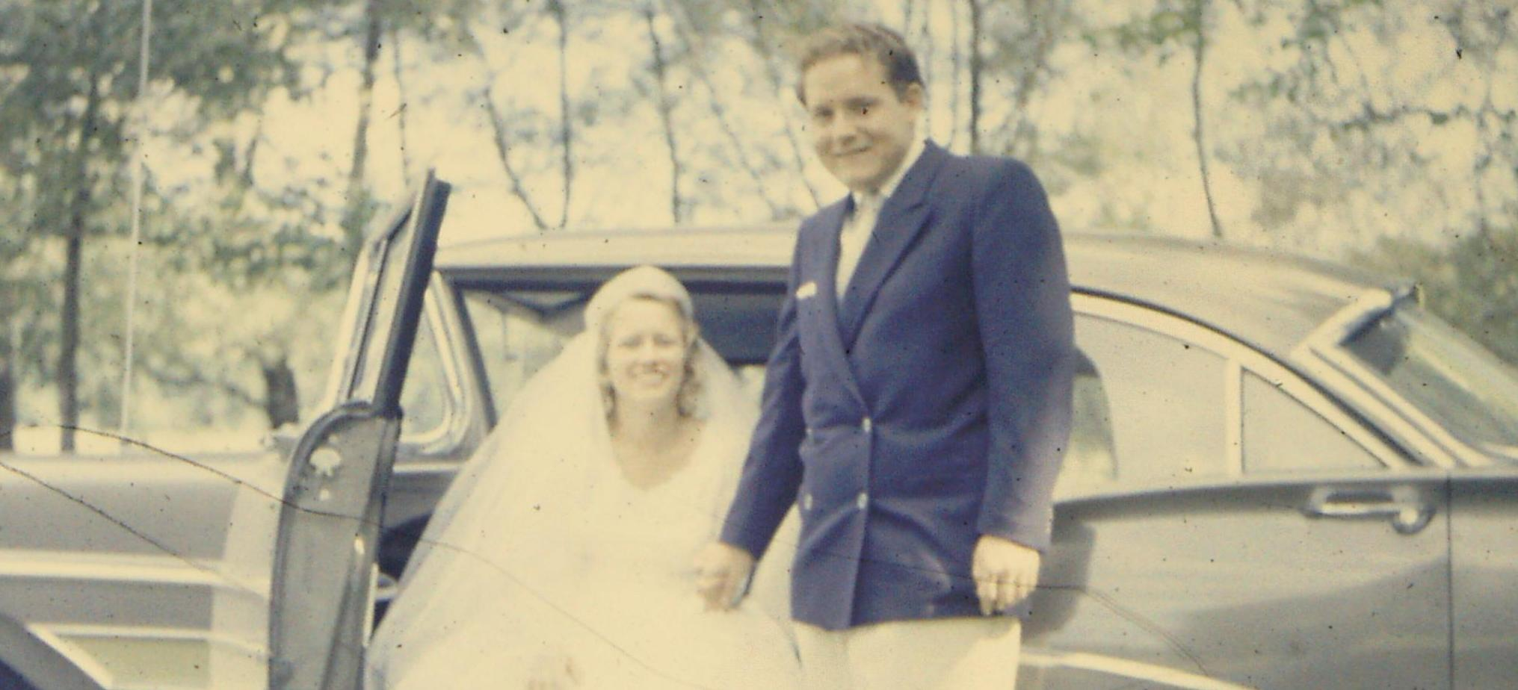
1957 Oakville, ON, Canada
1957年
8月17日
體育老師 Physical Education Teacher
青年基督徒的領袖Christian Youth Leader
氣喘 Asthma
心臟破洞 Hole in heart
醫生判定活不過兩年 < 2 years to live??

Slide 5
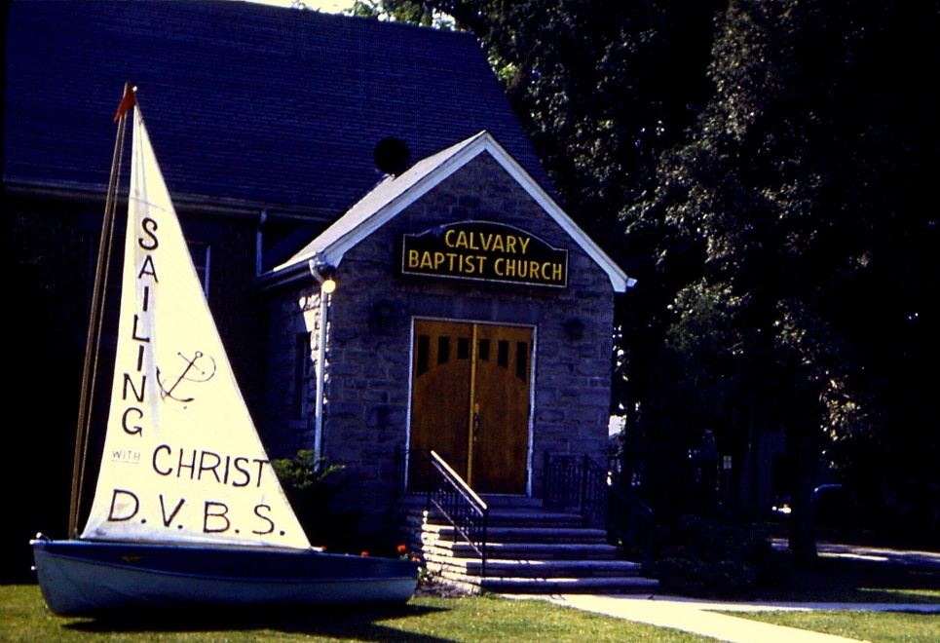
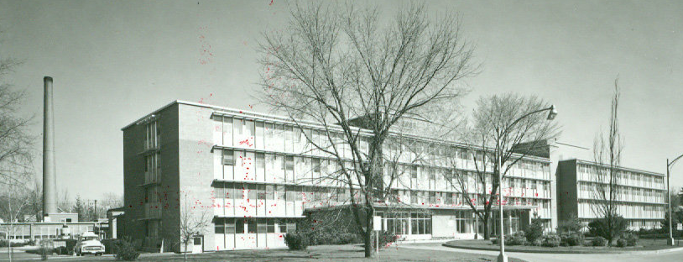
1961.05.10 A Baby (小宝宝来!)
伤心时刻 Not happy
医生告诉父亲 Doctor → father
  儿子将死 your son will die or be a vegetable
  试着救太太 try to save your wife
父亲请教会一起祷告 Father → church: Pray

Slide 6
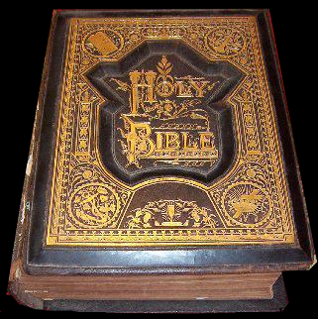
Two weeks later 兩星期後
One prayer answered: Mother goes home! Baby?
In Incubator
Severe Brain Damage
Doctor: Let Child Die
Parents: healthy or not we accept…
祷告得应允：妈妈回家！婴儿？
在保温箱
严重脑部受损
医生：让孩子自然死
父母：健康不健康 - 没关系
Children are a heritage from the Lord,
offspring a reward from him.
(Psalm 127)
儿女是耶和华所赐的产业;
所怀的胎是他所给的赏赐。
（诗篇127）

Slide 7
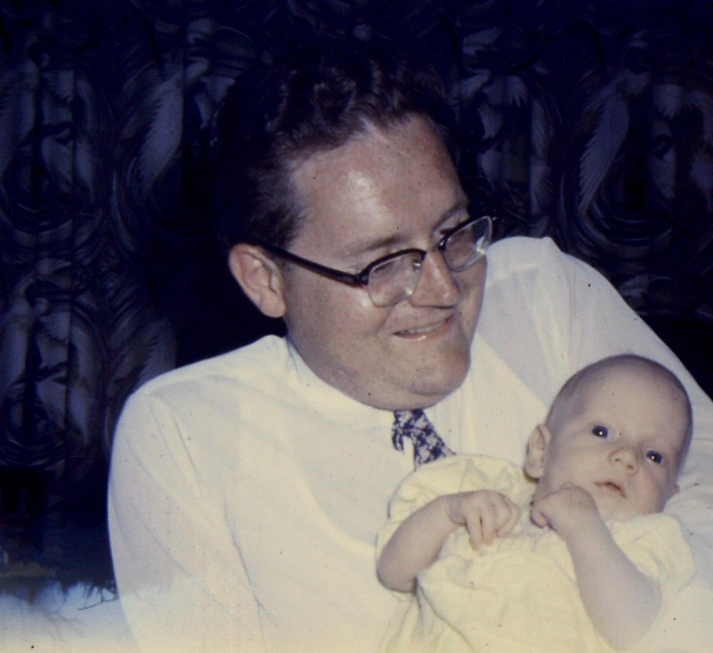
1961.06.10 一個月後
婴儿回家 Baby → home
脑部受损 Brain Damage
妈妈 mother
  第一次触摸 first touch
  停工作 mother end career
第一个相片 1st Pic →
Why God?
  My parents loved and served you.
  This mean my mother less time for ministry
上帝，为什么？
- 我的妈妈爸爸不是都事奉您？
- 这样我的妈妈没法专心事奉您？

Slide 8
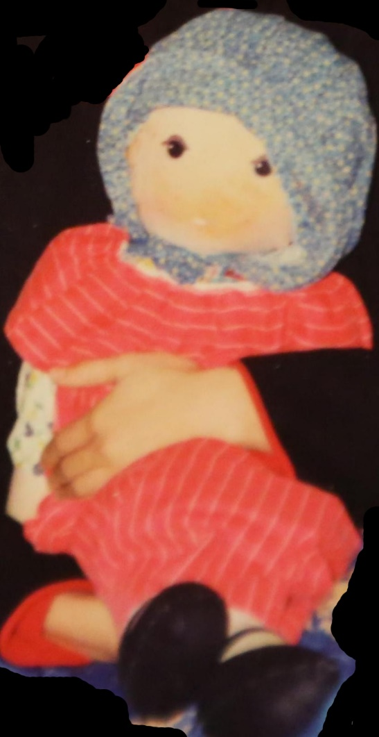
Act 2 (第2幕)
1983
1997年 -- 36 years later 36年后

Slide 9

God works with imperfect people to complete his perfect work.

Slide 10
Used by God 神用普通人 (Judges, 士师记)
3:15 Again the Israelites cried out to the Lord, and he gave them a deliverer—Ehud, a left-handed man, the son of Gera the Benjamite.
3:31After Ehud came Shamgar son of Anath, who struck down six hundred Philistines with an oxgoad. He too saved Israel.
4:21 But Jael, Heber’s wife, picked up a tent peg and a hammer and went quietly to him while he lay fast asleep, exhausted. She drove the peg through his temple into the ground, and he died.
3:15 以色列人呼求耶和华的时候，耶和华就为他们兴起一位拯救者，就是便雅悯人基拉的儿子以笏。他是左手便利的
3:31 以笏之后，有亚拿的儿子珊迦，他用赶牛的棍子打死六百非利士人。他也救了以色列人。
4:21 西西拉疲乏沉睡。希百的妻雅亿取了帐棚的橛子，手里拿着锤子，轻悄悄地到他旁边，将橛子从他鬓边钉进去，钉入地里。西西拉就死了。

Slide 11
Used by God 神用普通人 (Judges, 士师记)
7:20 The three companies blew the trumpets and smashed the jars. Grasping the torches in their left hands and holding in their right hands the trumpets they were to blow, they shouted, “A sword for the Lord and for Gideon!”
11:1 Jephthah the Gileadite was a mighty warrior. His father was Gilead; his mother was a prostitute.
15:15 Finding a fresh jawbone of a donkey, he grabbed it and struck down a thousand men.
7:20 三队的人就都吹角，打破瓶子，左手拿着火把，右手拿着角，喊叫说，耶和华和基甸的刀。
11:1 基列人耶弗他是个大能的勇士，是妓女的儿子。
15:15 他见一块未乾的驴腮骨，就伸手拾起来，用以击杀一千人。

Slide 12
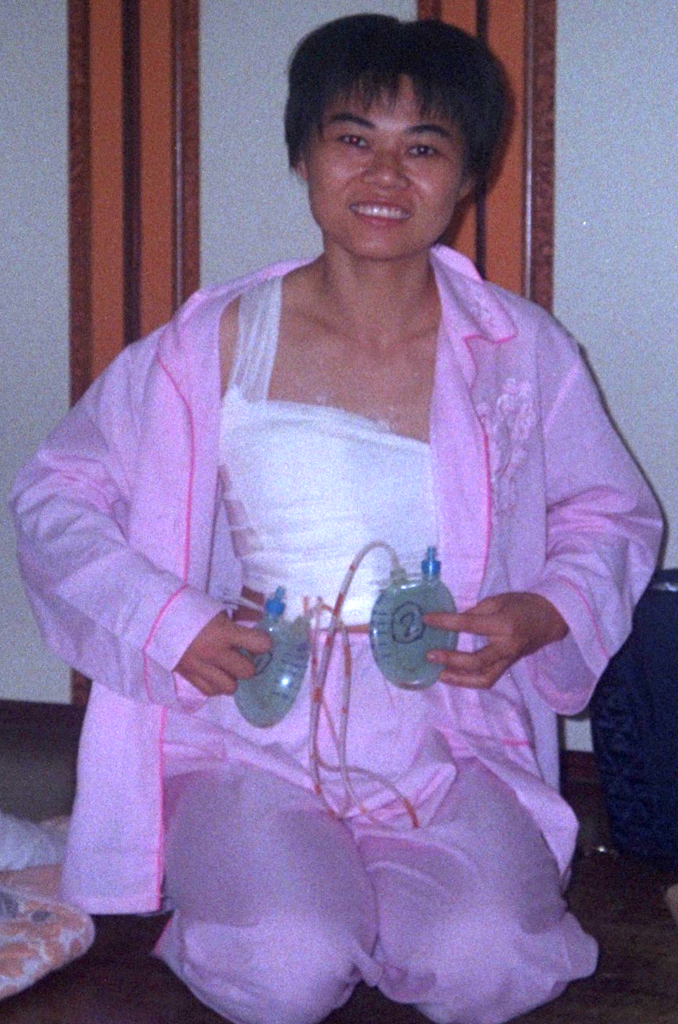
Many ask… 许多人问 “Why?”
Christians: “Sharon quit her job to work at church, did she go the wrong way?”
Non-Christians: “What crimes did Sharon’s ancestors commit?”
基督徒问：秀满顺服祢，放弃一切到教会服事 ，她走错路?
世人问：秀满或她的祖先做了什么坏事？

Slide 13
God Answered Me! 神对秀满的回答
The Blind Man (John 9)
…who comforts us
in all our troubles,
so that we can comfort
those in any trouble
with the comfort
we ourselves
receive from God.
瞎子的故事 (约翰9)
我们在一切患难中，
祂就安慰我们，
叫我们能用
神所赐的安慰
去安慰
那遭各样患难的人。
(2 Cr 1:4)
（林后1：4）

Slide 14
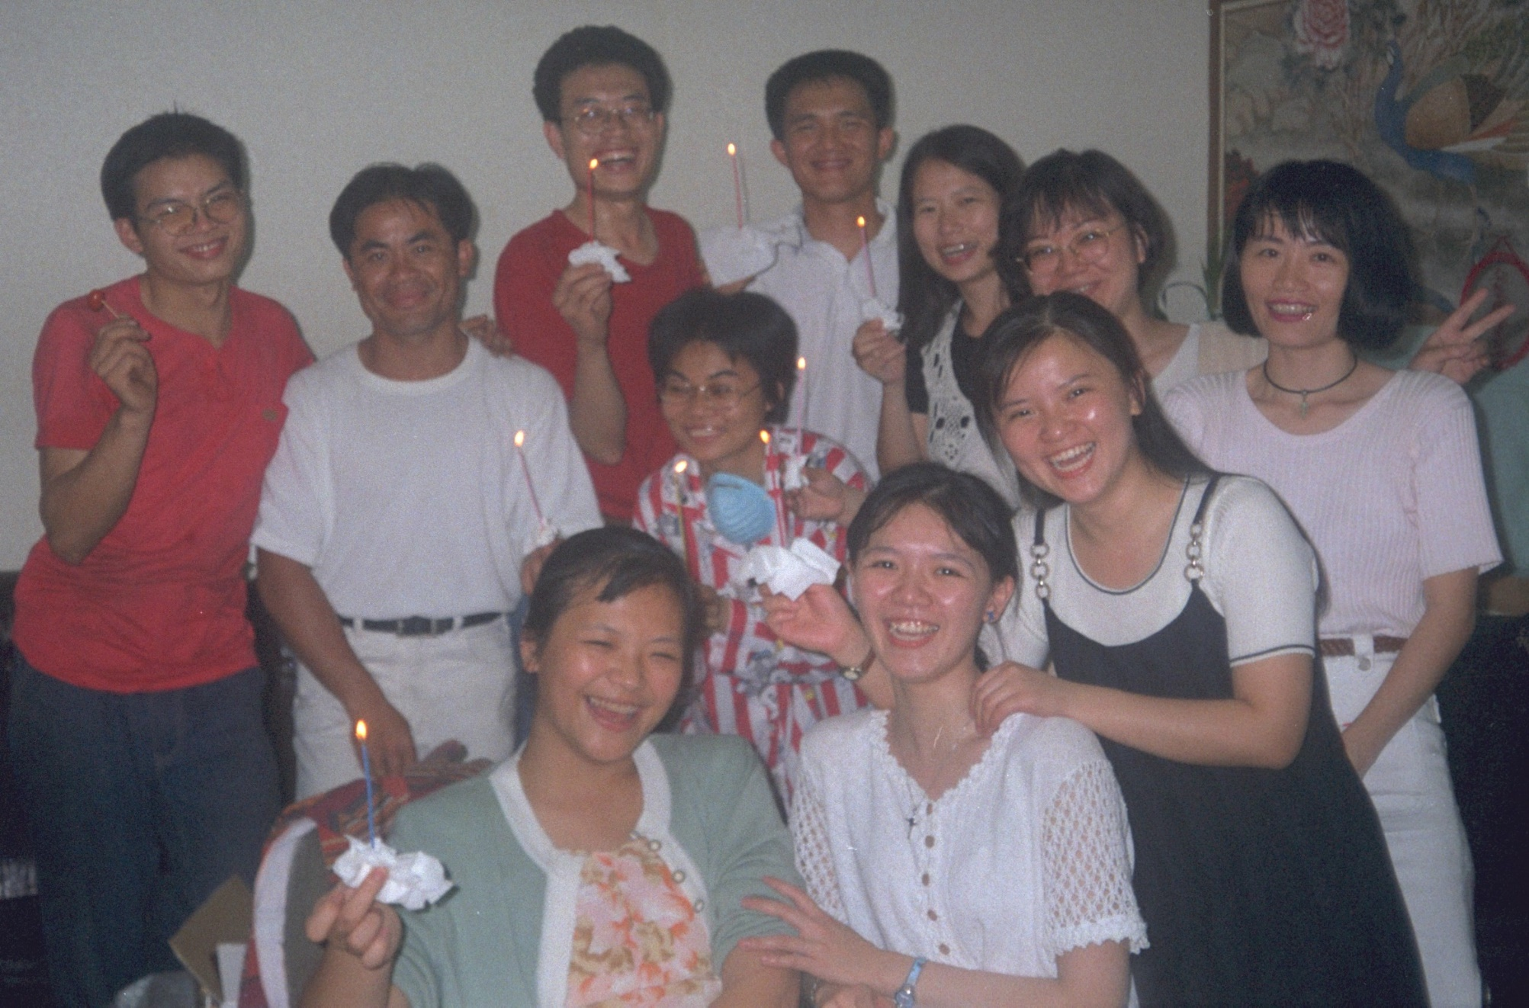
荣耀时刻 Moment of Glory
If one part suffers,
every part suffers with it;
if one part is honored,
every part rejoices with it.
(1 Cr 12:26)
若 一 个 肢 体 受 苦 ，
所 有 的 肢 体 就 一 同 受 苦 。
若 一 个 肢 体 得 荣 耀 ，
所 有 的 肢 体 就 一 同 快 乐 。
(歌前12:26)

Slide 15
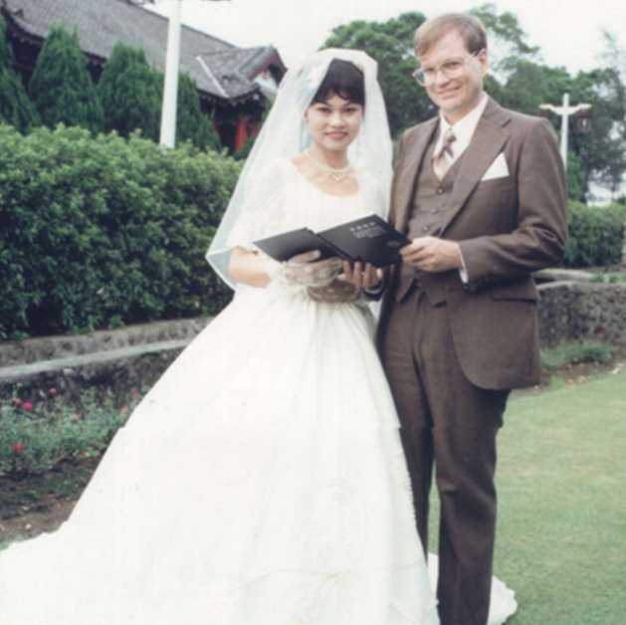
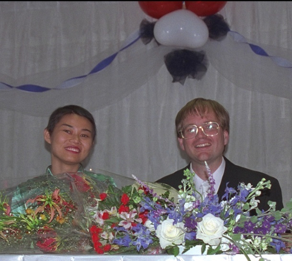
爱的见证 Witness of Love

Slide 16
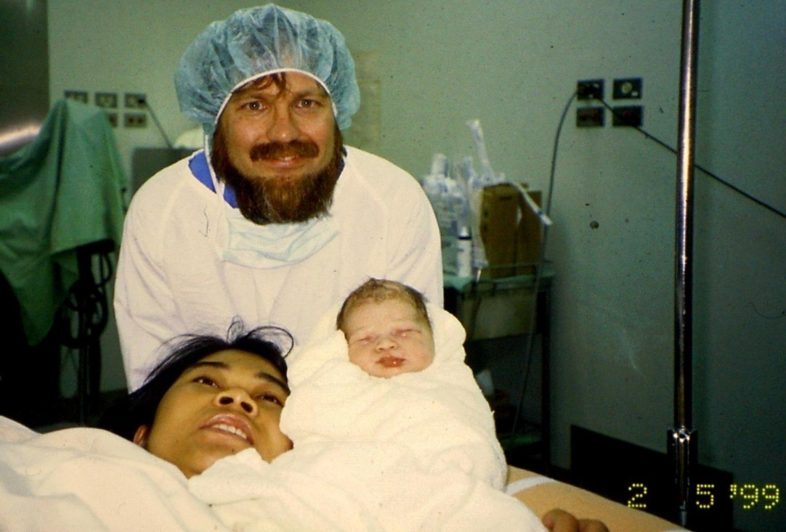
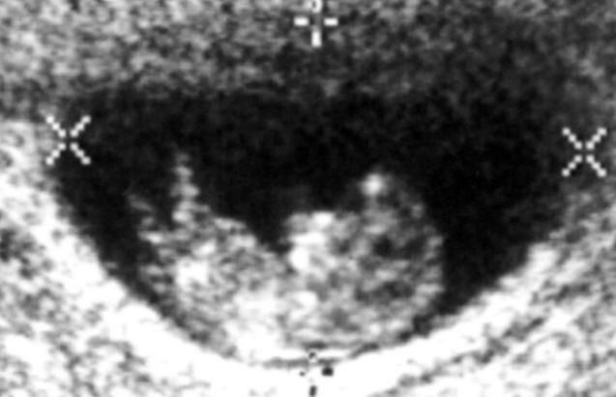
白爱恩 Charity-Grace (1999.05.02)
1998.09.26
Cannot have child (Why? X-grade drugs cause fetal deformation, high risk of death for mother, unhealthy child)
Oh no！Pregnant. Abortion suggested.
Heavenly Father, Why?
Aren’t I trying to serve you?
不可以有小孩 (服用X级药物不能有孩子: 胎儿会畸形, 妈妈可能死去, 小孩不健康)
糟糕! 怀孕了. 建议堕胎
天父, 为什么?
不是正努力服事祢吗?

Slide 17
白爱恩 Charity-Grace (1999.05.02)
1998.09.26
Accept child
- Children are a heritage from the Lord,
offspring a reward from him.
- Imitate those who through faith and patience
inherit what has been promised. (Hb 6:12)
Healthy or not we accept…
→ Daughter is healthy (Ai = love || cancer)
接纳孩子
- 儿女是耶和华所赐的产业;
所怀的胎是他所给的赏赐。
- 总要效法那些凭信心和忍耐
承受应许的人。(希 6:12)
健康不健康 - 没关系
→ 健康的爱(癌)恩

Slide 18
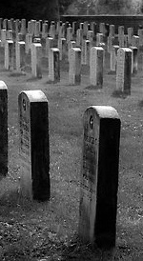
生命的黑暗时期(1999~2004)
Eager to serve God
Miscarriage – 3x
Depression tendency, cancer metastasis to the lungs?
Unspeakable pain
  Love children too much
  Experience too much grace → dare not complain
Heavenly Father, why?
2003.07 Moved back to Taiwan
渴望事奉上帝
流产三次
忧郁倾向，癌转移肺部？
说不出的痛苦
  太爱孩子
  经历太多恩典不敢抱怨
天父, 为什么?
2003.07 搬回台湾

Slide 19
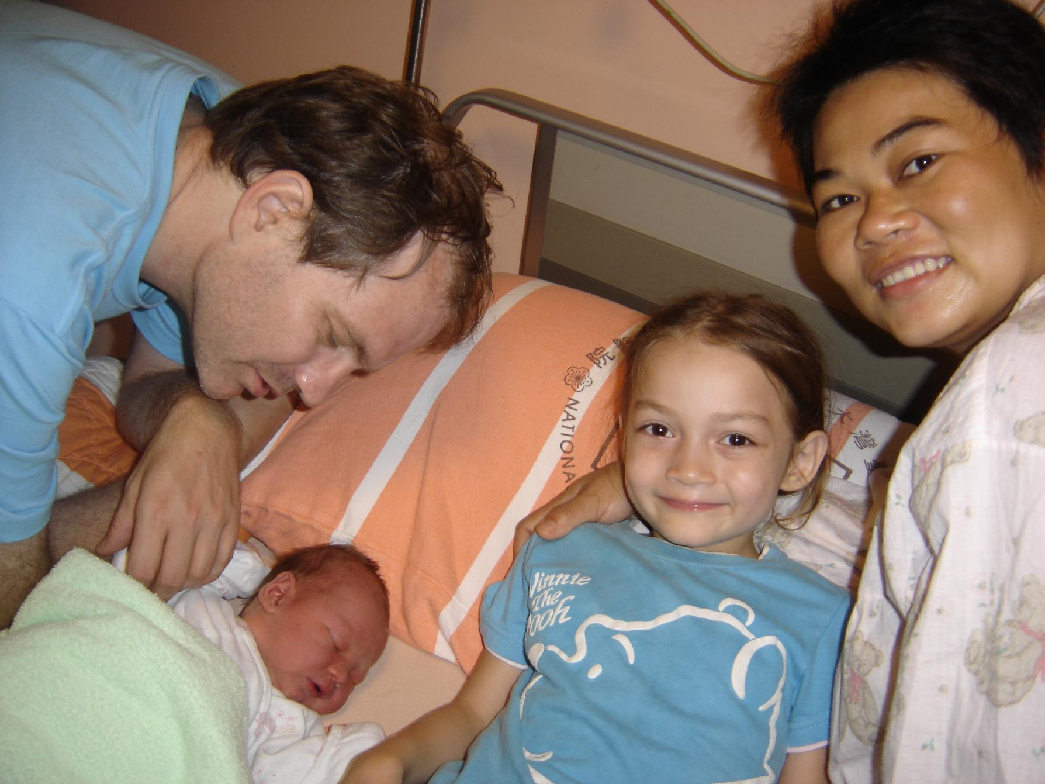
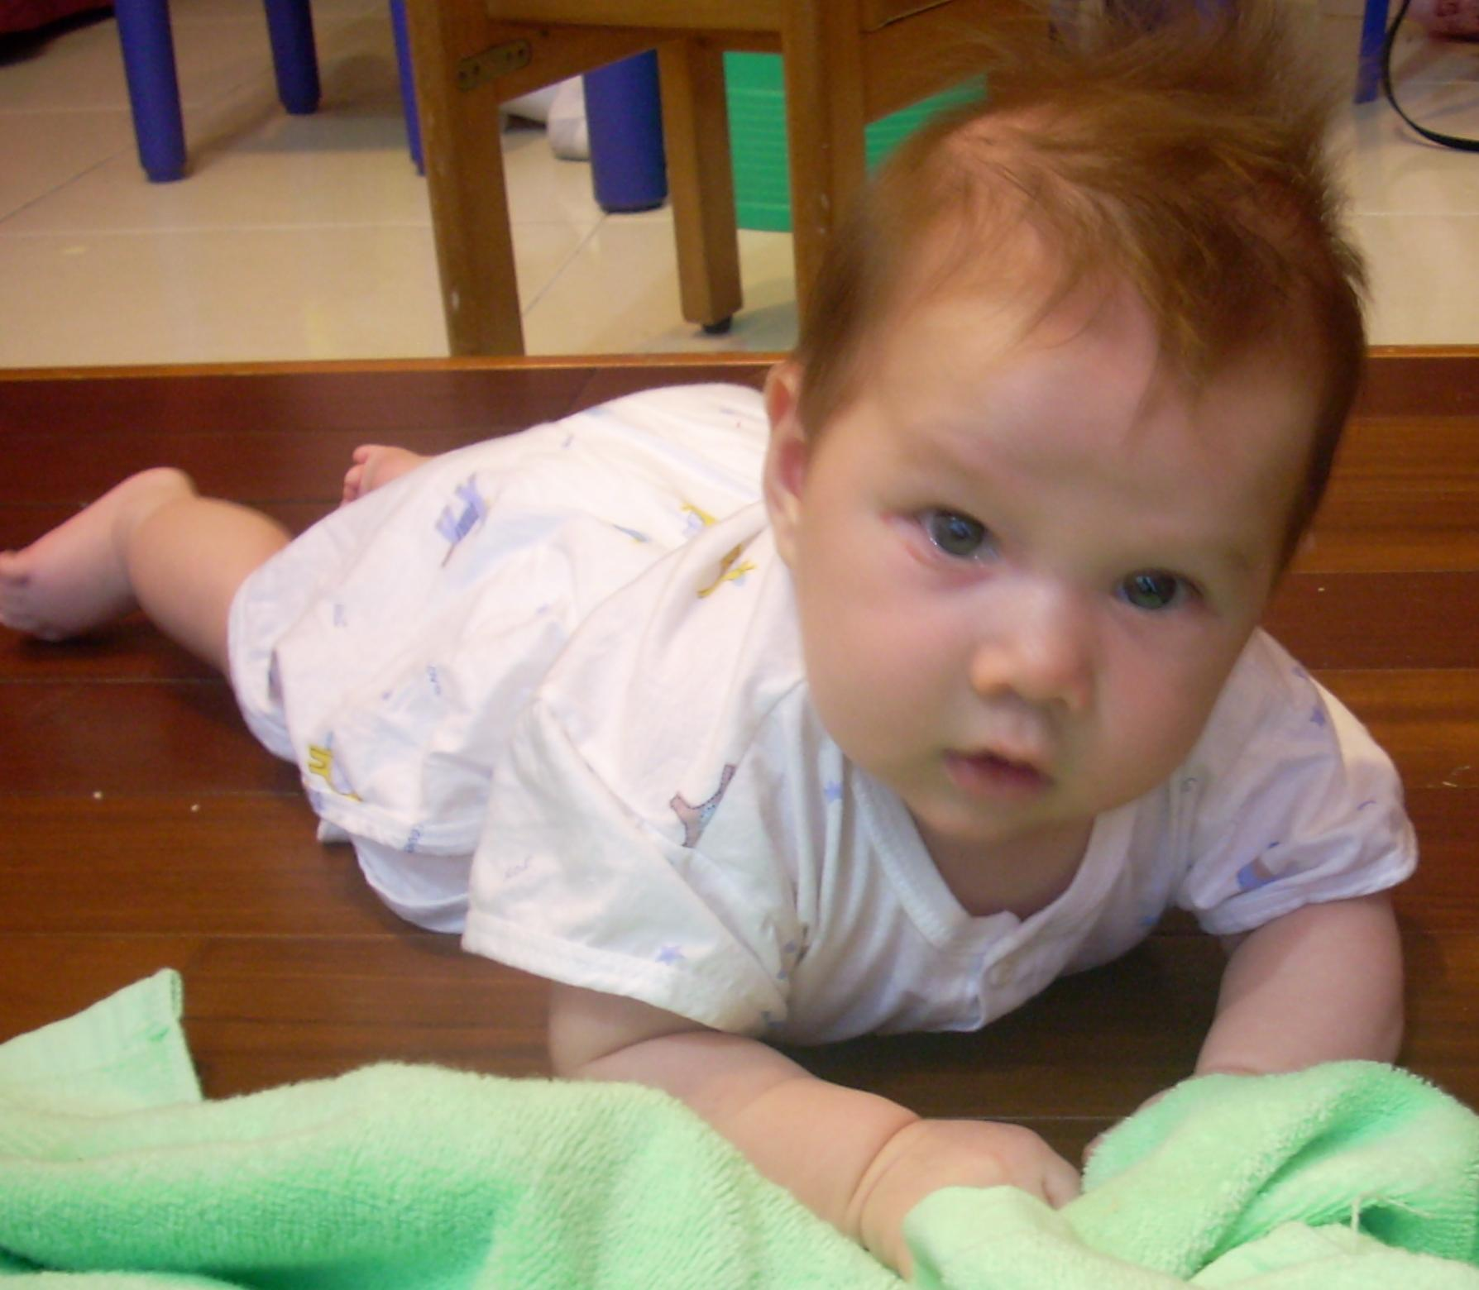
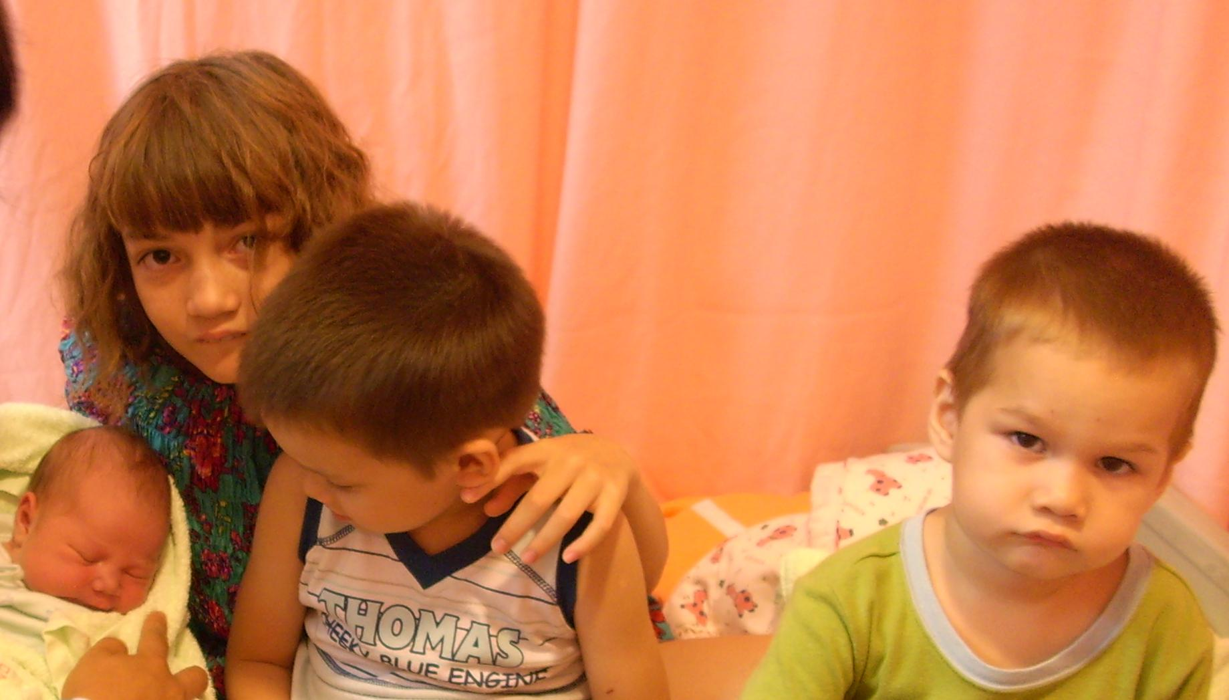
復活: 三位禮物 Recovery: 3 Gifts
又恩(2005), 力恩(2008), 亮恩(2010)
Johann, Leon Joshua, Ruth Ann
又恩(2005), 力恩(2008),
Johann, Leon Joshua
又恩(2005),
Johann

Slide 20
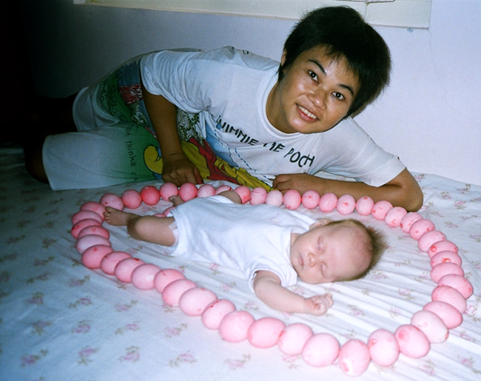
又恩的出生 Johann’s Birth
就在心被医治没几个月
就怀孕了
当时的状况：
右肺下有0.6公分的肿瘤
这是神再一次的恩典
Just a few months after my heart was healed,
I became pregnant.
Situation: 0.6 cm tumor under the right lung
God’s grace a 2nd time!.

Slide 21
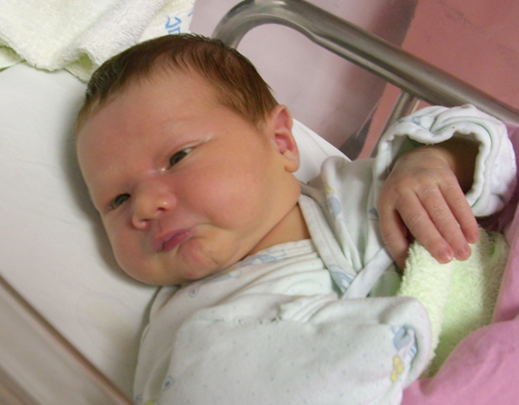
力恩的出生 Leon’s Birth
我靠着那加给我力量的，凡事都能做。
I can do all this through him who gives me strength.
(Ph 腓 4:13)

Slide 22
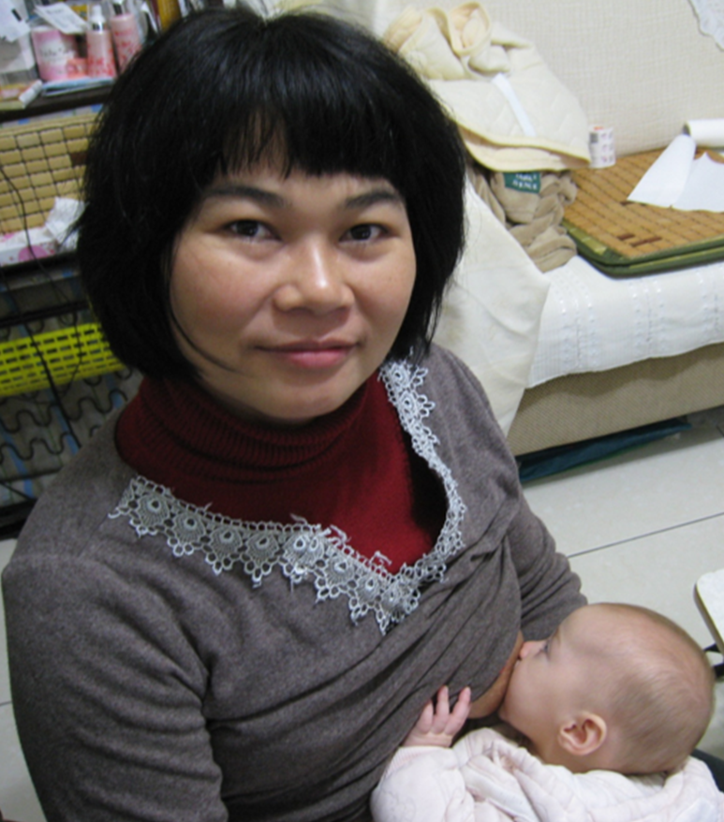
亮恩的出生 Ruth-Ann’s Birth
在你那里有
生命的源头，
在你的光中，
我们必得见光。
(诗36:9)
With you
is the fountain of life;
in your light
we see light. (Ps36:9)

Slide 23
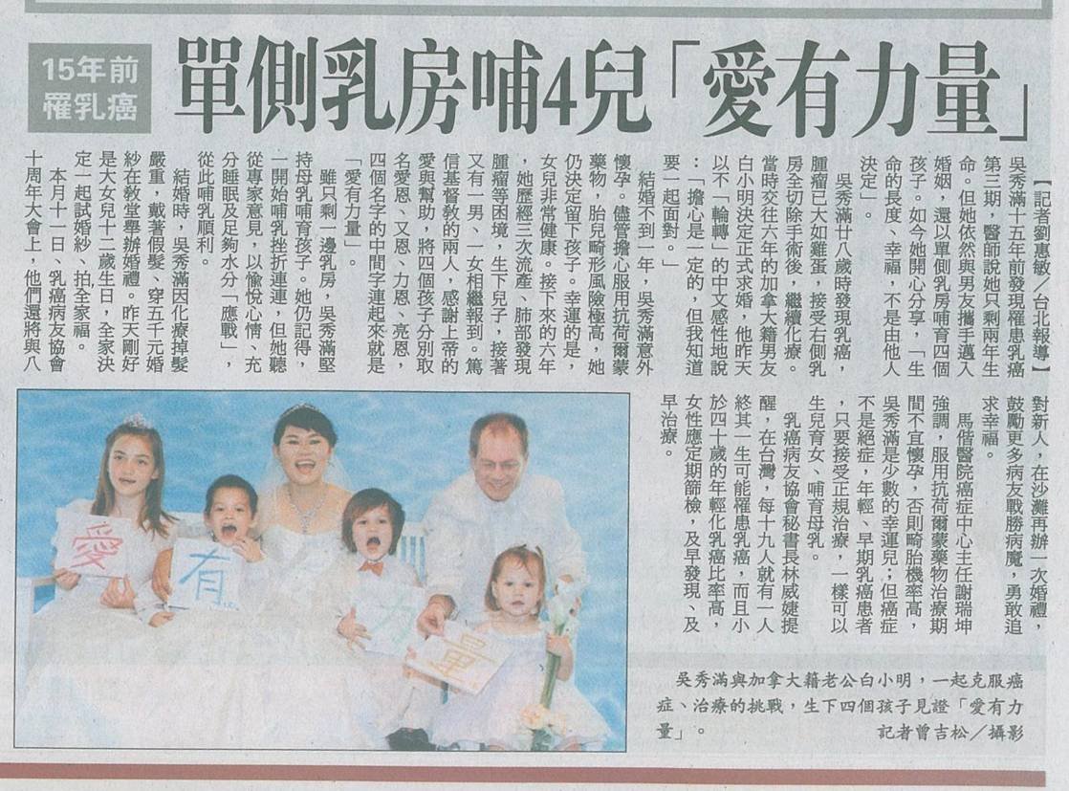
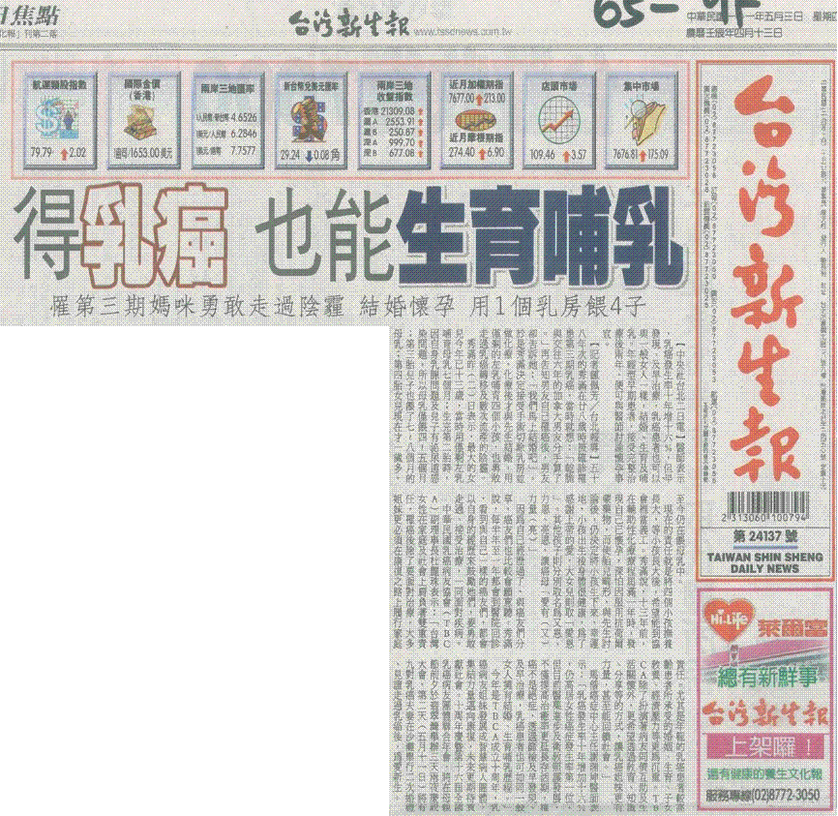
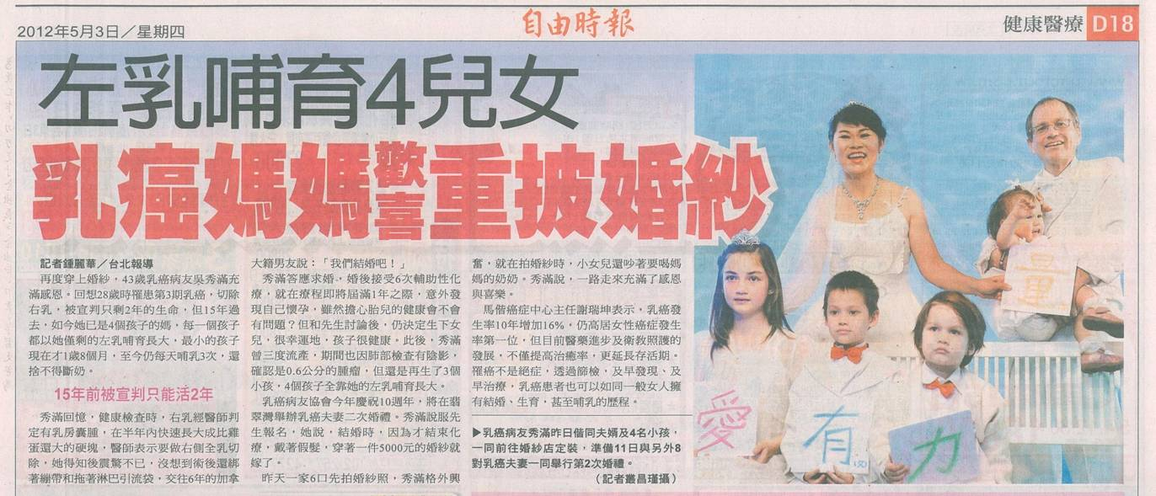
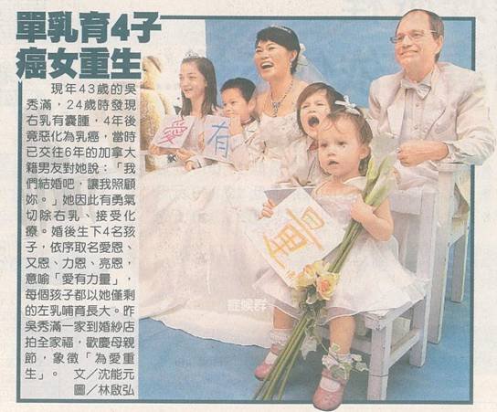
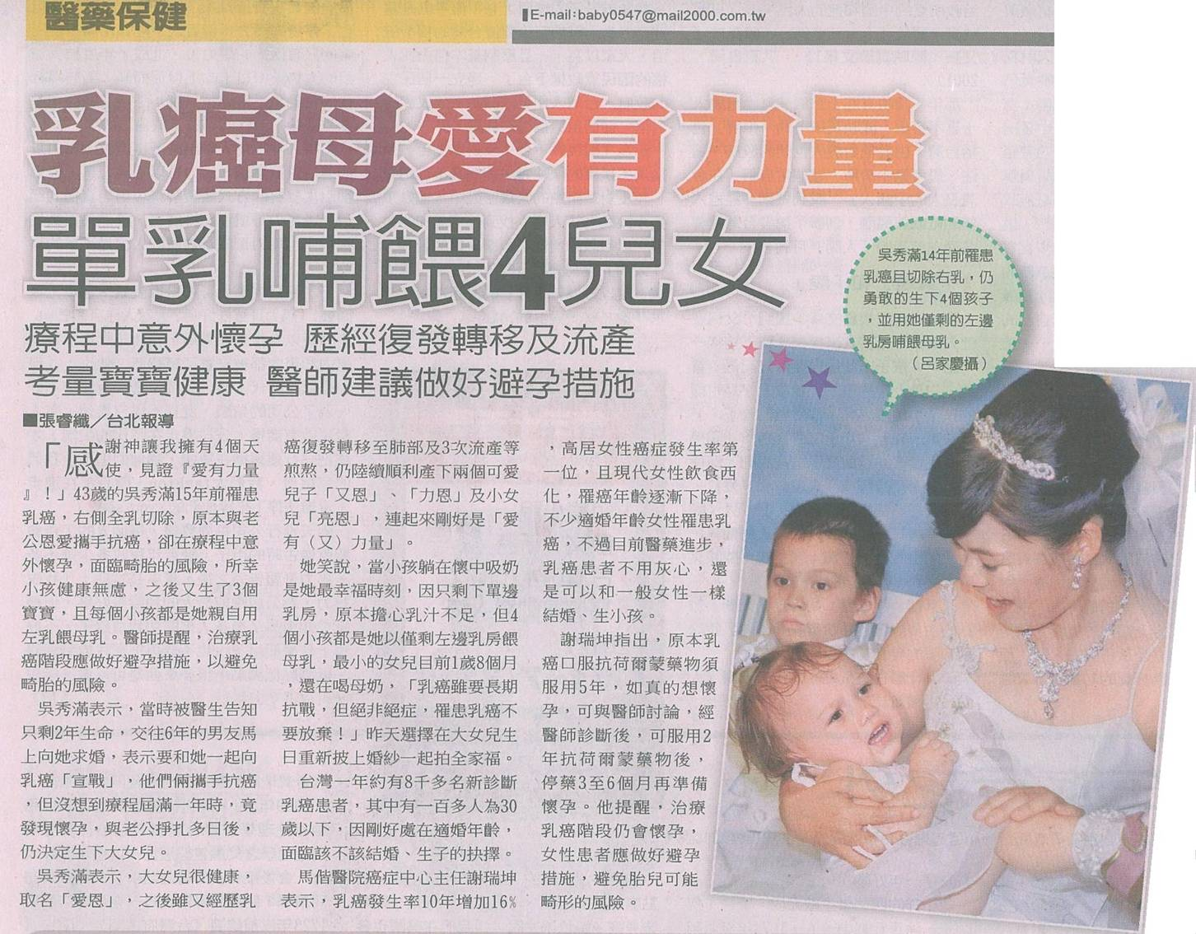
2012.05.02 乳癌协会记者会
Breast Cancer Association Press Conference

Slide 24
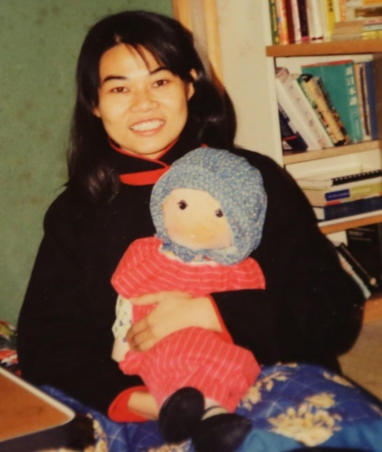
为什么? 5月2日 Why?
上帝有完美的时间表. God’s Timeline
5月
1961
5月
1983
5月2日
1997
5月2日
1999
5月2日
2012
牧师给秀满的圣经
话语: 腓1:24-26
Pastor gave Sharon
Philippians 1:24-26
小明的朋友送给他
一个叫秀满的娃娃太太
Jon’s HK friend gave him a
doll named Xiuman for wife!

Slide 25
为什么? 5月2日 Why?
上帝有完美的时间表. God’s Timeline
5月
1961
5月
1983
5月2日
1997
5月2日
1999
5月2日
2012
然而我在肉身活着，
为你们更是要紧的。
我既然这样深信，
就知道仍要住在世间，
且与你们众人同住，
使你们在所信的道上。
又长进又喜乐。
叫你们在基督耶稣里的欢乐，
因我再到你们那里去，
就越发加增。
牧师给秀满的圣经
话语: 腓1:24-26
Pastor gave Sharon
Philippians 1:24-26
but it is more necessary for you that
I remain in the body. Convinced of
this, I know that I will remain, and
I will continue with all of you for
your progress and joy in the faith,
so that through my being with you
again your boasting in Christ Jesus
will abound on account of me.
小明的朋友送给他
一个叫秀满的娃娃太太
Jon’s HK friend gave him a
doll named Xiuman for wife!

Slide 26
为什么? 5月2日 Why?
上帝有完美的时间表. God’s Timeline
5月
1961
5月
1983
5月2日
1997
5月2日
1999
5月2日
2012
牧师给秀满的圣经
话语: 腓1:24-26
Pastor gave Sharon
Philippians 1:24-26
健
康
的
爱
(癌)
恩
Healthy
Charity
Grace
-乳癌协会记者见证会
-婚姻见证+四个孩子名字正好是「爱有力量」
-Taiwan Breast Cancer Association Press Conference
- Marriage Witness + 4 children’s names: "love has power"
小明的朋友送给他
一个叫秀满的娃娃太太
Jon’s HK friend gave him a
doll named Xiuman for wife!

Slide 27
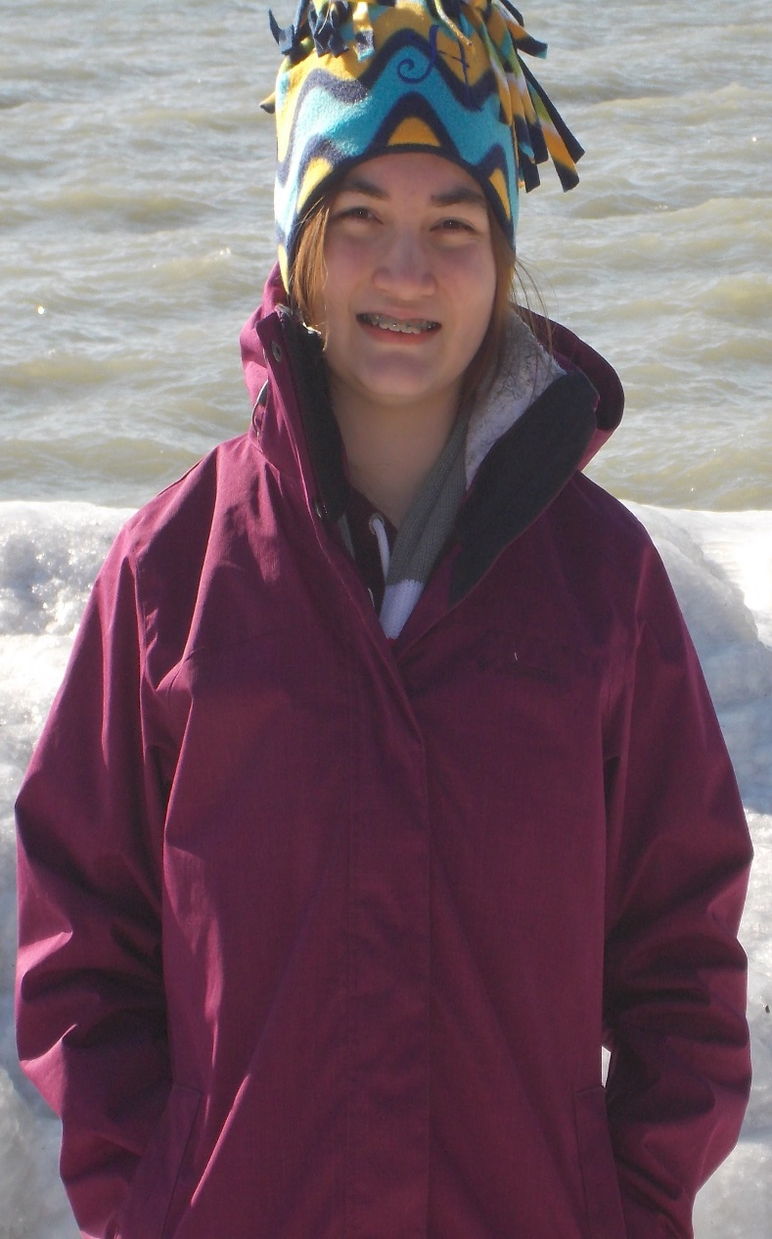
1999.05.02在祂没有难成的事
Nothing is too difficult for God
在化疗即将届满一年之际，
在仍吃着抗贺尔蒙药时仍能怀孕
且孩子是肢体五官、心理都健全。
（医生都强烈建议，吃抗贺尔蒙药至少要停药3~6个月才能怀孕）
总要效法那些凭信心和忍耐
承受应许的人。(希 6:12)
Just after finishing chemotherapy,
When still eating anti-hormone medicine, became pregnant…
But the child is physically functional and mentally sound.
(Doctors strongly recommend anti-hormone drugs be stopped at least 3 to 6 months before pregnancy)
Imitate those who through faith and patience
inherit what has been promised. (Hb 6:12)
Charity’s Birth
爱恩出生

Slide 28
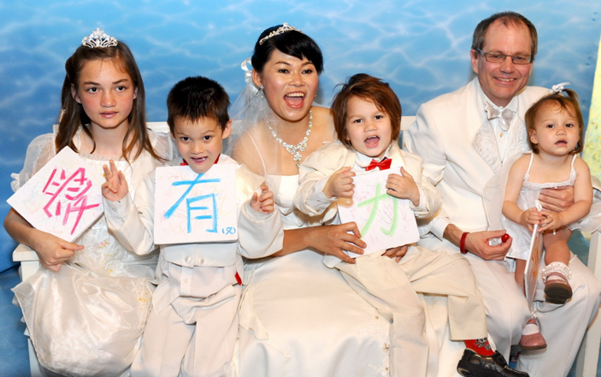
2012.05.02 神的荣耀时刻~爱有力量
Glory to God: God’s Love is Power

Slide 29
哥林多前書12：22，23
Those parts of the body that seem to be weaker are indispensable, and
-the parts that we think are less honorable we treat with special honor. And
-the parts that are unpresentable are treated with special modesty,
The mark on my body tells the glory of the Creator...
In the future, you will be a witness to bring hope to people.
身上肢体人以为软弱的，
更是不可少的。
身上肢体我们看为不体面的，
越发给他加上体面，
不俊美的，
越发得着俊美。
身上的记号正在述说
造物主的荣耀…
未来的您，
是另一个带给人希望
的见证人

Slide 30
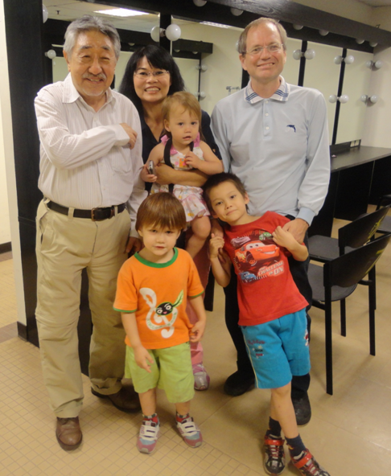

祂的意念高過我的意念
God’s Way Exceeds Our Way

Slide 31
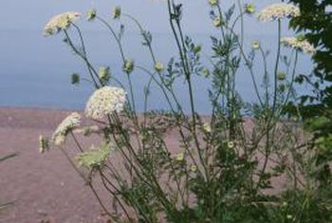
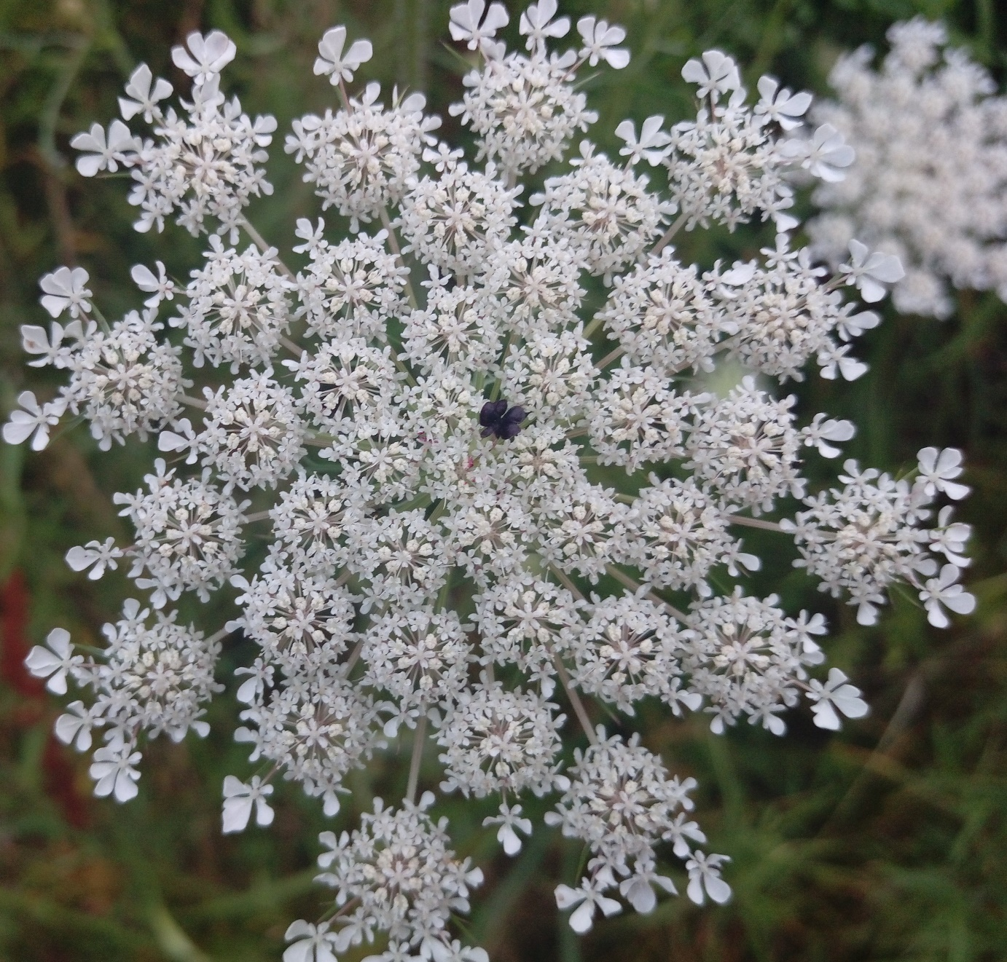

Slide 32
您的故事正在上演
神爱世人，
甚至将他的独生子
赐给他们，
叫一切信他的，
不至灭亡，
反得永生。
上帝使用
普通人

Slide 33
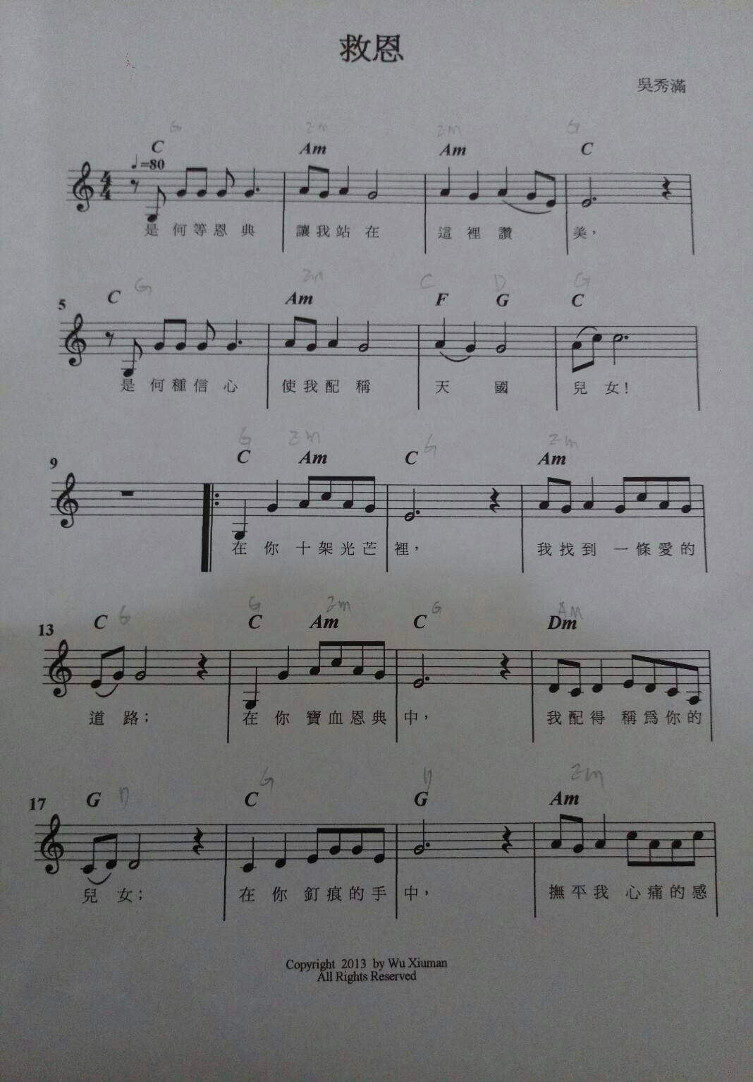
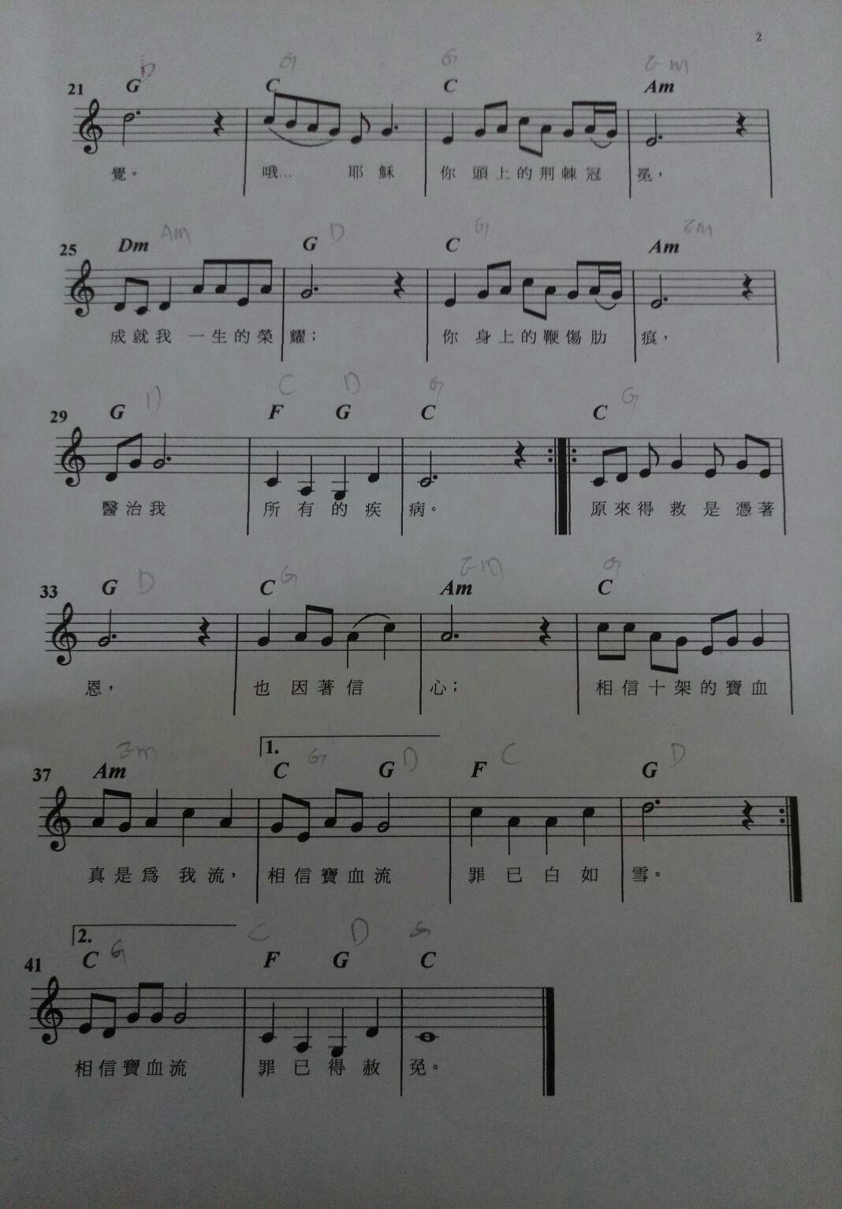

Slide 34
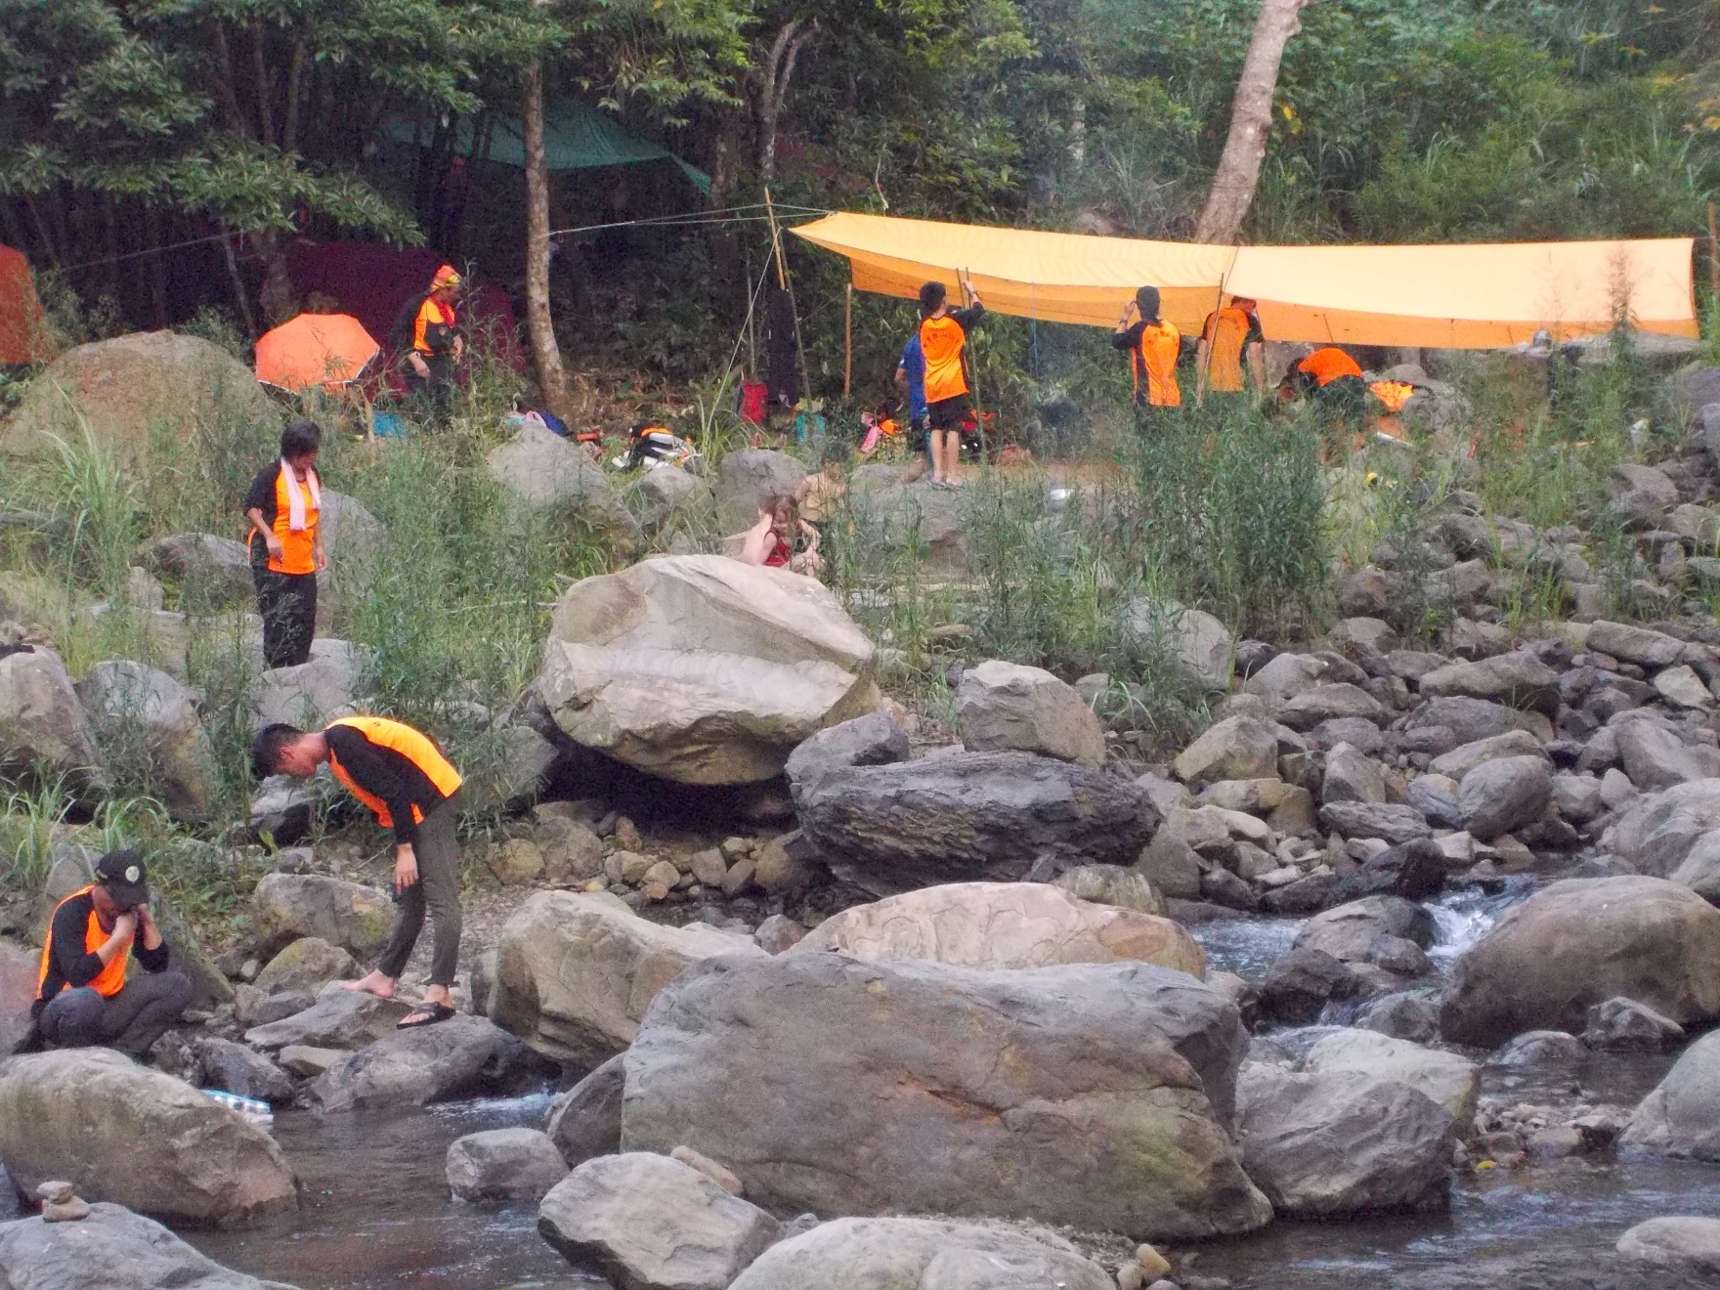
Following God is Life’s Greatest Adventure! Join Us!

