Slide 1
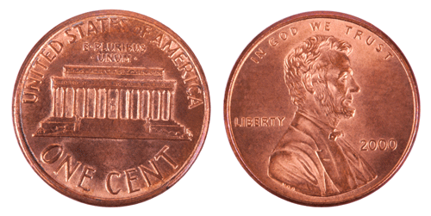
Two Sides of a Coin
Employing
Graphene
To Probe
MEH-PPV
Employing
MEH-PPV
To Probe
Graphene

Slide 2
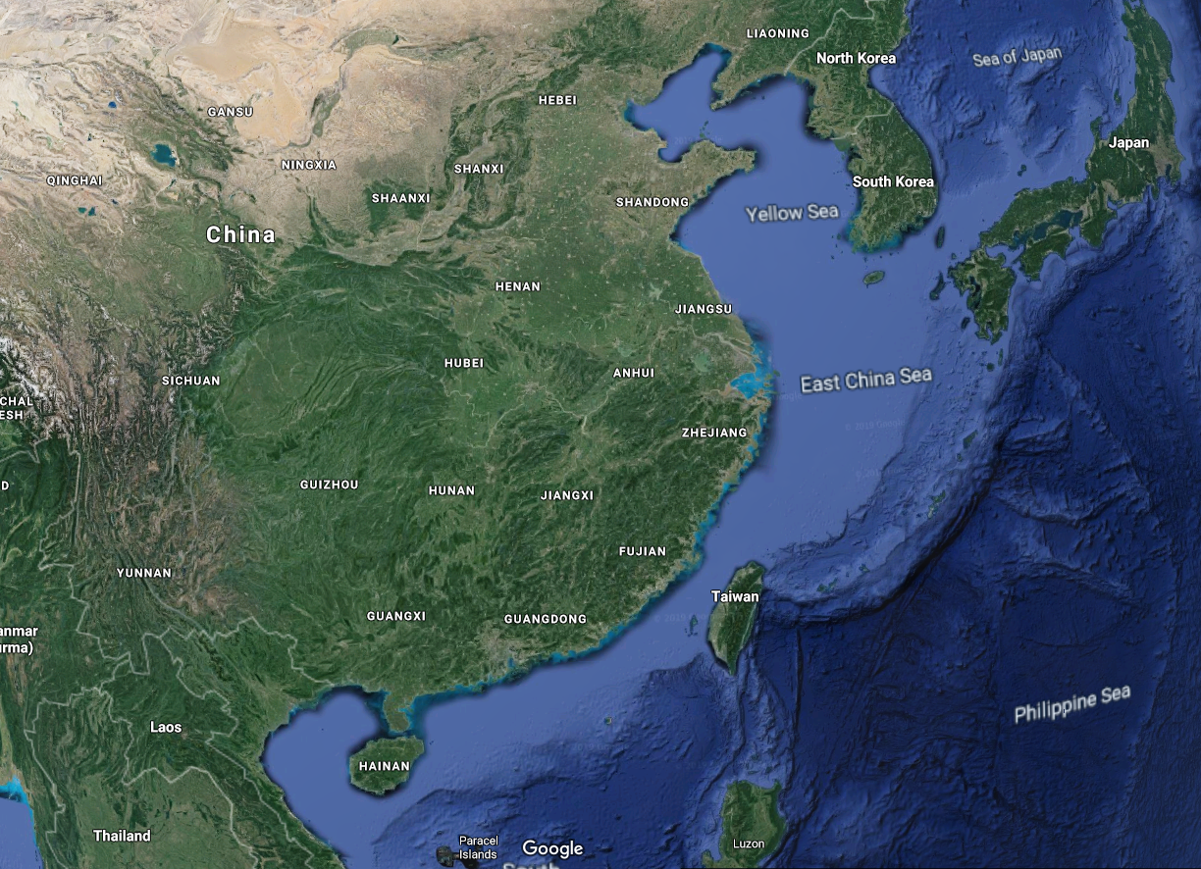
Republic of China: Taiwan

Slide 3
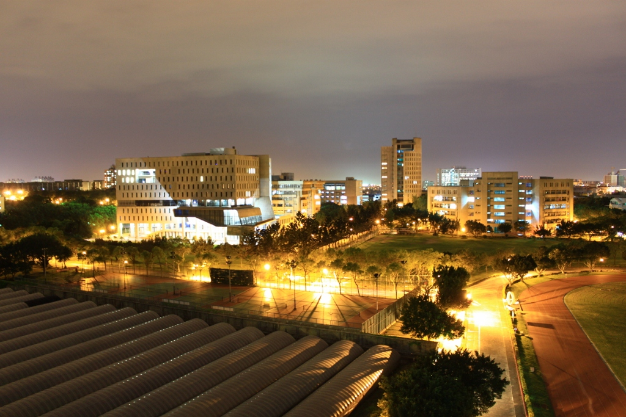
Yuan Ze University EE

Slide 4
Two Sides of a Coin
Use Graphene
to probe
MEH-PPV
Use
MEH-PPV
to probe
Graphene

Slide 5
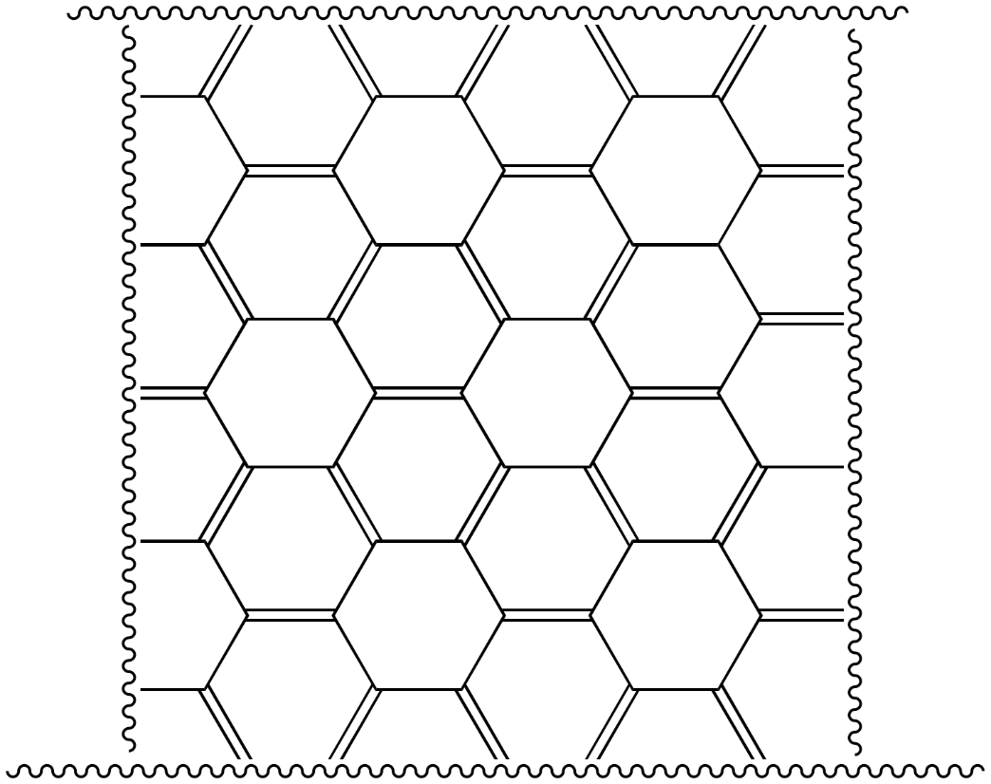
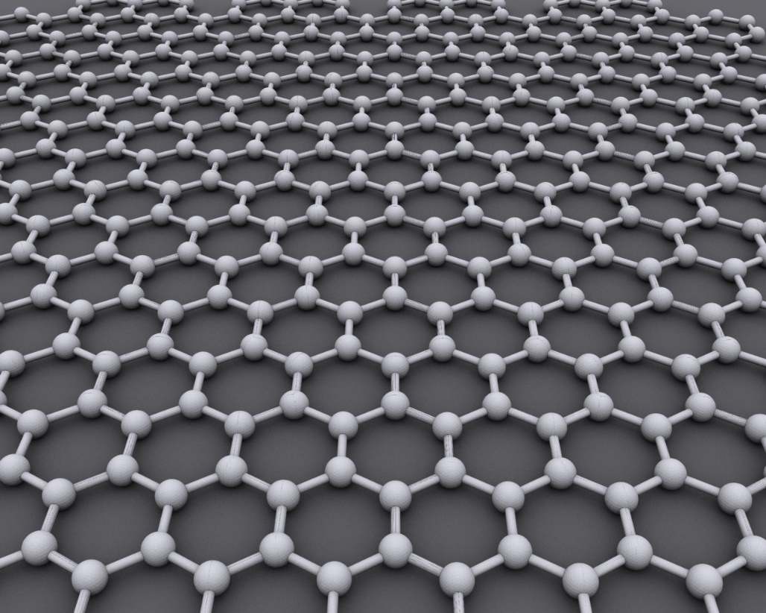
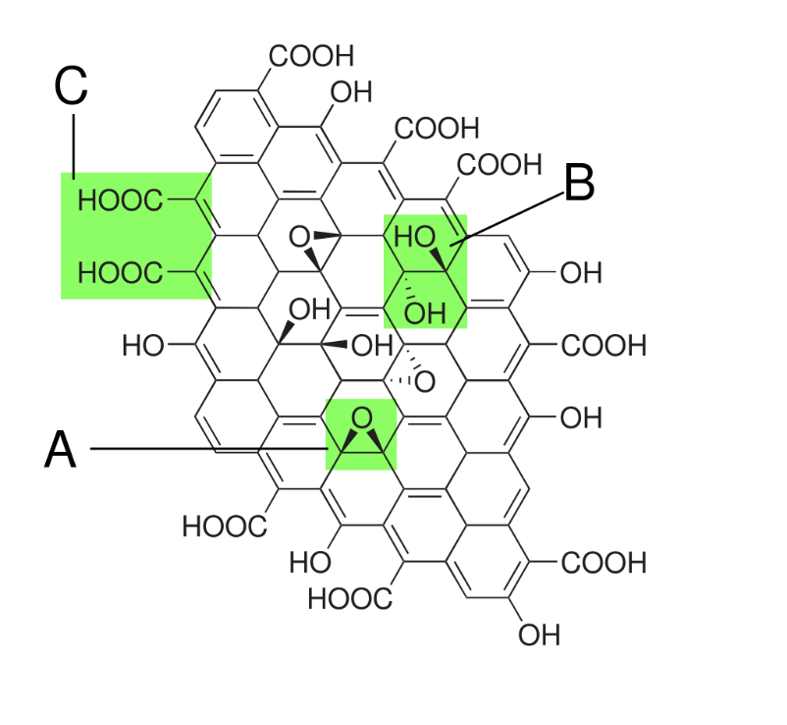
What is Graphene?
C in a 2D hexagonal lattice
big aromatic molecule
Conductor (Q + J)
Graphene oxide

Slide 6
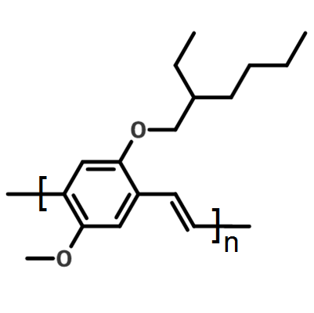
What is MEH-PPV?
Le MEH-PPV —poly[2-méthoxy-5-(2-éthyl-hexyloxy)-1,4-phénylène-vinylène] — est un polymère semiconducteur de type p (donneur d'électrons)
1D chain folding into a 3D structure w/1D substructure

Slide 7
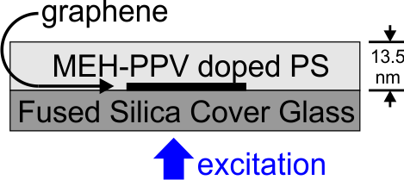
Solution: Graphene
observation

Slide 8
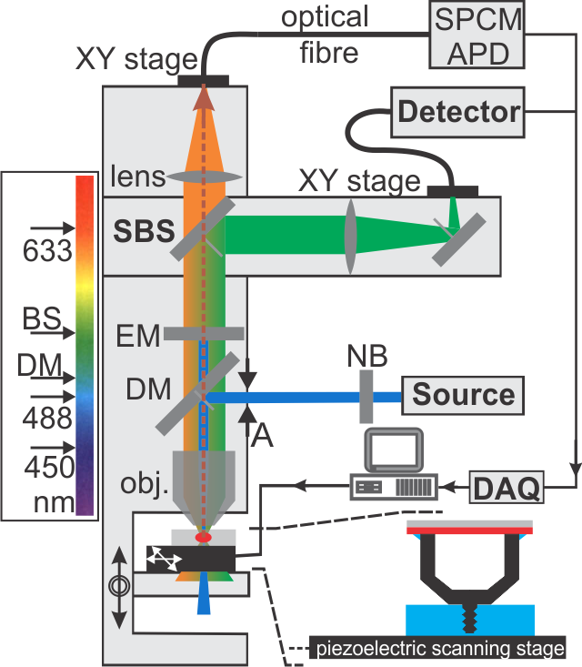
Confocal Microscope Setup

Slide 9
Two Sides of a Coin
Use Graphene
to probe
MEH-PPV
Use
MEH-PPV
to probe
Graphene

Slide 10
Tails: Outline
Background and Motivation: MEH-PPV
  What are we trying to understand?
  Why is it important?
  Why do we want to use graphene?
  Terminology
Exciton Model
Results: with and without graphene
Conclusions on Energy migration

Slide 11
Why MEH-PPV?
Most studied luminescent conjugated polymer
  >1000 papers published in the year 2017 alone
  Research started in 1970s!
Potential Applications: Solar Cells & PLEDs
  Quantum yield in solution 65%
  Drops to 3% in film. Why?
Numerous Single Molecule (SM) studies…
  from 2000 (Nature), one of first molecules studied
  to 2017 (ACS Nanoletters) and beyond
→ Prototypical luminescent conjugated polymer
→ But still holding secrets…

Slide 12
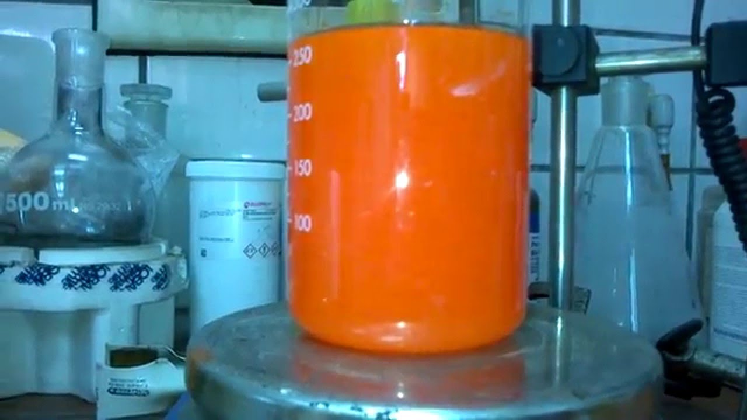
Review MEH-PPV Photo-Physics
Ref: https://www.youtube.com/watch?v=T4lyZ5rPbes
Photophysics
Roleplay

Slide 13
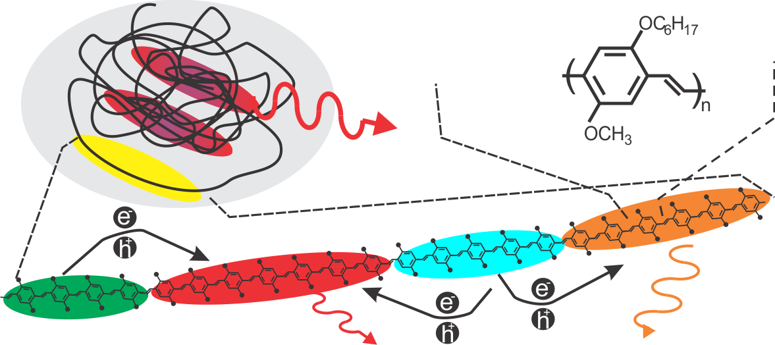
Exciton Model of MEH-PPV (@20)
Longer Conjugation
More Red

Slide 14
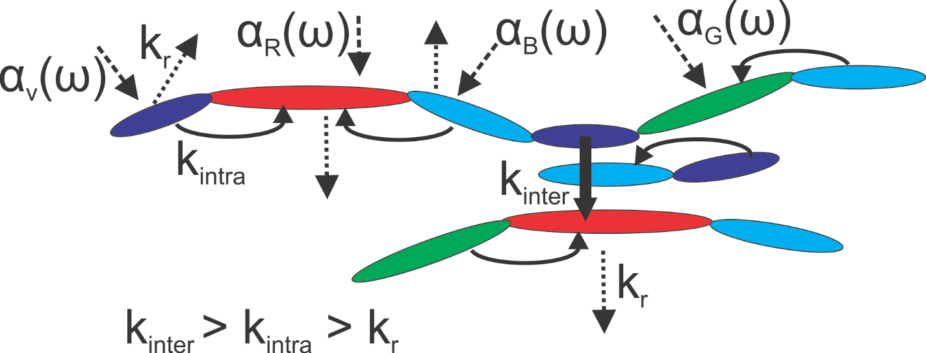
A Picture & A Question
We thought (2000): intra-chain energy is fast
We now know:
  Inter-chain energy transfer fast (<30 ps)
  Intra-chain energy transfer is slow
  Fluorescence lifetime ~ 1 ns
How slow is intra-chain energy transfer?

Slide 15
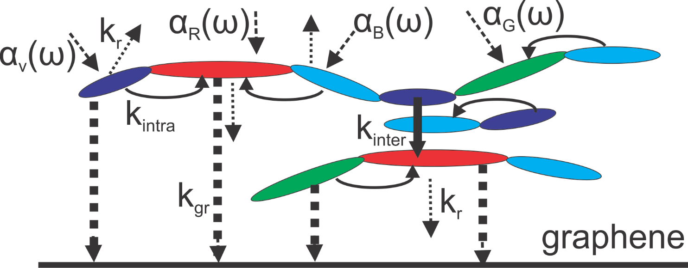
Use Quenching to Investigate
Open a new non-radiative channel
To quench the chromophores
Observe lifetime and spectral changes
→ approximate rate of intrachain energy transfer

Slide 16
So our goal is…
Understand changes to MEH-PPV photophysics brought on by quenching of fluorescence due to a nearby external quencher
Use this information to understand the rate of intrachain (k_{intra}) energy transfer.
Note: Quenching vs. Photo-bleaching
  -Both reduce fluorescence
  -Photo-Bleach: permanent (due to chemical changes to fluorophore)
  -Quenching: proximity (disappears when/if quencher is removed)

Slide 17
Challenge & Solution
Challenge: Energy Transfer between molecules
  Scales with (R/R_{o})⁻⁶
  Operational length scale: (2 – 8 nm)
  But our molecules are ϕ>10nm
  Complete quench of MEH-PPV not possible
  Difficult data interpretation
Solution: 2D Energy Transfer to 2D material
  Scales with (R/R_{o})⁻⁴
  Operational length scale: (2 – 30 nm)
  Whole molecule can be quenched.

Slide 18
Why use Graphene to Quench?
2D material (graphene) vs metal quencher
  Eliminate coupling to surface plasmon polaritons
  Minimize variations in local electric field strength
  More efficient quenching

Slide 19
MEH-PPV only

Slide 20
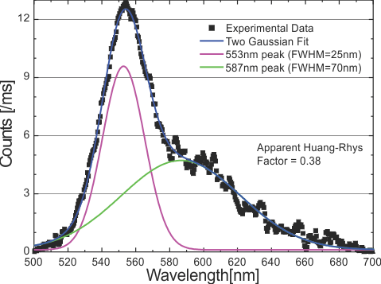
MEH-PPV Spectra (no Quencher)
Extended Chains Dominate

Slide 21
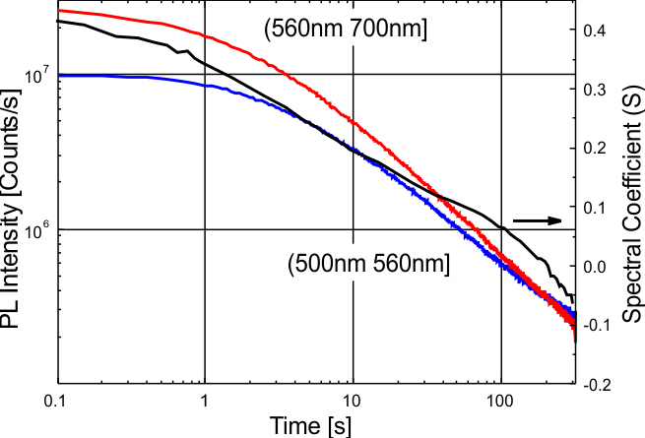

Photo-Bleaching (no quencher)
Longer
Conjugated
Segments
Bleach First

Slide 22
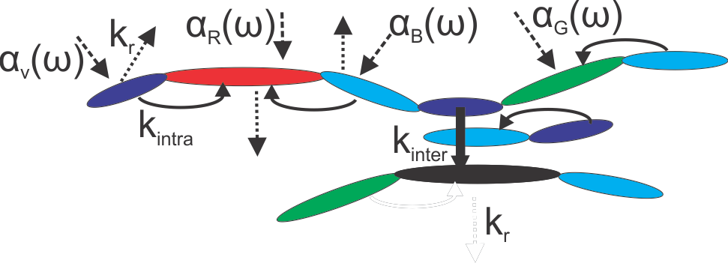
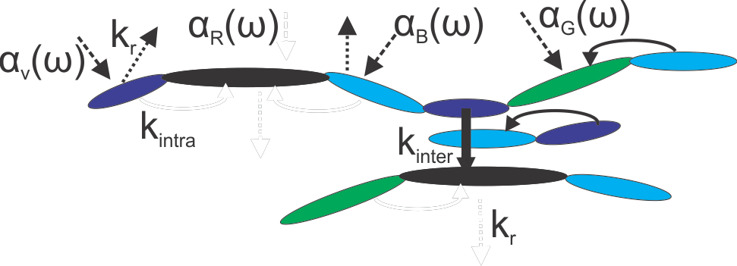
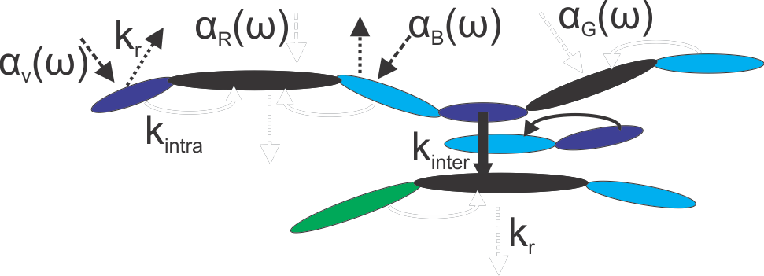
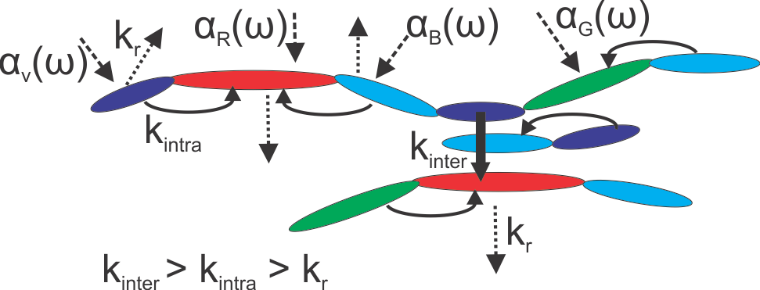
Exciton Model of Bleaching

Slide 23
With Graphene Quench

Slide 24
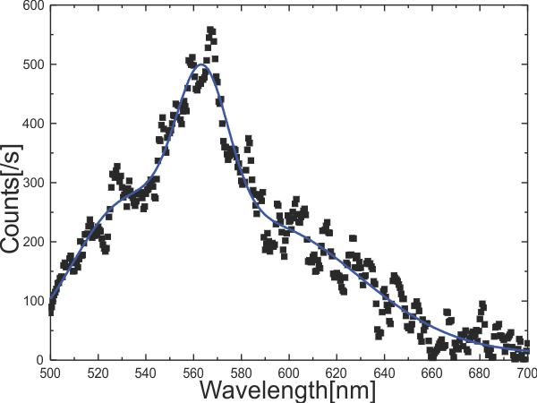
MEH-PPV Spectra

Slide 25
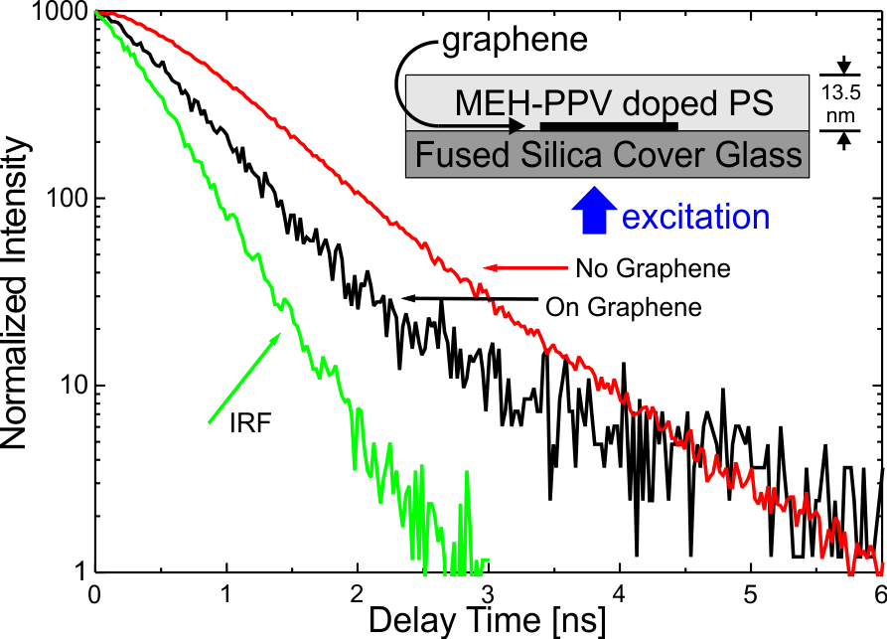
Lifetime/Intensity Quench
99% of emission is quenched
Mean Lifetime drops by 70%

Slide 26
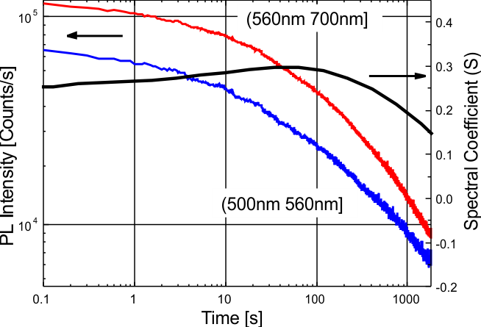
Photo-Bleaching with Quench
Time Scale: Order of Magnitude Longer
Spectrum: Initially more Blue, Constant

Slide 27
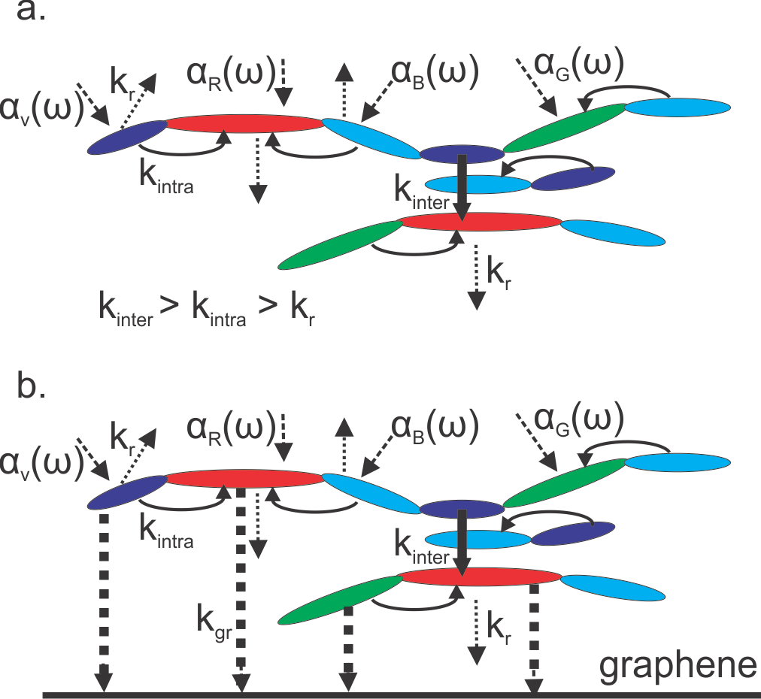
Exciton Model of MEH-PPV
Constant Spectra → Intrachain energy transfer arrested
→ k_{graphene} > k_{intra} (Note k_{r}~1 ns⁻¹)
Lifetime analysis suggests: k_{graphene} ~ 4 ns⁻¹
Bounds on the rate of intrachain energy transfer
i.e. 4 ns⁻¹ > k_{intra} > 1 ns⁻¹
Ho X, Nanotechnology 30, 065702 (2019)

Slide 28
Two Sides of a Coin
Use Graphene
to probe
MEH-PPV
Use
MEH-PPV
to probe
Graphene

Slide 29
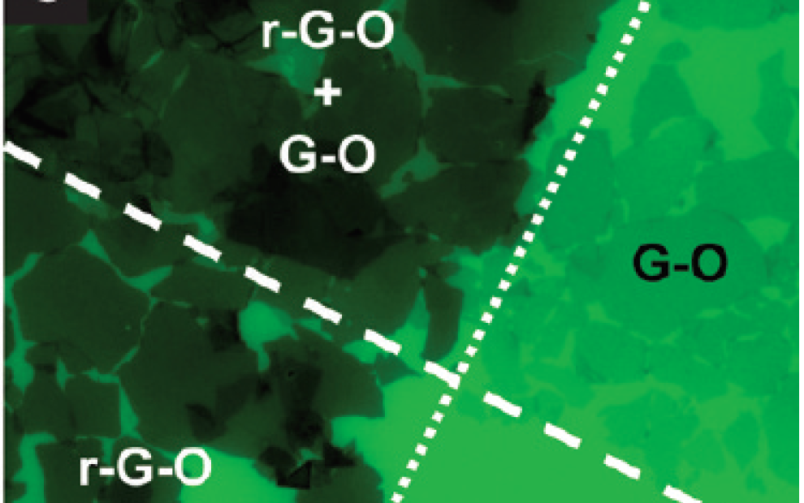
Graphene vs Graphene Oxide (GO)
From Kim J,
JACS 132,
261 (2010)
PL quench has been used to visualize GO/r-GO
Graphene Oxide…
  Quenches almost 100% <5 nm
  Has contrast for dye layers up to 300nm thick
r-GO quenches more efficiently than GO

Slide 30
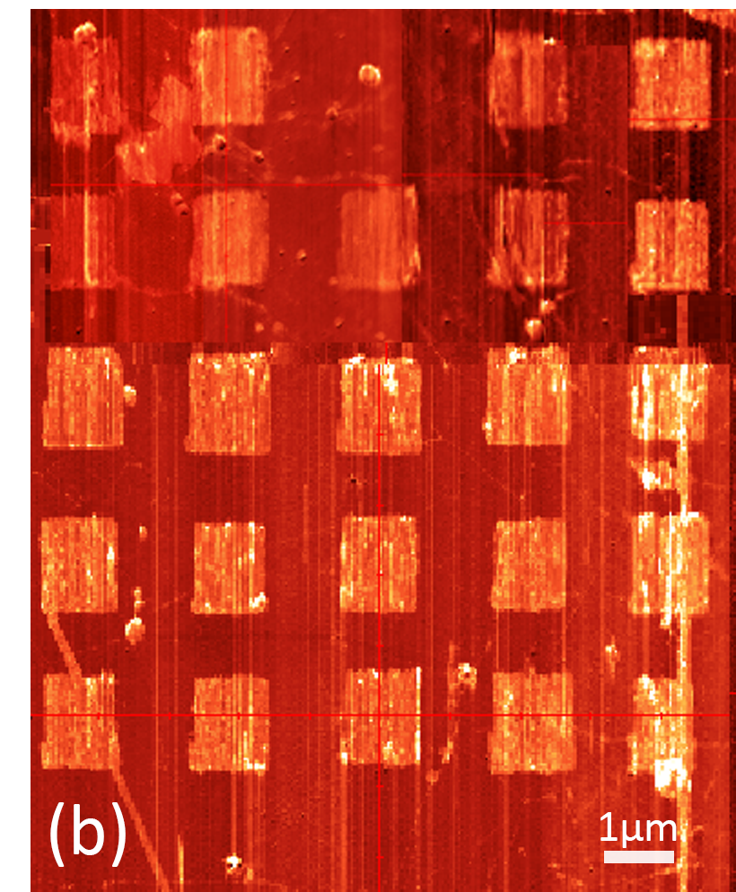
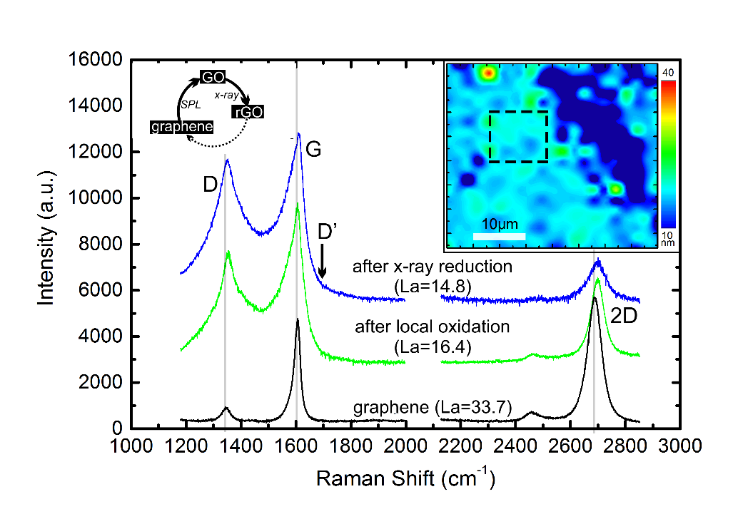
What is LAO Graphene?
Graphene in which areas have been selectively oxidized using a voltage difference across an AFM tip
# of sp³ bonds ↓
Between G and GO
How will degree of oxidation affect PL?
Can PL be used to estimate bond reduction?

Slide 31
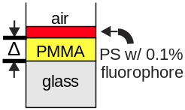
Why use MEH-PPV to probe?
State of graphene will affect PL of nearby molecules
Small fluorophore also subject to interface effects → ambiguity
MEH-PPV close to interface→ PL same as bulk.
Remove interface effects
No graphene
No graphene
Ho X, Chem Phys Lett 686, 212 (2017)

Slide 32
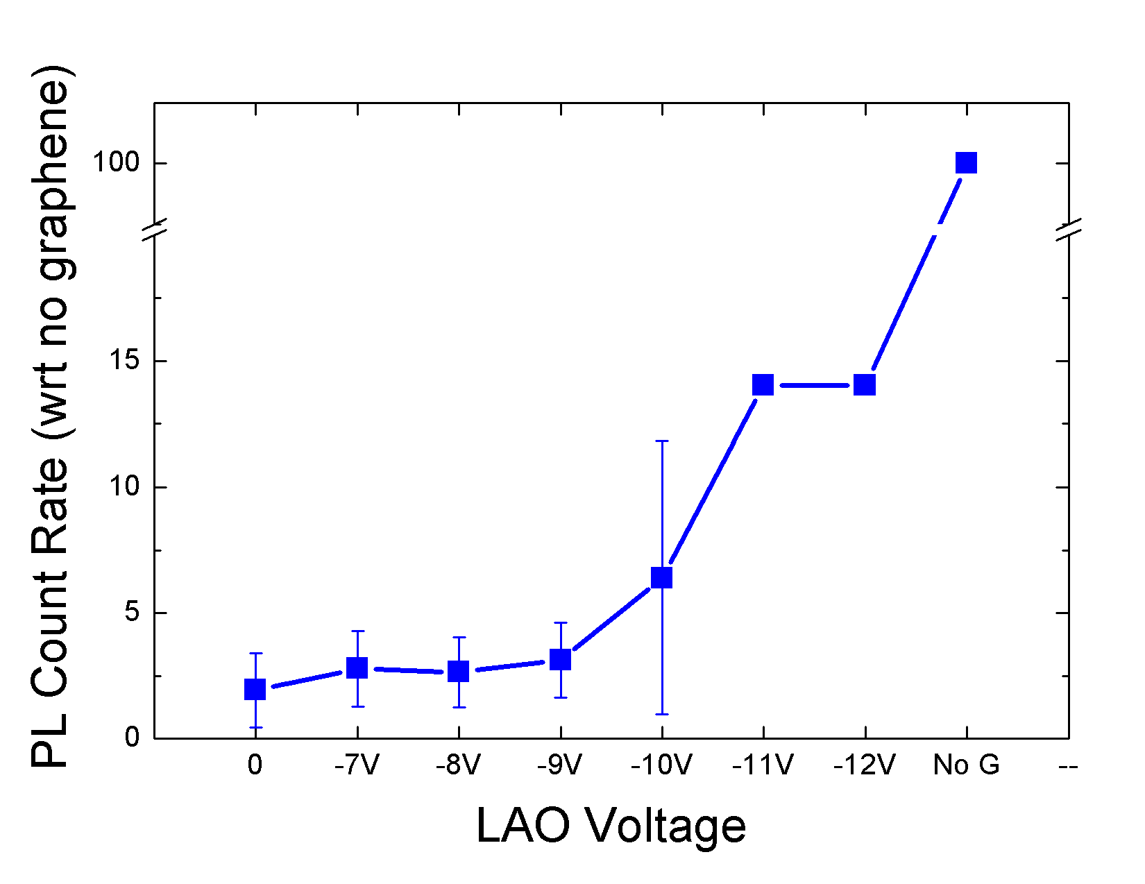
LAO ↑ → Quench ↓

Slide 33
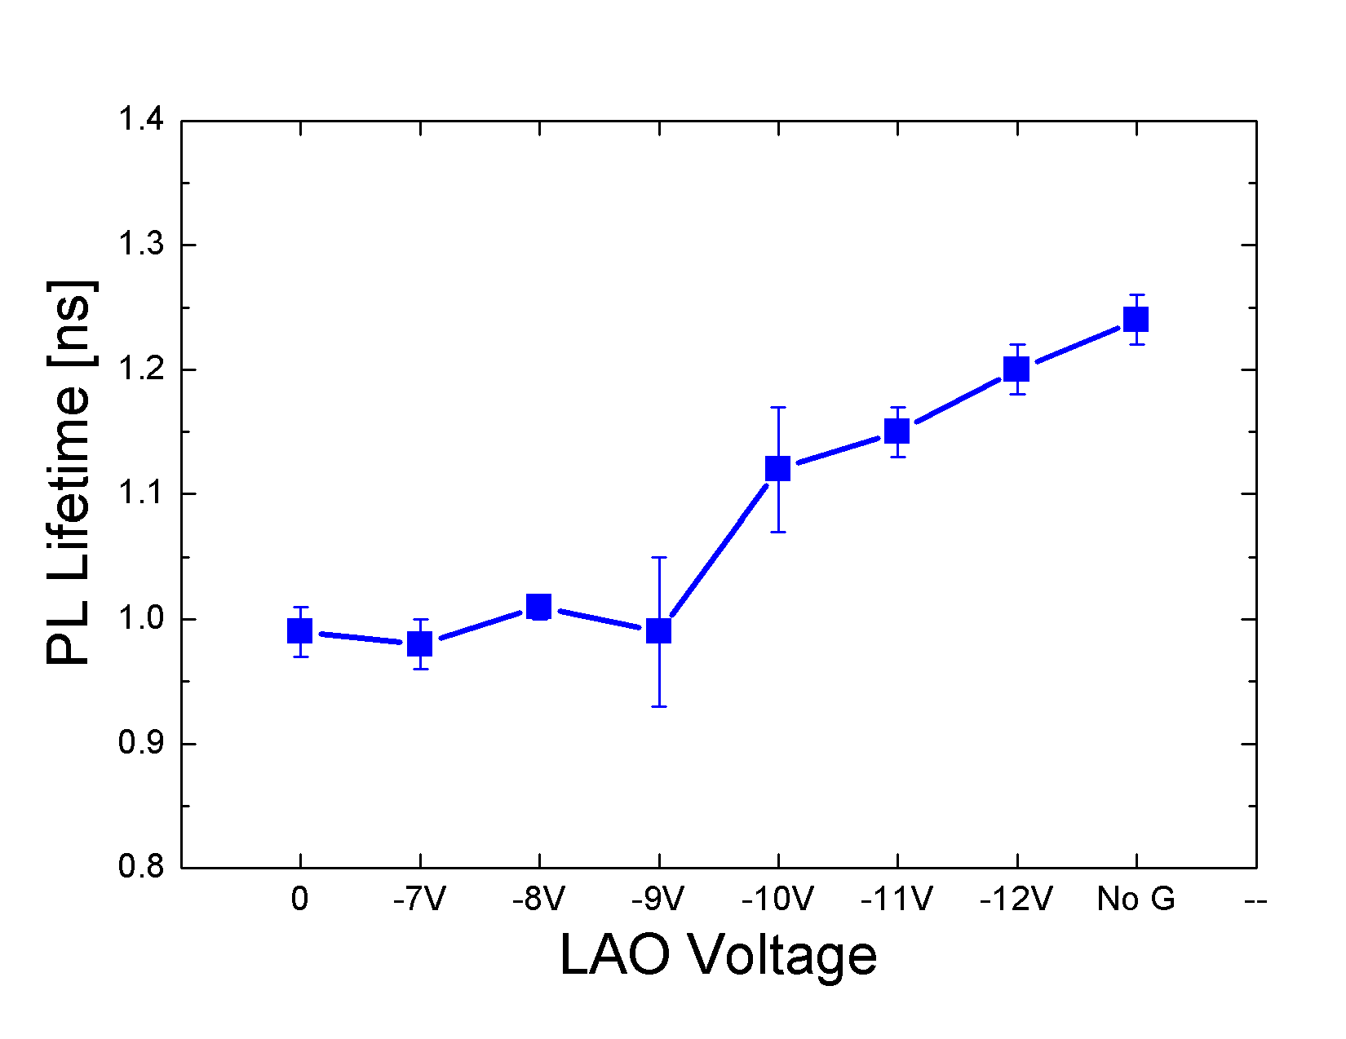
LAO ↑ → Lifetime ↑

Slide 34
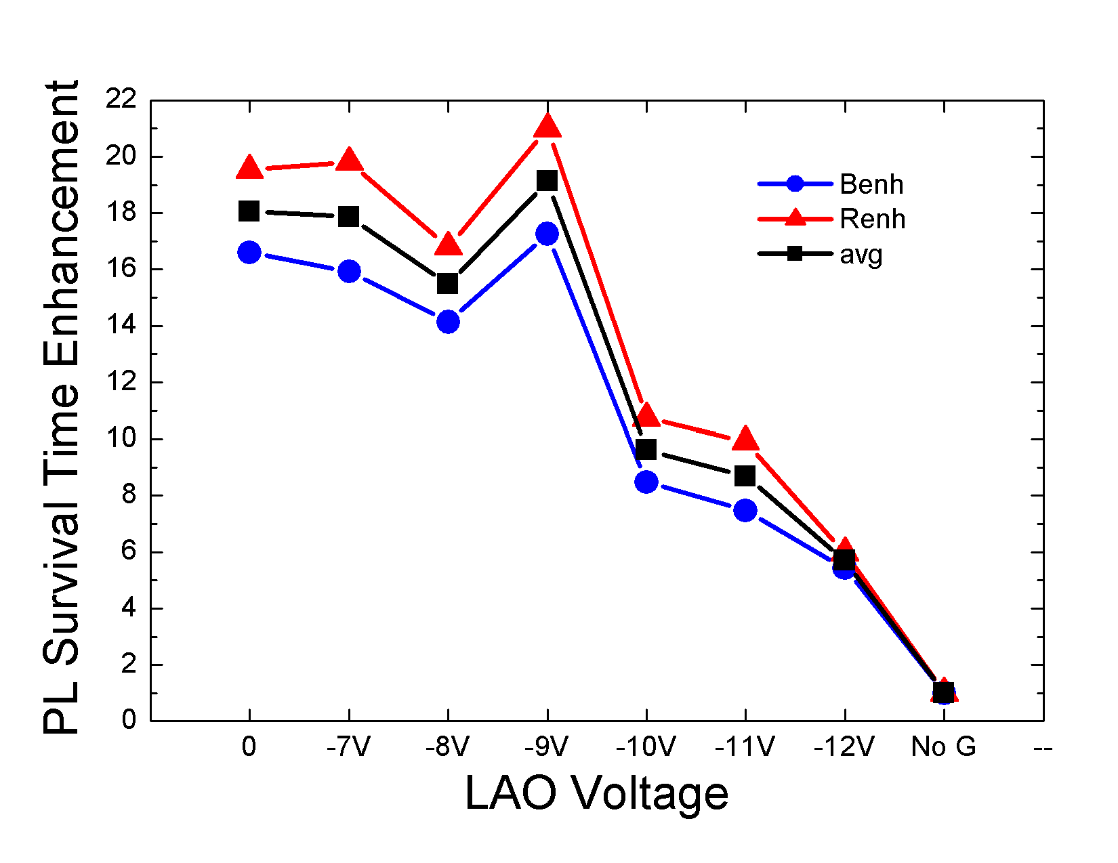
LAO ↑ → Survival Time ↓

Slide 35
Conclusions
Quenching spectroscopy can be used to gain insight into complicated polymer photophysics
Graphene (2D) is an ideal quencher due to its 2D nature (extended quench range) and the ability to control distance between the molecule and the quencher (spin coating)
Fluorescence of long chain polymers stable at interfaces
Changes in the fluorescence of long chain polymers can be used to gain insight into the degree of graphene oxidation/reduction.
GO ↑ →
  PL intensity ↑,
  Spectrum ,
  lifetime ↑
  survival time ↑,

Slide 36
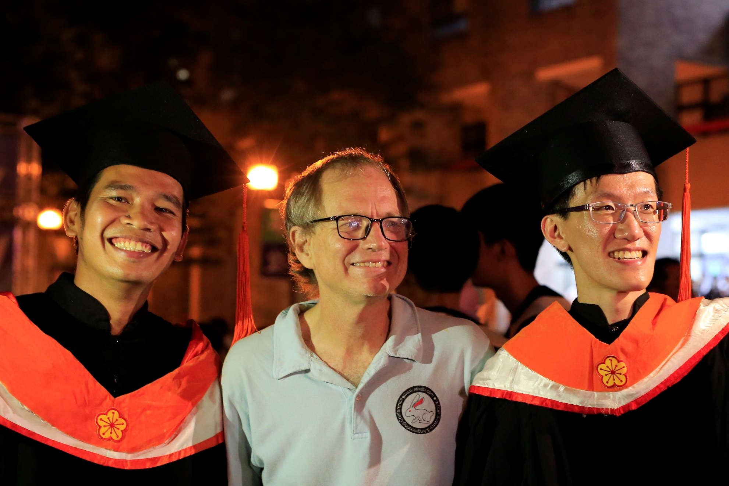
Welcome to Taiwan / Welcome to YZU

Slide 37
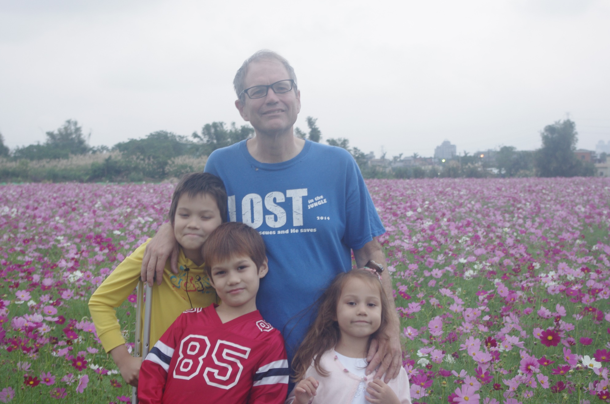
Welcome to Taiwan / Welcome to YZU

Slide 38
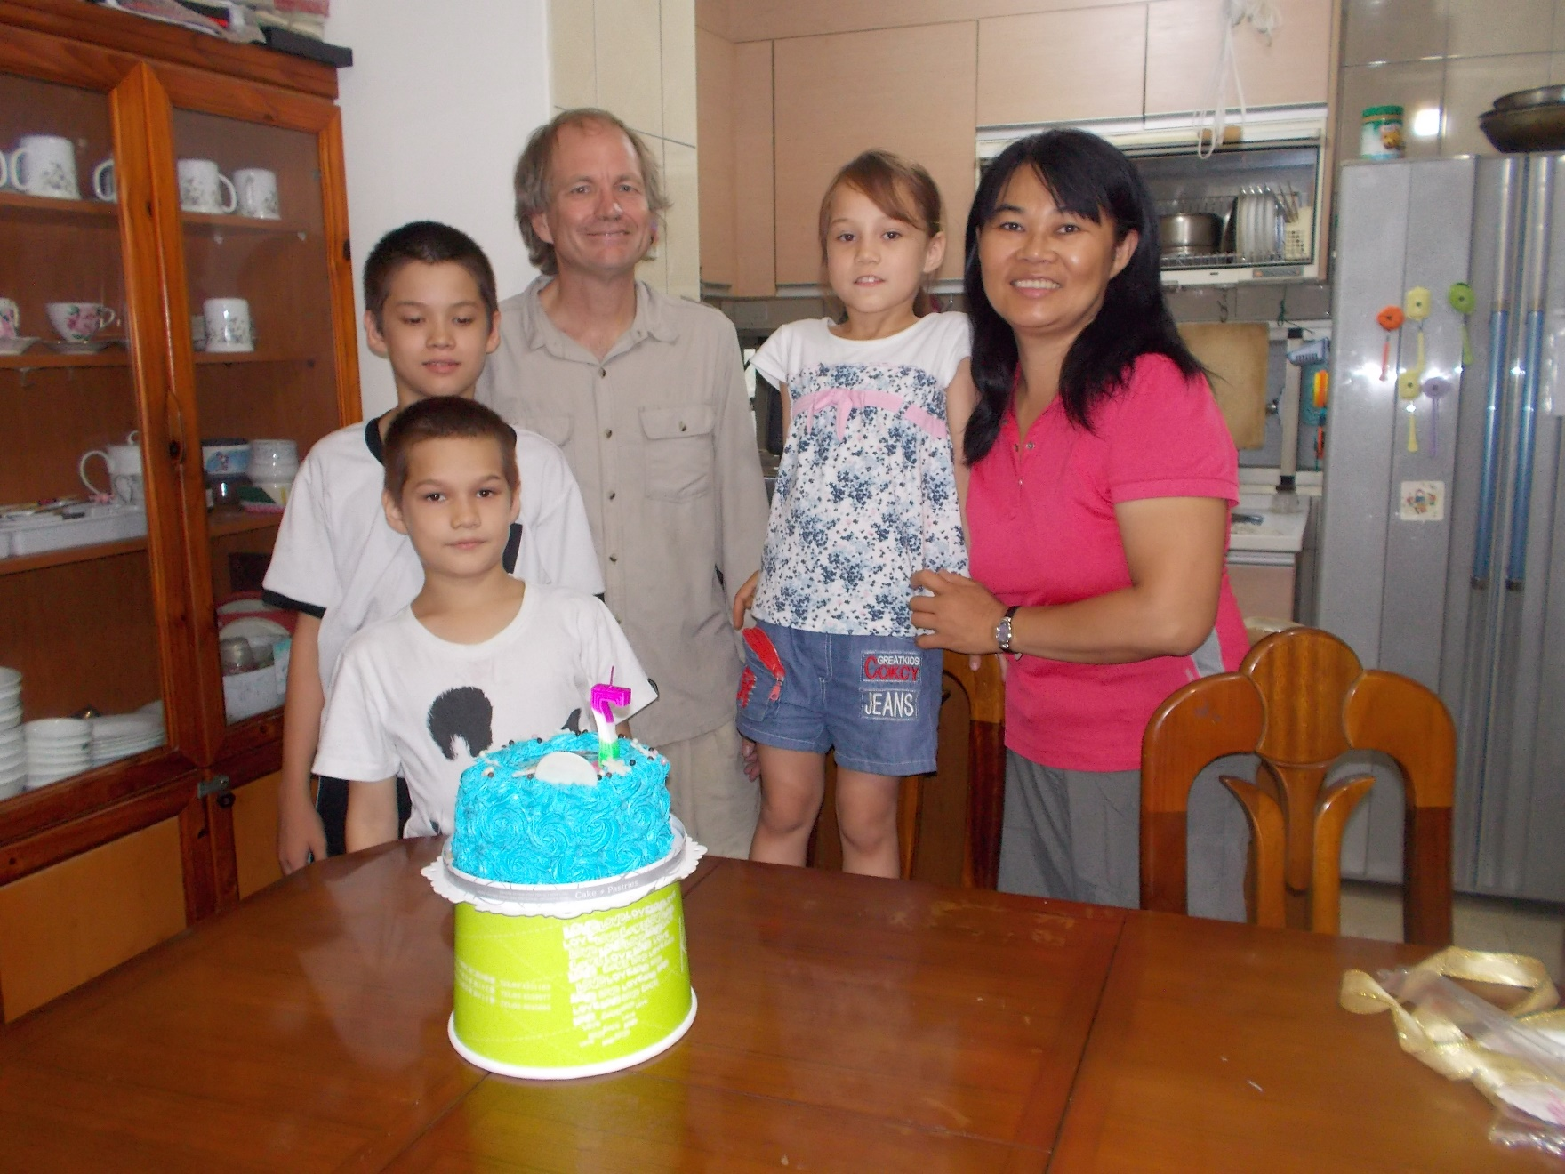

Welcome to Taiwan / Welcome to YZU
↑
TBCA: https://youtu.be/iGDBLIYcFS8?t=132

Slide 39
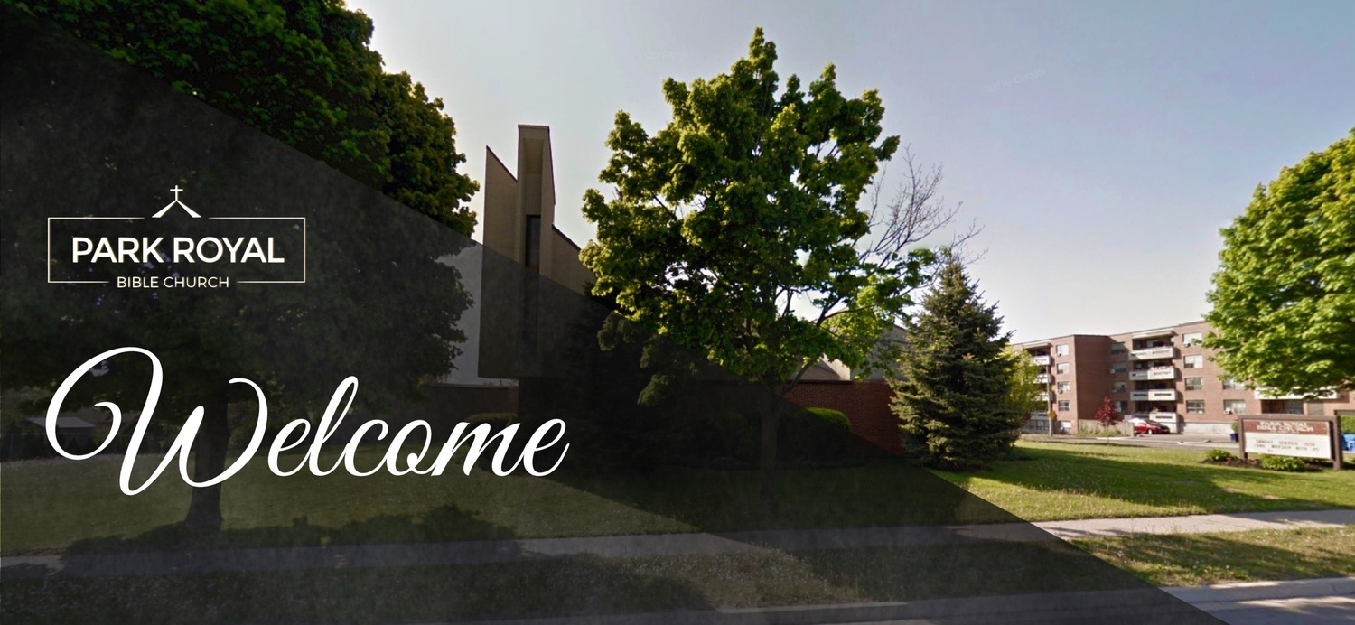
An Invitation
Title: Surviving Breast Cancer – The Role of Faith
Date: Sunday August 18, 2019
Time: 11:30 am
Venue: Park Royal Bible Church, 2400 Truscott Drive, Mississauga, ON L5J 2B2
Language: Chinese (Mandarin) & English
↑

