Slide 1
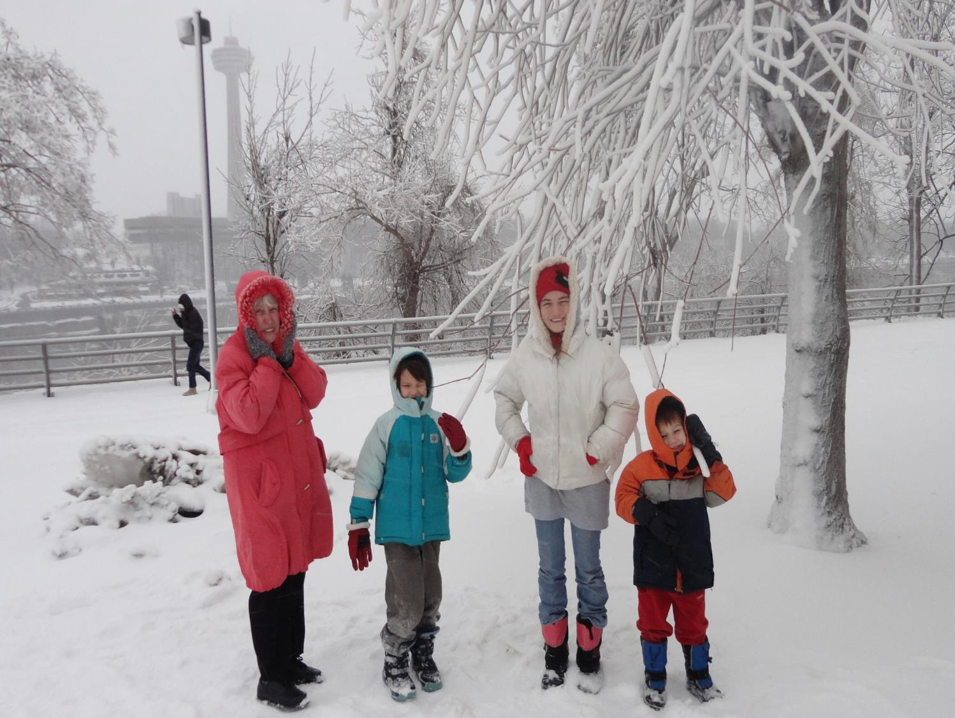
我的聖誕節經歷
My Christmas Experience in Canada
Jonathon David White (白小明)
Niagara Falls
2013
Notes:
I would like to share with you some wisdom from lessons a man who lived 3000 years ago learned and that I have re-learned by experience! I hope that these lessons will help you not have to learn them by experience.

Slide 2
Christmas in Canada
Growing-Up

Slide 3
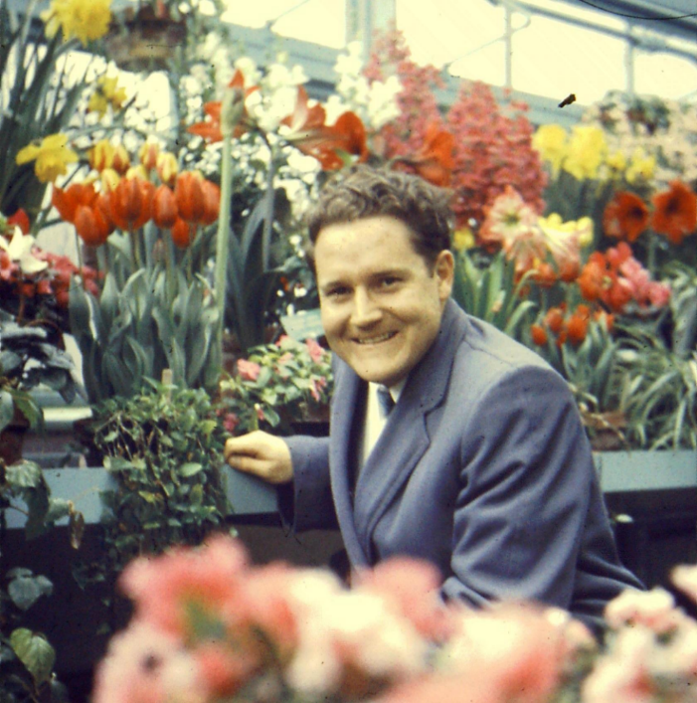
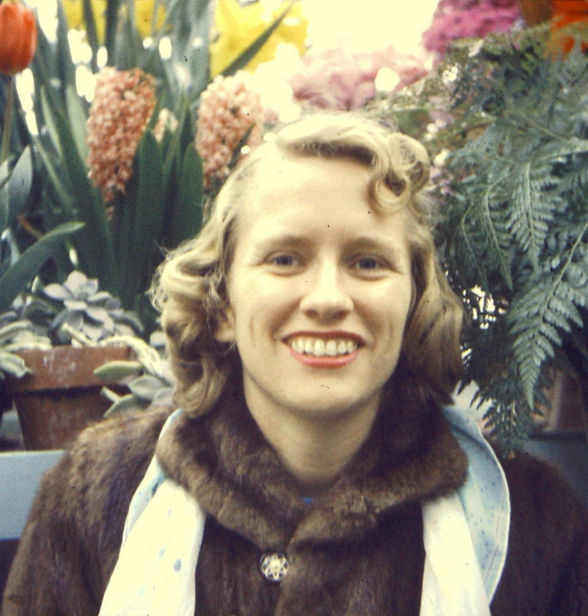
1957: Donald White Meets Marjorie Buck
The Greenhouse – Our Family Visited Every Christmas

Slide 4
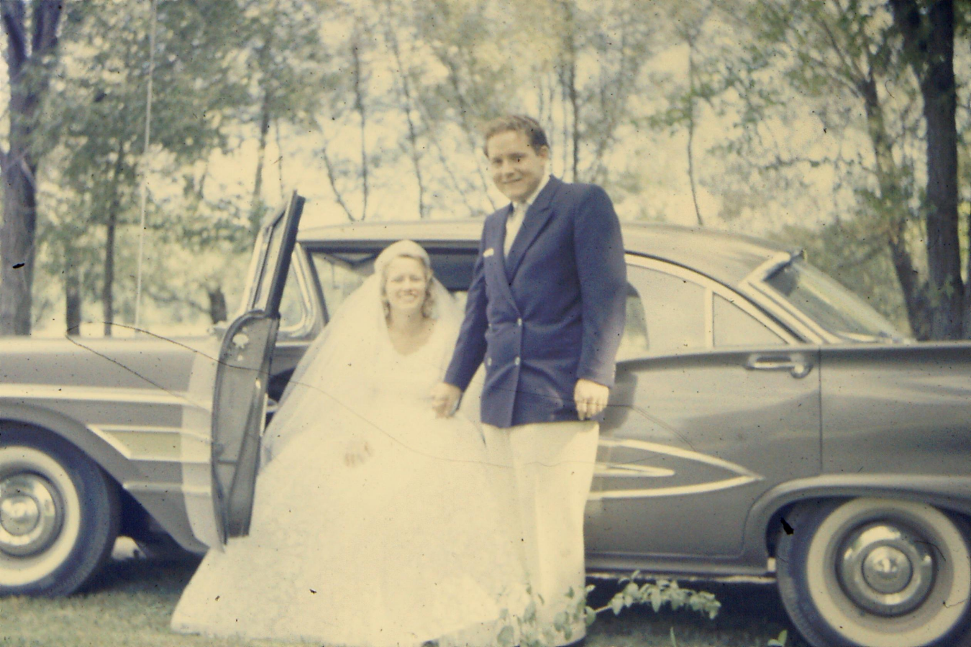
1958：Marriage 結婚

Slide 5
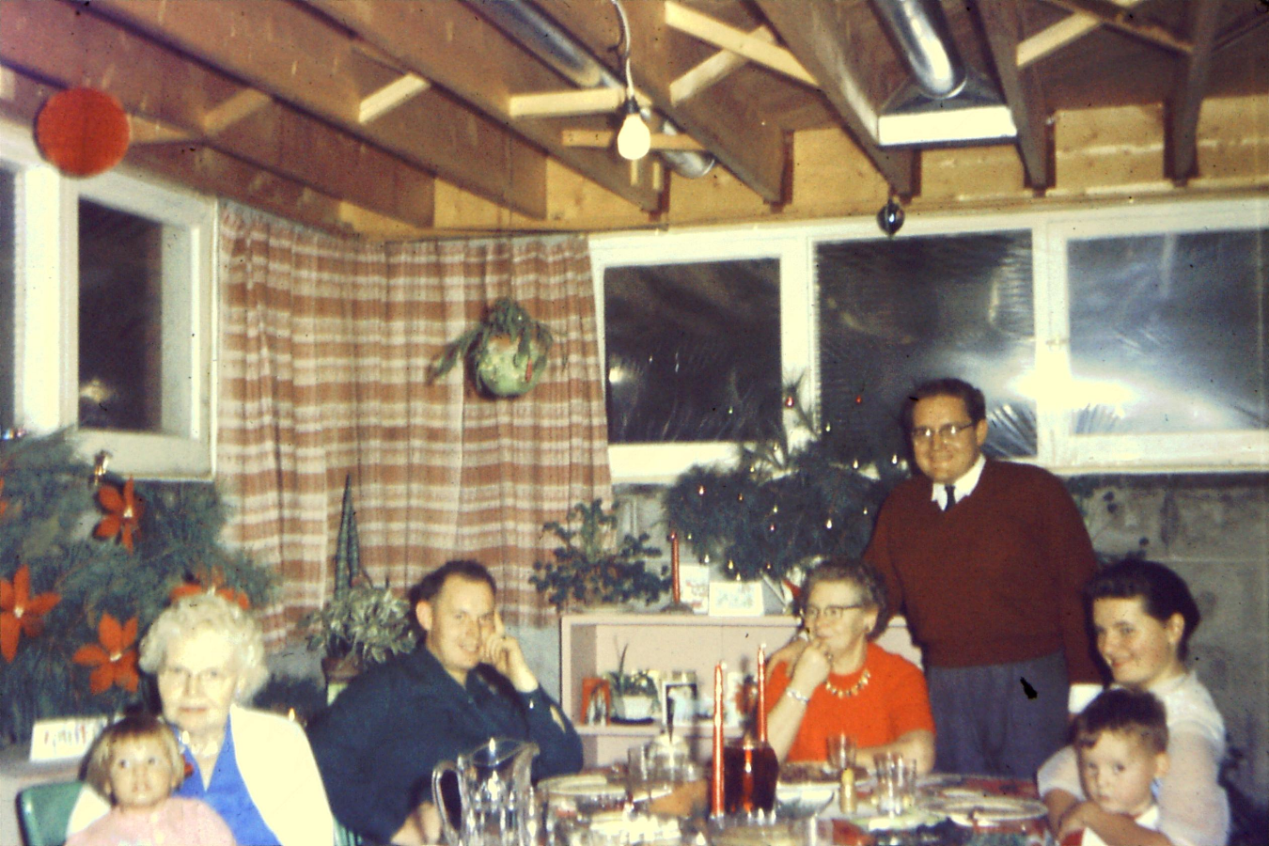
1960: Dad’s Family: Expectations

Slide 6
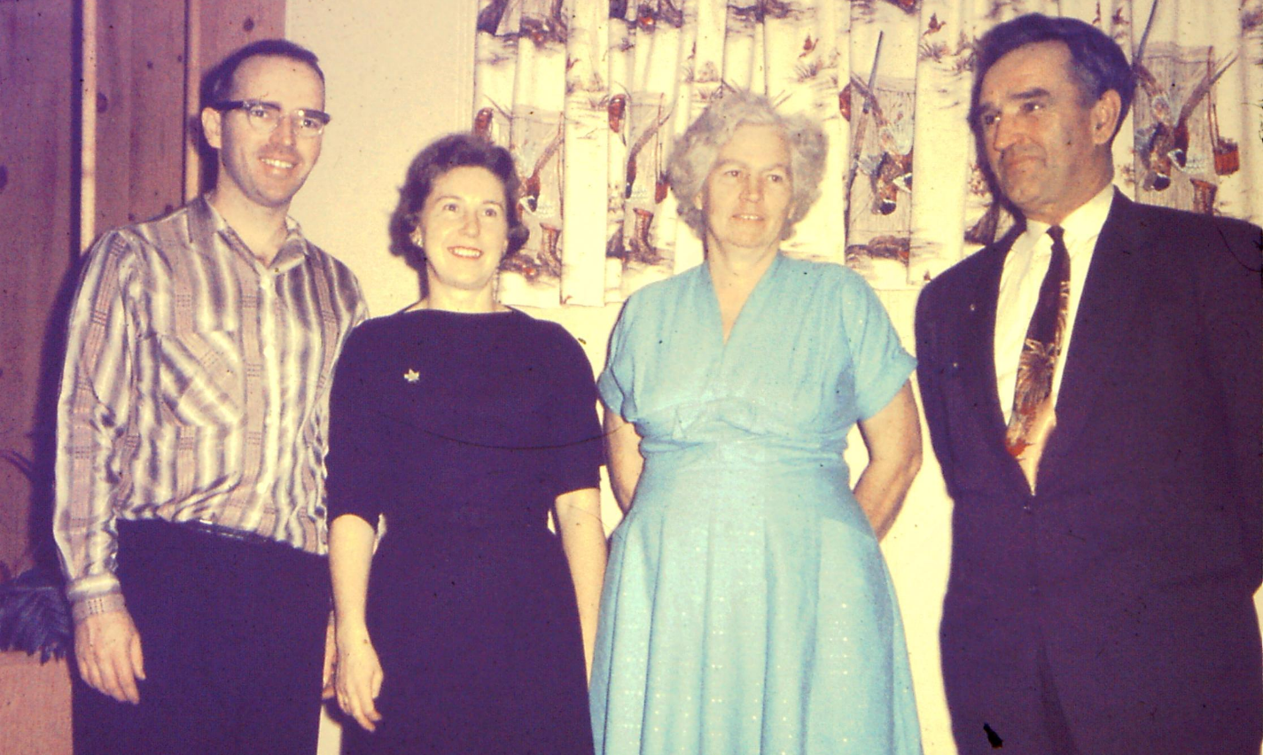
1960: Mom’s Family -- Expectations

Slide 7
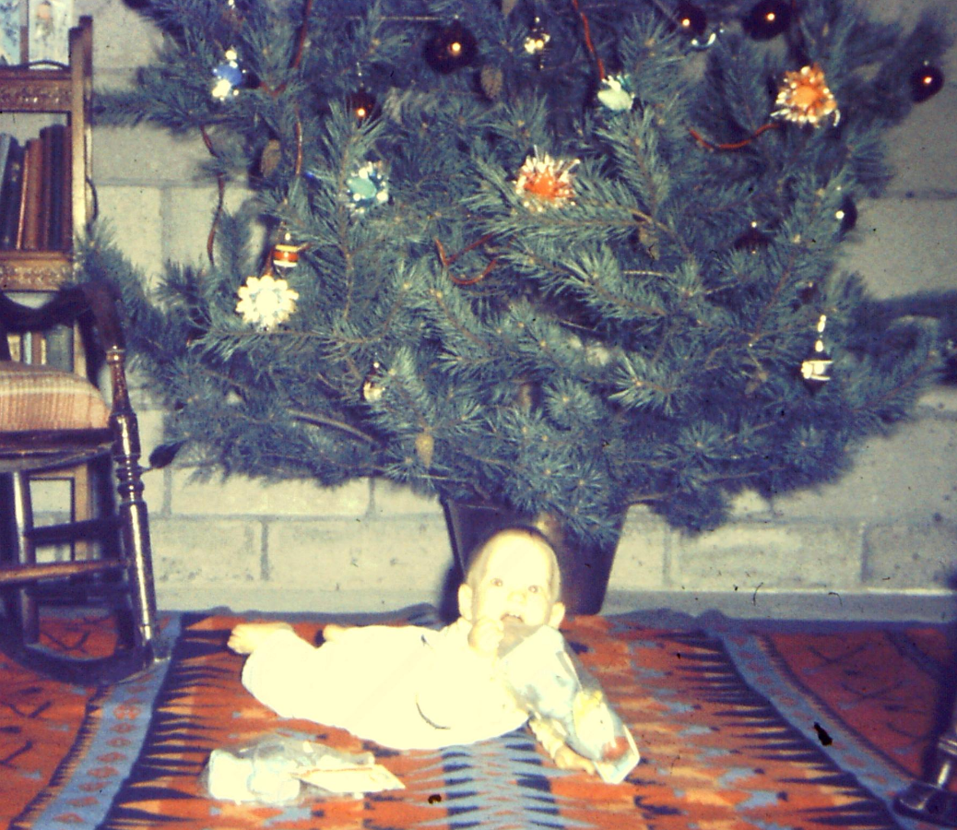
1961: A Son has Arrived!

Slide 8
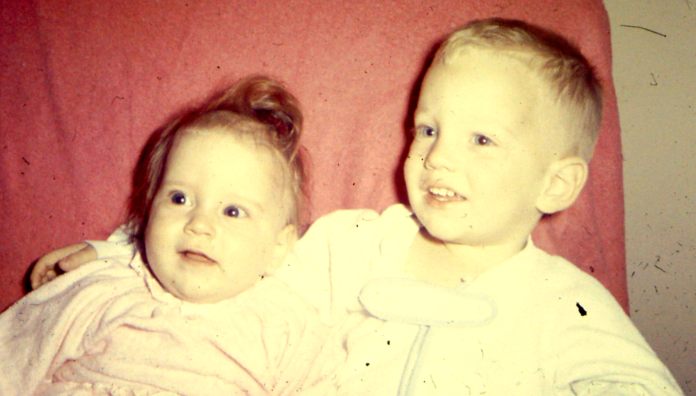
1963: A Little Sister (Jennifer)

Slide 9
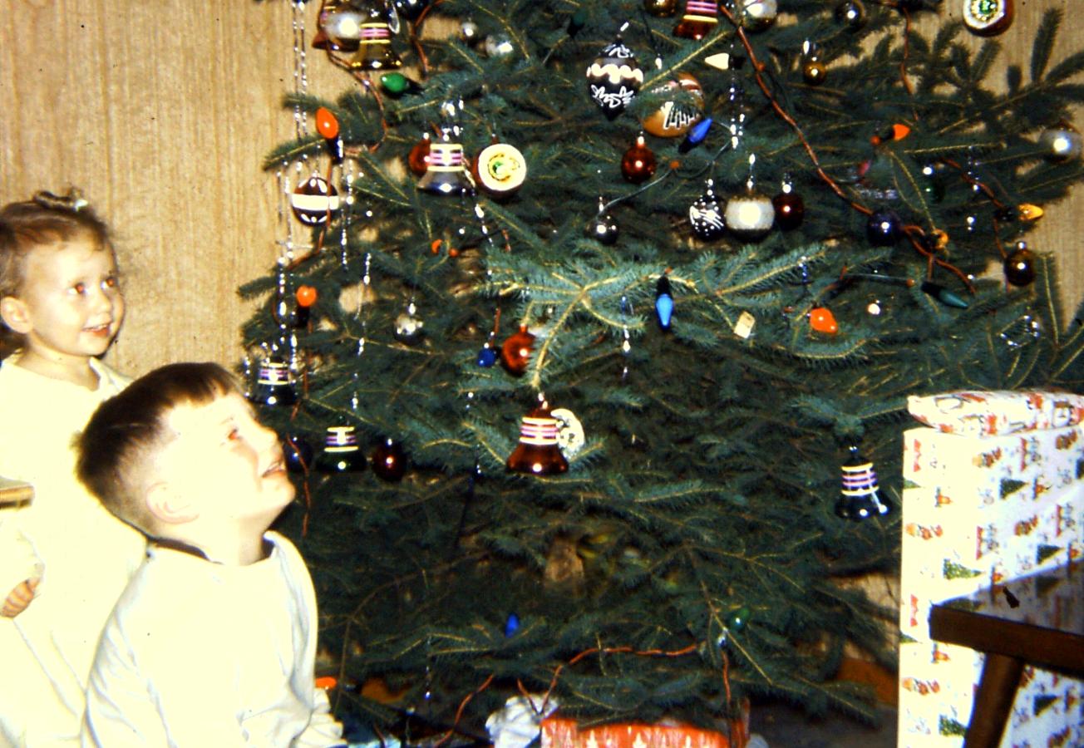
1967: A 2nd Sister (Janette)

Slide 10
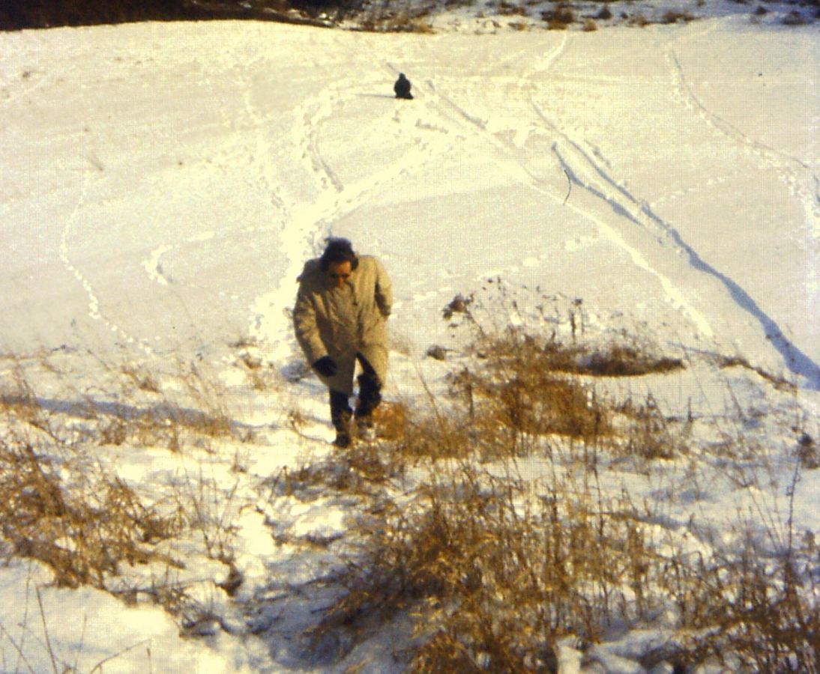
1973: Tobagganing at “the farm”

Slide 11
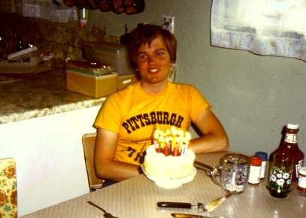
1980: Ready for University

Slide 12
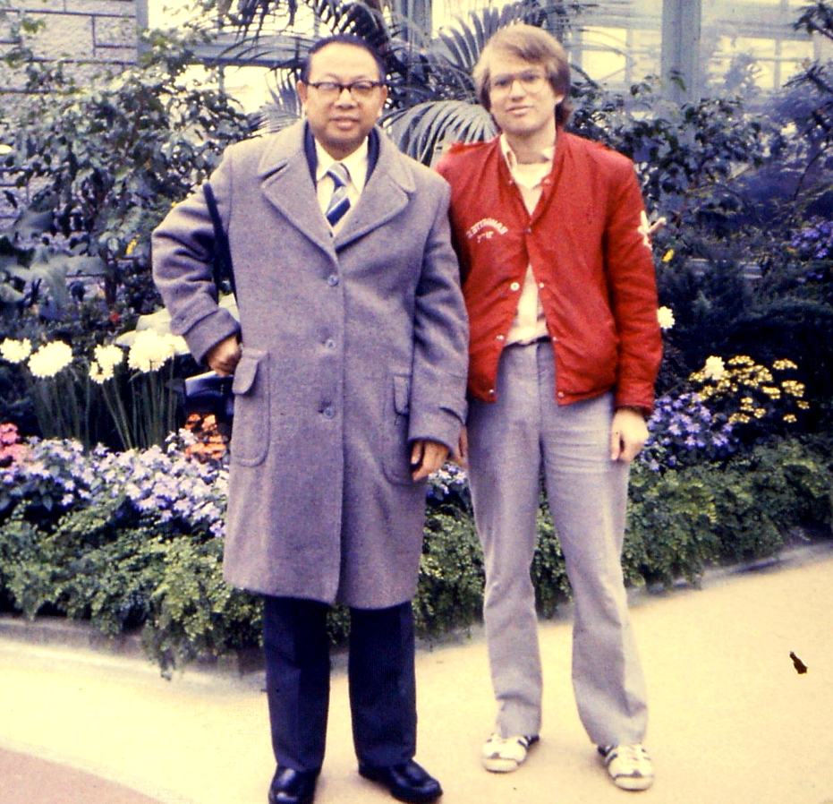
1984: Sharing with Tu Baohong
Niagara Falls
Greenhouse

Slide 13
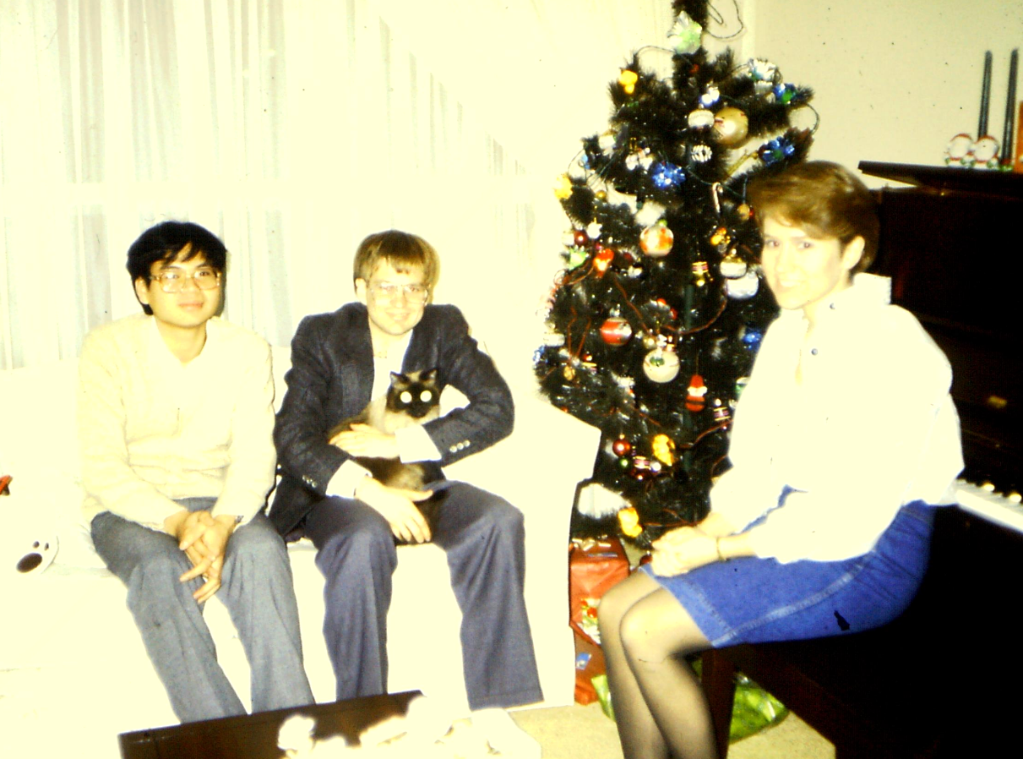
1986: New Home (w/Li Wang Xing)
Janette

Slide 14
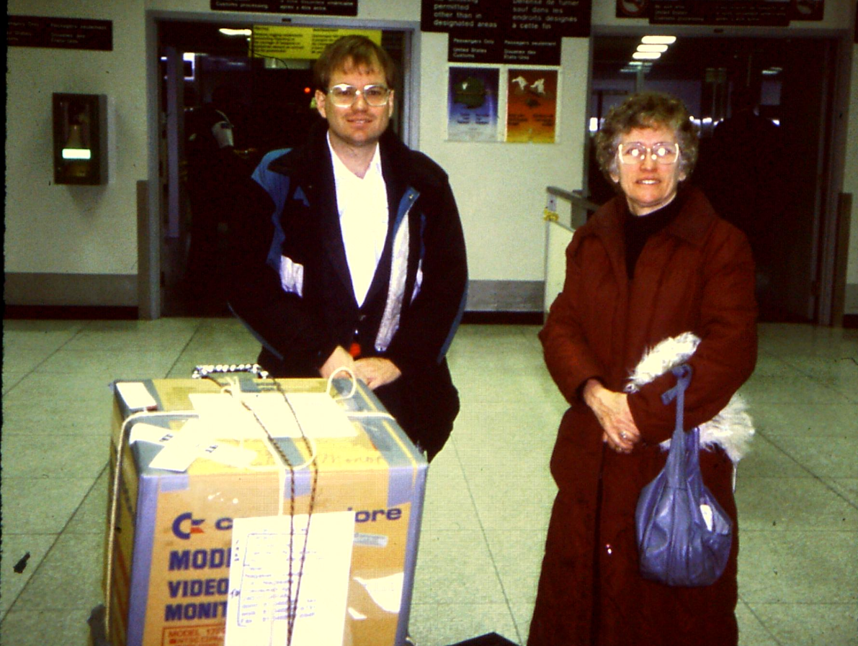
1993: Returning to Japan

Slide 15
Elements of Celebration

Slide 16
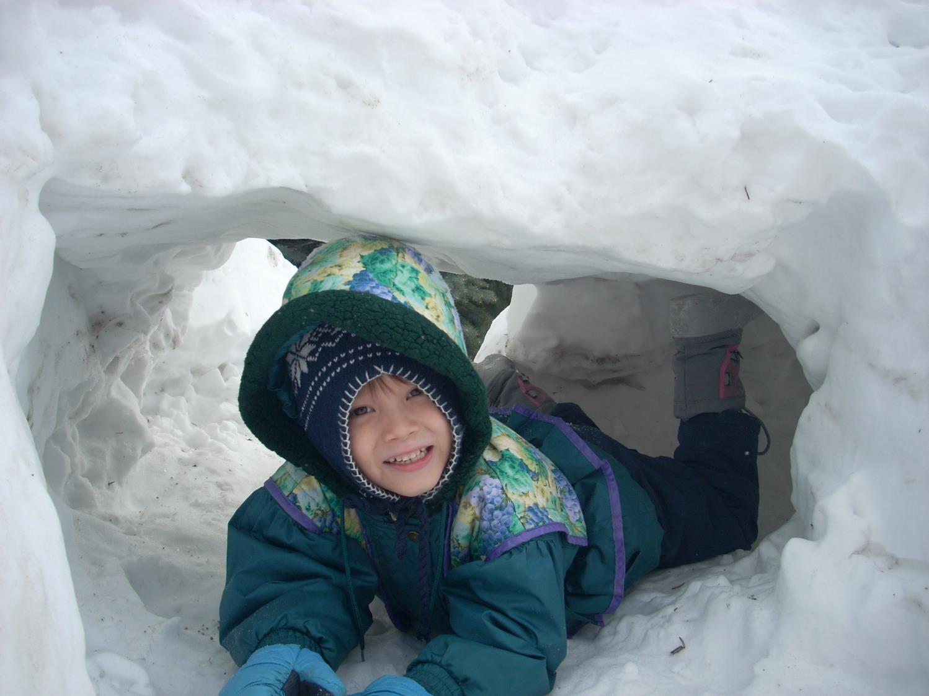
Growing Up: Pre-Christmas
Mother in August starts Christmas cake
Shopping for Presents
Family decorate inside house
Family sets up Christmas Tree
Father puts colored lights outside.
Mother bakes cookies
I go caroling
Yeh! School holiday starts!
Johann Tunneling 2011

Slide 17
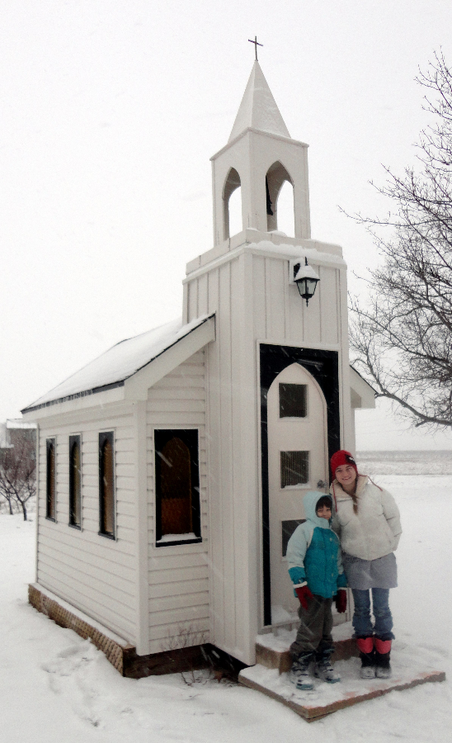
Growing Up: Christmas Eve (12/24)
Church
  sing praises to God for sending Jesus
  “Hear the story”
  Meet old friends
Home
  Hang stockings (socks) by fireplace
  Watch Movie: “A Christmas Carol” by C Dickens
Aien
Johann
2013

Slide 18
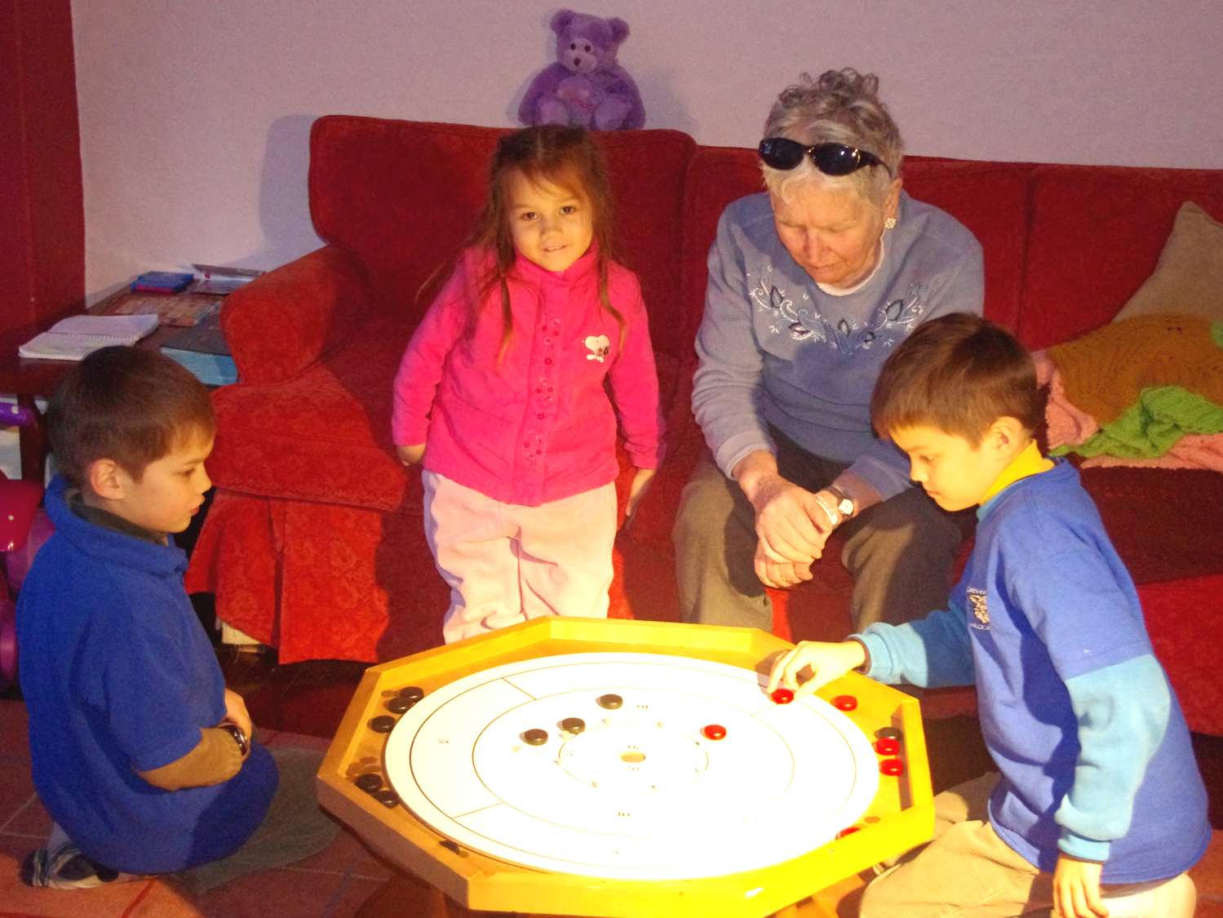
Growing Up: Christmas
Christmas Day (Dec 25):
  Morning Exchange Presents as family
  Turkey Dinner with mom’s family
  Internationals Stay Over (after I go Uni)
  Tobogganning
Boxing Day (Dec 26):
  Turkey Dinner with Dad’s family
  Exchange of Presents
  Crokinole
  Chinese Oranges
  Rice Candy
Leon
Ruth
Mother
Johann
Feb 2015

Slide 19
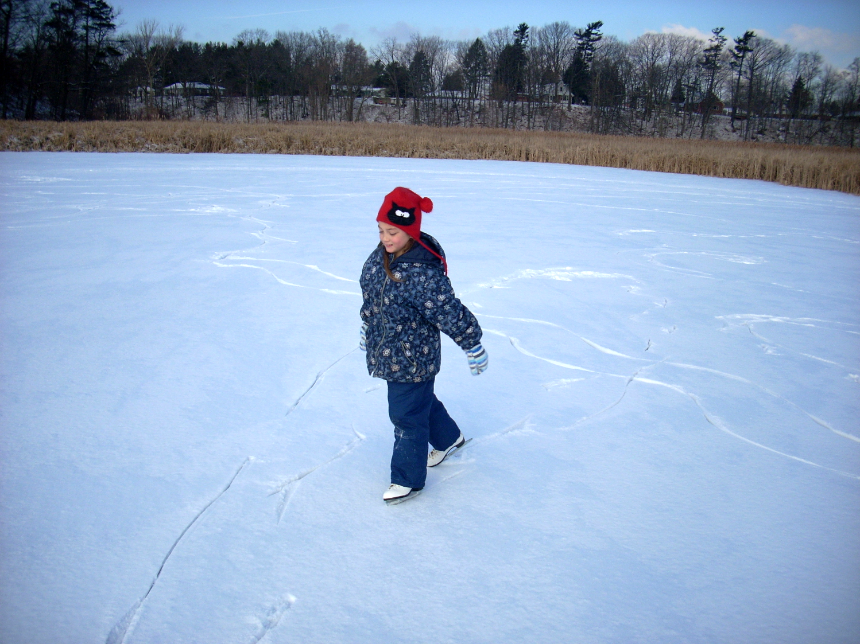
Growing Up: Post-Christmas
Father takes down lights
Family puts away decorations (til next year)
Visit Niagara Falls
  Greenhouse
  See Ice on Trees
Tobogganing (from Cree Indians)
Ice Skating (backyard)
Hiking
Aien Skating Jan 2008

Slide 20
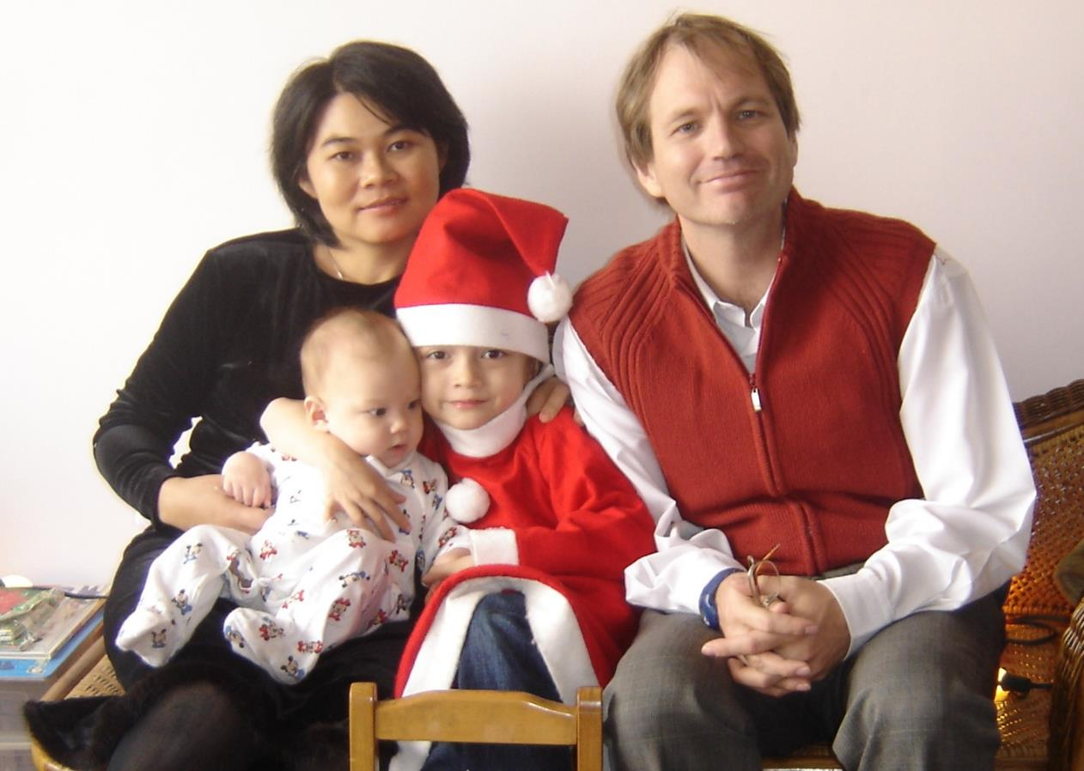
Celebrate in Taiwan (2005)

Slide 21
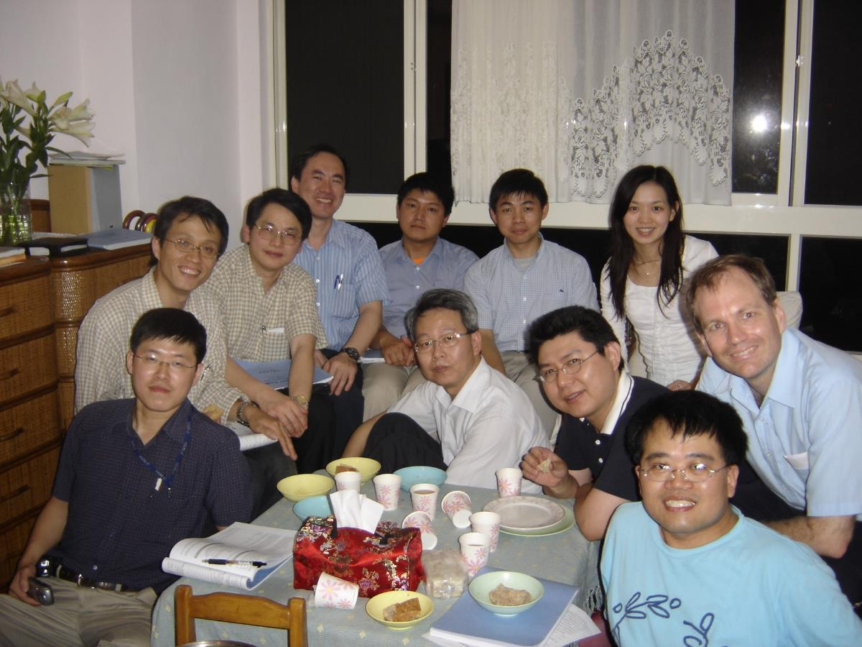
Celebrate with YZU students (2005)

Slide 22
Celebrate in Taiwan w/Friends
Insert 2013 pictures from Aray

Slide 23
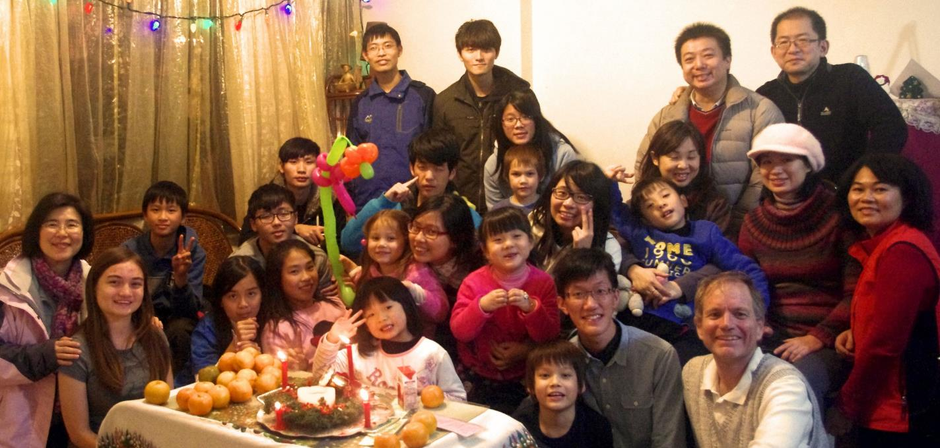
Celebrate in Taiwan w/ Friends
2014

Slide 24
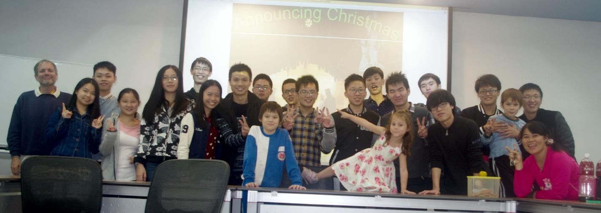
Celebrate in Taiwan w/Friends
2015

Slide 25
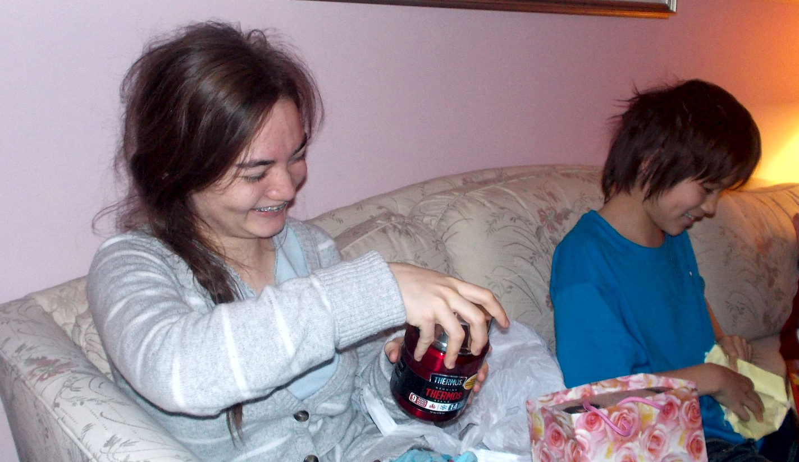
2016: Opening Presents
A
Aien Johann

Slide 26
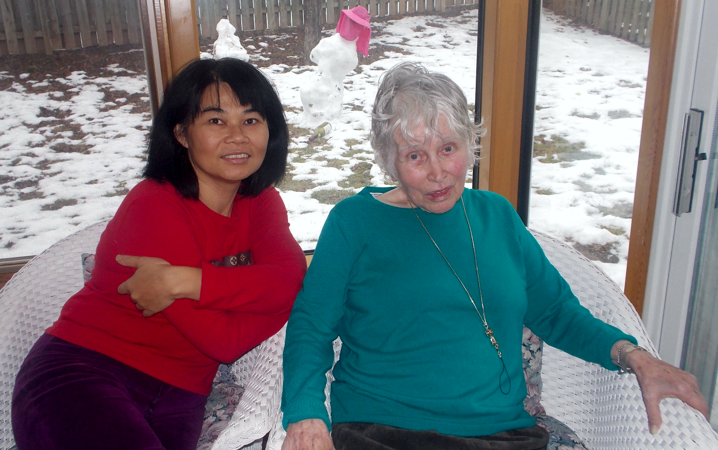
2016: Family Time
Sharon Marjorie Ruth

Slide 27
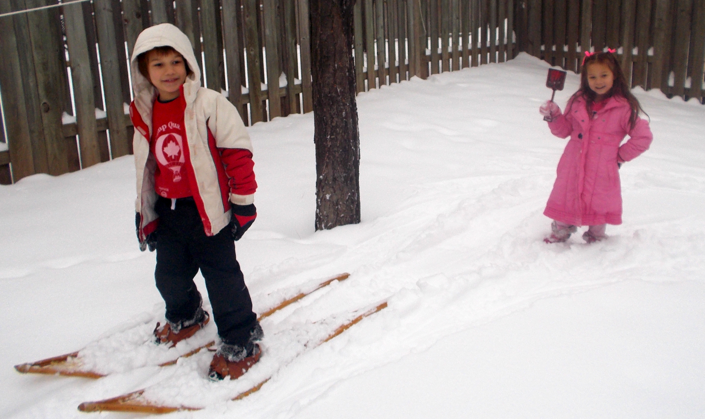
2016: Snowshoeing
Leon Ruth

Slide 28
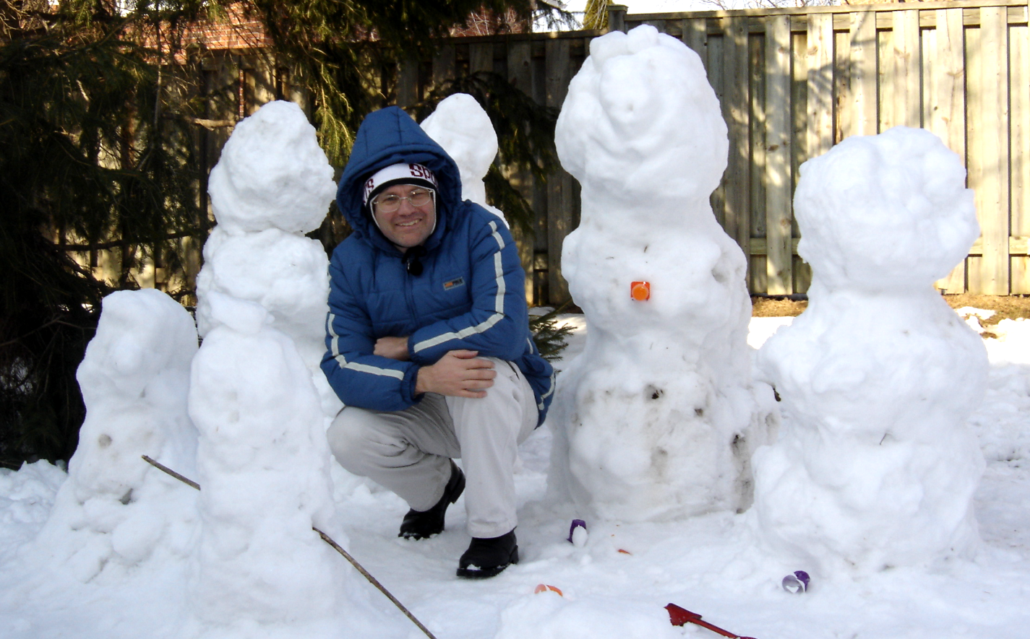
Making Snowmen
Jon
2005

Slide 29
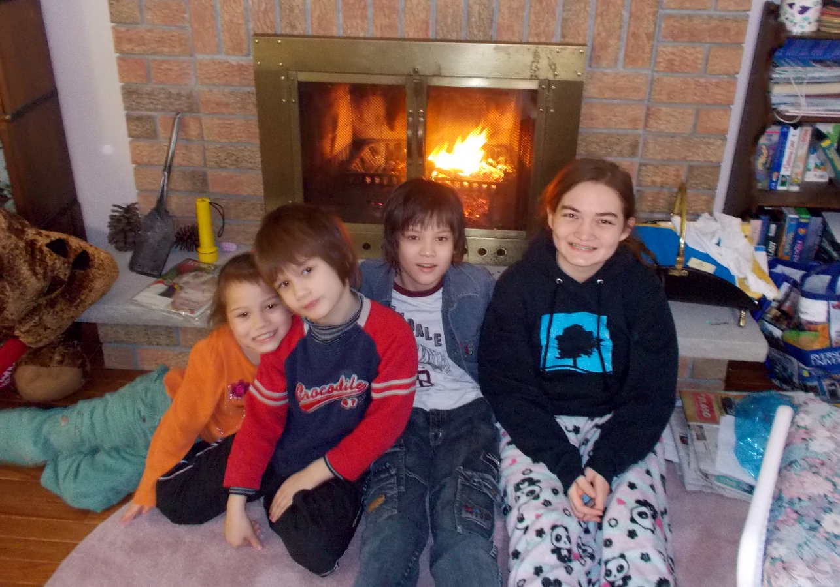
2016: A Warm Fire

Slide 30
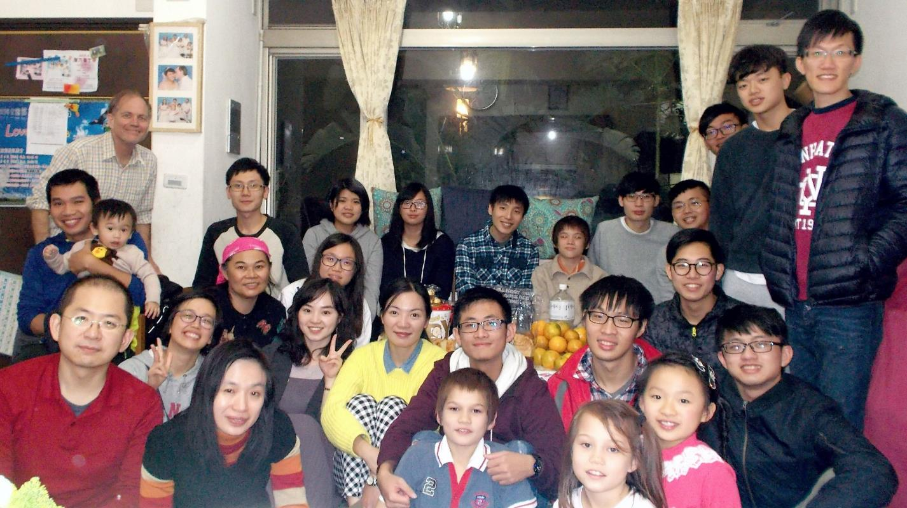
Celebrate in Taiwan w/Friends
2017

Slide 31
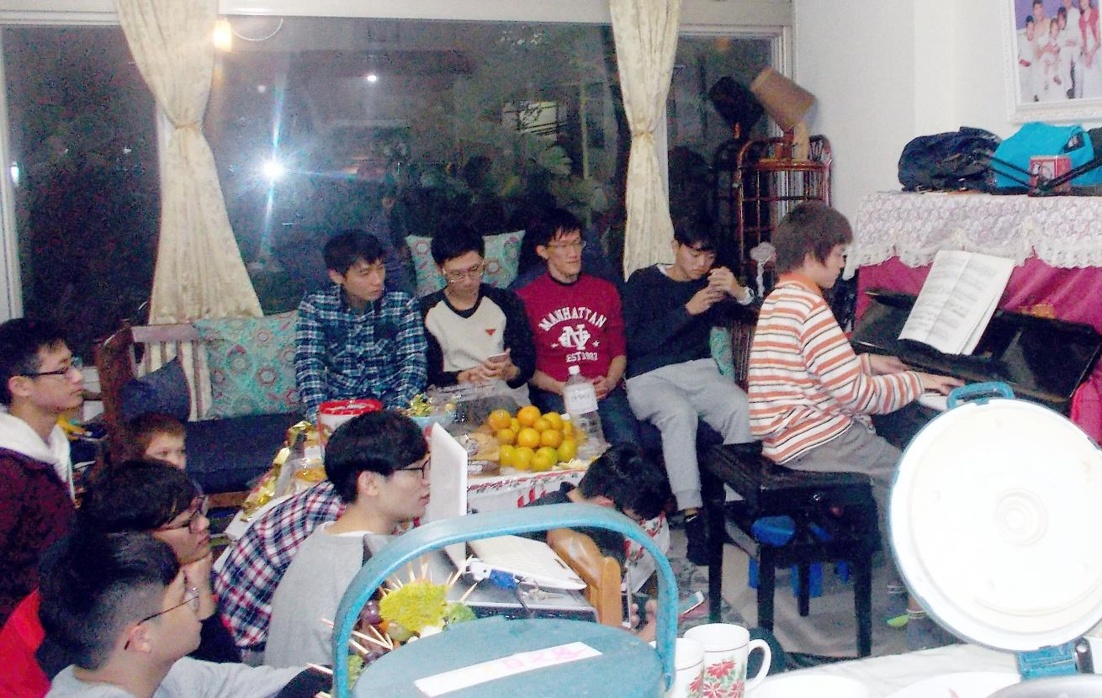
With Friends and Family 2017

Slide 32
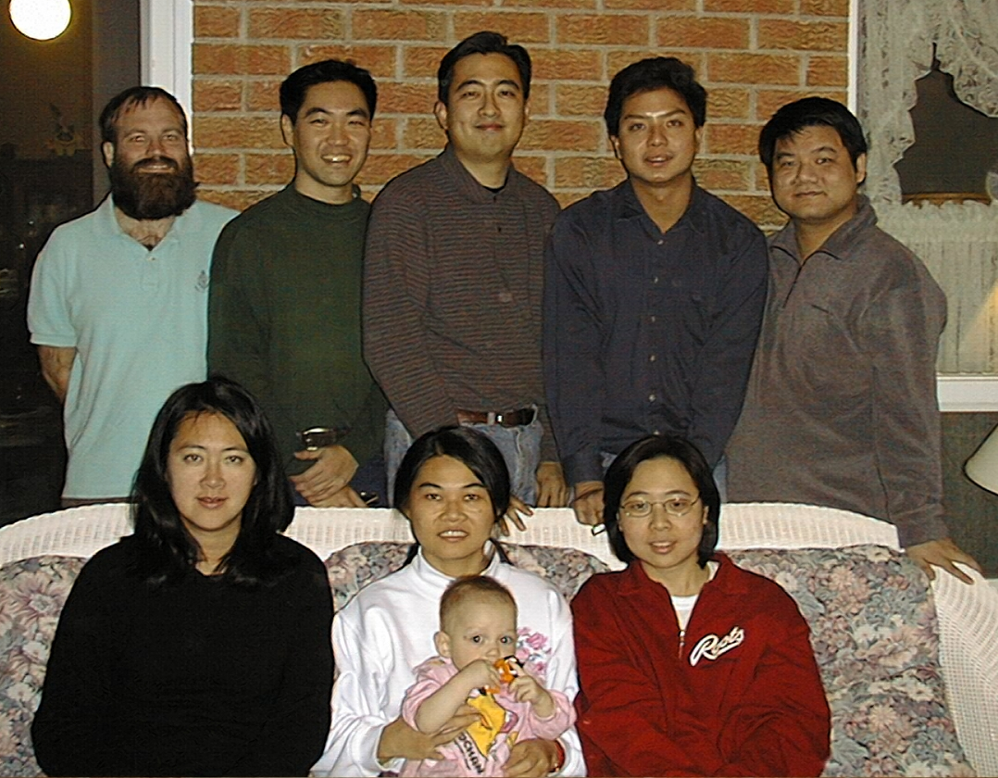
2018 Christmas? Celebrating w/ U!
2001

Slide 33
Lets Celebrate Christmas Eve Together
(Singing, Wreath, Story, Friends & Prayer)

Slide 34
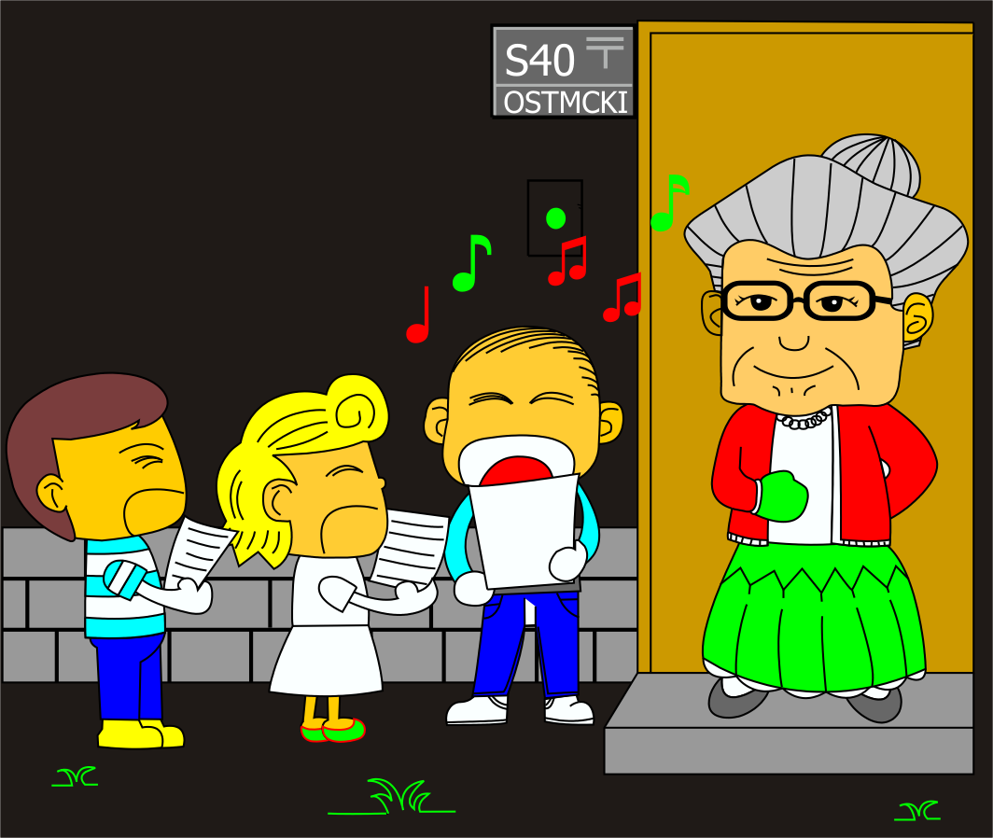
Christmas Carols

Slide 35
Christmas Carol Set
Joy to the World
普世歡騰!
Joy to the world,
the Lord is come!
Let earth receive her King;
Let every heart
prepare Him room,
And Heaven
and nature sing, (2x)
And Heaven,
and Heaven,
and nature sing.
普世歡騰!
救主下降!
大地結她君王;
惟願眾心,
預備地方,
諸天萬物歌唱
諸天萬物歌唱
諸天
諸天
萬物歌唱.

Slide 36
Christmas Carol Set
Angels we have heard…
天使 歌唱
Glo - - - - - - - - - - - - ri-a,
in ex-cel-sis De-o! (2x)
榮 ...... 耀 他 ,
榮耀 歸 最 高 神 (2x)

Slide 37
Christmas Carol Set
Silent Night
平安夜
Silent night, holy night
All is calm, all is bright,
Round yon virgin
mother and Child.
Holy Infant,
so tender and mild,
Sleep in heavenly peace(2x)
平安夜，聖善夜！
萬暗中，光華射，
照著聖母
也照著聖嬰，
多少慈詳
也多少天真，
靜享天賜安眠 (2x)

Slide 38
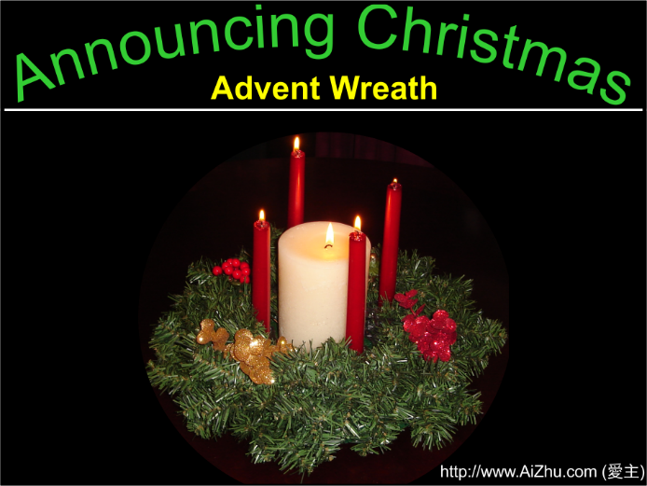
Christmas Wreath

Slide 39
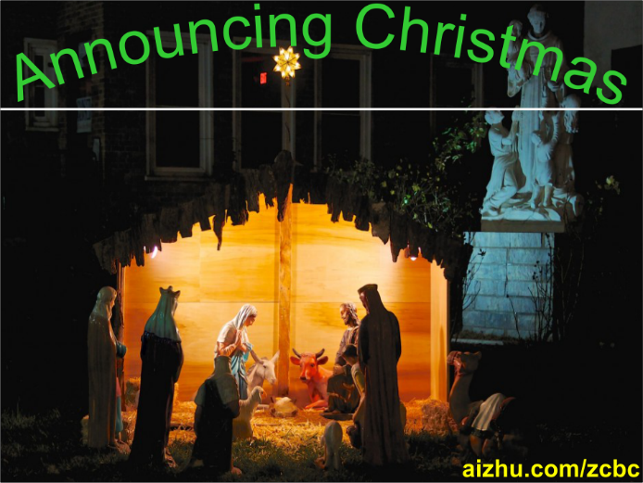

Christmas Story

Slide 40
Christmas Prayer

