Slide 1

https://medium.com/@explore.social.world/a-signal-in-the-smoke-ancient-communication-through-fire-a3b24f5fee17

Slide 2

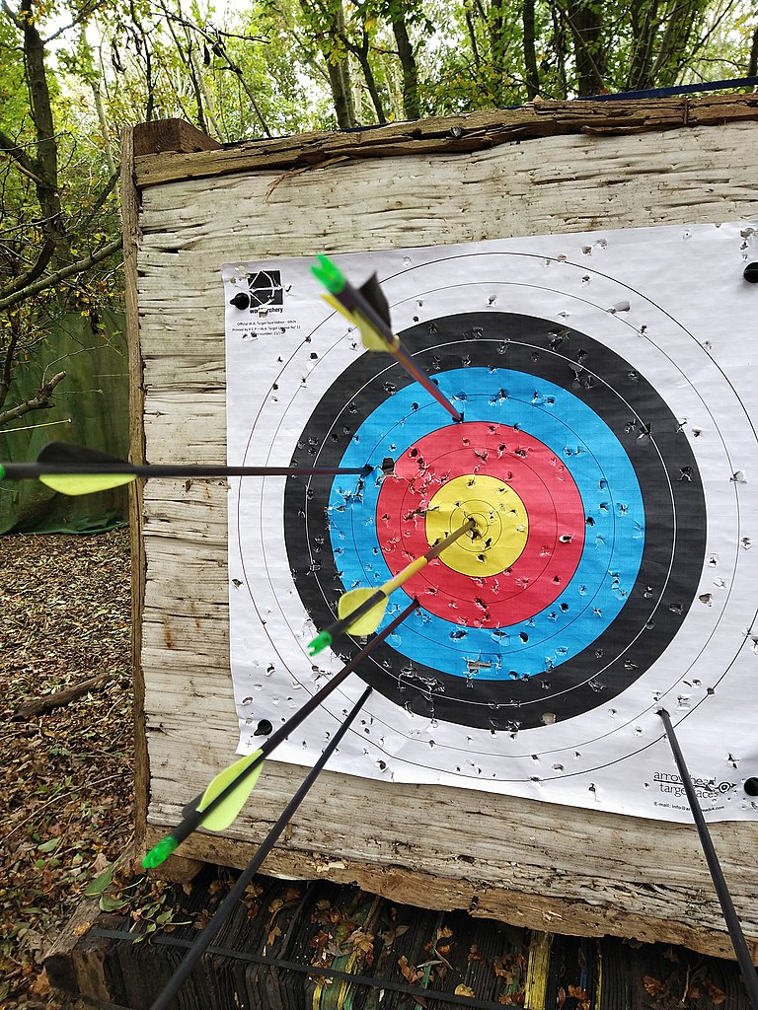
1 Today’s Objectives
To understand the motivation for this textbook and course,
To appreciate the teaching methodology to be used,
To understand the organization of these learning materials,
To perceive your role in the learning process

Slide 3

1.2 Class Setup
U

Slide 4
1.3 Teacher’s Self-Introduction
Listen to the Teacher’s self introduction
Note the opening, closing and information given.
Later you will use the same categories to introduce yourself.

Slide 5
1.3 Teacher’s Self-Introduction
Chinese name
Romanization
English name
Hometown
Background

Slide 6
2 Language Learning
Language…
Meaning
Interests
Understandable
Context
Risks
Interaction
… is the carrier of information and
… use relates to life needs and
… is
… is used in
… involves taking
… requires

Slide 7
2 Language Learning
Your experience
Reflect on how you have been learning English
Reflect on how you learned Chinese

Slide 8
2 Language Learning
Your experience
In learning Chinese you…
  Listened
  Connected
  Tried to talk about things of interest to you
  You weren’t understood, so you tried again.
All around you were people speaking Chinese

Slide 9
2 Language Learning
The Communicative Methodology
Aim is communication
Study as a system
Study using ‘communicative activities’.
Grammar
&
Spelling

Slide 10
2 Language Learning
Student/AV/Text/Teacher Roles
Focused on you
Surrounded by classmates
Guided by AV
Supported by textbook
Facilitated by the teacher

Slide 11

3 Nature of Courseware
Your Needs as an Engineer/Scientist
Taking part in social interactions
Conducting Correspondence
Attending lectures by visiting scientists
Researching information (Reading Papers)
Writing Scientific Papers
Presenting papers at conferences

Slide 12
3 Nature of Courseware
4 weeks
8 hours
Objective: Start, Continue & Close a conversation
Evaluation:
  Effort: Continuous Grading (7 pts)
  Theory: Written Quiz (8 pts)
  Application: Two (2) minute in-class presentation (10 pts)

Slide 13
3 Nature of Courseware
4 weeks
8 hours
Objective: Listen efficiently, boldly ask questions
Evaluation:
  Listening Quiz (10 pts)
  Written Quiz (7 pts)
  Continuous Grading (8 pts)

Slide 14
3 Nature of Courseware
4 weeks
8 hours
Objective:
  To write formal and informal letters
  To learn Pre- and Post-Writing Skills
Evaluation:
  Informal Letter of Introduction (6 pts)
  Formal Cover Letter and Resume (9 pts)
  Journal Entry (3 pts)
  Continuous Grading (7 pts)

Slide 15
3 Nature of Courseware
4 weeks
8 hours
Objective:
  To learn how to quickly understand an article
  To learn skills of skimming, scanning and reading
Evaluation:
  Reading Speed Test (10 pts)
  Journal Entry (7 pts)
  Continuous Grading (8 pts)

Slide 16
3 Nature of Courseware
16 weeks
8 hours
Objective:
  To learn how to format a research paper
  To write a formal research paper
Evaluation:
  Scientific Paper / Formal English Writing (50 pts)
  Journal Entry (20 pts)
  Continuous Grading (30 pts)

Slide 17
3 Nature of Courseware
8 weeks
16 hours
Objective:
  to organize a scientific talk
  to speak clearly and understandably
  to create scientific viewgraps
Evaluation:
  Continuous Grading (30 pts)
  XTOP conference presentation (50 pts)
  XTOP conference participation (15 pts)

Slide 18
3.3 Grading
Effort Based: Continuous Grading (each class)
Participation | Points | Comments
Absent | 0
Disruptive | 1 | e.g. talking others speaking
Late | 2
Quiet | 3 | e.g. sleeping
Sick (absent with leave) | 3 | MC required
Average | 4
Excellent | 5
* 2 points additional for homework

Slide 19

3.3 This Course: Grading
Effort Based: Journal Entry
When? Class time, written modules
What? Write a paragraph about the topic the teacher assigns
How? Communication, not grammar, spelling

Slide 20
3.3 This Course: Grading
Effort Based Component: Journal Entry
3 pts: Understand
2 pts: You can do better
1 pt: Don’t understand
1 pt: Not related to the question
0 pts: Blank Page

Slide 21




3.3 This Course: Grading
Objective Component
A QUIZ is a test you do in class.
  It is objectively marked!
  Cheating and copying are serious offences → fail
An ASSIGNMENT is a test you do at home.
  It is objectively marked!
  Cheating and copying are serious offences → fail
But HOMEWORK is effort based
  Right or wrong is not important for grade
  You can do it with others (and should)

Slide 22

4 Respect → Unspoken Rules
Attend all classes.
If absent, inform tutor before class.
Be on time.
Pay attention when classmates speaking.
Answer questions when asked
Be willing to try.
Use only English in class.
Do your own work.
Please, Don’t wait
until I am dead
to respect me!
https://www.flowerchimp.com.ph/collections/funeral-flower

Slide 23
5 Names
An Important Choice
Name is a handle
Make it easy for others
  To talk to you
  To remember you

Slide 24

5.0 Real Names
Do you know these celebrities’ original names?
Can you guess?

Slide 25
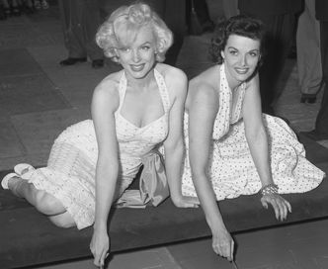
Marilyn Monroe
Birth Name: Norma Jeane Mortenson
By Los Angeles Times - Los Angeles Times photographic archive, UCLA Library. [1],
Public Domain, https://commons.wikimedia.org/w/index.php?curid=5730039

Slide 26
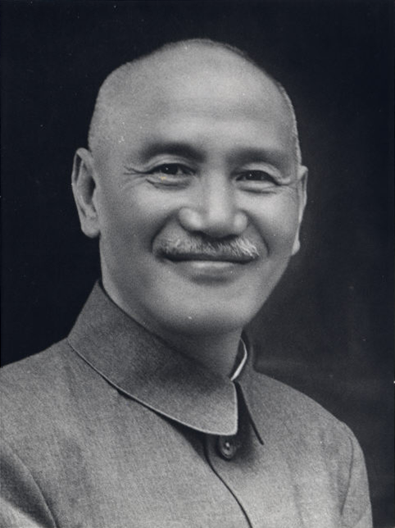
蔣中正 Jiǎng Zhōngzhèng
Birth Name:
蔣周泰
(Jiǎng Zhōutài)
By Office of the President of the Republic of China, Attribution, https://commons.wikimedia.org/w/index.php?curid=58340928

Slide 27

Donald Trump
Original Family Name: Drumpf
By Gage Skidmore from Peoria, AZ, United States of America (Donald Trump) [CC BY-SA 2.0 (http://creativecommons.org/licenses/by-sa/2.0)], via Wikimedia Commons

Slide 28
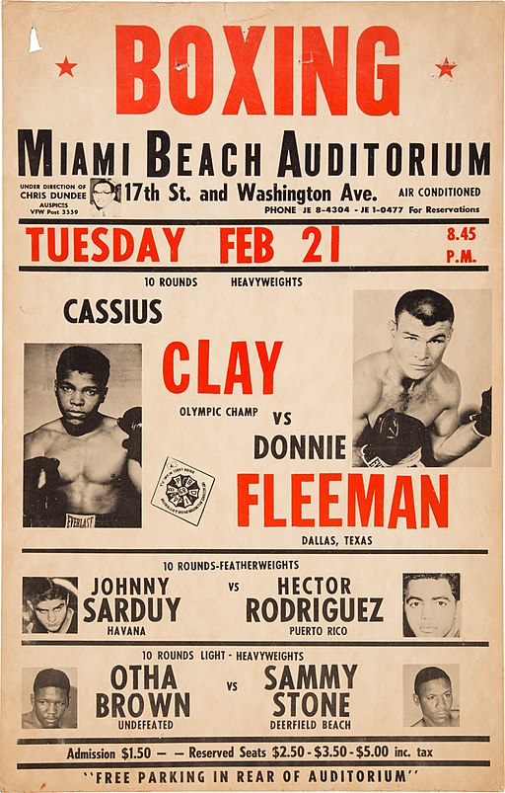
Muhammad Ali
Birth Name:
Cassius Clay
By IABPD (Heritage Auction) [Public domain], via Wikimedia Commons

Slide 29

George Orwell
Real Name: Eric Arthur Blair
Annonymous [Public domain], via Wikimedia Commons

Slide 30
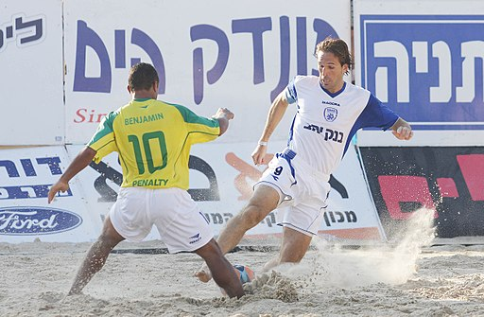
Pelé
Real Name: Edson Arantes do Nascimento
By Israeli Beach Soccer League (The spokesman of the Israeli Beach Soccer League.) [Public domain], via Wikimedia Commons

Slide 31
5.1 Handles are Important
A good name is…
Relatively common
Easy to spell
Easy to pronounce
Has no negative connotation (e.g. recently Karen)

Slide 32
5.2 Choosing an English Name
Relates to You
Pronunciation
Meaning
Personality

Slide 33

5.2 Choosing an English Name
Choose your Name
Choose a name
Write it on the blackboard.
Note
  1 person = 1 name
  1st Come, 1st Served

Slide 34
6 Hanyu Pinyin from Zhuyinfuhao
Two + One-step Conversion
Chinese(汉字)
→ Zhuyin Fuhao (注音符号)
→ Hanyu Pinyin （汉语拼音）
Compress (if need)
Check for Exceptions
(Rare)
白 小 明
ㄅㄞ ㄒ-ㄠ ㄇ- ㄥ
Bai Xiao Mieng
Bai Xiao Ming
中
ㄓㄩㄥ
zh + u + eng
zhong (u+e)
台 北
ㄊㄞ ㄅㄟ
Tai Bei
Taipei
Pinyin

Slide 35

6 Hanyu Pinyin from Zhuyinfuhao
Two + One-step Conversion
Chinese（汉字）to Zhuyin Fuhao（注音符号）
Zhuyin Fuhao（注音符号）to Hanyu Pinyin （汉语拼音）
Compress (if need)
In your book write…
  The characters
  Your name
  Your partner’s name
  Your supervisor’s name
On the blackboard
  Write your name
zh + u + eng
zhong (u+e→o)
m + i + eng
ming (i+e→i)
Pinyin

Slide 36
6 Hanyu Pinyin from Zhuyinfuhao
Writing Hanyu Pinyin
In your book write…
  The characters
  Your name
  Your partner’s name
  Your supervisor’s name
On the blackboard
  Write your name.
Chinese character
→ Zhuyin Fuhao
2. Zhuyin Fuhao
→ Hanya Pinyin
3. Contract

Slide 37
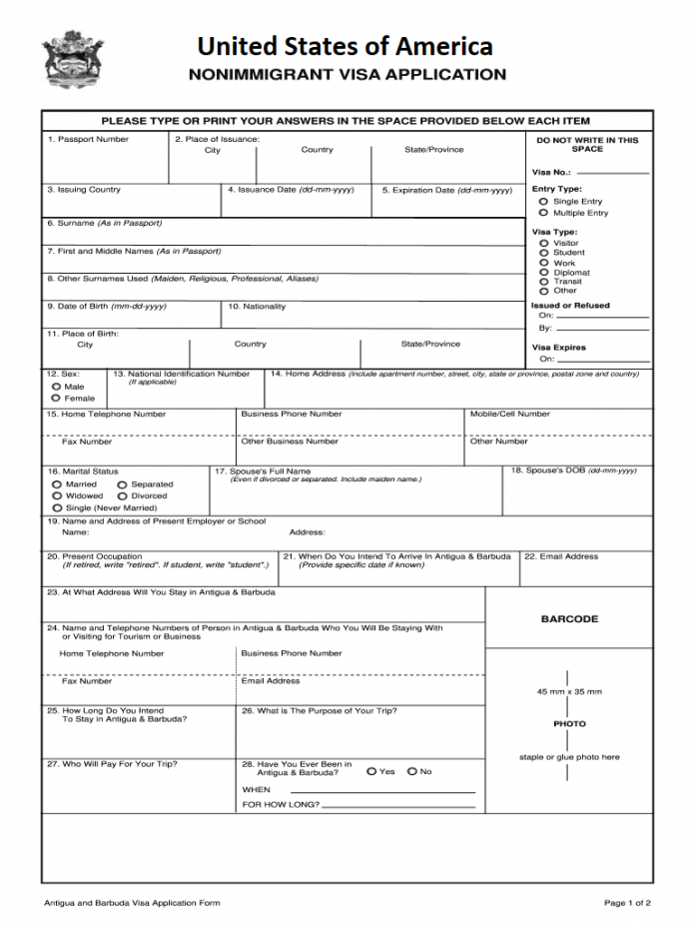
7 Forms
They’re everywhere
Tedious bit necessary part of daily life. i.e. conference, hotel room, visa application
Sample usually available
Write where you are supposed to write.
Don’t write in sections for office use!

Slide 38
7 Forms
Fill Out Survey
Fill out student form
It will be used for marking
If not able to finish in class, finish at home.
Use table to help write your name in Roman Characters

Slide 39
8 Getting to Know Each Other
Introduce Myself
1. Recite classmates’ names,
2. Add your own name at the end
Remember Names
Order
1. Form 2 teams
2. Line up in alphabetical order. 3. Raise hands when complete.
Share Uniqueness
State
your name,
your hometown
1. Find out something unusual about each member of your small group.
2. Decide who has the most interesting thing.
3. Choose a spokesman to introduce him/her.

Slide 40
9 Homework and Assignments
Internet & Email
Course
  Website: https://class.kejiyingwen.comz
    Evaluation Criteria and Marks
    Lecture Slides and Viewgraphs
    Useful links
    Software and Self-Learning Tools
  Email: info@kejiyingwen.com
  Assignments/Homework: scientificenglish@gmail.com
Junior High English Immersion Summer Camp:
  Website: https://camp.kejiyingwen.com
Conference (XTOP):
  Website: https://xtop.kejiyingwen.com
  Email: xtop@kejiyingwen.com

Slide 41
Electronic Submission
Guidelines
Assignments and Homework

Slide 42
Electronic Submission

Slide 43
To Line
To:
Send To

Slide 44
Subject Line
School
Student
ID
English
Name
Topic
Subject
Chapter
Course
Comma (,)
Separated
Correct my work?
YES or NO

Slide 45
Submission Body
ScientificEnglish@gmail.com
Submission in Message Body
Not an Attachment
(unless specified otherwise)

Slide 46
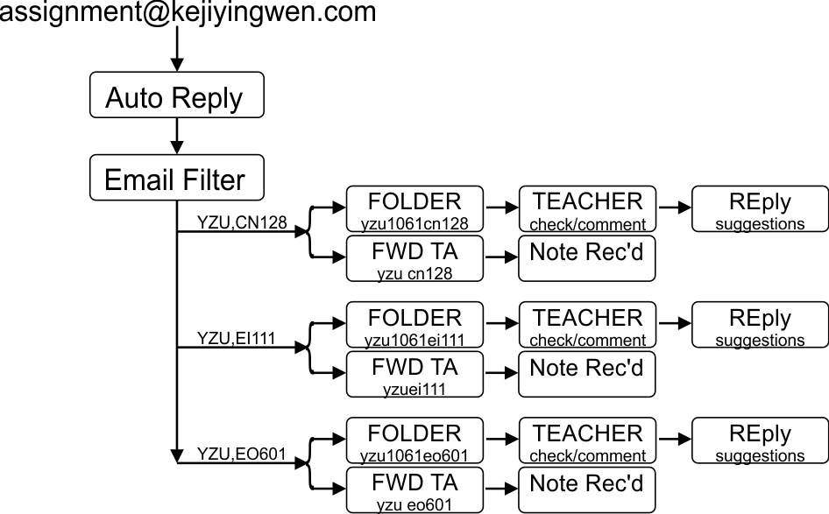
After Submission
ScientificEnglish@gmail.com
If you do not receive a reply
Within 10 minutes you have
Sent to wrong address!

Slide 47
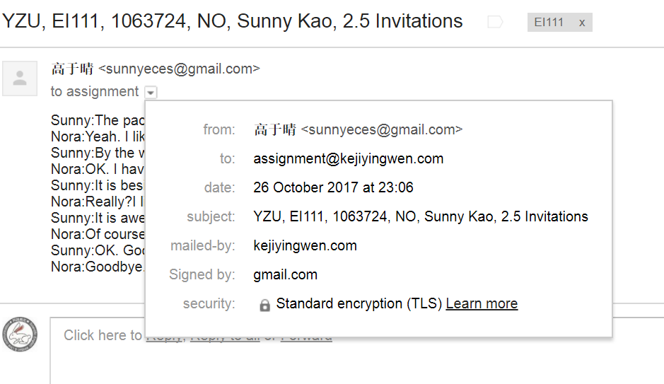
Deadlines (>24 hours before class)
Must be received
24 hours before class
ScientificEnglish@gmail.com

Slide 48
9 Homework
Purchase and bring to class:
  The textbook,
  Red, blue, green, and black pens
If your class is a Written course…
  Buy one additional Exercise book (Size B5)
  Glue the journal entry evaluation form to cover.

