Slide 1
§9.1 Presenting at Conferences
Overview of the Unit

Slide 2

1 Preparing a Presentation: Overview
Listen carefully as the facilitator introduces the unit.

Slide 3
1 Skill Sets
1 (you) : 1 (you) → 1 : ∞ (you) → 1 (you) : ∞
Scientific Presentations are an Integrated Skill
  Speaking
    Pronunciation
    Grammar
    Fluency
  Organization
    Logical
    Natural
  Viewgraph Quality

Slide 4
2 Objectives
To learn how to...
  Organize a technical talk for a conference
  Speak clearly and understandably
  Create technical viewgraphs
To experience presenting a technical talk to peers
To practice your listening skills

Slide 5
3 Contents
Public Speaking Skills
Preparing a Technical Presentation
- Organization
- Viewgraph Design
Presenting at a Conference
Evaluating Technical Presentations

Slide 6

3 Evaluation (§9 & §10)
Total: 100 pts
Class: Continuous Grading (30 pts)
XTOP Conference
  Presentation (50 pts)
  Participation / Peer Grading (20 pts)
See web sites for details

Slide 7

Response & Class Details
Questions?
Groups: Same as Last Semester
Seating Arrangement →

Slide 8
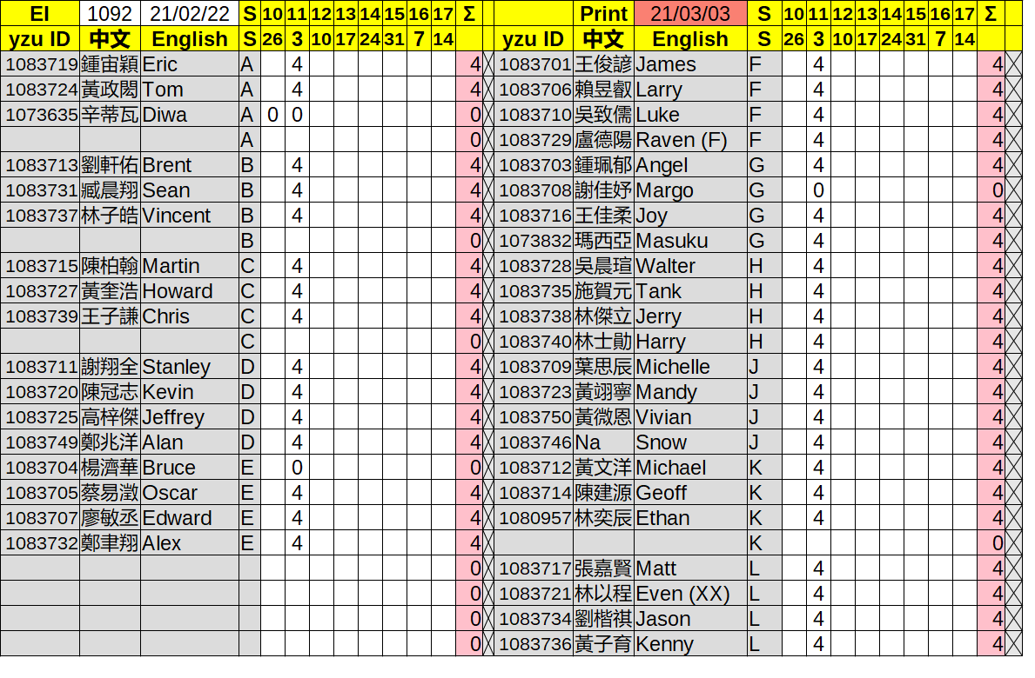
Groups

Slide 9
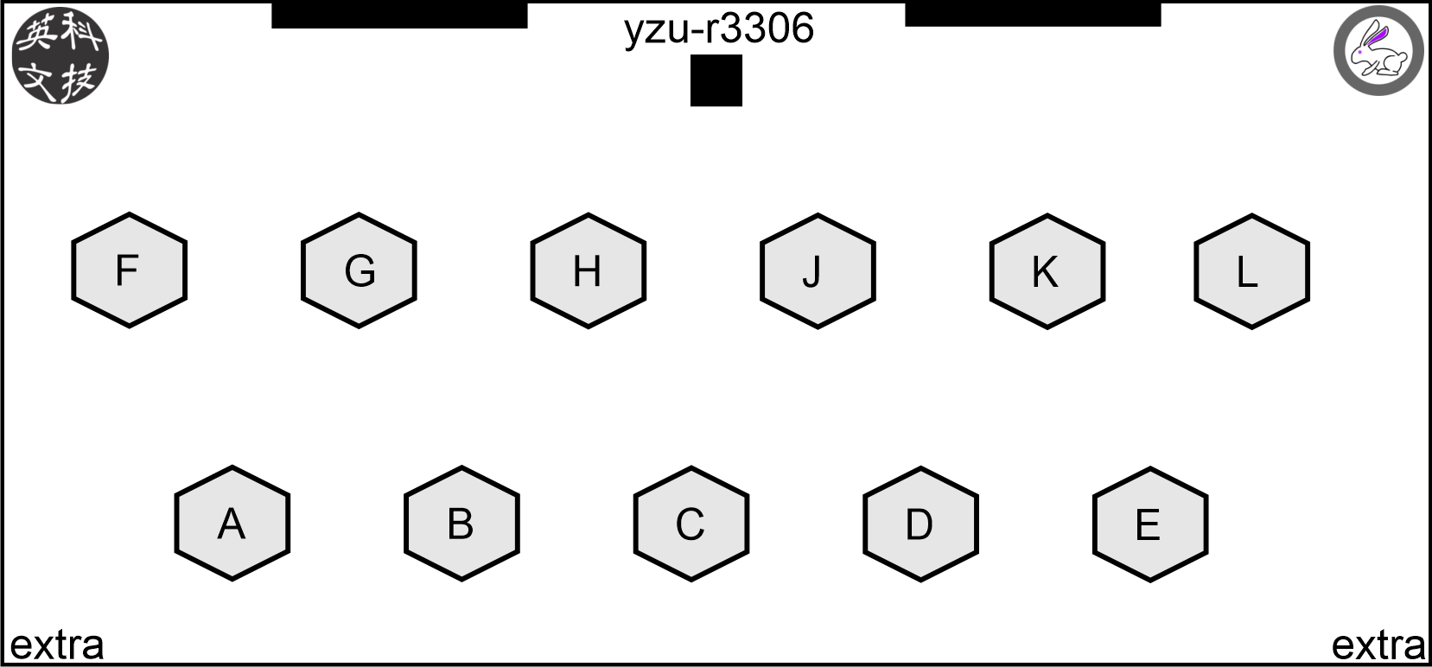
Seating

