Slide 1
§9.3 Organizing your Talk

Slide 2

1 What's the Key Point? (Hypothesis)
The Hypothesis
Important
  For Audience
  For Speaker
Examples
Aristotle: Objects fall with speed proportional to their weight (v = gm)
Galileo: If an object does not meet with resistance, then it will continue to move at a constant speed.
Newton: For every action there is an equal and opposite reaction.

Slide 3

1 What's the Key Point? (Hypothesis)
Define It!
Based on these examples, write down your own definition for hypothesis in your book
Do not refer to a dictionary!
Aristotle: Objects fall with speed proportional to their weight (v = gm)
Galileo: If an object does not meet with resistance, then it will continue to move at a constant speed.
Newton: For every action there is an equal and opposite reaction.

Slide 4
1 What's the Key Point? (Hypothesis)
Definition
Hypothesis [hi-poth-uh-sis] (noun): a proposed explanation for a phenomenon.
from ancient Greek:
  ὑπό (hupo) = under +
  θέσις(thesis) = something put forth
Plural: hypotheses
Scientific hypotheses must be:
  Testable
  Based on
    previous observations or
    extensions of scientific theories.

Slide 5

1 What's the Key Point? (Hypothesis)
Grammar
Look at the examples.
Fill in the blanks in your book.
Aristotle: Objects fall with speed proportional to their weight (v = gm)
Galileo: If an object does not meet with resistance, then it will continue to move at a constant speed.
Newton: For every action there is an equal and opposite reaction.

Slide 6
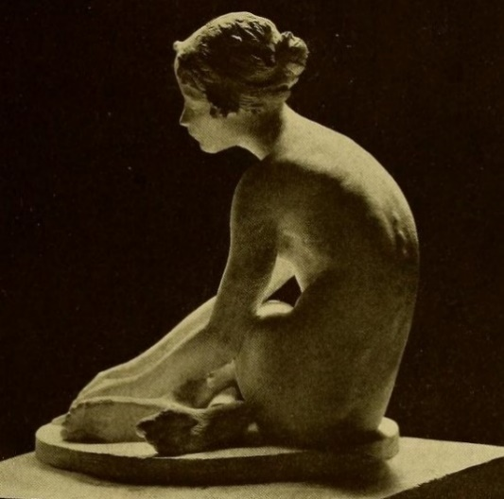

1 What's the Key Point? (Hypothesis)
Grammar
Tense:
  Universal
  Future
Status:
  False
  Unproven
  True
The woman is sitting.
Aristotle: Objects fall with speed proportional to their weight (v = gm)
Galileo: If an object does not meet with resistance, then it will continue to move at a constant speed.
Newton: For every action there is an equal and opposite reaction.

Slide 7
1 What's the Key Point? (Hypothesis)
Practice Writing
Write an hypothesis for two (2) of the topics listed in your workbook.
Remember: Future or Universal Tense
Aristotle: Objects fall with speed proportional to their weight (v = gm)
Galileo: If an object does not meet with resistance, then it will continue to move at a constant speed.
Newton: For every action there is an equal and opposite reaction.

Slide 8



1 What's the Key Point? (Hypothesis)
Argue your hypotheses
Join with another pair of students.
Correct form?
Is the hypothesis true?
Read hypothesis
Aristotle: Objects fall with speed proportional to their weight (v = gm)
Galileo: If an object does not meet with resistance, then it will continue to move at a constant speed.
Newton: For every action there is an equal and opposite reaction.

Slide 9
1 What's the Key Point? (Hypothesis)
Hypothesis for your talk
Write an hypothesis for your XTOP talk.
Aristotle: Objects fall with speed proportional to their weight (v = gm)
Galileo: If an object does not meet with resistance, then it will continue to move at a constant speed.
Newton: For every action there is an equal and opposite reaction.

Slide 10

2 North American Culture

Slide 11
3 Structure of a Presentation
Present the Story
Follow the talk in your workbook

Slide 12

3 Structure of a Presentation
Present the Story
Title of the Story
Setting the Scene
The plot Thickens
Hero to the Rescue
Conclusion

Slide 13

3 Structure of a Presentation
Present the Story
Title of the Story
Setting the Scene
The plot Thickens
Hero to the Rescue
Conclusion

Slide 14
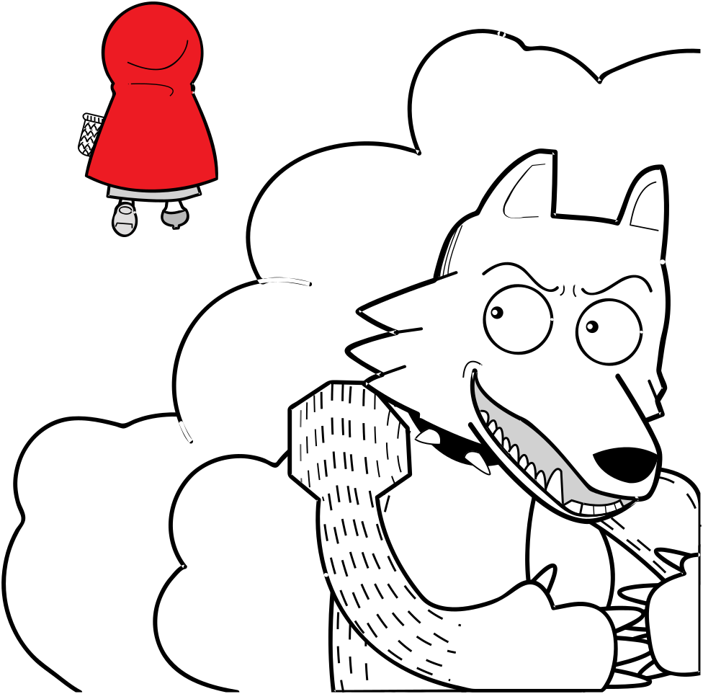
3 Structure of a Presentation
Present the Story
Title of the Story
Setting the Scene
The plot Thickens
Hero to the Rescue
Conclusion

Slide 15
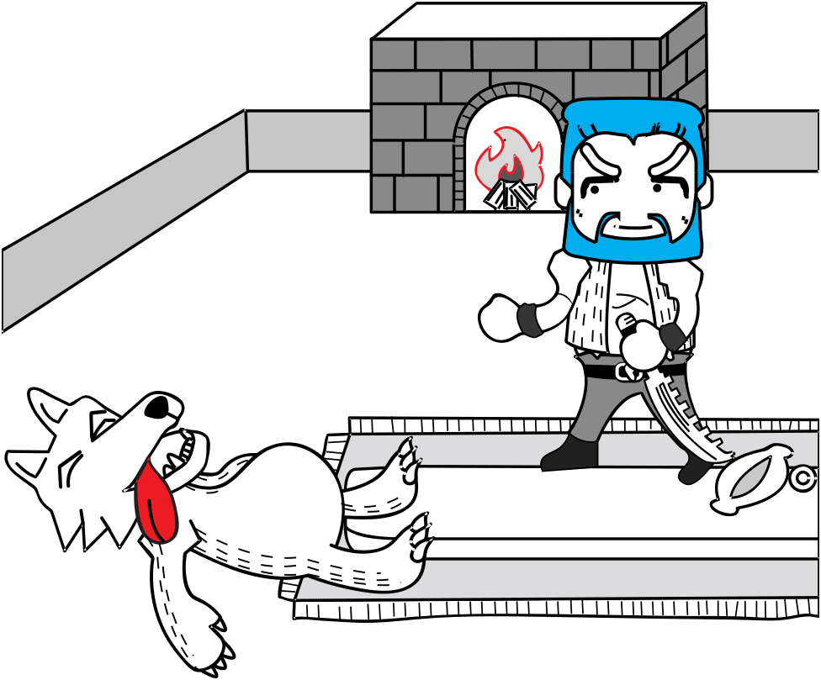
3 Structure of a Presentation
Present the Story
Title of the Story
Setting the Scene
The plot Thickens
Hero to the Rescue
Conclusion

Slide 16
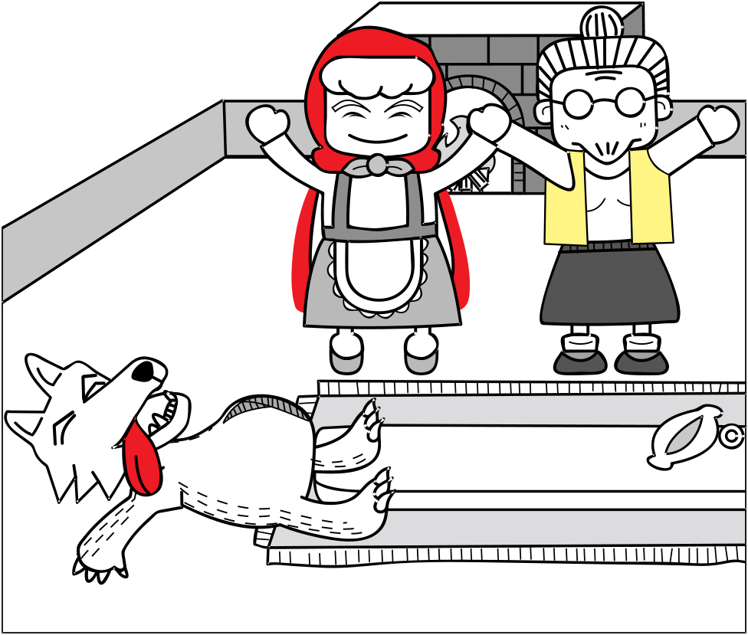
3 Structure of a Presentation
Present the Story
Title of the Story
Setting the Scene
The plot Thickens
Hero to the Rescue
Conclusion

Slide 17

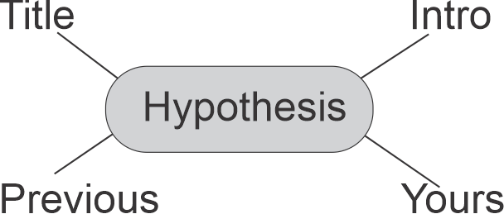
4 Homework and Assignments
For your conference presentation
Write an hypothesis statement.
Prepare a cluster diagram or mind map
Develop an outline for the presentation
Formulate your abstract (include your hypothesis in the abstract)

