Slide 1
Ao-§9.4 Speaking Clearly

Slide 2

ao-§9.4 Speaking Clearly
Ref: https://hubblesite.org/image/68 NASA Core of Whirlpool Galaxy (M51) Image Size:~600 light years
For ever since the world was created,
people have seen the earth and sky.
Through everything God made,
they can clearly see his invisible qualities—
his external power and divine nature.
Paul, Romans 1:20

Slide 3

1 Putting Together The Talk
Putting together paragraphs
Read your paragraph carefully.
When the facilitator says start…
  Find other people who have paragraphs from the same article.
  Sit down in a group when you have found all 5 paragraphs of your article
Do not look at other people’s paragraphs

Slide 4

1 Putting Together The Talk
Logical Sequencing
Follow along in your textbook.

Slide 5
1 Putting Together The Talk
Logical Sequencing
Find Last paragraph: Look at Last sentences
  eliminate those that seem transitional
Find First paragraph: Look at First sentences
  eliminate those requiring prior knowledge
Look for Numeric Clues
  e.g. Firstly, Secondly, Thirdly...
1. First
2. Last
3. Numeric

Slide 6
1 Putting Together The Talk
Logical Sequencing
Find Last paragraph: Look at Last sentences
  eliminate those that seem transitional
Find First paragraph: Look at First sentences
  eliminate those requiring prior knowledge
Look for Numeric Clues
  e.g. Firstly, Secondly, Thirdly...
1. First
2. Last
3. Numeric

Slide 7
1 Putting Together The Talk
Report on Title + Key Idea
If your name is called...
  Come to the front of the class
  Give a 15 s report (Title + Key Idea)
  Stop speaking when the teacher asks you to stop.

Slide 8
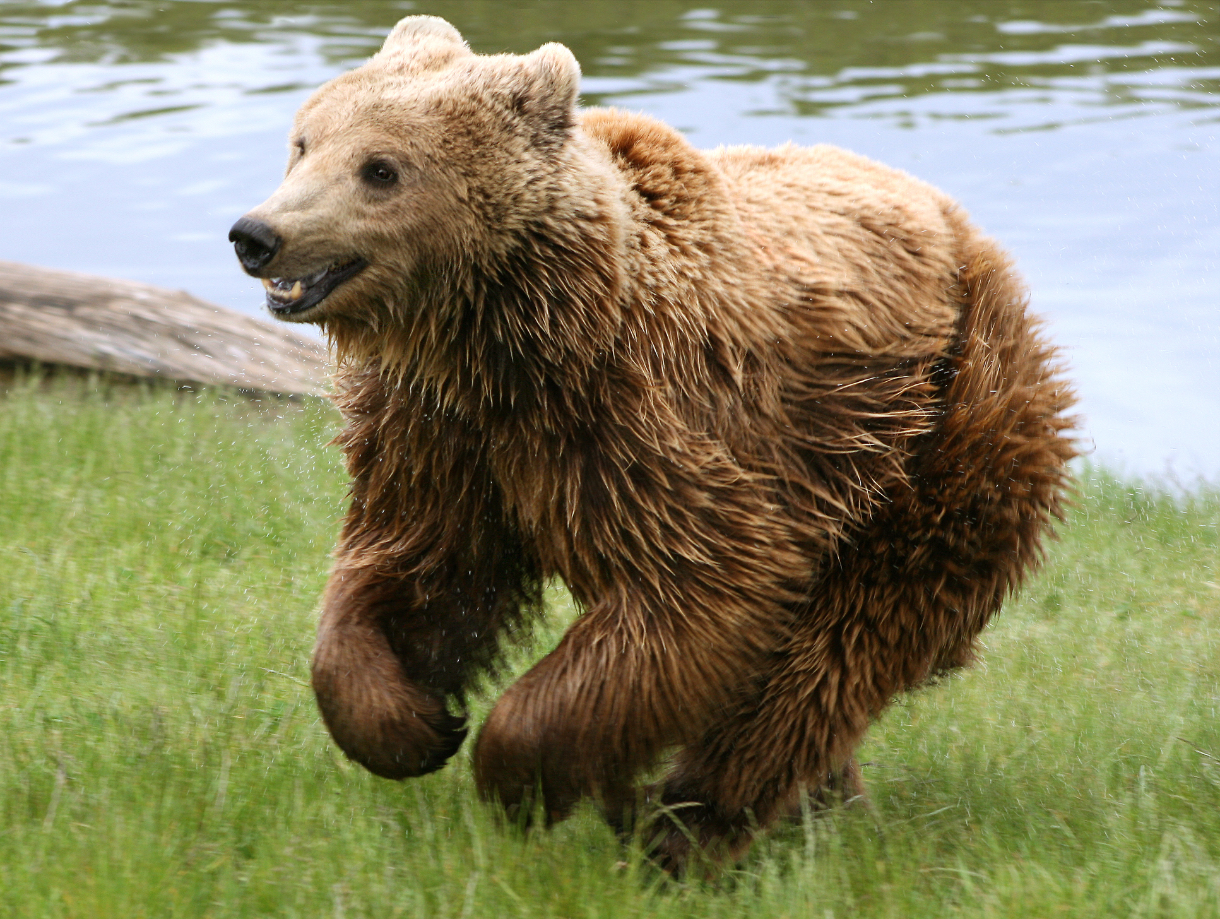
2 Preparing to Speak
A Tongue Twister
Fuzzy Wuzzy
was a bear.
Fuzzy Wuzzy
had no hair.
Fuzzy Wuzzy
wasn't fuzzy,
was he ?
https://upload.wikimedia.org/wikipedia/commons/2/2a/Brown_bear_%28Ursus_arctos_arctos%29_running.jpg

Slide 9


3 Delivering Your Talk
Synonym [sin-uh-nim]
Row, Row, Row your Boat,
Gently Down the Stream,
Merrily, Merrily, Merrily, Merrily,
Life is but a Dream.
Propel, Propel, Propel your Craft,
Placidly Down the Aqua-solution,
Ecstatically, Ecstatically, Ecstatically, Ecstatically
Existence is but an Illusion.

Slide 10
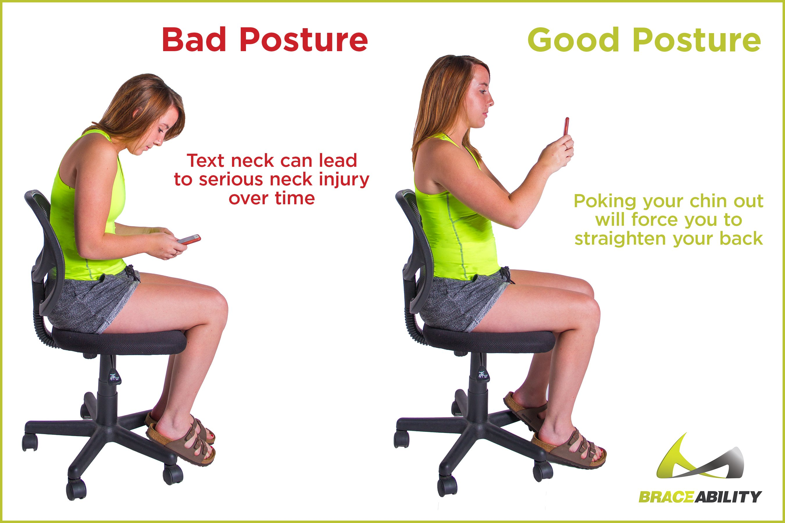
3 Delivering Your Talk
Synonym [sin-uh-nim]
Pronunciation [pruh-nuhn-see-ey-shuhn]
Posture [pos-cher]
  Erect [i-rekt]
  Sloppy [slop-ee]
Ref: https://www.braceability.com/blogs/info/bad-posture

Slide 11
3 Delivering Your Talk
Maintain Proper…
Follow along in your textbooks
Fill in the blanks

Slide 12
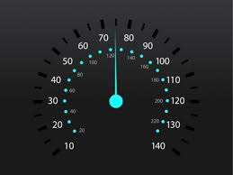
3 Delivering Your Talk
Maintain Proper…
Speed
Volume
Posture
Pronunciation
  Use easily pronounced synonyms
  Use easily distinguished synonyms
https://motoroctane.com/news/245545-5-tips-for-perfect-gear-change
The lavatory is beside the laboratory.
The toilet is beside the lab.

Slide 13
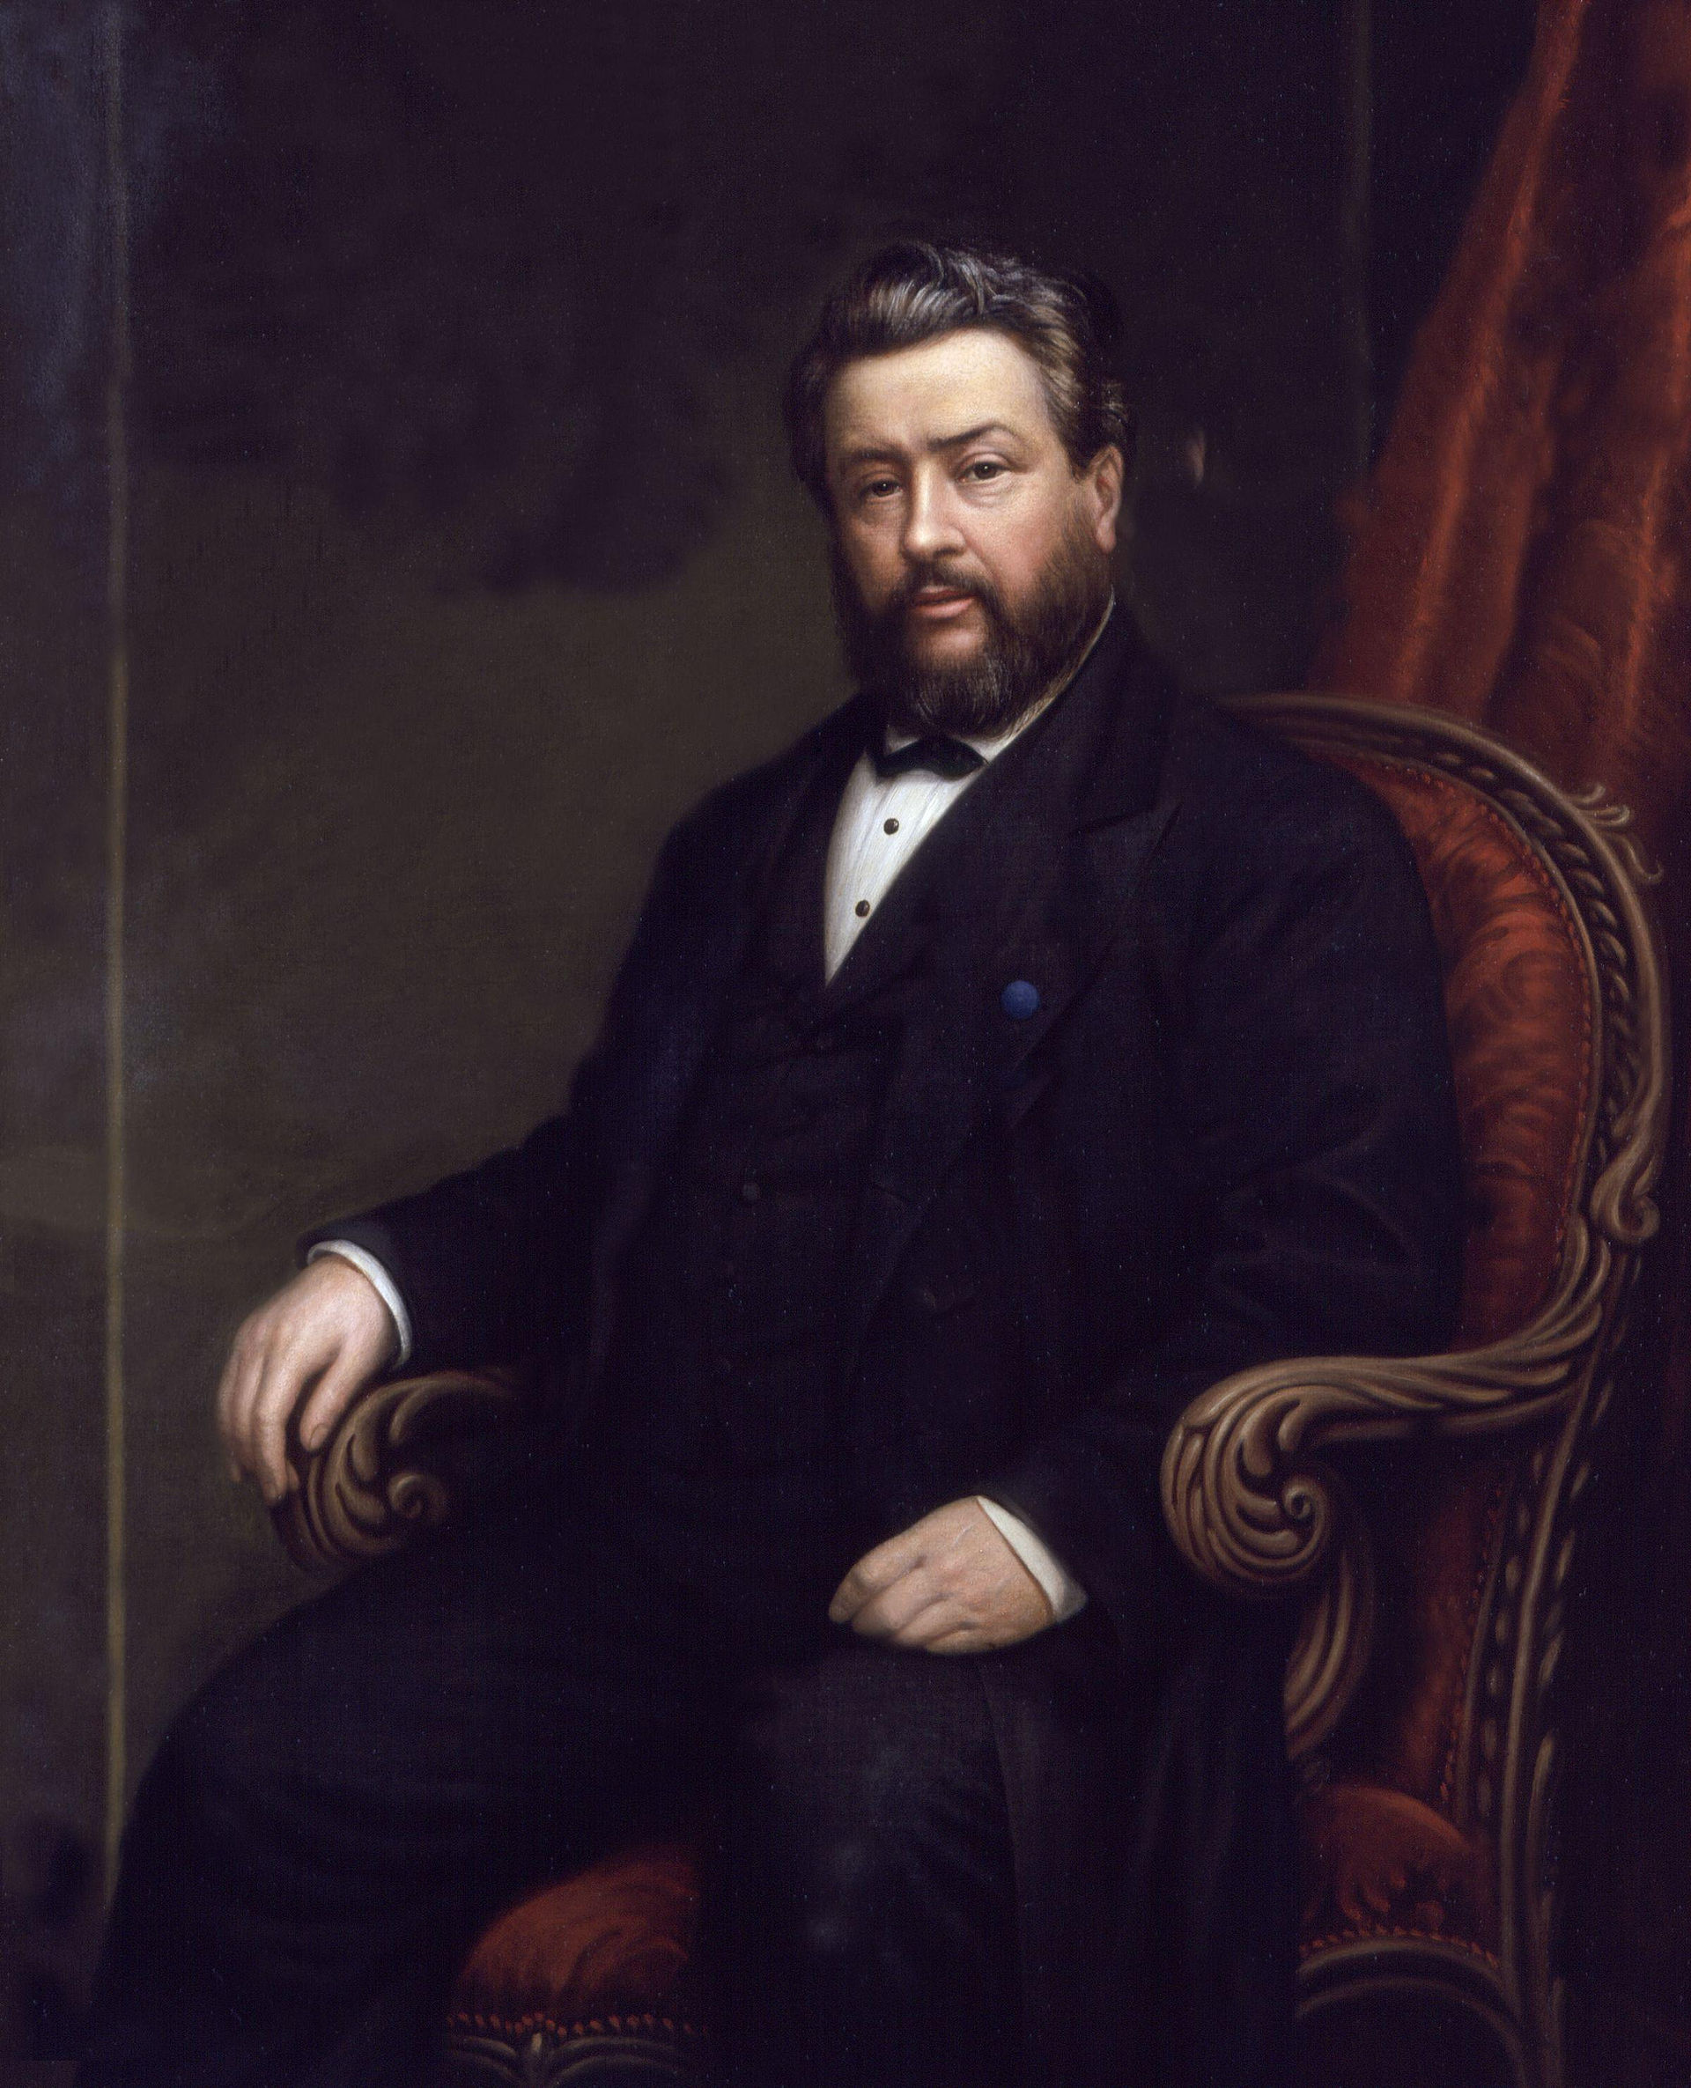
3 Delivering Your Talk
Requires…
https://commons.wikimedia.org/wiki/File:Charles_Haddon_Spurgeon_by_Alexander_Melville.jpg
Knowledge of material
Practice: e.g. Charles Haddon Spurgeon

Slide 14

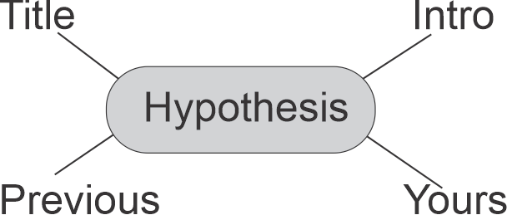
3 Delivering Your Talk
One Minute Speech
Choose a Topic
  Best Social Media Platform
  Best Youtube channel
  How not to get sick
  The best way to study
Make a hypothesis
Points in Cluster
Write a Speech (in book)
Stand up
Deliver it to yourself

Slide 15


3 Delivering Your Talk
One Minute Speech
Speaker
  Deliver your speech
  Stop when bell rings
  If finish early, repeat
Listeners
  Listen to speech
  Ask clarification questions.

Slide 16

4 Homework & Assignments
Reading
Read the Article: “Failure to Understand Time Means Failure” (§11.5)
Circle Key Words
Summarize the main ideas in a mind map.

Slide 17


4 Homework & Assignments
Assignment
Complete the abstract submission process for the XTOP conference.

