Slide 1
§9.5 Confidently Presenting
§9.3-§9.4
Logical
Organization
Prove Your
Hypothesis
§9.7
§9.4-§9.6
Clear
Slides
Fluent
Speaking

Slide 2
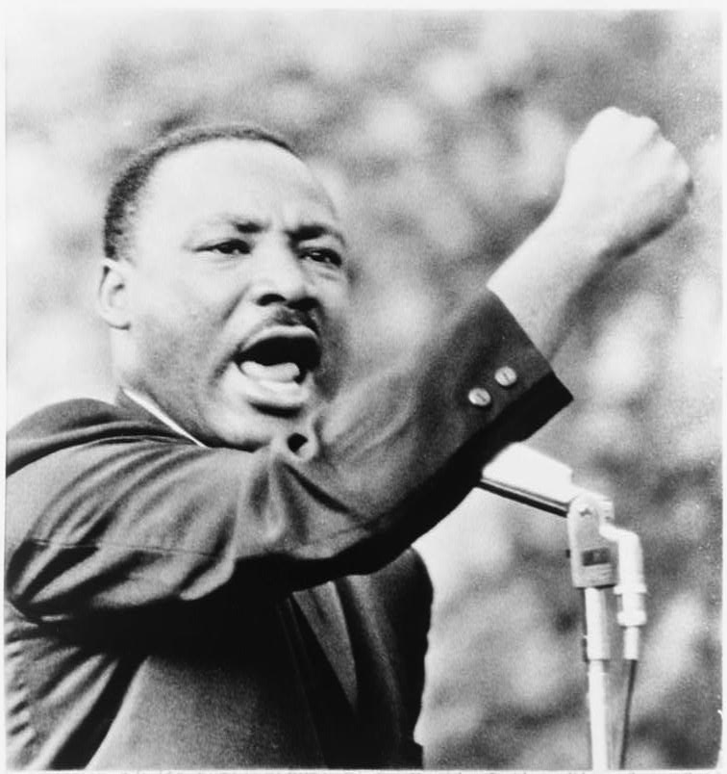

Ao-§9.5 Confidently Presenting
I have a Dream
Martin Luther King, Jr.
Ref: https://reclaimtheamericandream.org/wp-content/uploads/2016/01/MLK1965.jpg

Slide 3

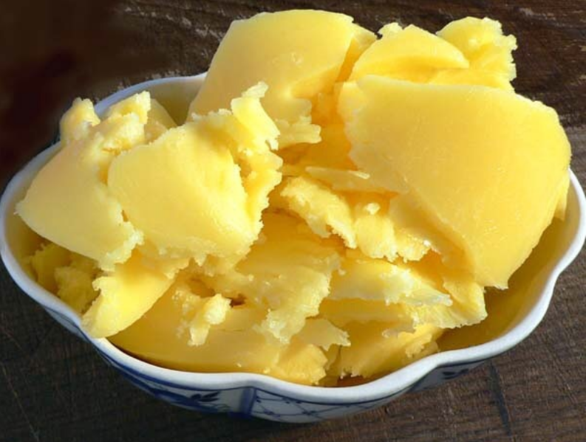
1 Popular Tongue Twisters
Betty Botter’s Butter
Betty Botter had some butter,
“But,” she said,” this butter’s bitter.”
If I bake this bitter butter,
it would make my batter bitter.
But a bit of better butter,
that would make my batter better.”
So she bought a bit of butter,
better than her bitter butter,
and she baked it in her batter,
and the batter was not bitter.
So ‘twas better Betty Botter
bought a bit of better butter.
Ref: Oleg Bor, https://commons.wikimedia.org/wiki/File:Sliced_clarified_butter.png

Slide 4

1 Popular Tongue Twisters
Night Light on a Light Night
You’ve no need to light a night-light
On a light night like tonight,
For a night-light’s light’s a slight light,
And tonight’s a night that’s light.
When a night’s light, like tonight’s light,
It is really not quite right
To light night-light’s with their slight light,
On a light night like tonight.
Ref: Tim Rademacher https://commons.wikimedia.org/wiki/File:2020-06-22_232305_Hannover_Night_of_Light_Marktkirche.jpg

Slide 5
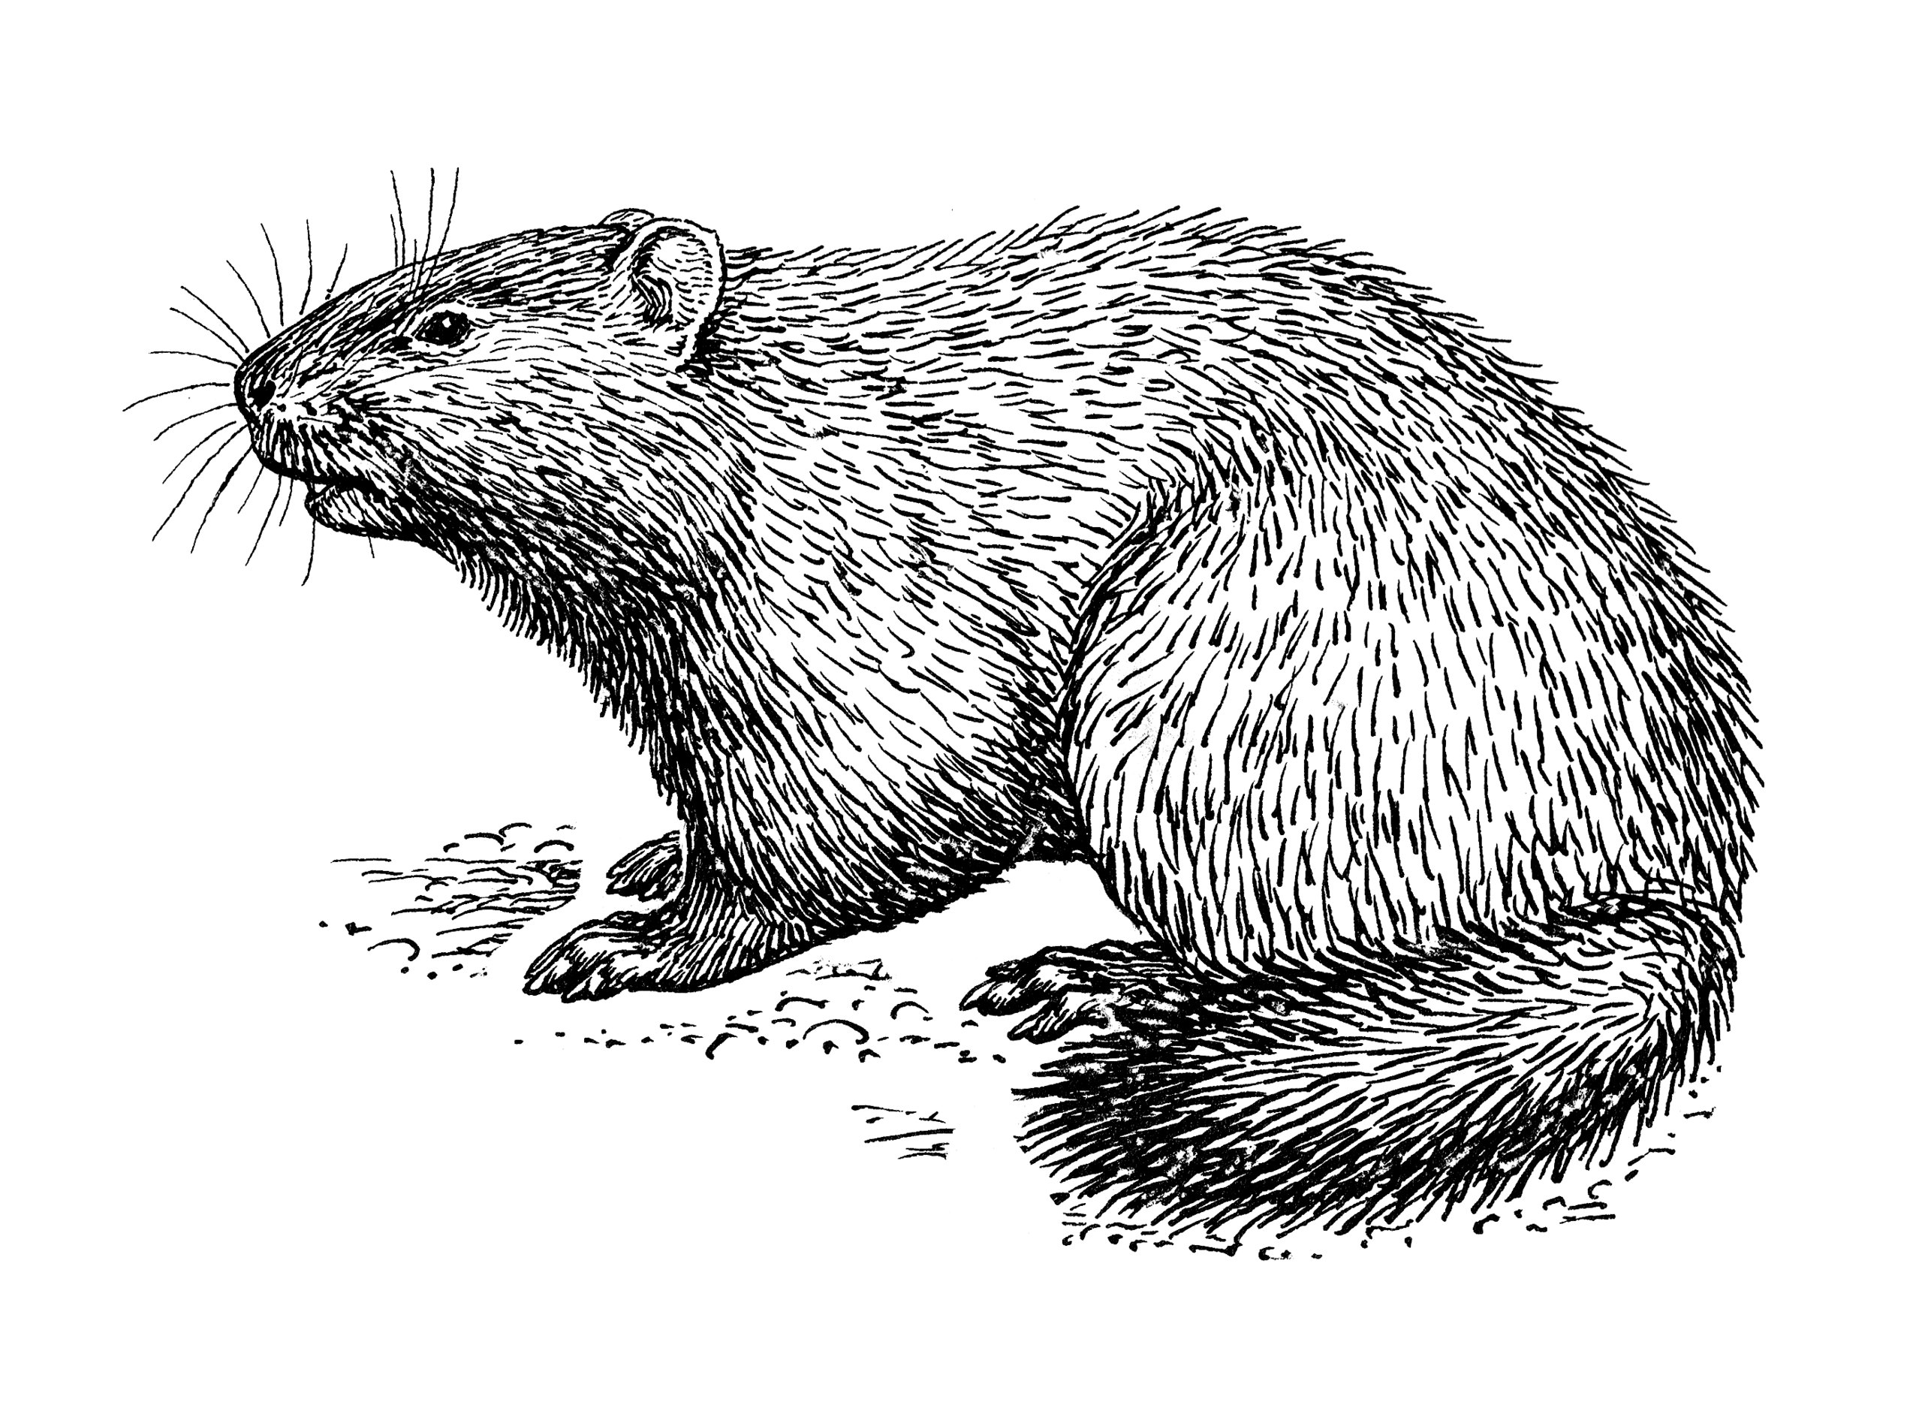
1 Popular Tongue Twisters
The Woodchuck
How much wood,
would a woodchuck chuck,
if a woodchuck could chuck wood?
He would chuck, he would,
as much as he could,
and chuck as much wood,
as a woodchuck would,
if a woodchuck could chuck wood.
Ref: Pearson Scott Foresman, https://commons.wikimedia.org/wiki/File:Woodchuck_1425_(PSF).png

Slide 6
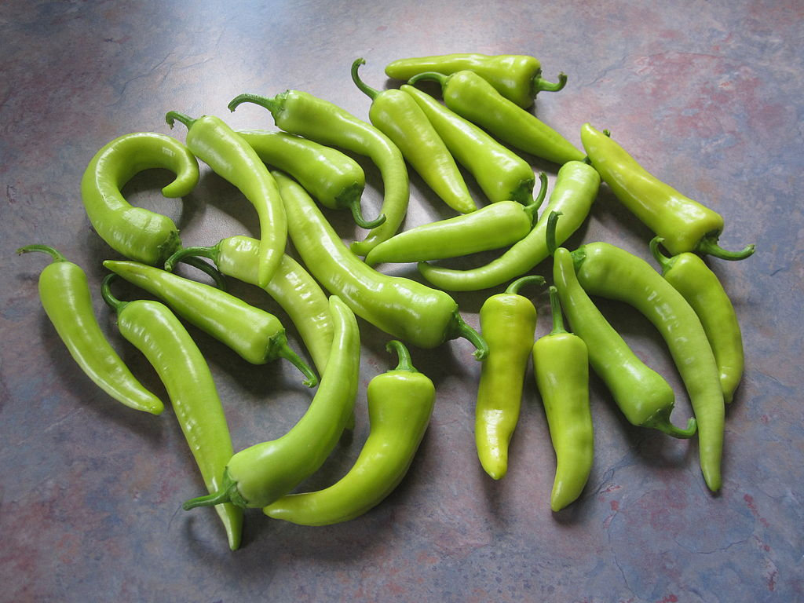
1 Popular Tongue Twisters
Peter Piper’s Picked Peppers
Peter Piper picked a peck of pickled peppers.
Did Peter Piper pick a peck of pickled peppers?
If Peter Piper picked a peck of pickled peppers,
Where’s the peck of pickled peppers,
Peter Piper picked?
Ref: Jaykup, https://commons.wikimedia.org/wiki/File:Banana_Peppers_20120903.jpg

Slide 7
1 Popular Tongue Twisters
Thoughts
I thought a thought.
But the thought I thought,
Wasn’t the thought,
I thought I thought.

Slide 8

1 Popular Tongue Twisters
Practice
Practice the tongue twister your group is assigned.
Prepare to say in front of class. Three times:
  slowly
  medium
  fast
Ref: Tim Rademacher https://commons.wikimedia.org/wiki/File:2020-06-22_232305_Hannover_Night_of_Light_Marktkirche.jpg
Ref: Pearson Scott Foresman, https://commons.wikimedia.org/wiki/File:Woodchuck_1425_(PSF).png
Ref: Oleg Bor, https://commons.wikimedia.org/wiki/File:Sliced_clarified_butter.png
Ref: Jaykup, https://commons.wikimedia.org/wiki/File:Banana_Peppers_20120903.jpg

Slide 9

2 Overcoming Nervousness
Take Control!
Fill in the blanks in your workbook as you listen to the talk
Ask clarifying questions when you don’t understand something.

Slide 10


2 Overcoming Nervousness
Before You Present
While You Present
Material
Drinking
Sex-Life
Room
Focus
Breathing
Face
Take Control!

Slide 11
3 Cultural Point: The Nature of Time
: Compare Western and Eastern Views
Compare and contrast American and Taiwanese approaches to time. (table in workbook)
Discuss the positive and negative aspects of both approaches to time. (table in workbook)
Deeper discussion:
  How much is Taiwanese thinking affected by traditional Oriental thinking?
  How much have Taiwanese absorbed the Western views of time?
  How does the different views of time impact on fighting in the Middle East?

Slide 12

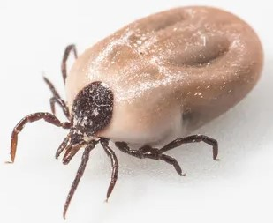
4 Scientific Presentations
Vocabulary
Verbal tick (noun)
Ticks (noun)
Tick off (verb)
Qualifier (noun)
Apologize (verb)

Slide 13
4 Scientific Presentations
: Formal Presentations: Four No’s
Fill in the blanks in your workbook as you listen to the talk

Slide 14
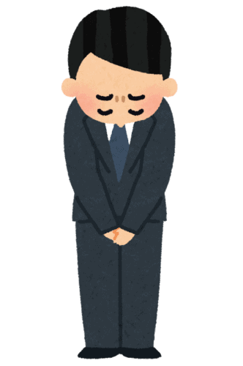
4 Scientific Presentations
Formal Presentations: Never…
Never apologize
Never be unprepared
Never use filler words or verbal ticks
Never use informal qualifiers
Ref: https://voyapon.com/japanese-culture-apologizing/

Slide 15
4 Scientific Presentations
Formal Presentations: Qualifiers
Echo the qualifiers in your textbook.

Slide 16

5 Homework & Assignments
Assignment
Complete the abstract submission for XTOP

