Slide 1
§9.6 Key Word Outline

Slide 2

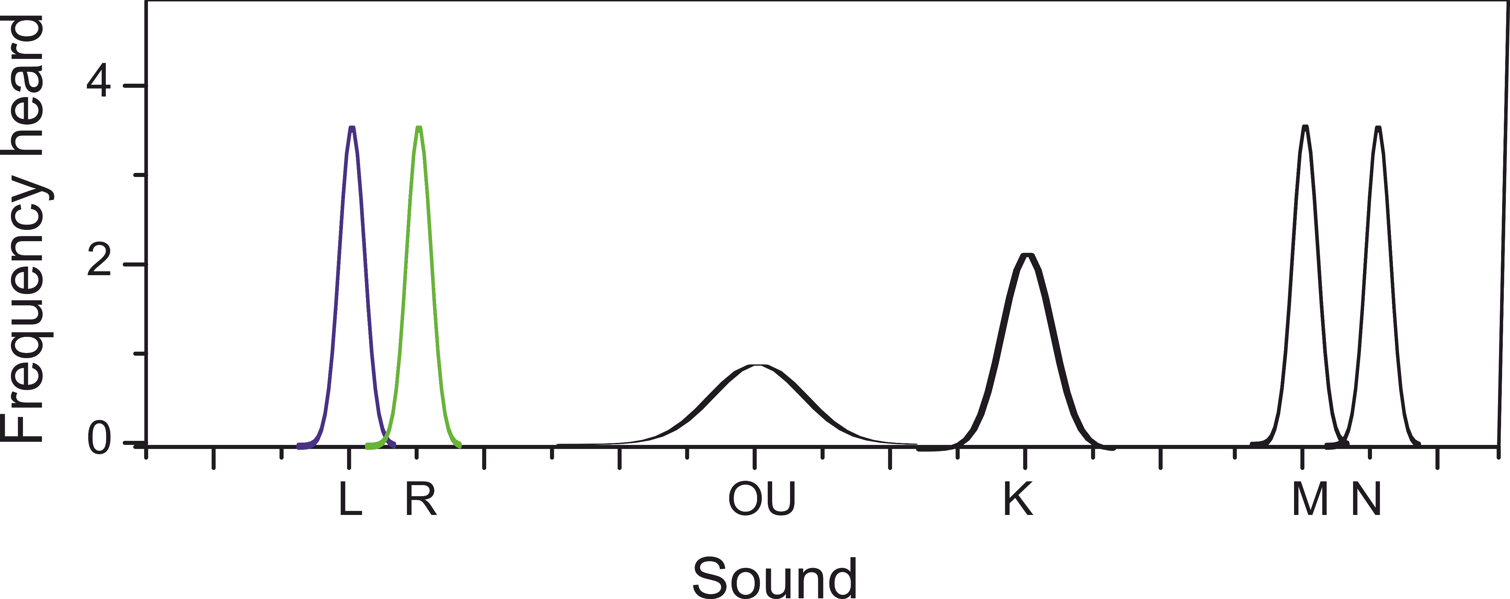
1 Distinguishing Sounds
How to Practice Pronunciation

Slide 3
1 Distinguishing Sounds
How to Practice Pronunciation
Letters with…
  Similar Pronunciation
    Narrow Distribution
  Unique Pronunciation
    Wide Distribution

Slide 4
1 Distinguishing Sounds
How to Practice Pronunciation
Letters with…
  Similar Pronunciation
    Narrow Distribution
    Meaning
  Unique Pronunciation
    Wide Distribution
    Accents

Slide 5

1 Distinguishing Sounds
How to Practice Pronunciation
Goal: To be understood
Concentrate on similar sounds
Practice Methodology
  Syllable
    Beginning
    Middle (vowels)
    End
  Minimal pairs
    eg. ship vs sheep
    eg. Leer vs rear

Slide 6


1 Distinguishing Sounds
Class Activity: Pronunciation Practice: Letter “L”
Echo after the tape.
Starting a Syllable
(lack - lamb – lame)
Ending a Syllable
(male - ball)
Minimal Pairs
(allay - array)

Slide 7

1 Distinguishing Sounds
Pronunciation Practice: Letter “L”
One person pronounces pair in random order
Partner guesses the order eg. L-R or R-L
(Alternate & Keep Score!)

Slide 8

2 Categories of Speeches
Manuscript [man-u-script] (n)
Outline [out-line] (n)
Transcript [tran-script] (n)
Hierarchical [hi-er-ar-chi-cal] (adj.)
Principal
Math Teacher
Physics Teacher
English Teacher
Susan
Jon

Slide 9
2 Categories of Speeches
Four Categories of Speeches
1st time: Listen
2nd time: Ask Clarifying Questions
Both times: Fill in the Blanks

Slide 10
2 Categories of Speeches
Four Categories of Speeches
Impromptu: one does not prepare (“off-the-cuff”)
Manuscript: one reads
Memorized: one recites
Extemporaneous: one uses a key word outline

Slide 11
3 Scientific Presentations
Four Categories of Speeches
Which one is best for a scientific talk?
Why?

Slide 12
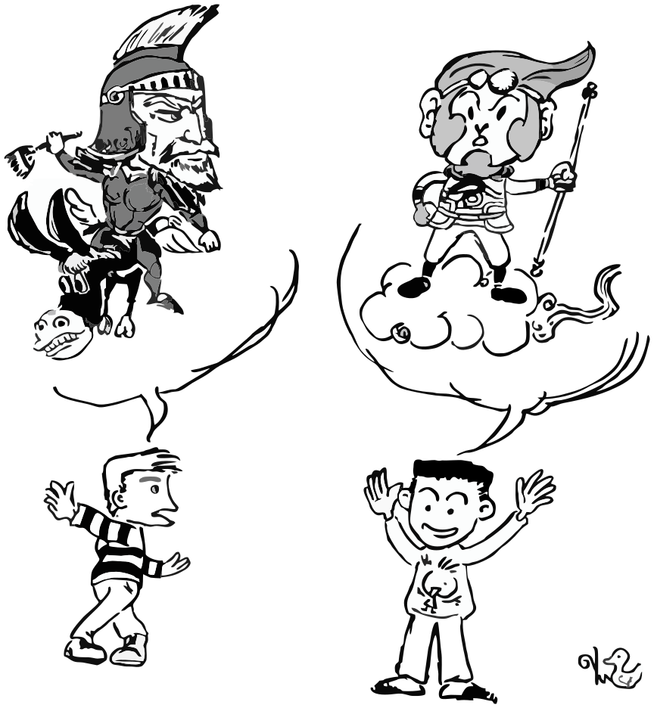
3 Scientific Presentations
Appropriate Type of Speech
Important to give a lively, accurate talk so
Impromptu → errors
Manuscript → boring
Memorized → forget
Extemporaneous
  Lively
  Accurate
→ Need Key Word Outline

Slide 13


4 Understanding Key Word Outline
The Place of a Key Word Outline
1
Definition
Place in Preparation
Hometown
  Mom
  Dad
  Sister
  Girlfriend(Susan)
University
  Classmates
  Girlfriend(Michelle)
  Friends
Internet
  Gaming Buddies
  Girlfriend(Vivian)
Idea
Word

Slide 14
5 Learning from an Example
Observing a Key Word Outline
Compare/Contrast the Linear Outline and the Key Word Outline in your text.
What similar?
What is different?

Slide 15
5 Learning from an Example
Key Observations
Hierarchical
Sentence →1(2) words
1 idea: 1 line
Outline is not unique
Hometown
  Mom
  Dad
  Sister
  Girlfriend(Susan)
University
  Classmates
  Girlfriend(Michelle)
  Friends
Internet
  Gaming Buddies
  Girlfriend(Vivian)

Slide 16


5 Learning from an Example
Developing a Key Word Outline
Topic: “What I did Yesterday”
Length: 3 min
Steps:
On piece of paper write a talk outline. (10’)
Practice the talk (for timing) (3’)
In your workbook, write a key word outline (7’)

Slide 17
5 Learning from an Example
Speaking from a Keyword Outline
Speakers: try to look at group members
Listeners: listen politely

Slide 18
6 Word Processing Software
Demonstration
Watch as teacher demonstrates using computer software for a keyword outline

Slide 19


7 Homework & Assignments
Homework for XTOP
Finish your Talk Outline
Write a manuscript for your XTOP talk.
Write a Key word outline

