Slide 1
ao-§9.7 Viewgraphs

Slide 2

ao-9.7 Viewgraphs
Topics
Marks of Quality
Presentation Flow
Types
Sequencing
Optimizing
Avoiding Technical
Difficulties

Slide 3

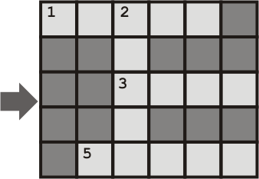
1 Designing a Crossword Puzzle

Slide 4

1 Designing a Crossword Puzzle
1. Choose a Theme

Slide 5


1 Designing a Crossword Puzzle
2. Place related words

Slide 6
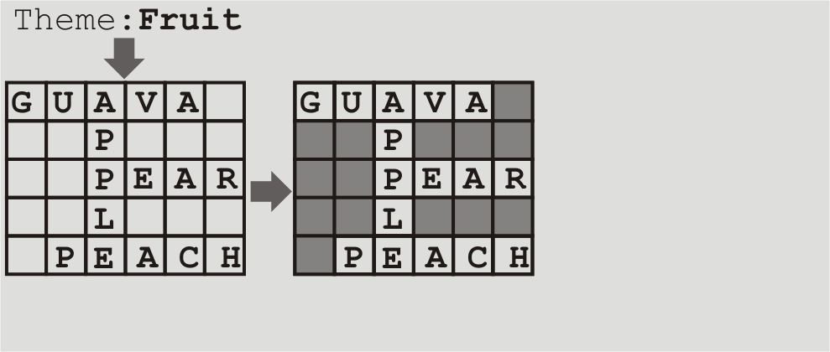
1 Designing a Crossword Puzzle
3. Blacken Unused Squares

Slide 7
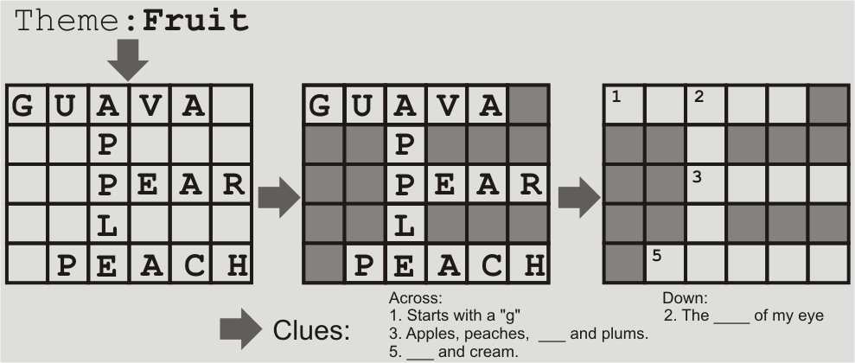
1 Designing a Crossword Puzzle
4. Remove Word and Provide Clues

Slide 8
1 Designing a Crossword Puzzle
5. Score
5 Guava + 4 Pear + 5 Peach + 5 apple = 19 points

Slide 9

1 Designing a Crossword Puzzle
Use the grid in your workbook to create a crossword puzzle.
You do not have to write clues, just set up the words.
You have 15 minutes only.

Slide 10
1 Designing a Crossword Puzzle
Pass your crossword to another group.
Score the crossword.
=5Guava+4Pear+5Peach+5apple= 19 points

Slide 11


2 Mark of Quality
Viewgraph [view-graf] = VG
Clarity [klar-i-tee]
Font
  Size
  Weight
  Face

Slide 12


2 Mark of Quality
Viewgraph
10 years ago…
  Slide
  Transparency
    ≡ Overhead
    ≡ OHP
Now, with computers…
  Viewgraph ≡ slide!

Slide 13
2 Mark of Quality
Clarity
T
T
T
T

Slide 14
2 Mark of Quality
Font
Size
Weight [R B]
  light
  med
  heavy
Face
8pt
10pt
12pt
18pt
24pt
36pt
48pt
72pt
96pt
Time New Roman
Arial
Courier New
Symbol (Σψμβολ)

Slide 15
2 Marks of Quality
Objective Clarity
Listen to the talk
Fill in the blanks in your workbook

Slide 16


2 Marks of Quality
Optical Clarity
  Large size fonts
Clarity of Purpose
8pt
10pt
12pt
18pt
24pt
36pt
48pt
72pt
100pt

Slide 17
2 Marks of Quality
Optical Clarity
  Large size fonts
  Standard font faces
Clarity of Purpose
Times New Roman
Arial
Courier New

Slide 18
2 Marks of Quality
Optical Clarity
  Large size fonts
  Standard font faces
  Contrasting colours
Clarity of Purpose
Yellow on Blue
Yellow on White

Slide 19

2 Marks of Quality
Optical Clarity
  Large size fonts
  Standard font faces
  Contrasting colours
  Avoid photocopies
Clarity of Purpose

Slide 20
Optical Clarity
  Large size fonts
  Standard font faces
  Contrasting colours
  Avoid photocopies
Clarity of Purpose
  Why show?
  What remember?
  How relate to hypothesis?
  What’s the key info?
?

Slide 21
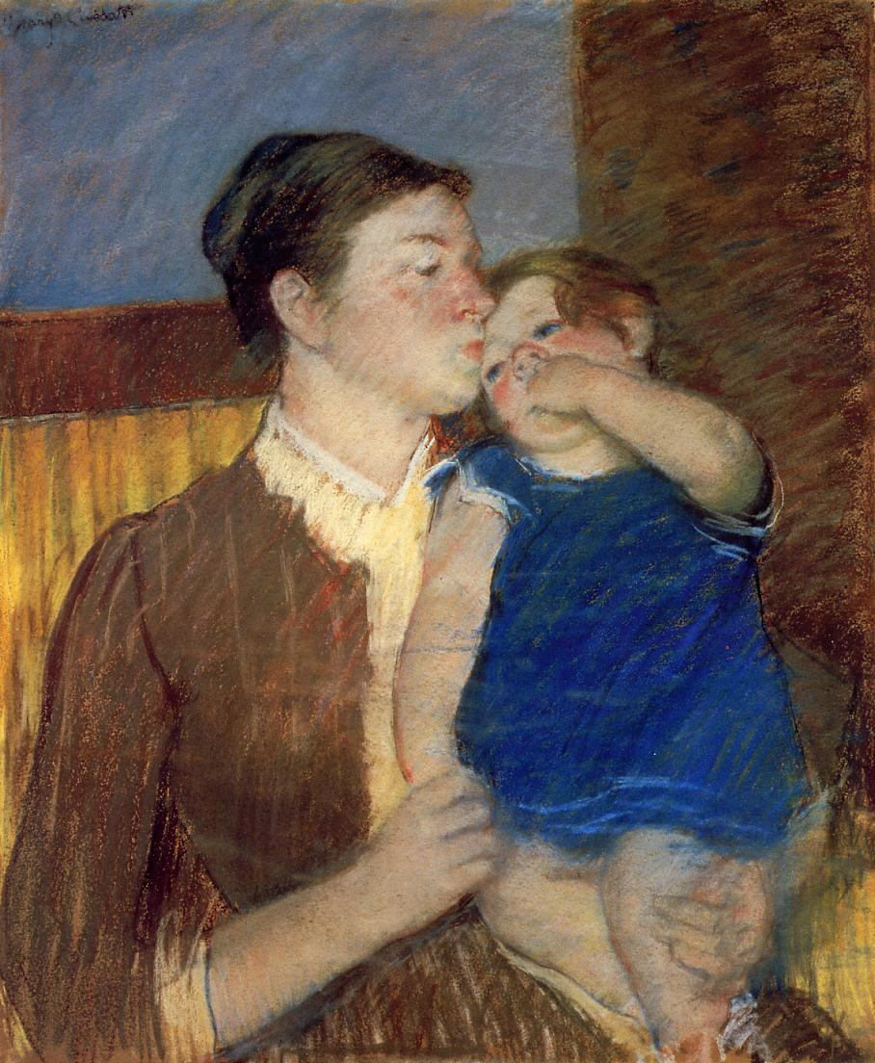
2 Marks of Quality
Keep
It
Short and
Simple

Slide 22

2 Marks of Quality
“test-drive”
-location: close/far
-lighting: on/off

Slide 23

2 Marks of Quality
What is wrong?

Slide 24
2 Marks of Quality
What is wrong?
Optical Clarity
1. Use large font size
In general, you should not use < 24 pt size fonts. Large fonts will make it
easy for the Audience to read. It is very frustrating to have to squint to
try to read the axis of a graph.
2. Use standard font faces.
Stick to “Time New Roman”, ”Arial” or “Symbol” as these fonts are found
on most computers. Using a nice looking font that is installed on your
computer with Chinese Windows, is likely to lead to disastrous results
when displayed on a computer running an English version of Windows.
Once you have decided on a font use it consistently.
3. *&^)(%$#( &%*K)*&(
4. Avoid the use of photocopies of book pages or journal articles.
font
  too small
  non-standard
  too many
colours:
  too many
  red
info: too much

Slide 25
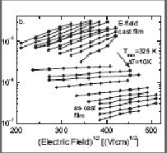
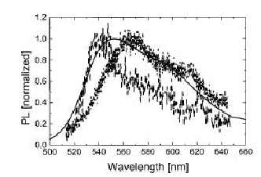
2 Marks of Quality
What is wrong?
Photocopy hard to see
Why this slide?
Unrelated info
What audience remember?
Reference?
No colour
Too many curves
No label on Y-axis
Slide title: useless
I
Introduction (3)
Mobility as a
function of
Electric Field
Single Molecule
Spectrum

Slide 26
3 Putting it Together: VG by VG
Listen to the talk

Slide 27

3 Putting it Together: VG by VG
1. Presentation Flow

Slide 28
3 Putting it Together: VG by VG
2. Dividing the viewgraphs
12 + 4?? = 16 total
Section Specialized General
Title 1
Outline/Summary 1
Introduction 1 3
Techniques 2 3
Results 5 2
Conclusions/Summary 1
Acknowledgments 1

Slide 29
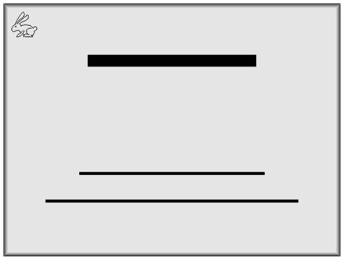
3 Putting it Together: VG by VG
Title
Authors
Affiliation

Slide 30
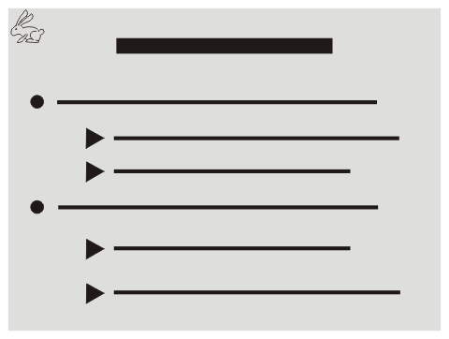
3 Putting it Together: VG by VG
what said
what will say

Slide 31
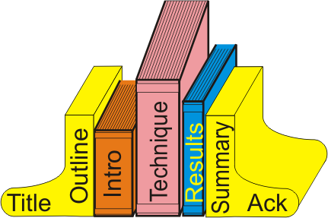
3 Putting it Together: VG by VG
Book Stops

Slide 32
3 Putting it Together: VG by VG
Text Slides
< 7 lines/slide
< 7 words/line

Slide 33

3 Putting it Together: VG by VG
Text + Image
Summarize
  Briefly
  Only what needed
Meaningful Title
Include Schematics

Slide 34
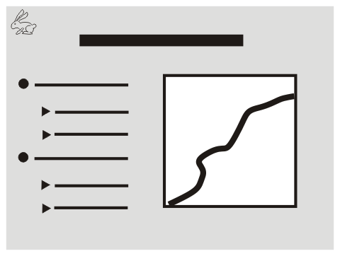
3 Putting it Together: VG by VG
Graph + Text
1 Figure/VG
Color
Label axis clearly
Remove extra curves

Slide 35
3 Putting it Together: VG by VG
Figure Intro
Slide Title
Y-axis
X-axis
All curves
Key results
Significance

Slide 36
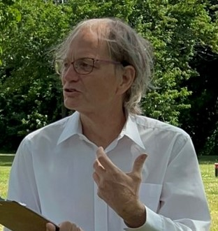
3 Putting it Together: VG by VG
$

Slide 37
3 Putting it Together: VG by VG
Extra VGs
Complicated derivations
Answer to possible questions
Unused slides

Slide 38
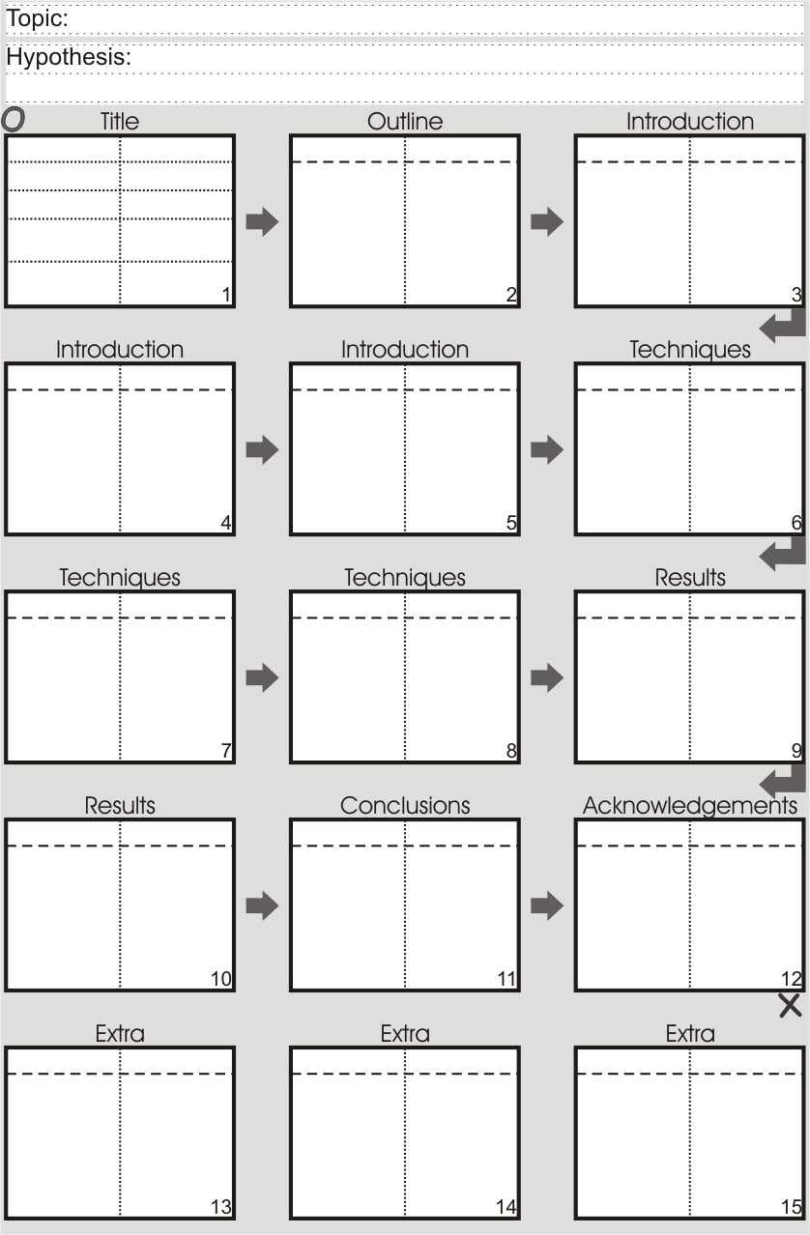
4 Graphical Sequencing

Slide 39
4B Aside: Outlines
Talk Manuscript
What?
  All ideas in point form
  Arranged hierarchically
When?
  After cluster diagram
  Before 1st draft of paper/talk
Length: 4 pages long
Purpose: organize manuscript

Slide 40
4B Aside: Outlines
Viewgraph
What? schematic of each VG
When?
  After final draft
  Before viewgraphs
Length: 1 page
Purpose: visual organization

Slide 41
4B Aside: Outlines
Keyword
When?
  After viewgraphs
  Before talk
What?
  Key words
  Arranged hierarchically
Length: 1/2 page
Purpose: jog memory as give talk

Slide 42

4 Graphical Sequencing
Sequence your slides
Sketch your presentation slides in your workbook.
Refer to your talk outline as you write.

Slide 43
5 Optimizing your Slides
Form of the Presentation
Background
Text
Balanced Point
Equations
Transition
Eye Motion

Slide 44
5 Optimizing your Slides
Form of the Presentation
In working with viewgraphs your presentation can take one of three forms. In the first form the speaker puts his entire presentation on the viewgraphs and just read the presentation. This is the worst way to give a scientific presentation. The speaker is unnecessary.
An improvement over this method of presentation is one in which the slides dominate the presentation. In this case, all the required information is on the slides. The speaker faces the slides and help the audience to understand the viewgraphs.
In the final type of presentation, the speaker, facing the audience, dominates providing all the content while the slides reinforce the message of the speaker.
Entire Presentation on VGs
  Face Manuscript
  Speaker Reads VG
  VG have all info (no need speaker)
Visual dominate
  Face Slides
  Speaker Explains VGs
  VGs have all KEY information
Speaker dominate
  Face Audience
  Speaker Provides Content
  VGs Reinforce Speaker

Slide 45
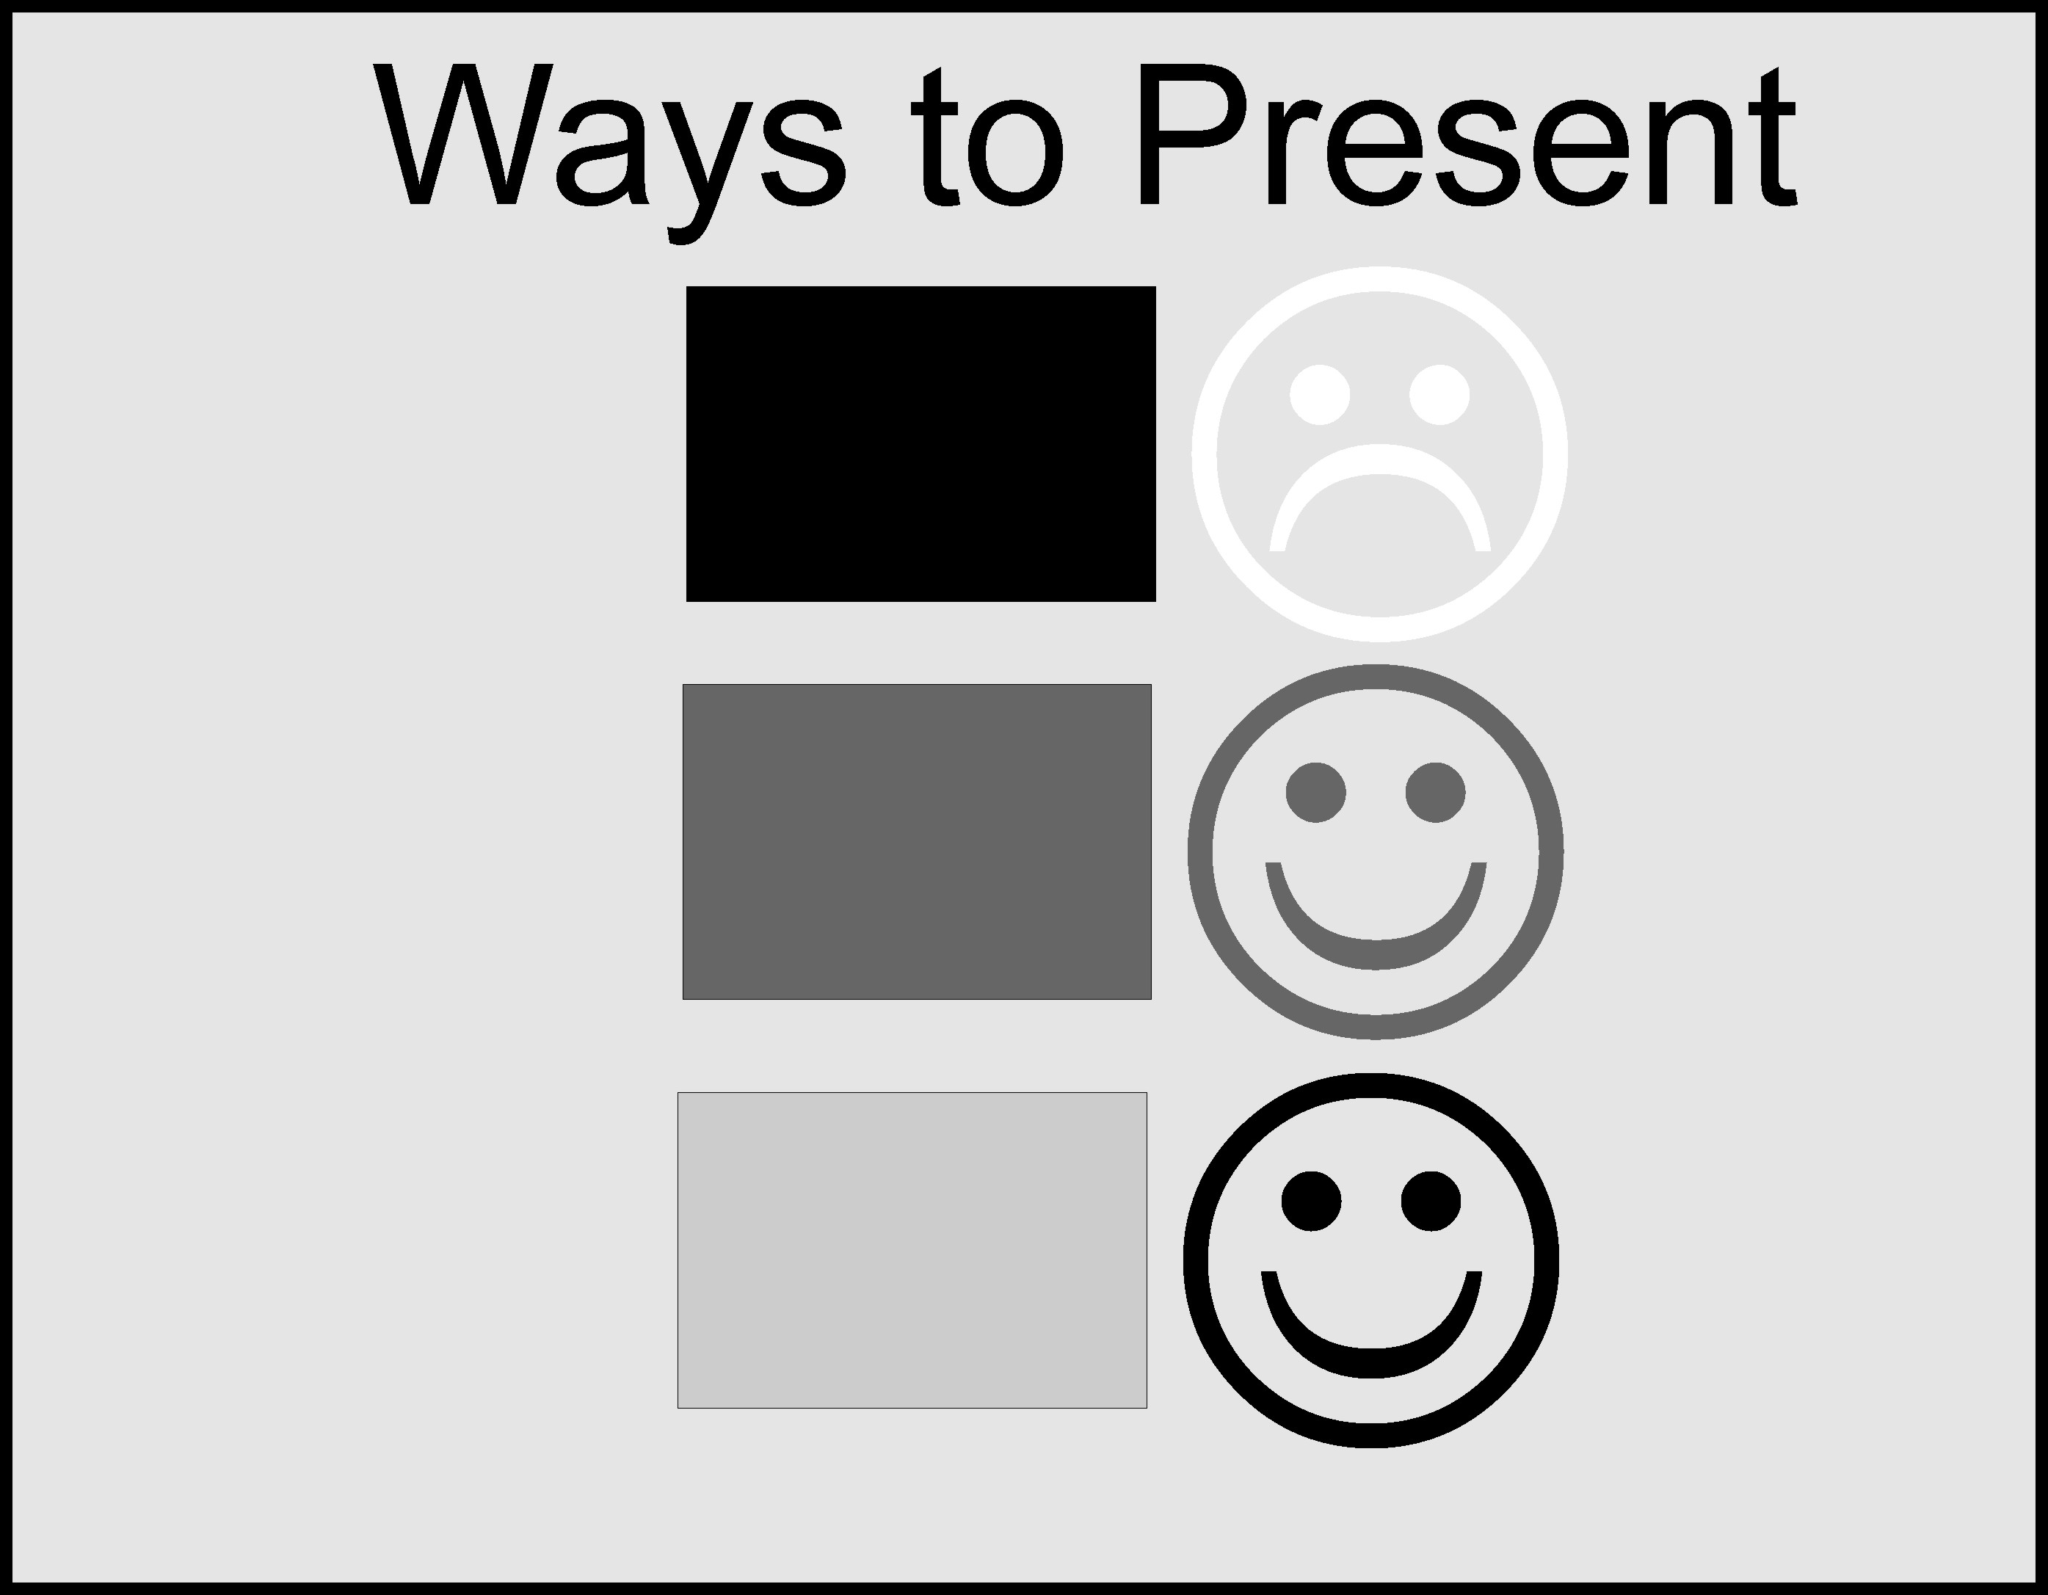
5 Optimizing your Slides
Form of the Presentation

Slide 46
5 Optimizing your Slides
Background: Same
I like to change my colour
Very Very Colourful!
I am a colourful person!
Good Job Mandy

Slide 47
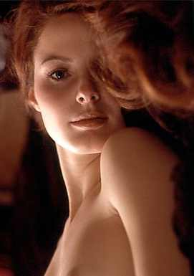


5 Optimizing your Slides
Background : Simple & Static
Hope and Go to scool
Simply Me!

Slide 48
5 Optimizing your Slides
Background : Dark
Dark on Light
Light On Dark

Slide 49
5 Optimizing your Slides
Background : Numbered i.e. 1,2,3…
(52)

Slide 50
5 Optimizing your Slides
Background
Same
Simple
Dark
Numbered 1,2,3,4

Slide 51
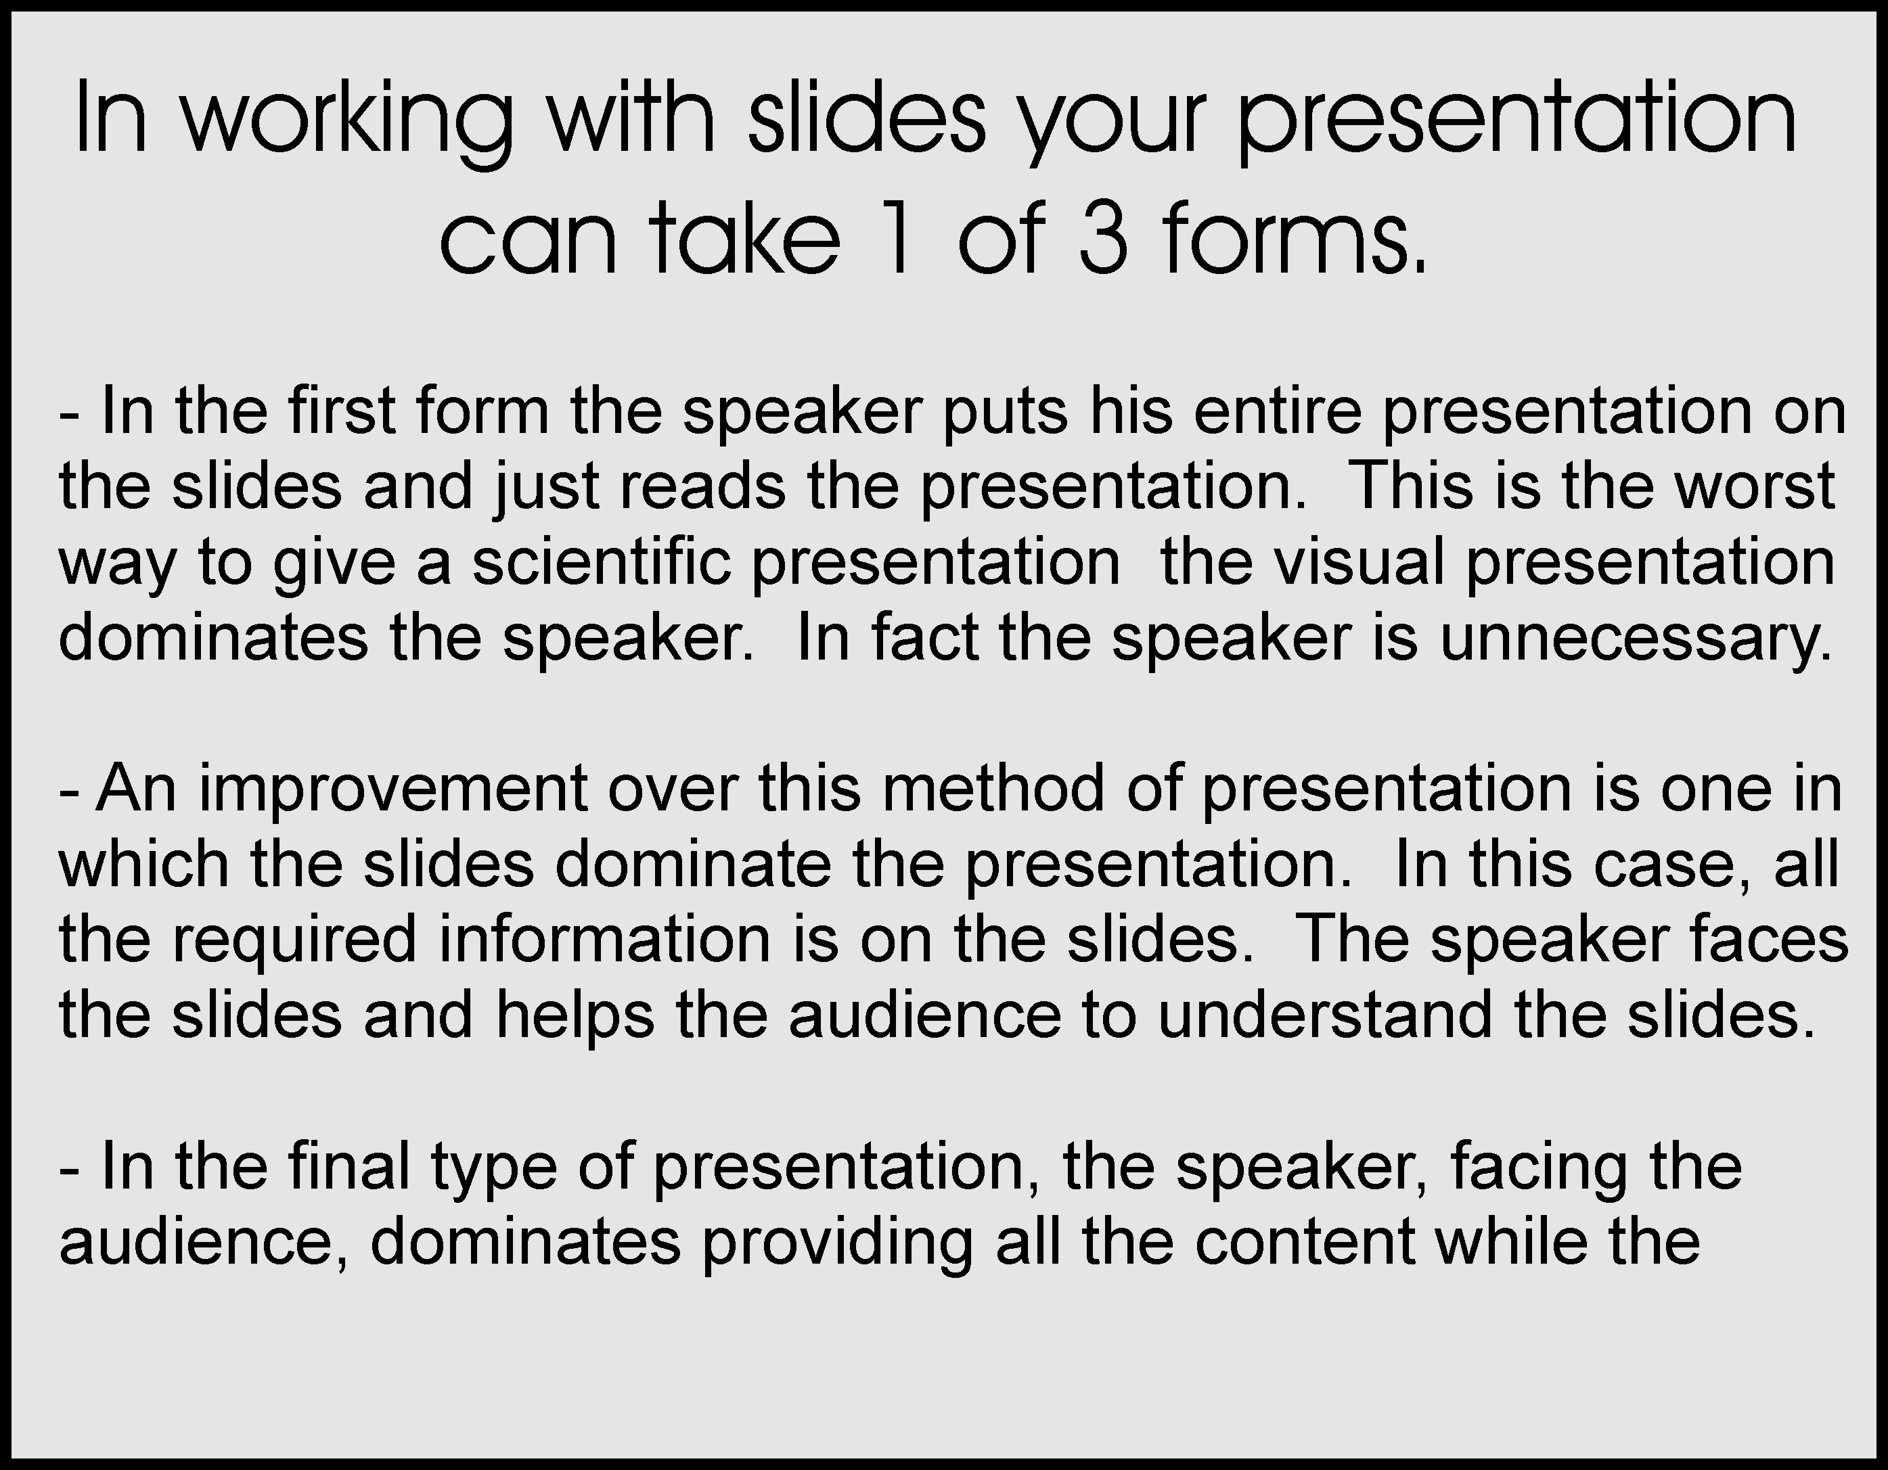
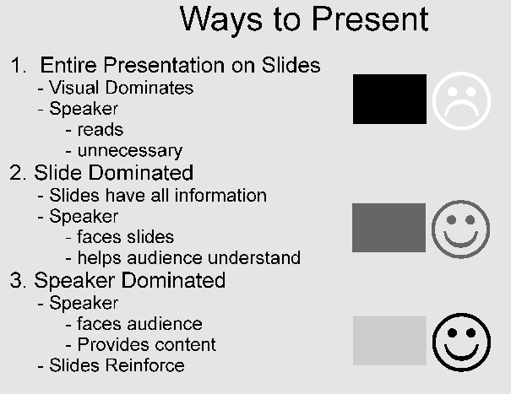
5 Optimizing your Slides
Text

Slide 52
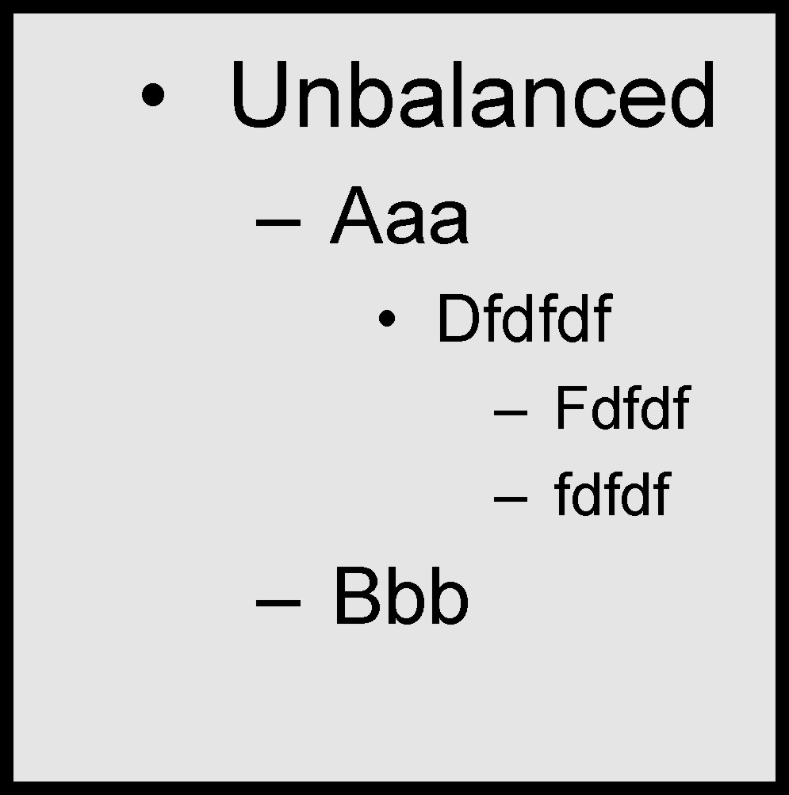
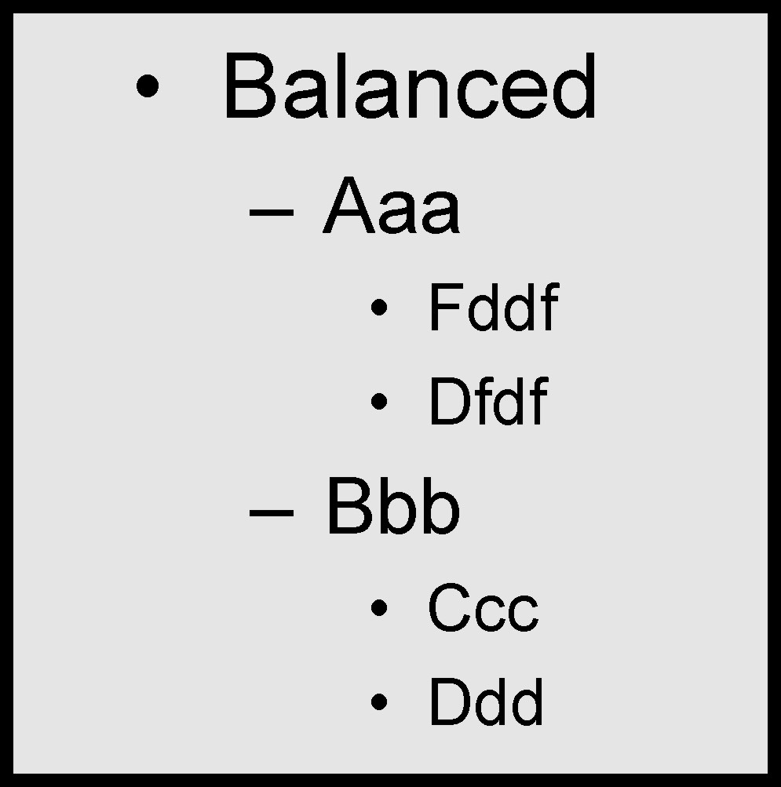
5 Optimizing your Slides
Balance

Slide 53
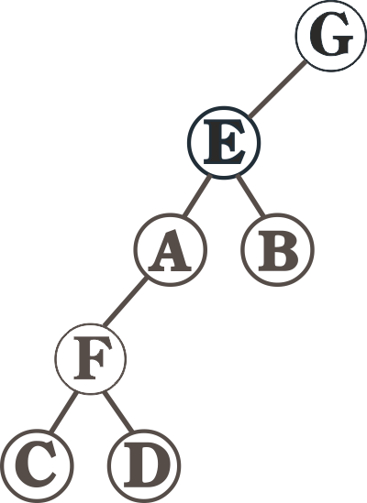
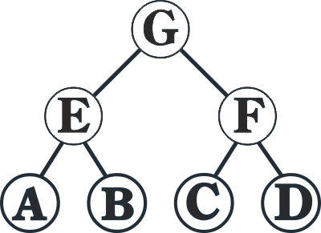
5 Optimizing your Slides
Balance

Slide 54
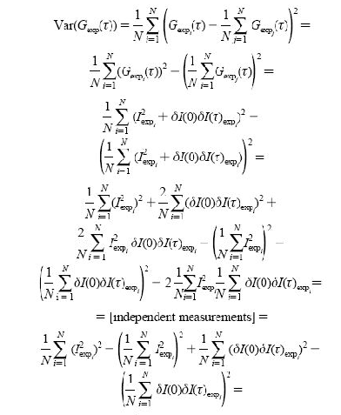
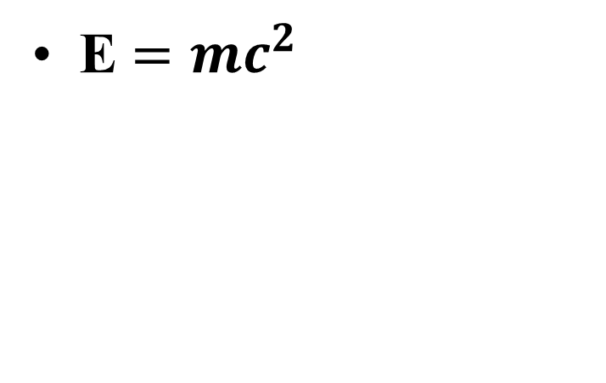
5 Optimizing your Slides
Equations
E $={mc}^{2}$

Slide 55
5 Optimizing your Slides
Transitions
Fly In
Fly In
Wipe-in
Wipe-in

Slide 56
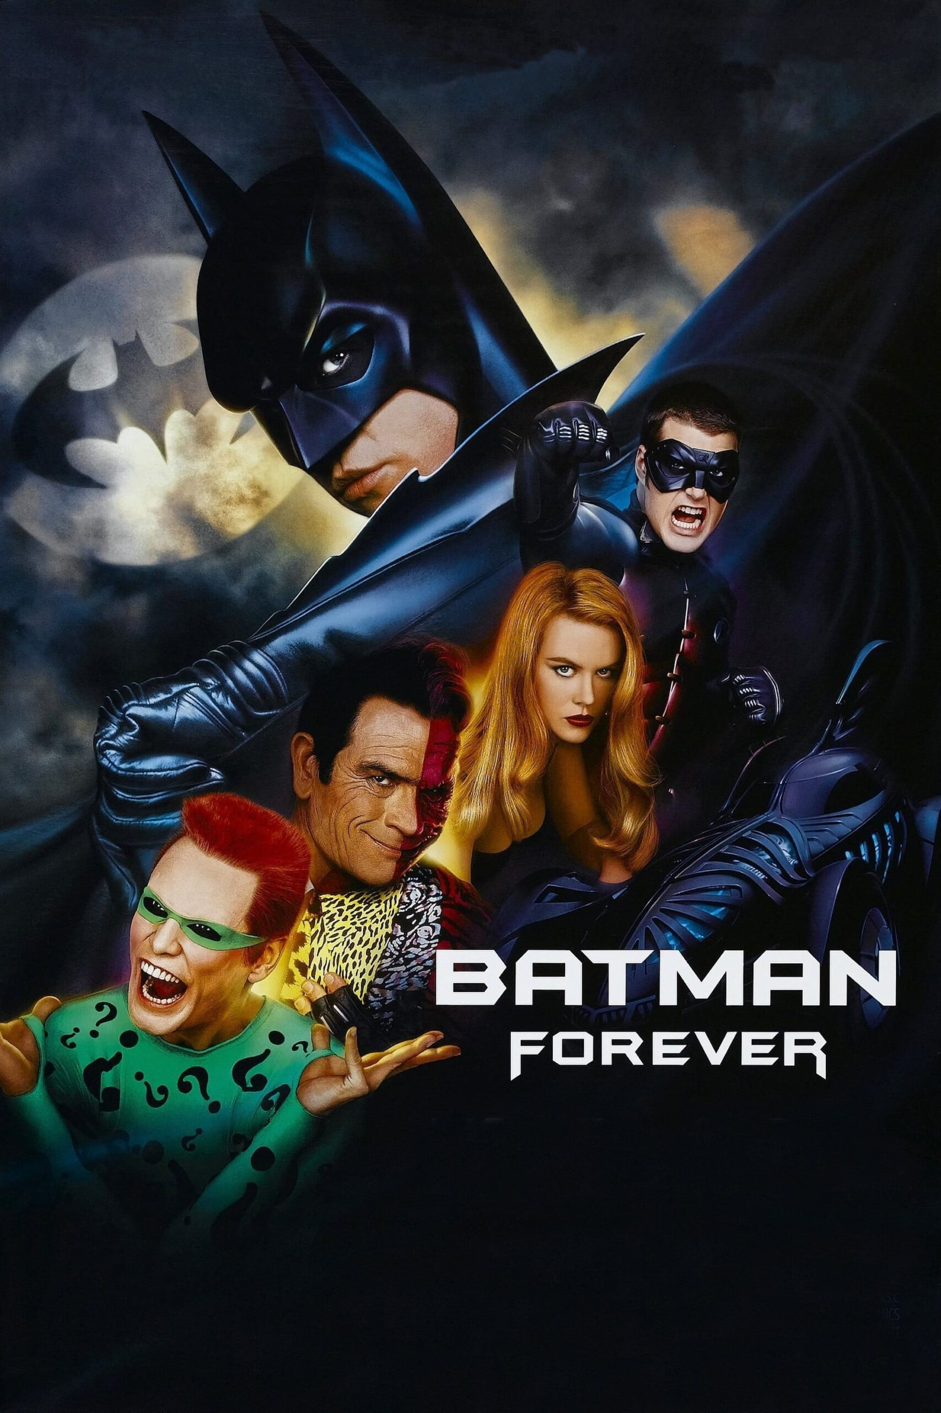

5 Optimizing your Slides
Eye Motion
Ref: https://bingeddata.s3.amazonaws.com/uploads/2020/11/batman-forever-scaled.jpg

Slide 57

5 Optimizing your Slides
Eye Motion

Slide 58
5 Optimizing your Slides
Summary
Form: Slide or Speaker Based
Background: Same, Simple, Dark, Numbered
Text: Less is Best
Points: Balanced
Equations: Few as Possible (Supp. Slides…)
Transitions: Wipe not Fly
Contrast: Higher is Better!
Remember Eye Motion: Z

Slide 59


6 Avoiding Technical Difficulties
Don’t Bet Against Murphy’s Law!
Email your Viewgraphs to a Webmail Account
Arrive Early to Upload From Your USB Drive
Look Through your Viewgraphs (right version)
Additional Suggestions on XTOP website
Periscope Film LLC: https://commons.wikimedia.org/wiki/File:Book_cover_of_%22A_History_of_Murphy%27s_Law%22.jpg

Slide 60

6 Homework & Assignments
Complete the viewgraphs for your conference presentation

