Slide 1
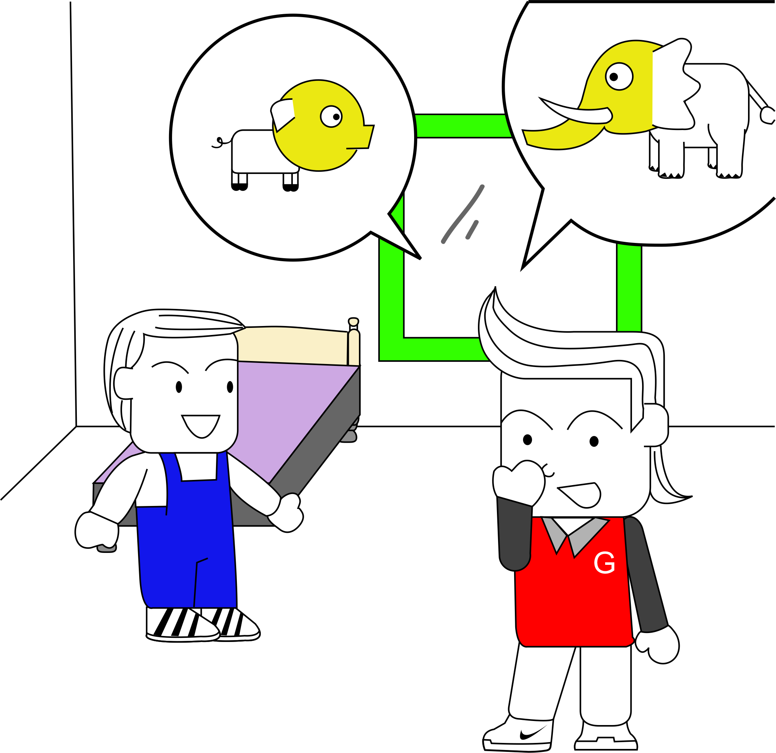
ao-§10.2 Audience

Slide 2

1. Review: Key Word Outline

Slide 3

1. Review: Key Word Outline
Prepare a 2 minute talk
My favorite….
  Piece of clothing,
  Song,
  Movie,
  Sport,
  Recreational activity,
  Elementary school teacher,
  Girlfriend/wife
Why is it your favorite?
Cluster / Outline on scrap paper.
Create a keyword outline (in workbook)

Slide 4

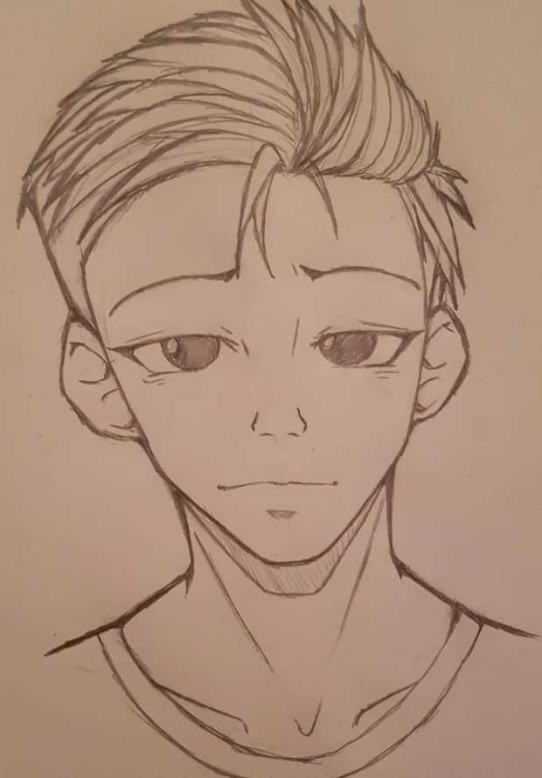
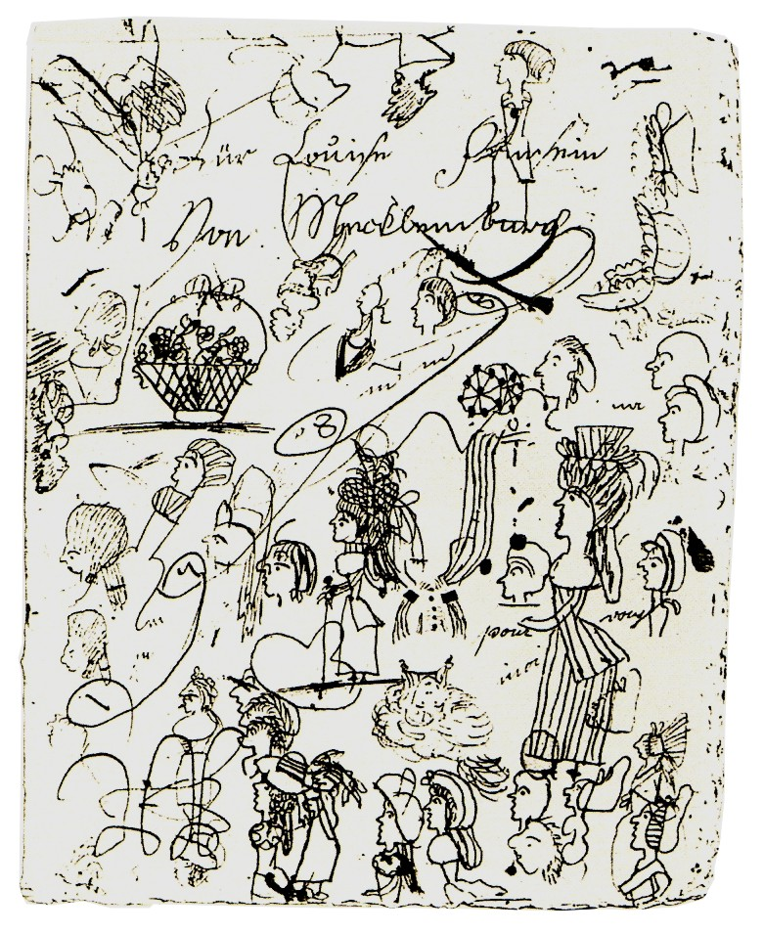


2 Behaviour
Nonverbal Communication
Blank stare
Doodling
Twiddling your thumbs
Doodling: https://en.wikipedia.org/wiki/Doodle#/media/File:Luise_Kritzelzeichnung.jpg
Blank Stare: https://www.reddit.com/r/sketches/comments/pqtrog/blank_stare/?rdt=55028

Slide 5
2 Behaviour
Non-verbal Clues
Listen to the talk
Fill in the blanks in your workbook.

Slide 6
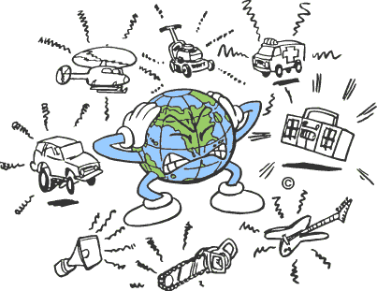
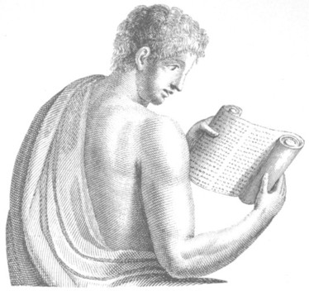

2 Behaviour
Non-verbal Clues
Cultural Differences
Noise
Body Language
Reading Writing
https://vancouver,ca/ctyclerk/cclerk/970513/citynoisereport/noise2.gif
https://www.gutenberg.org/files/26378/26378-h/26378-h.htm

Slide 7
3 Reading
Observe Carefully
Requires preparation (key word outline)
Requires practice

Slide 8
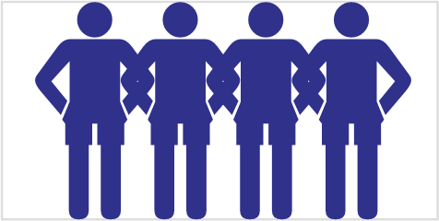
3 Reading
Class activity: Read the audience!
Speaker leaves the classroom
Class decides on a behavior
Speaker gives his talk
After talk, speaker explains how he “Read the Audience”

Slide 9
4 Responding
Responding to the Clues
Bewilderment [be.wil.der.ment]
Rude [rood]

Slide 10
4 Responding
Responding to the Clues
Listen to the talk
Look at the table in your workbook.

Slide 11
4 Responding
Responding to the Clues
Interested
Bored
Bewildered
Disagreement
Rude
Insulting

Slide 12
4 Responding
Respond to your Audience!
Each Speaker:
  Give your speech
  Leave the room
  Adjust your speech
Every Listener:
  Listen quietly
  Decide on a behavior
  Demonstrate the behaviour

Slide 13

5 Homework & Assignments
Borrow an LCD projector
Practice giving your talk to 2 or 3 friends
  Have one friend sit at the front of the room
  Have one friend at the back of the room.
Ask your friends:
  Are the viewgraphs clear?
  Can they hear and understand?
  Is the timing OK?

