Slide 1
ao-§10.3 Questions:
Traps or Opportunities

Slide 2

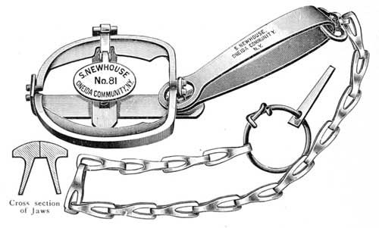
Questions: Traps or Opportun
Trap
Dread = paralysing fear
wander
https://www.gutenberg.org/files/34098/34098-h/34098-h.htm

Slide 3

Questions: Traps or Opportunities
Handling Questions
Your attitude is important
Don’t oppose, welcome questions.
Don’t miss the point: listen carefully
Don’t wander: Focus on the questioner
?

Slide 4

Questions: Trap or Opportunity
Choose:
  1 chairperson
  1 speaker
  2 audience
Assume the speaker has just finished his talk.
The chairman says: “The talk is now open for questions. I would like to remind you to introduce yourself and your affiliation before asking your question.”
Ask a question (Each member of the audience must ask 1 question).
Repeat with next speaker…

Slide 5
ao-§10.3 Questions
Practice Responding to Questions
Form a group of 4 people.
Choose a chairperson
[3]Choose a speaker
Assume that the speaker has just finished his talk. The chairman says: “The talk is now open for questions. I would like to remind you to introduce yourself and your affiliation before asking your question.”
Ask a question (either audience or chairman)
The speaker will reply.
Rotate to next speaker. GOTO [3]

Slide 6

ao-§10.3 Questions
Think about questions
Write 3 questions that a person listening to your talk might ask.
Think about how to answer them.
?

