Slide 1

§6.3 Short Communications

Slide 2


8 Life Story: Cluster and Linear Outline
Cluster and Linear Outline
Complete the cluster diagram for the 400 - 500 word essay on your life story.
Convert it into a linear outline
Think about a title for your “life story”
Hand in at the beginning of the next class.

Slide 3
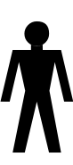

1 Attitudes to Learning English
Prof
1
2

Slide 4


2 Types of Publications
Formerly §6.5.2
TheAHL, CC BY 2.0 <https://creativecommons.org/licenses/by/2.0>, via Wikimedia Commons
referee: re-fer-ee (noun)
anonymous: a-no-ny-mous (adj.)

Slide 5

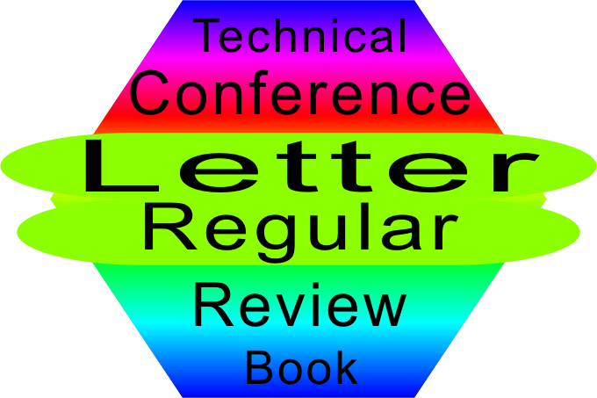
2 Types of Publications
Listen to the Talk
Ensure you Understand what the word “Letter” means in Scientific English.

Slide 6
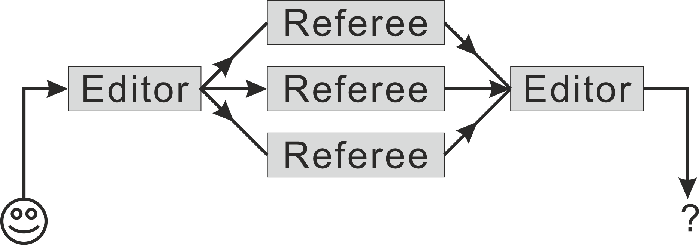



2 Types of Publications
-research in progress
-not complete
-non-refereed
-uncertain quality
-may give many details
-e.g. master’s thesis
Research Papers
  Categories
    Letters (Short Comm)
    Regular Full Length
  Review Process
  Response
-no new info
-summarize other papers
-generally senior
-useful for learning new field

Slide 7
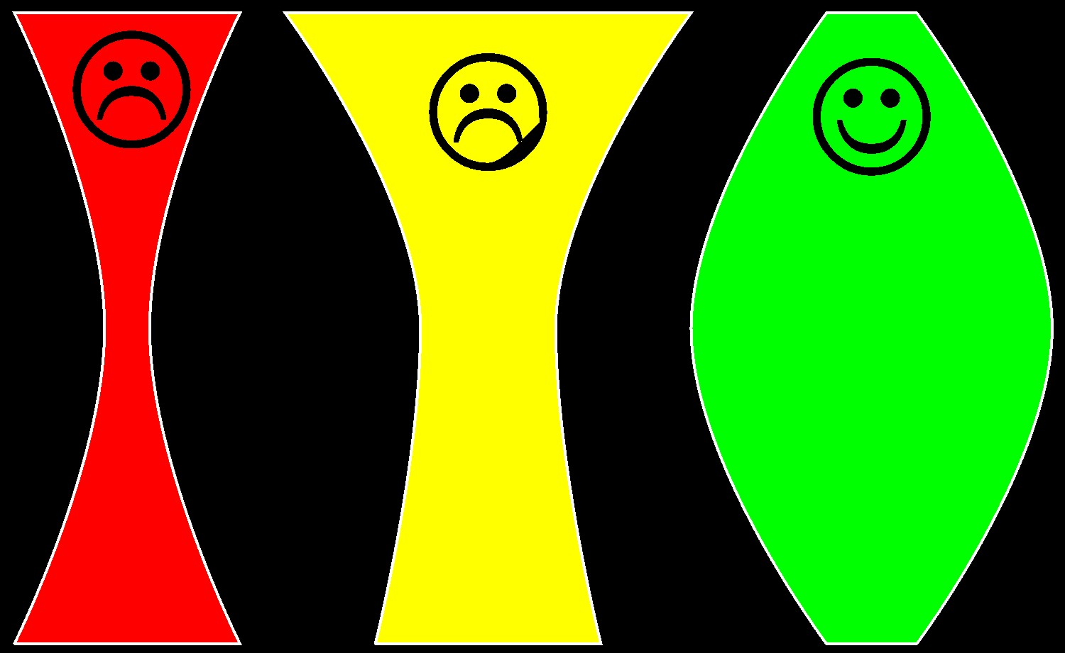
3 Structure of a Letter

Slide 8
4 Body
3 paragraphs: Fat! (10-80-10)
Order
  chronological (time)
  logical
  order of importance (most to least)
1 paragraph → 1 aspect of topic
Straightforward if….
  good cluster diagram
  complete linear outline
void paragraph (idea) {
main idea in 1 sentence;
for (i=0 ; i<3 ; i++) {
make supporting point;
elaborate;
}
summary sentence;
}
拔
苗
助
长
Haste Makes Waste

Slide 9
5 Introduction
Purpose
Introduce topic
Give a general background
Arouse the reader’s interest
Present the thesis
Indicate the overall flow of paper

Slide 10
5 Introduction
2
parts
Contents
General
statements
Specific
statements
Pick up some food on your way home
Pick up one 16” cheese pizza at Napoli on your way home
Thesis
Presentation Method

Slide 11
5 Introduction
Questions to Evaluate
Do I understand what the paper is about?
Is there enough background info?
Do I want to read the paper?
Can I tell what will be covered?

Slide 12

5 Introduction
Learn from Sample Introductions
Read each introduction.
Does it fulfill each requirement? How?
Decide if each sentence is
  General (G), or,
  Specific (S) to this paper
Determine each sentence’s role in the introduction
[G] General || [S] Specific
[1] Intro [2] Background [3] Interest [4] Flow [5] Thesis

Slide 13
5 Introduction
Learn from a Sample General Introduction
Each person’s life is a story. (G1) Some are happy, some are sad (___). All stories have unexpected turns and twists (___). I would like to tell you my story (___). It is a story of God’s mercy and love, starting from my birth, studies, arrival in Asia, marriage and children, and finally, arrival in Taiwan (___).
[G] General || [S] Specific
[1] Intro [2] Background [3] Interest [4] Flow [5] Thesis

Slide 14
5 Introduction
Learn from a Sample Scientific Introduction
Conjugated polymers have the potential to transform the world of semiconductor physics and flat panel displays due to their low cost and inherent processability (___). Application has been limited, however, due to low charge carrier mobility (___). We demonstrate that applying an electric field during deposition can improve charge carrier mobility by an order of magnitude (___). We first explain the method and then verify using the time-of-flight technique (___).
[G] General || [S] Specific
[1] Intro [2] Background [3] Interest [4] Flow [5] Thesis

Slide 15
5 Introduction
Write an Introduction for Edison Article
Compose an introductory paragraph for the Thomas Edison encyclopedia entry (§6.2)
Length: 3 or 4 sentences
Make a cluster diagram
Order the points (It is short)
Note each point’s role
Finally, write the introduction in the form of a complete English paragraph
[G] →[S]
[1] Introduction
[2] Background
[3] Interest
[4] Flow
[5] Thesis

Slide 16

5 Introduction
Write Your Own Short Paper’s Introduction
Prepare an introductory paragraph for the story of your life
Draw a cluster diagram (As it will be short, you don’t make a linear outline, simply order your points.)
Note each sentence’s role
As you write, remember:
  The flow (general → specific)
  The five purposes
  Your paper’s contents
[G] →[S]
[1] Introduction
[2] Background
[3] Interest
[4] Flow
[5] Thesis

Slide 17
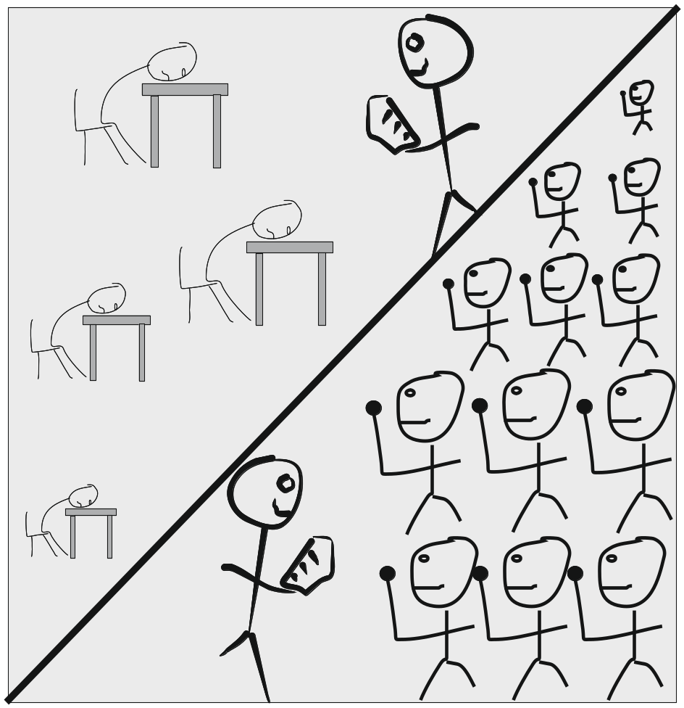
6 Conclusion
Marks of a quality conclusion
Summarize the paper
Restate hypothesis
Propose new directions
Excite the reader!

Slide 18
6 Conclusion
Learn from Sample Conclusions
Read each conclusion.
Does it fulfill each requirement? How?
What is the role of each sentence?
Do you feel excited when you read?
[1] Summarize [2] Thesis [3] Propose [4] Excite

Slide 19
6 Conclusion
Learn from a Sample General Conclusion
So that is my story – born in Canada, studying in the USA, working in Japan and China, and finally teaching in Malaysia and Taiwan (___). It has not always been an easy road, but it has always been interesting. All along the road, I have experienced God’s mercy and love (___). I hope that you also, like me, can experience God’s mercy and love (___).
[1] Summarize [2] Thesis [3] Propose [4] Excite

Slide 20
6 Conclusion
Learn from a Sample Scientific Conclusion
In summary, a low-cost controlled environment near-field scanning optical microscope has been developed (___). Operation in a nitrogen environment of a few milliTorr is shown to be sufficient to eliminate photo-bleaching in environmentally sensitive organic films on the typical experimental timescale (___). We believe that the ability to control the environment will allow the production of novel two-dimensional organic photonic crystals (___).
[1] Summarize [2] Thesis [3] Propose [4] Excite

Slide 21
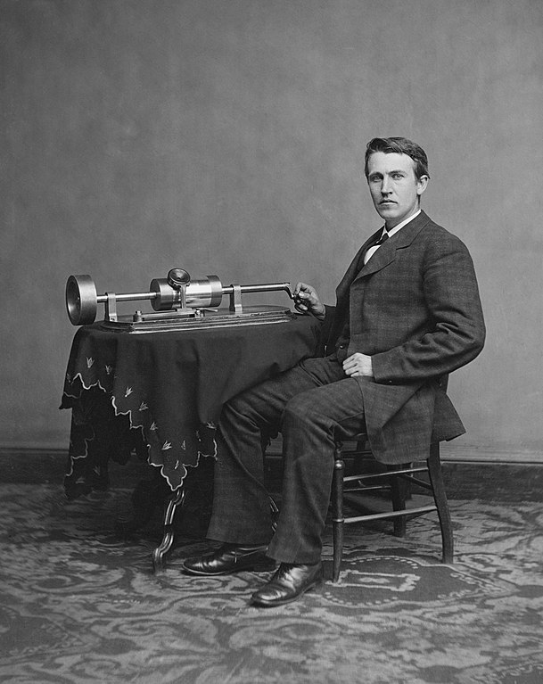
6 Conclusion
Write a Conclusion for the Edison Article
Compose a concluding paragraph for the Thomas Edison encyclopedia entry (§6.2)
Length: 3 or 4 sentences
Make a cluster diagram
Order the points
Note each sentence’s role
Finally, write the conclusion in the form of a complete English paragraph
As you write, remember the
  marks of a good conclusion
  contents of the Edison Article
[1] Summarize [2] Thesis [3] Propose [4] Excite

Slide 22

6 Conclusion
Write Your Own Short Paper’s Conclusion
Prepare a concluding paragraph for “The Story of My Life”
Make a cluster diagram
Order the points
As you write, remember:
  Target Length: 50 words
  Contents of your paper
Don’t Forget the purposes of the conclusion
  Summarize your life story
  Restate your thesis (hypothesis)
  Propose an exciting application

Slide 23
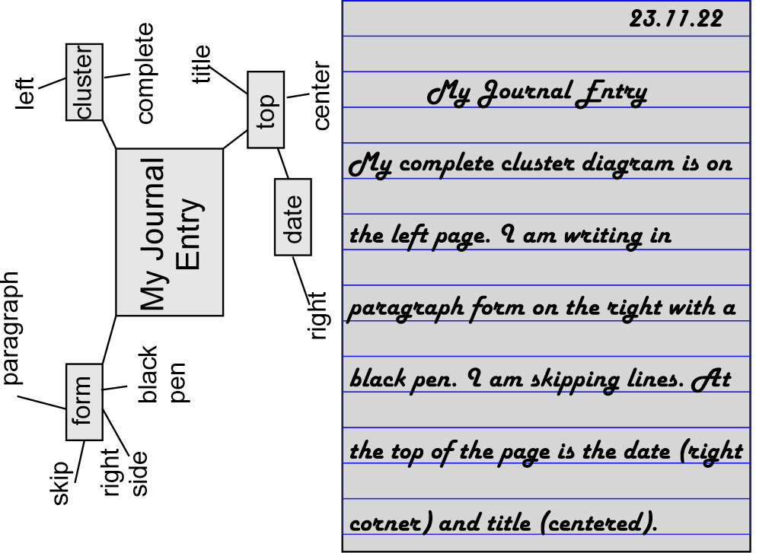
7 Journal Entry: A typical Friday
Tell me about a typical Friday in your life.
For example, tell me
  What time do you get up?
  What do you do after getting up?
  What do you eat for breakfast?
  How long to get to school?
  What do you do at work?
  Friday evening?
Remember to include an introductory sentence or two at the beginning!

