Slide 1

§6.4 Documenting Sources

Slide 2

1. Why? Avoid Plagiarism
plagiarize [pley-juh-rahyz]
intentional [in-ten-shuh-nh]
unintentional [uhn-in-ten-shuh-nl]

Slide 3

1. Why? Avoid Plagiarism
Follow along watching the viewgraphs.

Slide 4


1. Why? Avoid Plagiarism
Plagiarism
Serious Offense
Real Consequences
Documenting sources is expected.
Why? We don’t think independently.
Not to reference or acknowledge is stealing.
Just because it is ideas does not mean it is not theft
https://budgetdvdhunter.wordpress.com/wp-content/uploads/2009/07/stealing-dvds-for-profit3.jpg

Slide 5

1. Why? Avoid Plagiarism
How do you feel when someone else gets (takes) credit for something you did?

Slide 6
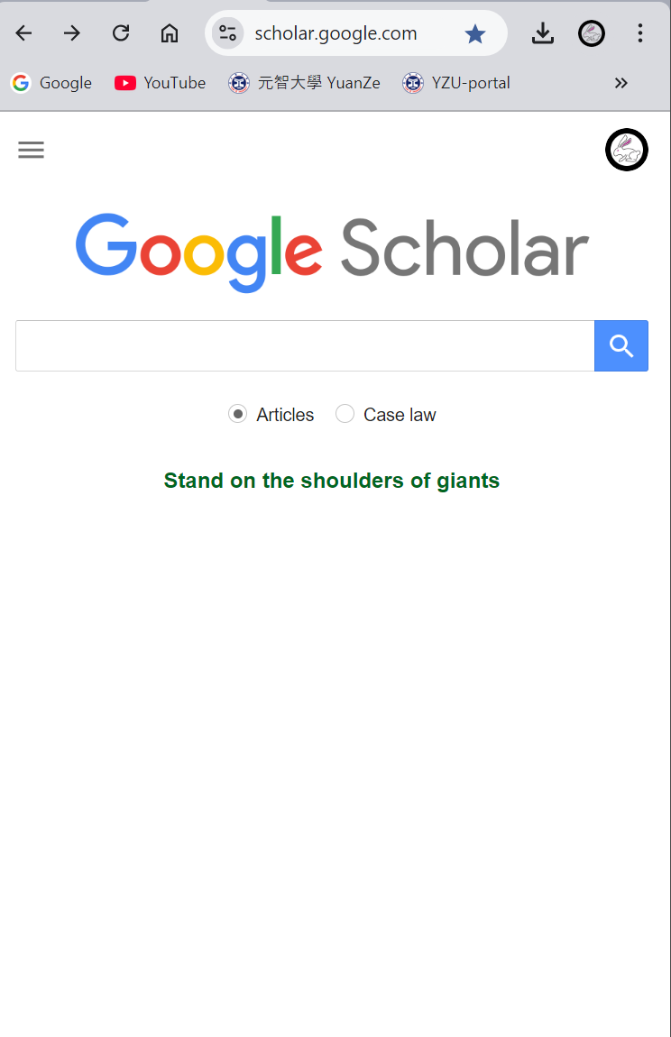
2. Searching and Finding References
Observe as the teacher demonstrates using Google Scholar to find related articles.

Slide 7
2. Searching and Finding References
Summary
Why?
  Avoid duplication
  Give Ideas for work
How?
  Keyword Search
  Citation Search
  Author Search
  Email Notification

Slide 8
3. Building a Reference Database
reference [ref-er-uhns]
citation [sahy-tey-shuhn]
The first experimental studies related to the conformation of short-chained polymers was published in 2001 [1]. Despite the…
[1] J.D. White, J.H. Hsu, W.S. Fann, Shu-chun Yang, G.Y Pern, S.A. Chen, Chem. Phys. Lett. 338, 263-268 (2001)

Slide 9
3. Building a Reference Database
Follow along in your textbooks.

Slide 10
3. Building a Reference Database
Reasons to Reference as you Read
Avoid unintentional plagiarism
Don’t forget a useful paper
Quickly find a useful paper
For convenience
  as you do research
  as you write up research

Slide 11
3. Building a Reference Database
Tips on Formatting
Include complete information
Store in a single formatted ASCII file (e.g. txt)
  Easy access
  Easy processing → spreadsheet, HTML
Separate each field with a semicolon(;) not comma
  Semicolon is rarely used in English
Name the file “index.csv”
Filename (PDF)
Paper Info
  Authors
  Title
  Journal Name
  Volume, Page, Year
Comments (Yours)
  < 30 words
  E.g. good intro…
  E.g. key result: E=mcc

Slide 12
3. Building a Reference Database
Naming your files: Follow a Convention
Suggest 8.3 format
First four (4) characters of the author’s last name
  first, or,
  corresponding
First character of author’s first name
Last two (2) digits of the year
a,b,c to designate different papers by same author
PERIOD (.)
File type (i.e. PDF)
e.g. J.D. White, J.H. Hsu…(2001) → WhitJ01a.pdf

Slide 13
Authors
Filename
Semicolon
Authors

Slide 14
Title

Slide 15
Journal Name, Volume, Pages

Slide 16
Date

Slide 17
Comments

Slide 18
File Naming Convention
first paper I read
by this author for this year

Slide 19
3. Building a Reference Database
DEMO
Converting Database to HTML Format
Observe as Teacher Builds a Reference Database Step-by-Step
Create
index.csv
View
index.htm
Download & Run C Program

Slide 20
4. Citing your Database
Follow the viewgraphs

Slide 21
4. Citing your Database
Cite as you Write
Starting with your Cluster Diagram
Continue in the Linear Outline
Introduction.
  Intrusions have serious adverse effects.
  Conventional intrusion detection has weaknesses [TartA06a]
  Can’t detect Whitonian intrusions [WhitJ07a].
  ….

Slide 22
4. Citing your Database
Cite as you Write
Bring into your First Draft
Tartakovsky et al. have recently proposed an adaptive sequential and batch-sequential change-point detection method to detect of intrusions in computer networks [TartA06a]. Although this method is successful in protecting against conventional intrusions, it has limited ability to detect a Whitonian style intrusions [WhitJ07a]. Thus…

Slide 23
4. Citing your Database
Cite as you Write
By citing your reference database
Using your filename to denote source[TartA06a]
Ensuring you…
  don’t mix up references (very easy)
  don’t confuse 2 papers by the same author
  can easily change reference and citation styles i.e. if the journal changes due to your or the editor’s decision

Slide 24

4. Citing your Database
Discuss…
Where are you in preparing your thesis?
  reading papers?
  starting to write?
How will you apply this lesson this week?

Slide 25
5. Finalizing the Format
What?
  Convert citations to the journal’s required format
  Convert references to the journal’s required format
When?
  After final draft is finished
  Decided on journal submit.
Why? Requirements vary between journals.
How?
  look at the style guides
  look at the journal’s website (Author info)
  copy format from recent papers

Slide 26
5. Finalizing the Format
Converting References: Journal Article
J.D. White, J.H. Hsu, W.S. Fann, S.-C. Yang, G.Y Pern, S.A. Chen, “Deduction of the conformation of short chain luminescent conjugated polymers from single molecule photophysics”, Chem. Phys. Lett. 338, 263-268(2001)
→ Elsevier Chemical Physics Letters
J.D. White, J.H. Hsu, W.S. Fann, S.-C. Yang, G.Y Pern, S.A. Chen, Chem. Phys. Lett. 338 (2001) 263

Slide 27
5. Finalizing the Format
Converting References: Journal Article
J.D. White, J.H. Hsu, W.S. Fann, S.-C. Yang, G.Y Pern, S.A. Chen, “Deduction of the conformation of short chain luminescent conjugated polymers from single molecule photophysics”, Chem. Phys. Lett. 338, 263-268(2001)
→ AIP, Applied Physics Letters
J.D. White, J.H. Hsu, W.S. Fann, S.-C. Yang, G.Y Pern, S.A. Chen, Chem. Phys. Lett. 338, 263 (2001)

Slide 28
5. Finalizing the Format
Converting References: Journal Article
[WhitJ01a] J.D. White, J.H. Hsu, W.S. Fann, S.-C. Yang, G.Y Pern, S.A. Chen, “Deduction of the conformation of short chain luminescent conjugated polymers from single molecule photophysics”, Chem. Phys. Lett. 338, 263-268(2001)
→ IEEE Transactions on ….
J.D. White, J.H. Hsu, W.S. Fann, S.-C. Yang, G.Y Pern, S.A. Chen, “Deduction of the conformation of short chain luminescent conjugated polymers from single molecule photophysics”, Chem. Phys. Lett. 338, pp. 263-268 (2001).

Slide 29
5. Finalizing the Format
Converting References: Books
I. Chai, J.D. White, Structuring Data and Building Algorithms -- An ANSI-C based approach( McGraw-Hill International, Singapore 2006), p.89.

Slide 30
5. Finalizing the Format
Converting References: Conferences (IEEE)
D.B. Fogel, “Using evolutionary programming to construct neutral networks that are capable of playing tic-tac-toe,” in Proc. 1995 IEEE Int. Conf. Neural Netw., 1995, pp. 875-8

Slide 31
5. Finalizing the Format
Converting References: Website
Xiaotu Conference for Graduate students in Science and Engineering with Open Participation. Retrieved January 5, 2005, from http://www.xiaotu.com/xtop/index.htm

Slide 32
5. Finalizing the Format
Converting References: Online Journals
Fred, J.P. (2000, March 6). New approach to polymer physics, Physics Express, 3, Article 1. Retrieved January 13, 2005 from http://www.newphysics.com/express/308401.htm

Slide 33
5. Finalizing the Format
Converting References: Internet only Newsletter
Black, J.P. (2005, July). New standards on the way, Wireless Networking, Retrieved from http://www.hotwire.org/subscribe/newsletter7.htm

Slide 34
5. Finalizing the Format
2. Converting Citations
The first experimental study related to the conformation of short-chain polymers was published in 2001 [WhitJ01a]. Despite the…
→ IEEE, Transactions on Evolutionary Computation
The first experimental study related to the conformation of short-chain polymers was published in 2001 [22]. Despite the…

Slide 35
5. Finalizing the Format
2. Converting Citations
The first experimental study related to the conformation of short-chain polymers was published in 2001 [WhitJ01a]. Despite the…
→APS, Physical Review B
The first experimental study related to the conformation of short-chain polymers was published in 2001²². Despite the…

Slide 36
5. Finalizing the Format
2. Converting Citations
The first experimental study related to the conformation of short-chain polymers was published in 2001 [WhitJ01a]. Despite the…
→ Wiley, Journal of Microscopy
The first experimental study related to the conformation of short-chain polymers was published in 2001 (White, 2001). Despite the…

Slide 37
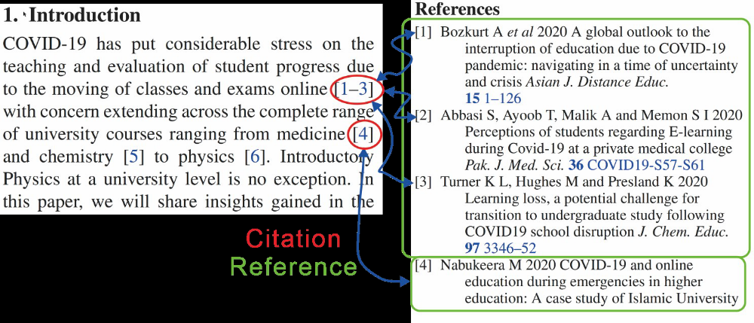
6. Summary

Slide 38
6. Summary
Reference as you Read.
Cite as you Write.
Format when you’re Finished.

Slide 39

7. Homework
Start a Reference Database: Your Life Story
Find two or three papers you may be able to cite in the introduction of your life story paper
For example,
  a quote that is meaningful to you and your life story
  Someone else’s life story that is related to your story
Create a reference database
  Name the file: ‘index.csv’
  Use the format: “filename; author; reference; comments”
Convert to HTM with xtrefman.exe
Submit hard copies to class next week
  Your text file index.csv
  The HTML files generated by xtrefman.exe

