Slide 1

בְּרֵאשִׁ֖ית בָּרָ֣א אֱלֹהִ֑ים אֵ֥ת הַשָּׁמַ֖יִם וְאֵ֥ת הָאָֽרֶץ׃
Translation:
In the beginning, God created the heavens and the earth.
Moses
Genesis 1:1
~1400 BC
Core of M51 Whirlpool Galaxy (Image Size: 1100 light-years)
The center of the cross is the location of a Black Hole (Image by NASA’s Hubble Telescope)

Slide 2

1 Cause & Effect
Assumption
  uh-suhmp-shuhn
  Noun
  A thing that is assumed to be true
assume:
  verb
  uh-soom
  To suppose something without any evidence

Slide 3

1 Cause & Effect
Basic Assumption of Science → every natural effect has a natural cause
Role of the Scientists → discover natural causes for effects
Role of the Engineer → employ cause and effect laws to create something new and beneficial

Slide 4

1 Cause & Effect
Skim the article
Fill in the chart with
  the cause
  the connecting word
  the effect
Cause
Connector
Effect

Slide 5
1 Cause & Effect
Color and Perception (example):
We see colour because of the way our brains respond to different wavelengths of electromagnetic radiation.
Cause
Connector
Effect
brains respond
because
see colour

Slide 6
1 Cause & Effect
Skim the article.
Fill in the chart with
  the cause
  the connecting word
  the effect
Cause
Connector
Effect
brains respond
because
see colour

Slide 7
1 Cause & Effect
Expressing Cause & Effect in English
  C → E
caused / causes
C
results in
E
produces
was caused by / due to
E
is a result of
C
is produced by
because (of)
If / When / As
E
Owing to / Due to
C
if / when / as
E
owing to / due to
C

Slide 8

1 Cause & Effect
Create Four C → E Sentences
Write 4 sentences expressing casual relations.
Replace C and E with your clauses.
Careless smoking
caused / causes
E
C
results in
the fire.
produces
was caused by / due to
E
is a result of
C
The fire
is produced by
careless smoking.
because (of)
If / When / As
you smoke carelessly,
E
Owing to / Due to
C
there will be a fire.
E
if / when / as
C
There will be a fire
owing to / due to
you smoke carelessly.

Slide 9
2. Expressing Cause and Effect
Condition → Consequence (Same Grammar)
The word of Yahweh came to Solomon, saying,
Concerning this house which you are building,
If you will
  walk in my statutes, and
  execute my ordinances, and
  keep all my commandments to walk in them;
Then I will
  dwell among the children of Israel, and
  not forsake my people Israel.

Slide 10
2. Expressing Cause and Effect
Distinguishing Causality and Condition
Statements of causality require the antecedent to precede or coincide with the consequent in time
Conditional statements do not require temporal order.

Slide 11
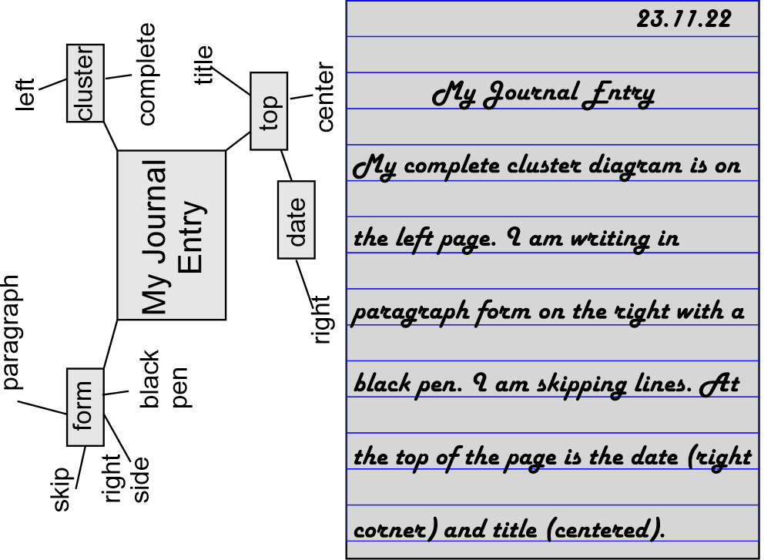
3 Journal Entry
Life’s Causes and Effects
Write about how…
  your mother & father met, and you arrived.
  you met your SO*
Choose one only!
Use cause and effect phrases!
*SO = significant other (e.g. spouse, boyfriend, cat, dog…)

Slide 12
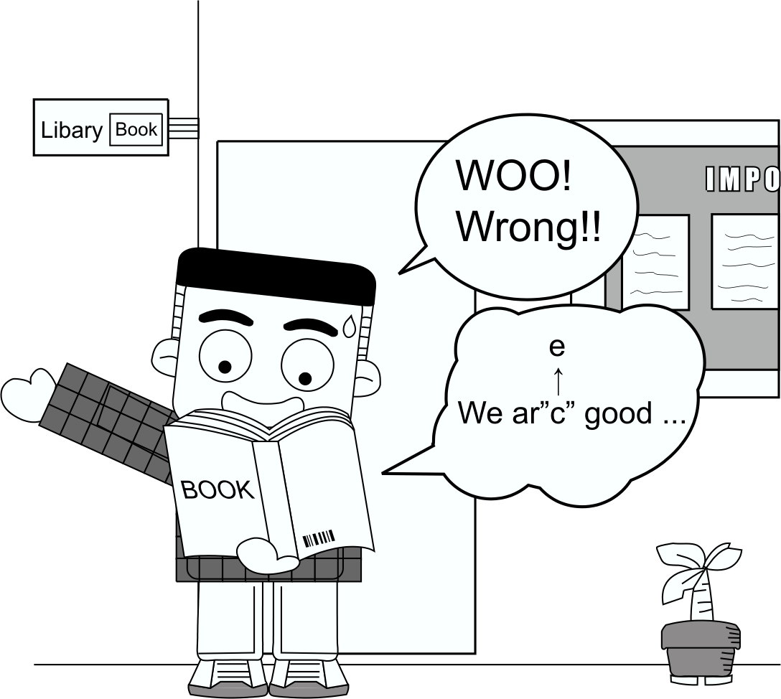
4. Common Writing Errors

Slide 13
4. Common Writing Errors
Different cultural backgrounds cause/result in different common writing errors
Focus on writing errors due to a Chinese background

Slide 14

4. Common Writing Errors
Problem Solution
- too many ideas in 1 paragraph
- split into separate paragraphs
- expand on each idea.
macro-
- introduction too long
- shorten to <20% of paper
- chaotic, unorganized
- more time linear outlining
- big words
- use simpler words
micro-
- long sentences
- divide into shorter sentences
- wrong word (i.e. lift not life,
- check manually
common mistake if using word
processor)

Slide 15

4. Common Writing Errors
Sentence Correction
Correct sentences in textbook.

Slide 16
4. Common Writing Errors
Correct your Sentences
Discuss the errors I have marked in your homework.
With aid of your partners, correct them.

Slide 17
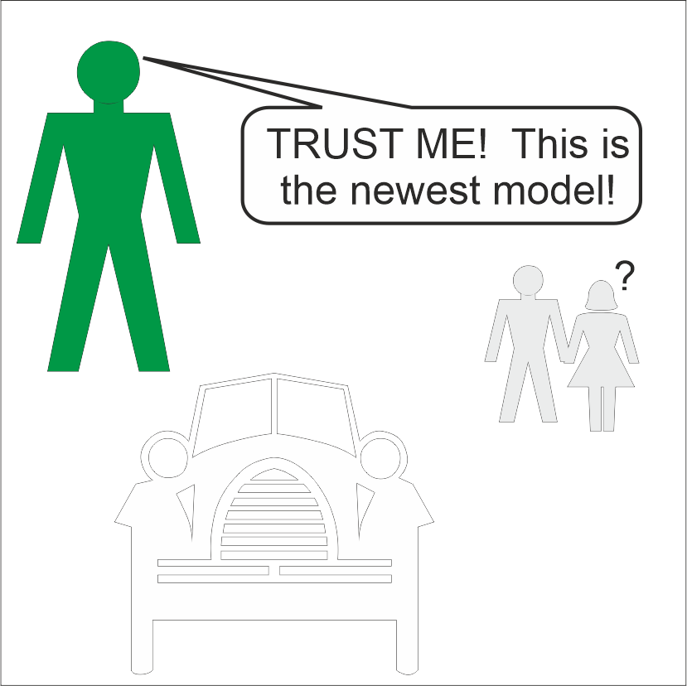
5. Salesmanship
Learn from
  McDonald’s
  Coke
  GE
  Nike
Conclusions
  Make Sentences Short
  Keep Verbs Simple
  Use expressive adjectives
  1 idea: 1 paragraph
Choose words carefully

Slide 18

5. Salesmanship
McDonald’s
McDonald’s Diversity. McDonald’s is the world’s community restaurant. We are proud of our long-standing commitment to a workforce that is diverse. We believe in developing and maintaining a diverse workforce that will strengthen the McDonald’s system. Diversity at McDonald’s is understanding, recognizing, and valuing the differences that make each person unique.

Slide 19

5 Salesmanship
Coke
The Coca-Cola Company exists to benefit and refresh everyone it touches.

Slide 20

5 Salesmanship
GE
Imagination at work
Innovation. GE’s limitless future is seen in an array of innovative, technically advanced products and services.

Slide 21

5 Salesmanship
Nike
Just Do It!

Slide 22
5. Salesmanship
U R a salesman.
Sell your work!
Learn from
  McDonald’s
  Coke
  GE
  Nike
Conclusions
  Make Sentences Short
  Keep Verbs Simple
  Use expressive adjectives
  1 idea: 1 paragraph
Choose words carefully

Slide 23
Types of Publications
Moved to §6.3.2 Short Communications

Slide 24

6. Homework & Assignment
Story of your Life
Revise your first draft according to my comments
If you are confused, lets talk…
Submit the revision by email before Monday.

