Slide 1

7. Writing
Full Length Papers

Slide 2

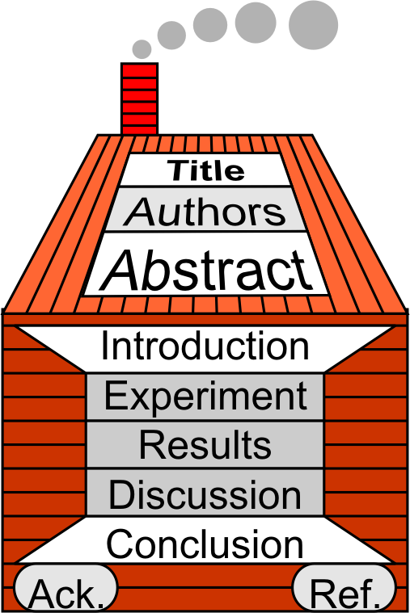

7.1 Flow of a Research Paper
Keywords
Header
Main paper
Foundation
  Acknowledgements
  References
Keywords
Keywords

Slide 3

7.1 Flow of a Research Paper
Papers in your field
Do papers you are reading follow this format?
If not, how do they differ?
Keywords

Slide 4


Final Assignment: Full Length Paper
Final Assignment Introduction
Group Project (~4 per group)
Complete a short research project
Write together a full-length research paper
See Website for details.
This is 25% of the course mark.
Next semester Oral presentation will also be based on this project (but will be presented individually)

Slide 5


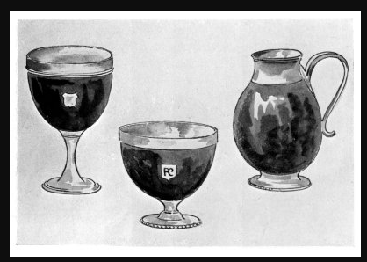
7.1 Flow of a Research Paper
Groups: Choosing a Research/Survey Topic
In your group of ~4 people
Choose a topic for your group research paper
Research
Topic of
Your Lab
https://www.gutenberg.org/files/25294/25294-h/images/fig_23-25.jpg

