Slide 1
§7.2 The Introduction
Don’t Wait! Start Now!

Slide 2
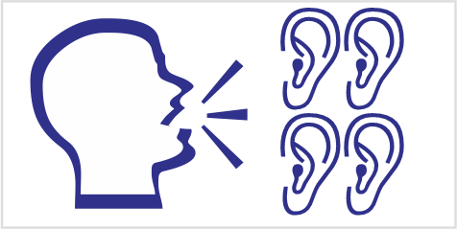
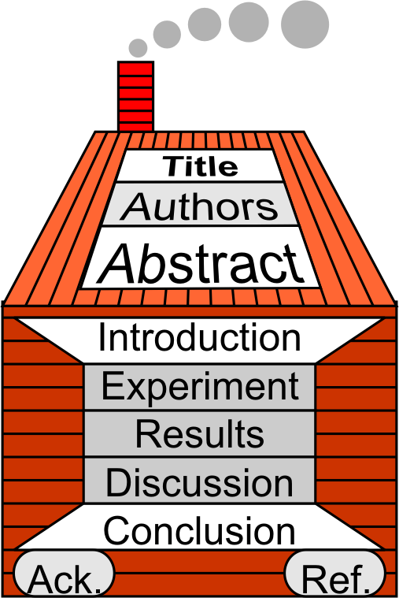


§7.2 The Introduction
Don’t Procrastinate!
Start Now!
Complete Outline One Year Before Expected Graduation Date
Keywords
Picture created with Generative AI (Co-Pilot)

Slide 3

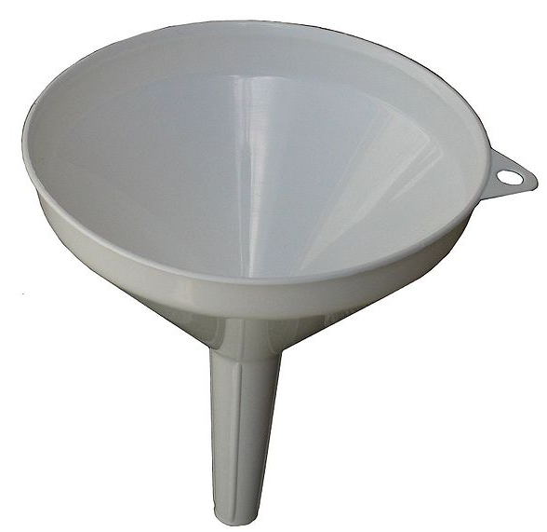
1 It’s Five (5) Stages
funnel: fun-nel
https://upload.wikimedia.org/wikipedia/commons/thumb/1/11/Kitchen_Funnel.jpg/601px-Kitchen_Funnel.jpg

Slide 4
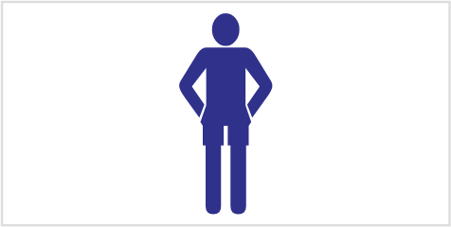
1 It’s Five (5) Stages
Skim
Skim read the sample introduction in your book.
(you don’t need to understand every word, we are interested in the format not contents.)

Slide 5
1 It’s Five (5) Stages
Skim

Slide 6
1 It’s Five (5) Stages
1. Setting
2. Prior Work
3. Need
4. Thesis
5. Value
Organic thin-film electro-luminance based on conjugated polymers is the focus of extensive research due to their potential application in next generation flat panel displays [FrieR99]. However, in order for these conjugated polymers to be optimized, it is necessary for the fundamental photo-physics and exciton migration within these polymers to be understood. One of the most commonly studied polymers is MEH-PPV
Published works have reported vastly different behavior for the fluorescent time trace. Exponential decay [HuseT00], emission at 2 levels [HuD99], and emission at 4 or 5 equally spaced intensities [WhitJ99] have all been observed.
equally spaced intensities [WhitJ99] have all been observed. A direct comparison, however, is difficult due to difference in sample and sample preparation. Additional research is needed to probe the effect of individual parameters on the photo-physics.
In this paper we report on a study into the effect of chain length on photoluminescence on the millisecond time scale. In particular, in which we have repeated these experiments varying only one parameter – chain length – demonstrating that three-dimensional energy transfer is an important parameter controlling the photophysics of conjugated polymers.
photophysics of conjugated polymers. These experiments shed light on exciton migration within conjugated polymers and should help in producing better PLEDs.

Slide 7
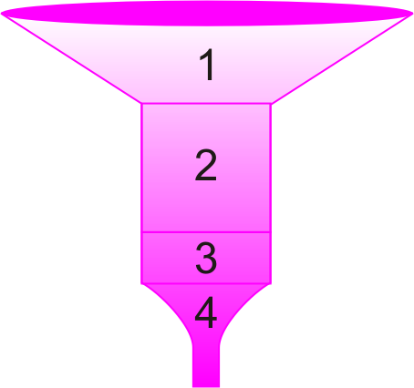
1 It’s Five (5) Stages
Funnel Analogy
Collect as much water (many readers) as possible
Direct the water (reader) to a small outlet (your thesis)
General Statements
Previous Work
Need
Thesis
(value)

Slide 8
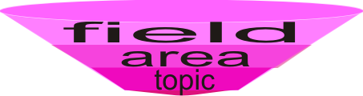
2 Stage 1: The Setting
General Statements about….
Organic thin-film electro-luminance based on conjugated polymers is the focus of extensive research due to their potential application in next generation flat panel displays [FrieR99]. However, in order for these conjugated polymers to be optimized, it is necessary for the fundamental photo-physics and exciton migration within these polymers to be understood. One of the most commonly studied polymers is MEH-PPV
Organic thin-film electro-luminance based on conjugated polymers is the focus of extensive research due to their potential application in next generation flat panel displays [FrieR99].
However, in order for these conjugated polymers to be optimized, it is necessary for the fundamental photo-physics and exciton migration within these polymers to be understood. One of the most commonly studied polymers is MEH-PPV
However, in order for these conjugated polymers to be optimized, it is necessary for the fundamental photo-physics and exciton migration within these polymers to be understood. One of the most commonly studied polymers is MEH-PPV

Slide 9
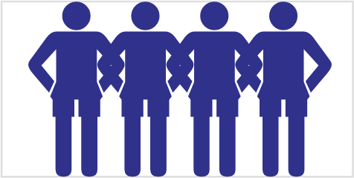
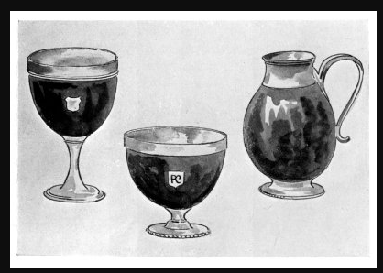
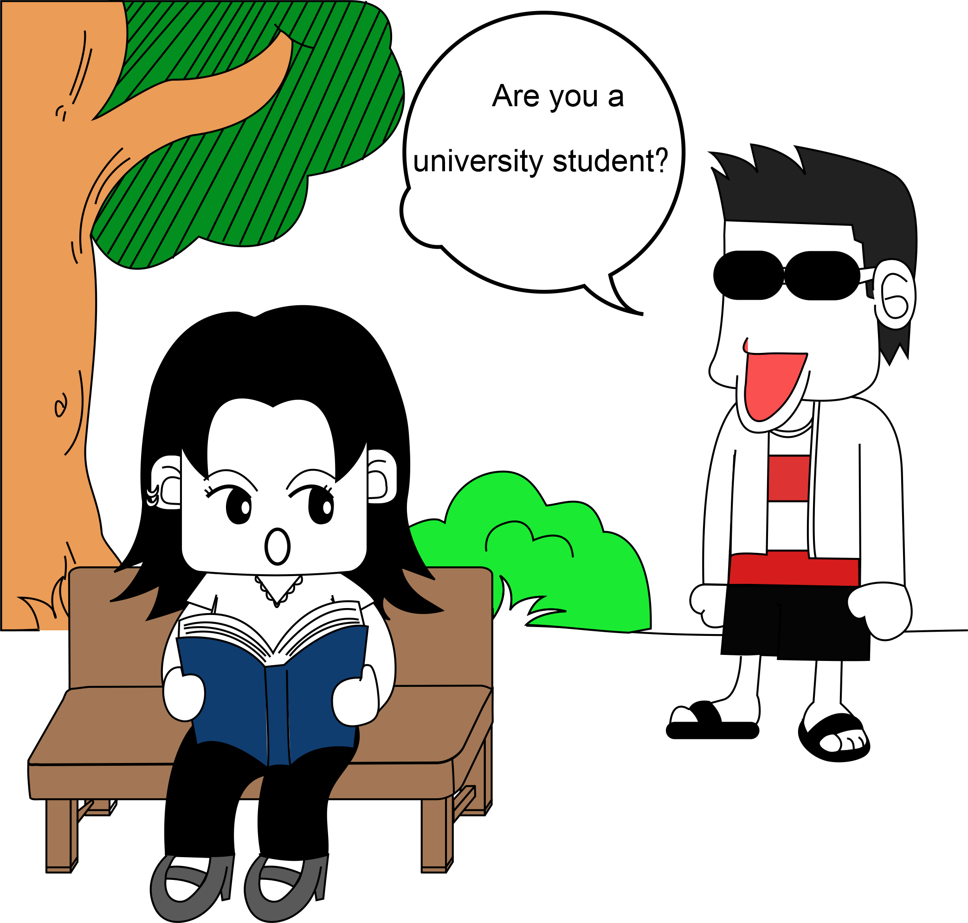
2 Stage 1: The Setting
Group Formation
Form a group of 4 people (same lab if possible)
Decide on a research (survey) topic
Research
Topic of
Your Lab
https://www.gutenberg.org/files/25294/25294-h/images/fig_23-25.jpg

Slide 10
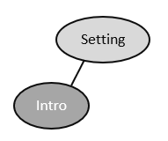
2 Stage 1: The Setting
Create the Setting
Brainstorm for ideas for
  Field
  Area
  NOTE Topic of the paper (bubbles in cluster diagram)
Convert best ideas to
  Linear Outline
  Sentences

Slide 11
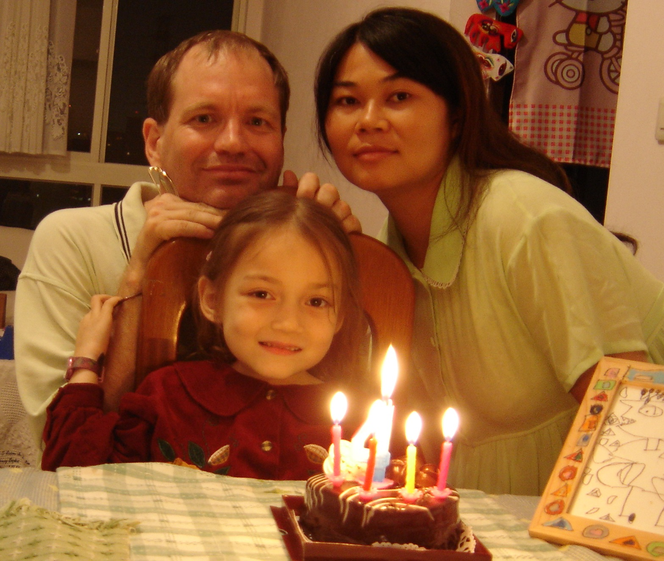

3 Journal Entry
Describe the Picture
What are they doing?
Are they happy? sad?
Who’s the special person?
How does this picture make you feel?

Slide 12

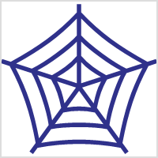
4 Stage 2: Literature Review
You want to…
Show you are familiar with the field
Cite your referees
Tell editor who should referee your work
Include review articles to
  Help a reader new to the field get basics
  Allow a reader new to the field to find your paper
Use recent references
Only cite what you have read!

Slide 13
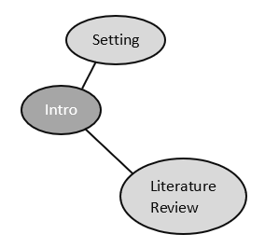
4 Stage 2: Literature Review
Cite some Papers
Brainstorm for ideas of paper to cite and their contents. (these may be “fictitious” papers)
Each paper should occupy 1 bubble on your cluster diagram
Convert best ideas to
  Linear Outline
  Sentences

Slide 14

5 Stage 3: Need for Study
You need to:
Justify need for study
Identify unanswered questions
Quote from established people
Why is this particular study needed?
?
Newton said: “…”

Slide 15
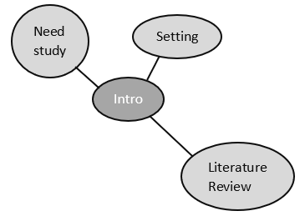
5 Stage 3: Need for Study
Justify the need
Brainstorm (cluster)
Add to cluster
Choose Best Ideas
Convert to Linear Outline
Why is this particular
study needed?

Slide 16

6 Stage 4: The Hypothesis
1. Purpose:
State your Thesis
Paper Organization

Slide 17
6 Stage 4: The Hypothesis
2. Structure
Hypothesis
  Single sentence
  Question or statement (see journal for format)
Paper Organization
  Single sentence
    “In this paper we will first…then.. and finally…”

Slide 18
6 Stage 4: The Hypothesis
2. Structure
The
[purpose || aim || object]
of this
[paper || letter || report]
is to determine if

Slide 19
6 Stage 4: The Hypothesis
2. Structure
The
[purpose || aim || object]
of this
[study || investigation || research]
is to determine if

Slide 20
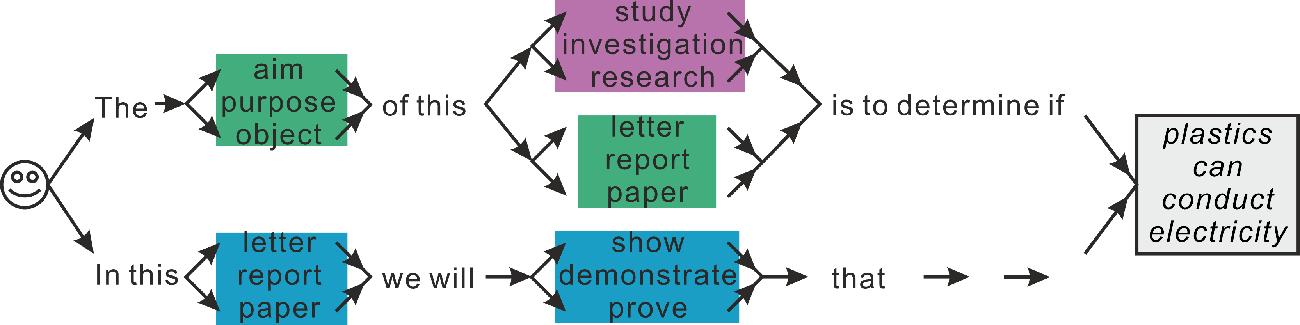
6 Stage 4: The Hypothesis
2. Structure
In this
[paper || letter || report]
we will
[show || demonstrate || prove]
that

Slide 21
6 Stage 4: The Hypothesis
Brainstorm (cluster) (Generate up to 4 ideas)
Choose the best Add to Linear Outline
Convert to Correct Sentence Form (try writing in 3 different ways)

Slide 22

7 Homework & Assignments
The Introduction
Complete your Group’s cluster diagram for your research paper
Convert to a Linear Outline (first version)
Suggestion: Use LibreOffice Template!

