Slide 1
§7.4 Western Logic

Slide 2


§7.4.0 Logic Structures in Computers
UML Activity Diagrams, anyone?
Sequence (Linear Flow)
Selection (Conditional)
Repetition (loops)
This is not what we are discussing here!

Slide 3
Disjunctive Syllogism
Premise: The universe had a beginning. (Big Bang)
Premise: Every event has a cause. (Law of Causality)
Conclusion: A personal agent willed the creation of the universe.
Kalam Cosmological Argument
(disjunctive syllogism)
Ref :
https://yaallahoo.blogspot.com/2006/03/kalam-cosmological-argument-definitve.html (Download December 11, 2007)
https://en.wikipedia.org/wiki/Kalam_cosmological_argument (Download December 9, 2024)
History:
Based on Aristotle’s concept of Prime Mover
Encapsulated by Al-Ghazali (11th century Islamic Scholar)
Modern Variation by William Craig (1979) incorporate Big Bang Theory to support Premise

Slide 4


§7.4.1 Seven Logic Structures
Exemplify: ex-em-pli-fy (verb)
Analogy: a-nal-o-gy (noun)
Compare: com-pare (verb)
Contrast: con-trast (verb)
}
(Daily English)
Comparison
includes…
(logic)
compare
- Emphasis on Similarity
contrast
- Emphasis on Difference

Slide 5

§7.4.1 Seven Logic Structures
Skimming
Skim the article: “Common Logic Structures in scientific writing”
Concentrate on the examples that demonstrate the logical structure.
You don’t need to understand the vocabulary in the examples.

Slide 6
§7.4.1 Seven Logic Structures
Common Structures in Scientific Writing
Cause/Effect
Illustration
We conclude by summarizing our finding in a single schematic depicting the energy landscapes of typical polymers with ovals indicting the active emission excitons.
Figure 3 shows the temporal evolution of the mean of the ensemble-averaged spectral shift for all measured long-chain polymers

Slide 7
§7.4.1 Seven Logic Structures
Common Structures in Scientific Writing
Cause/Effect
Illustration
Order of importance
Exemplification
Analogy
Monitoring the single molecule at a long time scale can tell us what events occurred at an earlier time.
For example, if not all the energy funnels into a single emitting site but rather goes into two sites, then two emitters will be observed in the single molecule experiment.
Patterning with a near-field optical probe is analogous to writing Chinese characters with a brush. Just as the thickness of the characters is dependent on the closeness of the brush to the surface, the line width of the nano-wire is determined by the tip-substrate separation.

Slide 8
§7.4.1 Seven Logic Structures
Common Structures in Scientific Writing
Cause/Effect
Illustration
Order of importance
Exemplification
Analogy
Comparison
Contrast
Figure 4 compares the relative spectral shift for short rod-like and long-chain polymers. Both polymers have similar…
Figure 4 contrasts the relative spectral shift for short rod-like and long-chain polymers. In contrast to long-chain polymers, short chain polymers….

Slide 9

§7.4.1 Seven Logic Structures
Recognizing logic structures
Identify the logic structures in each of the paragraphs.
There may be more than one.
Cause/Effect
Illustration
Order of importance
Exemplification
Analogy
Comparison
Contrast

Slide 10
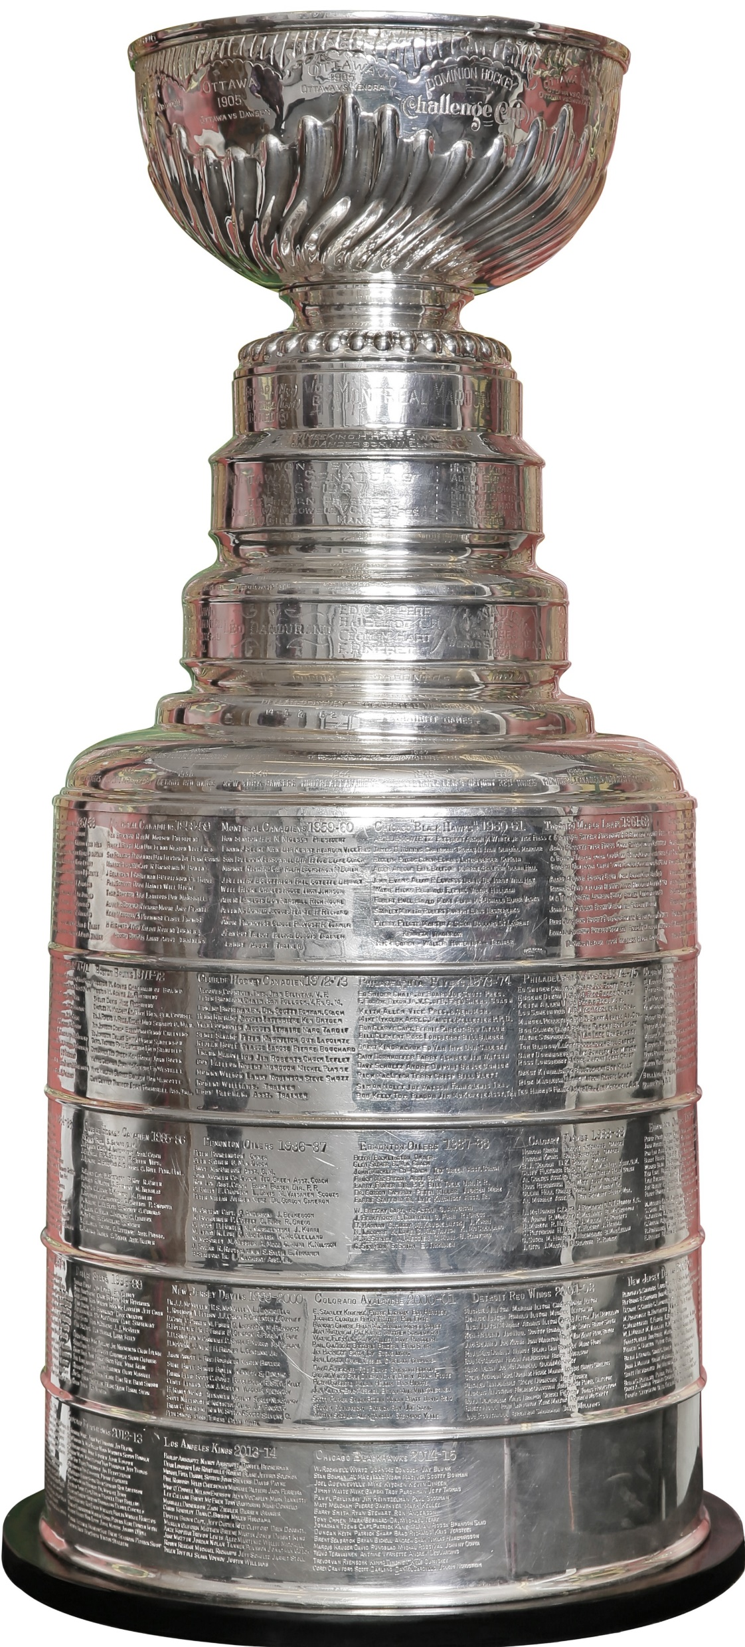



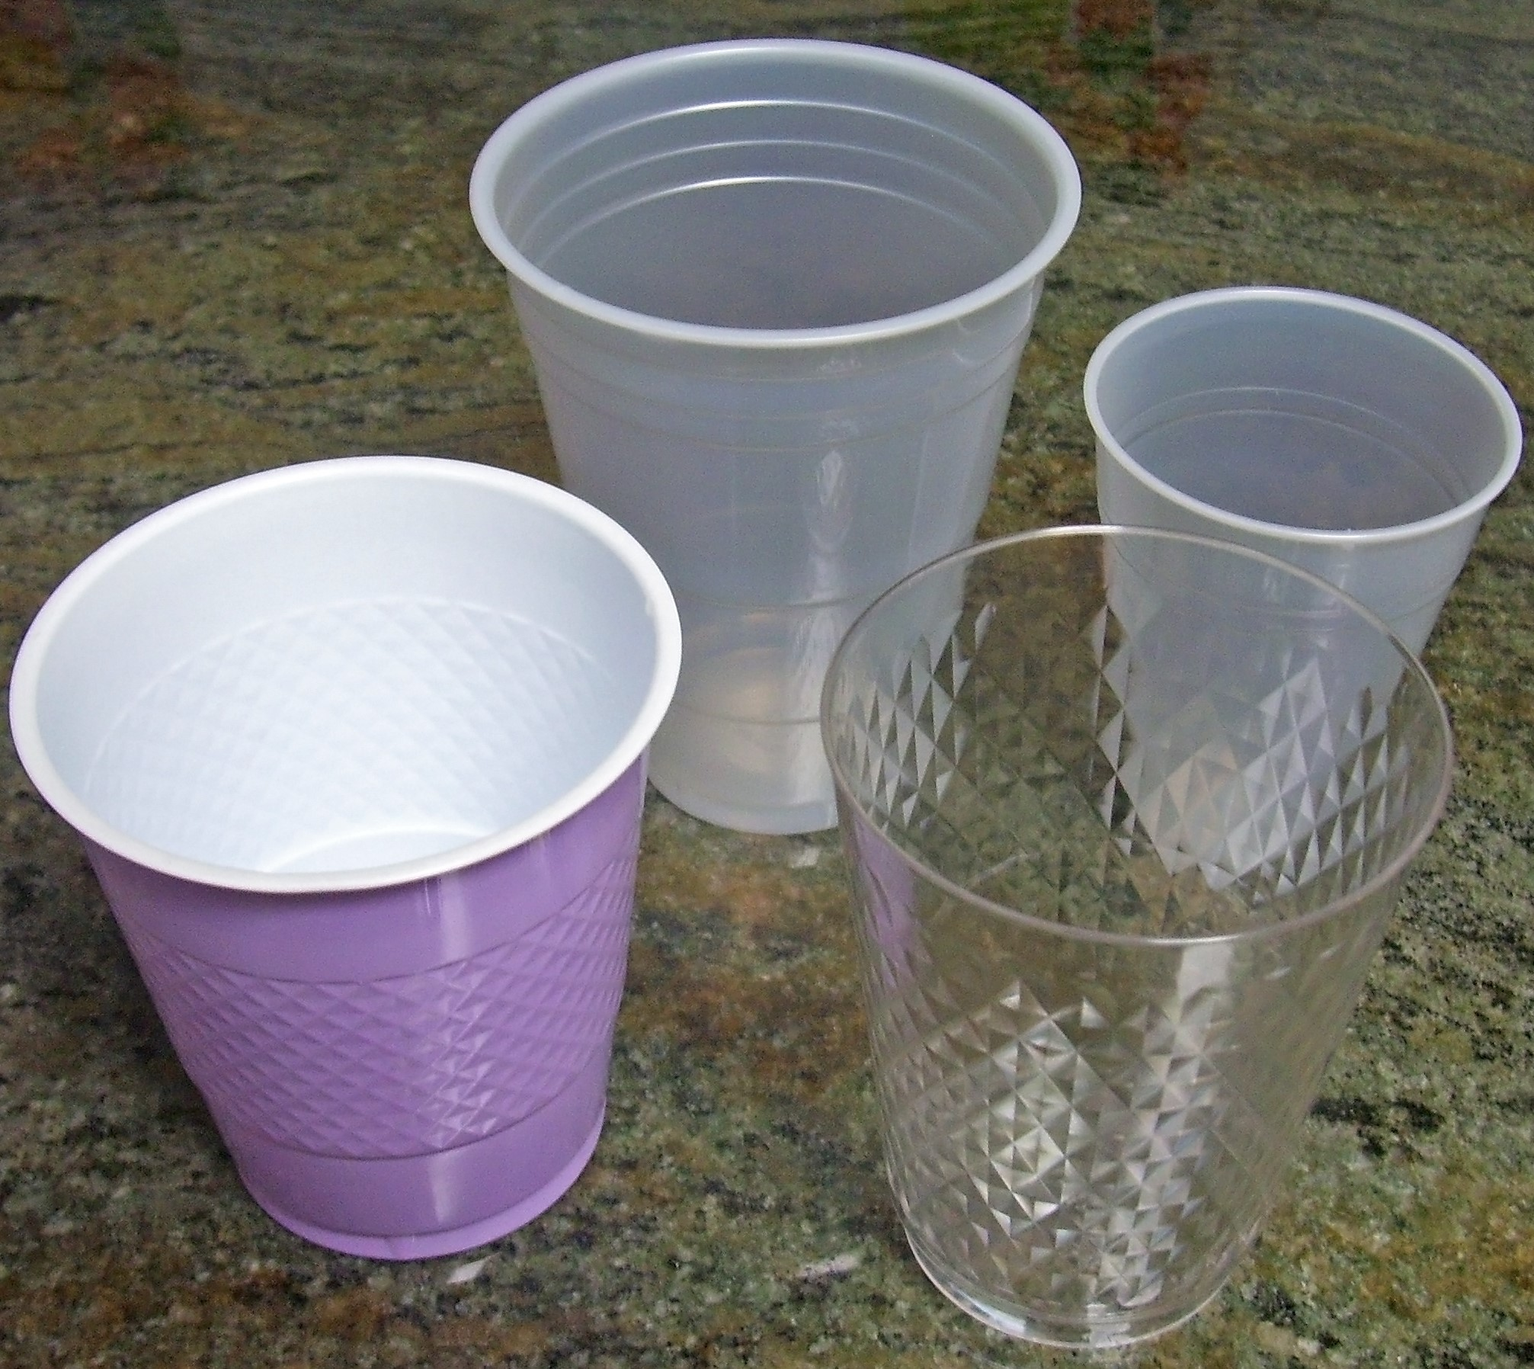
§7.4.2 Journal Entry
Writing: Describe Using Logic Structures
Write about the cups
Use > 4 logic structures
Ref: Images from
https://commons.wikimedia.org

