Slide 1
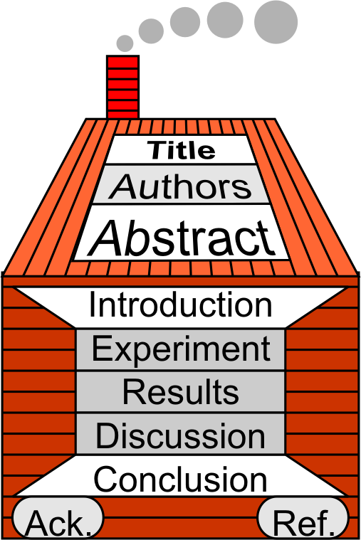
§7.5 The Results Section
Keywords

Slide 2
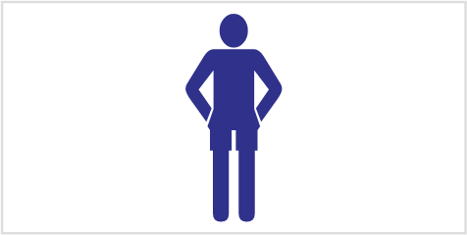
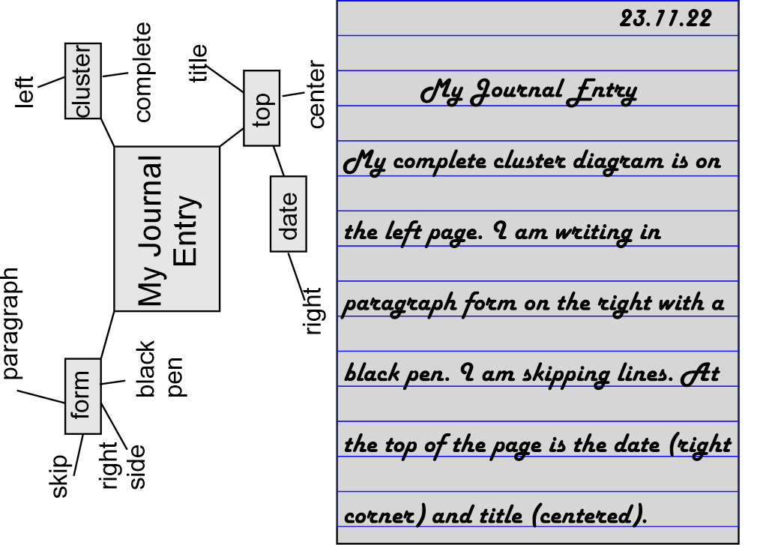

1 Journal Entry
My favorite leisure activity
Tell me about your favorite leisure activity.
  What is it?
  Why do you like it?

Slide 3

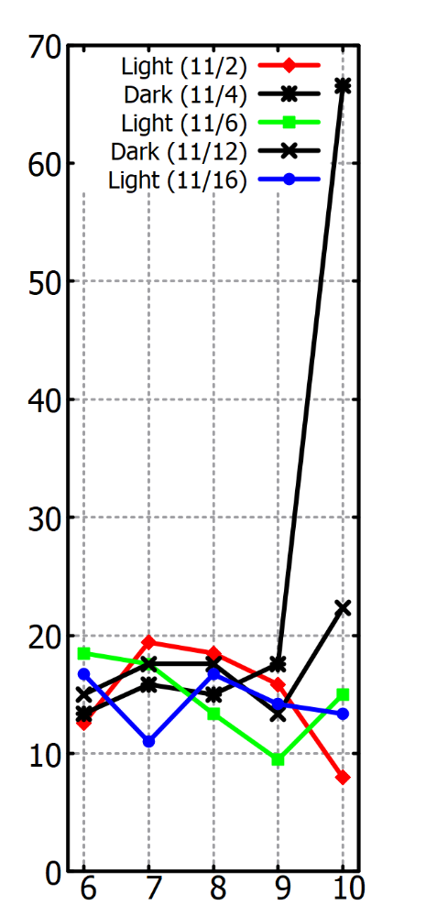
2 Purpose & Content
Figure [fig-yer] (noun):
  Graph
  Table
  Schematic
  Picture
Puzzle [puhz-uhl] (noun):
  A game, toy, or problem requiring ingenuity to solve.
  E.g. a picture divided into 1000 pieces

Slide 4

2 Purpose & Content
Objective: Present your Findings

Slide 5
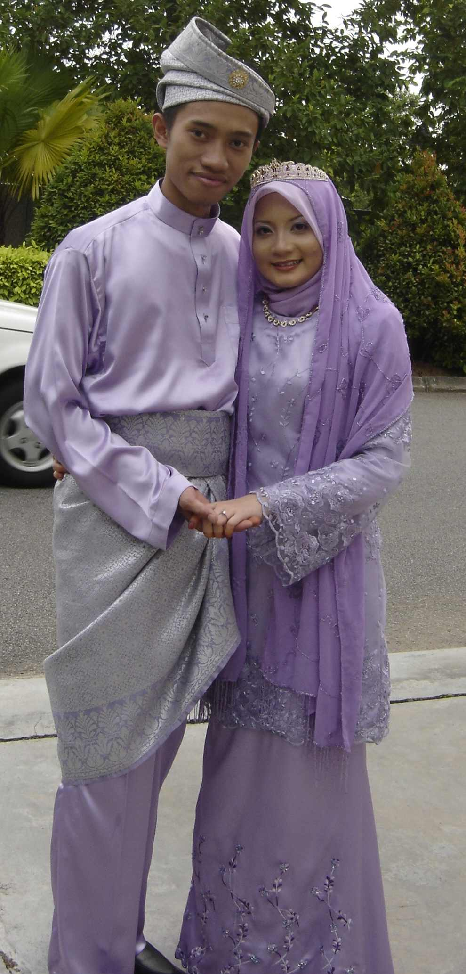
2 Purpose & Content
Contents: Figures + Text
Figures: the bride
Text: the groom
Different Roles
Focus is on the bride
But the groom must be there

Slide 6
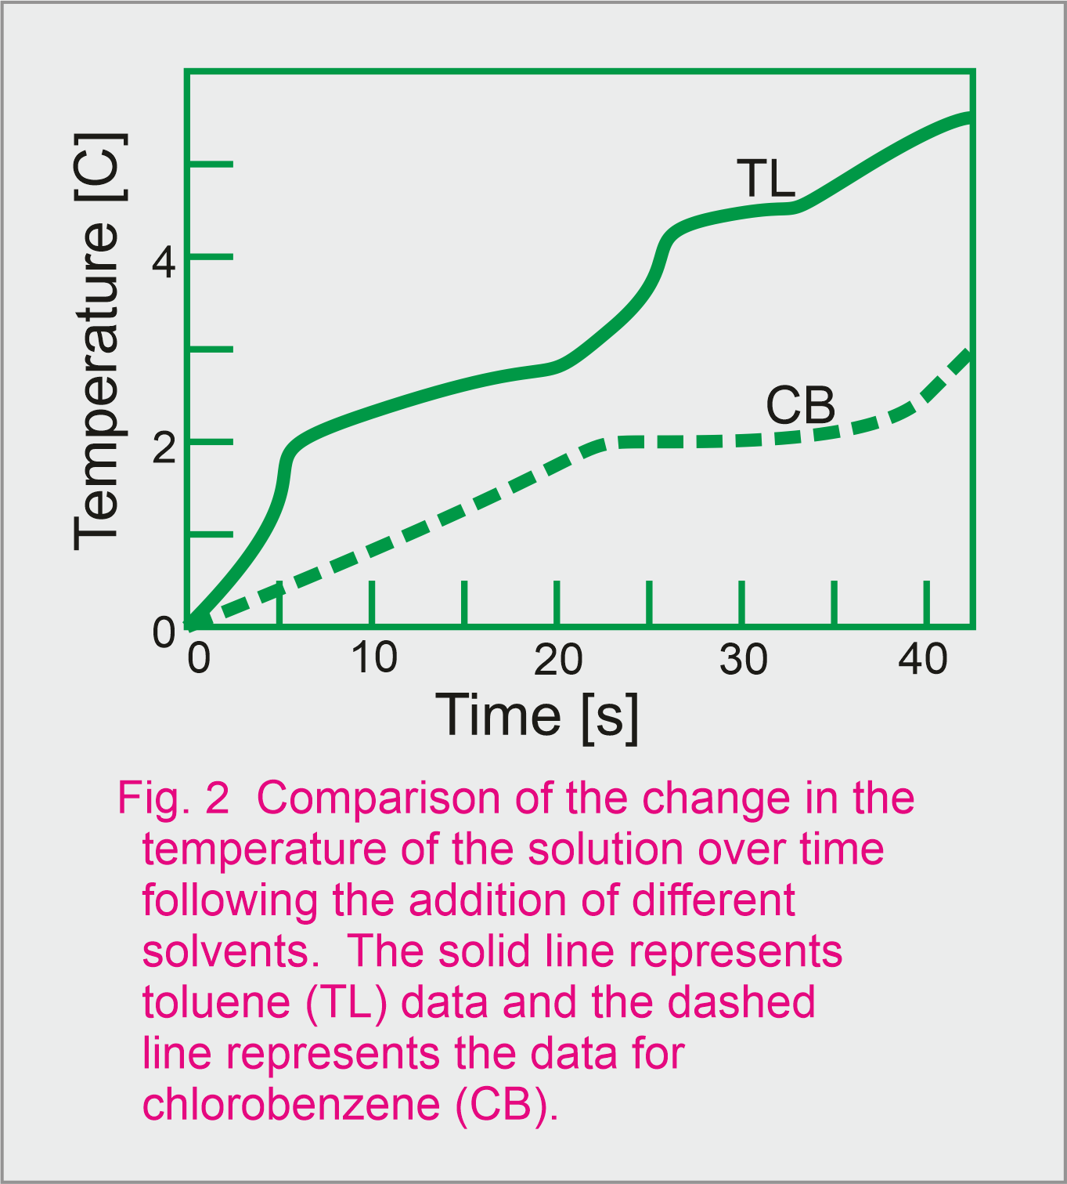
3 Figures: The Bride
Visually present key results
Created before text
Independent of text
Consistent in format
Includes
- Artwork
- Labels
- Captions

Slide 7
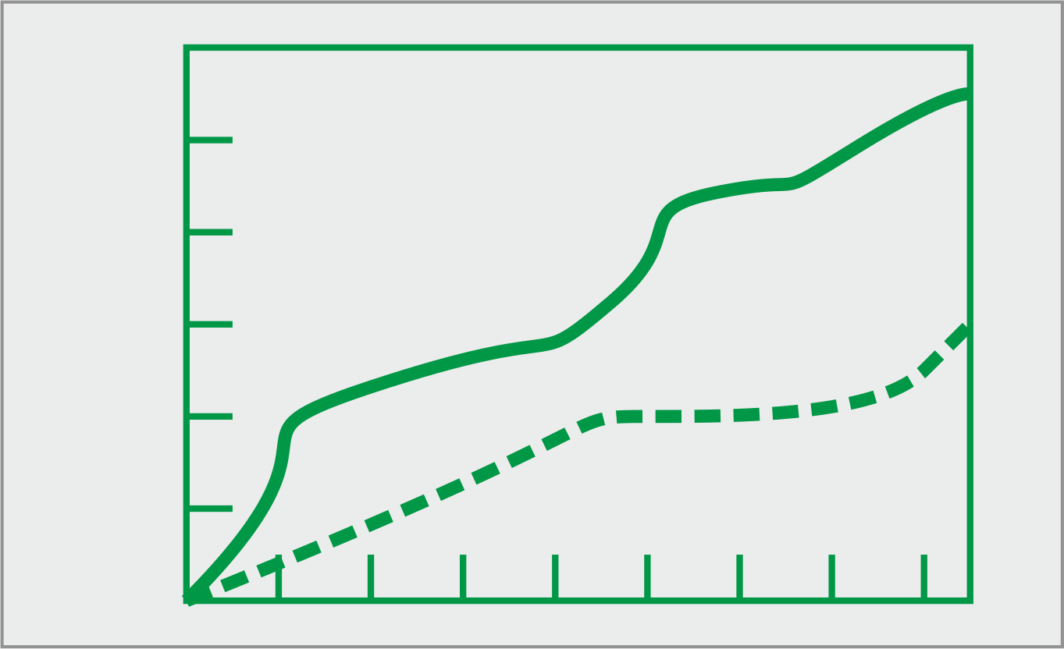
3 Figures: The Bride
Artwork
Sized as will appear in journal
Lines thick enough to reproduce
Labels (a) and (b) part of artwork
Colour avoided.

Slide 8
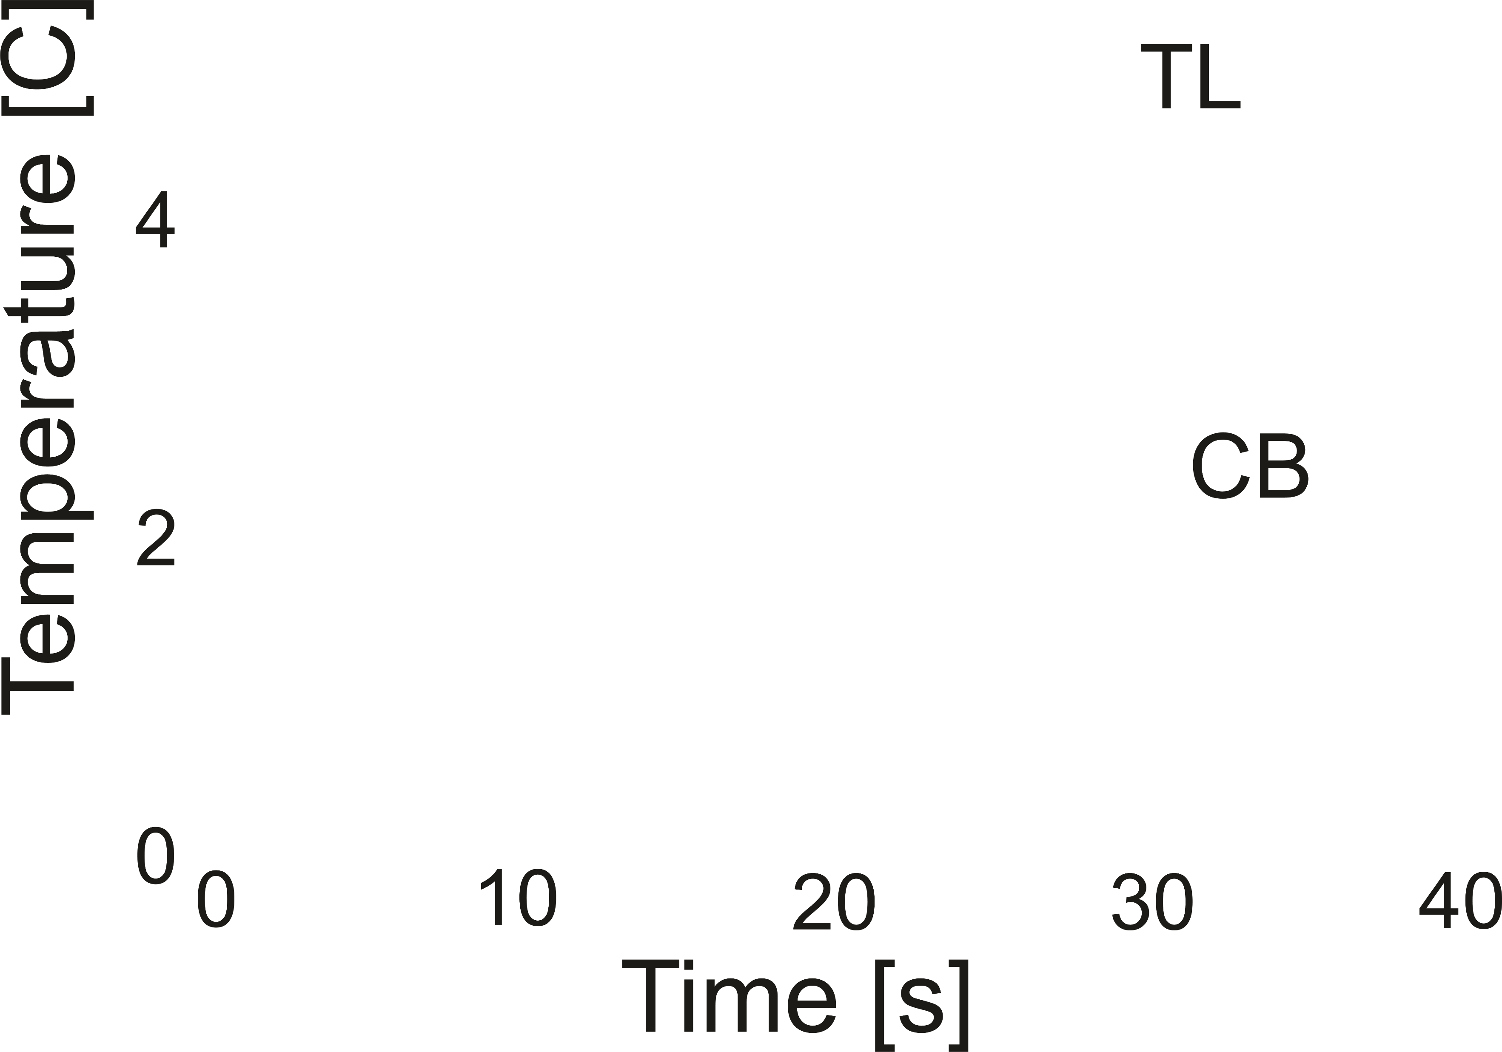
3 Figures: The Bride
Labels
Clear, Legible
  8 point font required
  10 or 12 point font better
Words not Symbols
  “Hole Mobility” not “µh”
  Time not t
Abbreviations avoided.
  If required, define in caption
Units in Parenthesis with SI prefixes
  “[kA/m] or [mA/m]” not “[A/m]/1000”
Correct Spelling!
Black (Usually)

Slide 9
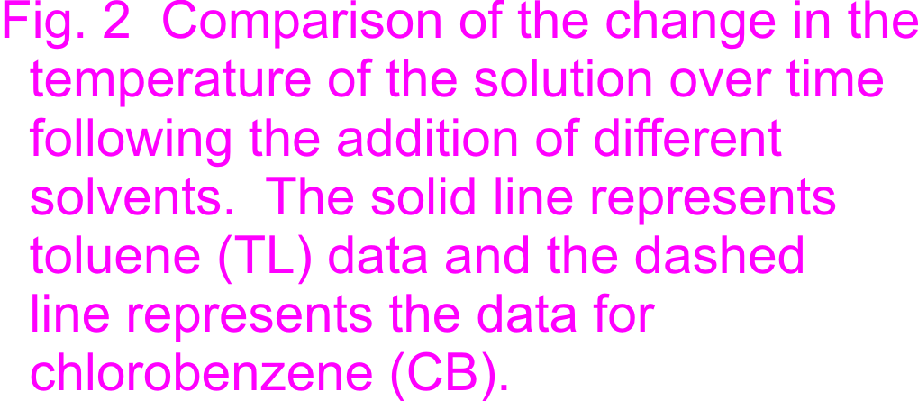
3 Figures: The Bride
Captions
Concise: no long discussion
Complete: enough info to understand results
Abbreviations defined

Slide 10
3 Figures: The Bride
Captions
Fig. 4 Summary of the field dependent hole mobilities
plotted as a function of the square of the electric field.
Chlorobenzene (CB) spin cast mobilities are indicated
by the dashed line, while the toluene (TL) spin cast
films by solid line.
The Time of Flight (TOF) technique
was used for all measurements.
What information is being presented
Definitions of symbols and abbreviations
Highlight the measurement techniques used (important for interpretation of this data)

Slide 11
4/5 Planning
Figures First
⸪ Figures present the key results and are the bride
⸫ Figures should be prepared first.
What results are important enough to have a figure?
What results will benefit from a figure?
  E.g., A Yes/No question does not need its own pie chart?
  Can just mention in text.
How does this figure support the hypothesis?
Papers generally have ~4 figures

Slide 12
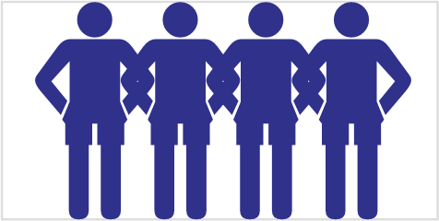
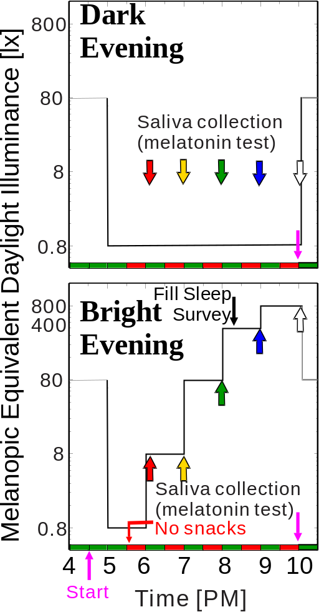
4/5 Planning
Final Research Paper
Decide which results require a figures

Slide 13
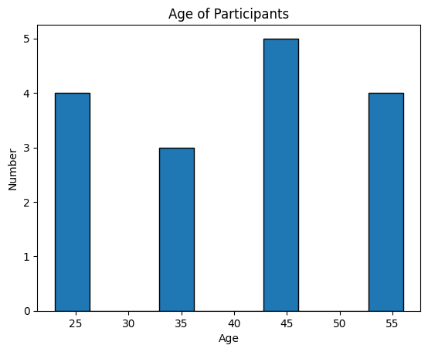
4/5 Planning
Choosing the Figure Type
Histogram [his-tuh-gram] (noun)
Microsoft Co-Pilot Generated

Slide 14
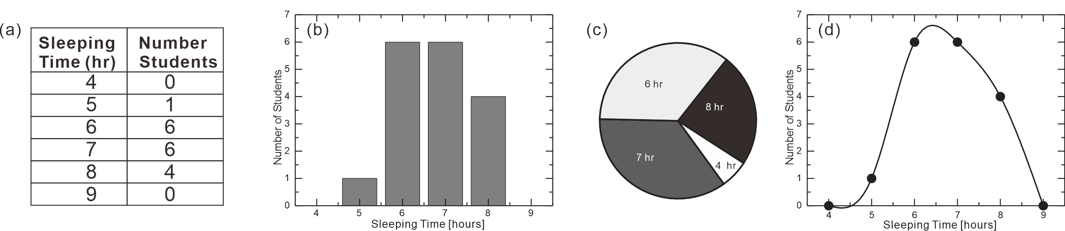
4/5 Planning
Choosing the Figure Type
Many different types of figures
Each type allows a different emphasis
Choose the best type for your story
E.g., How many hours do you sleep every night?

Slide 15
4/5 Planning
Choosing the Figure Type
Group Leader → assign one figure to each member
Decide the type of figure most suitable to present your results
Draw the figure in the box (§7.5.5)
Write a caption.
Types of Figures
  Pie chart
  Table
  Schematic
  Picture
  Graphs
Graphs
  Scatter
  Line
  XY
  Radial
  3D

Slide 16
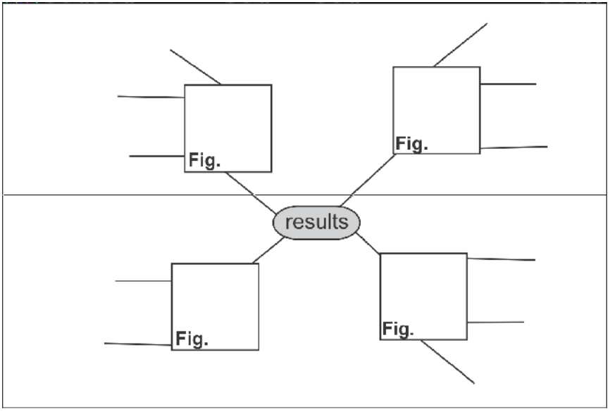
4/5 Planning
Choosing the Figure Type
Have each member present their work
Discuss
Copy sketches of the figures into the results section cluster diagram (§7.5.4 Fig 7.12)

Slide 17
6 Text: The Groom
1. Locate the figures
Voice
  Active
  Passive
Verb Tense: Present
Figure 1 illustrates the
relationship between light
intensity and cell activity.
The relationship between
Light intensity and cell
activity is illustrated in Fig.1.

Slide 18
6 Text: The Groom
2. Present the findings
Verb Tense: simple past
But a few engineering journals use present tense.
At low excitation powers, cell
activity was linearly
dependent on light intensity.

Slide 19
4 Text: The Groom
1+2 Locating + presenting
Cell activity was found to be
linearly dependent on light
intensity over a wide range
(Fig.1)

Slide 20
6 Text: The Groom
3. Comment briefly
To generalize the result
To explain possible reasons
To compare briefly with published results
Verb tense:
  Published results: Past
  Explanation: Present

Slide 21
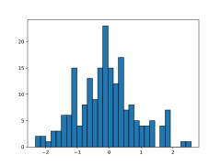
6 Text: The Groom
4. For Example…
Figure 1 is a histogram of the age at which students in the survey first made use of the internet.
The average age at which students first accessed the internet was 17.4 years old. The distribution was non-symmetric with a considerable variation between students (σ=3.6).
Comment Present Locate
This variation is likely due to the diverse backgrounds of students before entering university and the fact that once a student arrives at university, he/she obtained internet access.

Slide 22
6 Text: The Groom
5. Present Multiple Findings (1 figure)
An alternating pattern
A sequential pattern
void alternate(struct Figure fig) {
fprintf(fig.location);
for (i=1; i<=nfind; i++){
fprintf(fig.finding[i]);
fprintf(fig.comment[i]));
}
}

Slide 23
6 Text: The Groom
5. Present Multiple Findings (1 figure)
An alternating pattern
A sequential pattern
Choice of method
depends on correlation
void sequential(struct Figure fig){
fprintf(fig.location);
for (i=1; i<=nfind; i++)
fprintf(fig.finding [ifind]);
for (i=1; i<=nfind; i++)
fprintf(fig.comment[i]));
}

Slide 24
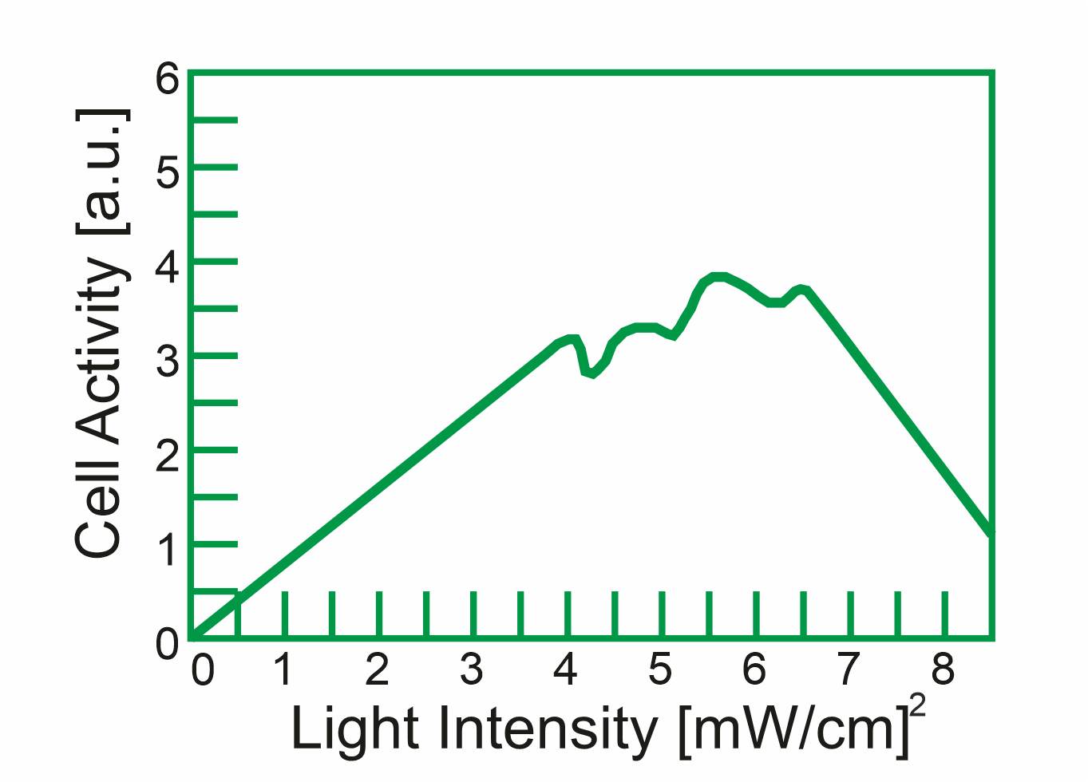
6 Text: The Groom
5. Present Multiple Findings: Alternatively
At low excitation powers, cell activity
was linearly dependent on light intensity.
This was likely due to the fact that at low
light levels there was insufficient light to
allow efficient operation.
At moderate levels of light intensity, no clear correlation was observed. The cell most likely has as much light as it can use and some other factor dominates cell activity.
At high light levels, the cell activity decreased rapidly. This was a result of the light killing the cells.

Slide 25
6 Text: The Groom
5. Present Multiple Findings: Alternatively
At low excitation powers, cell activity was linearly dependent on light intensity.
At moderate levels of light intensity, no clear correlation was observed.
At high light levels, the cell activity decreased rapidly.
This was likely due to the fact that at low light levels there was insufficient light to allow efficient operation, at moderate levels, the cell has as much light as it can use. At high power levels, the light killed the cells.

Slide 26
4 Text: The Groom
Summary
Locate the Figure (present tense)
Present the Findings (simple past tense)
Briefly Comment (tense comment dependent)
Multiple Results from One Figure
  Alternating pattern
  Sequential pattern
Decide based on correlation

Slide 27
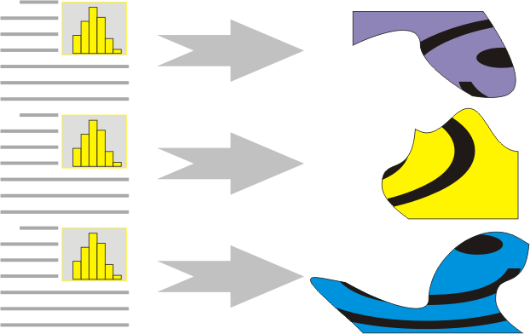
6 Text: The Groom
Summary

Slide 28
6 Text: The Groom
Final Research Paper
For the figure you created…
Write Sentences to
  1 Sentence to locate the figure
  A few sentences to present the results
  A few sentences to briefly comment
Based on the correlation, decide the order

Slide 29
4 Text: The Groom
Final Research Paper
Each Member should introduce their work
Listen as others introduce their work.
  Is their format correct?
  Did they use correct verb tenses?
  Are they missing any key point?
Add to complete cluster diagram of this section (§7.5.4 Fig 7.12)

Slide 30

5 Music and Culture

Slide 31

6 Homework & Assignments
Group Project
(Individual) Complete the figure (including caption) that your group leader has assigned. Send it to the group leader to include in linear outline at the end of the linear outline file.
(Group) Complete the linear outline to include the results section with figures and figure captions at the end.

Slide 32




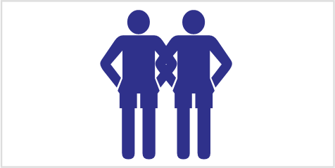




Blank Slide

