Slide 1
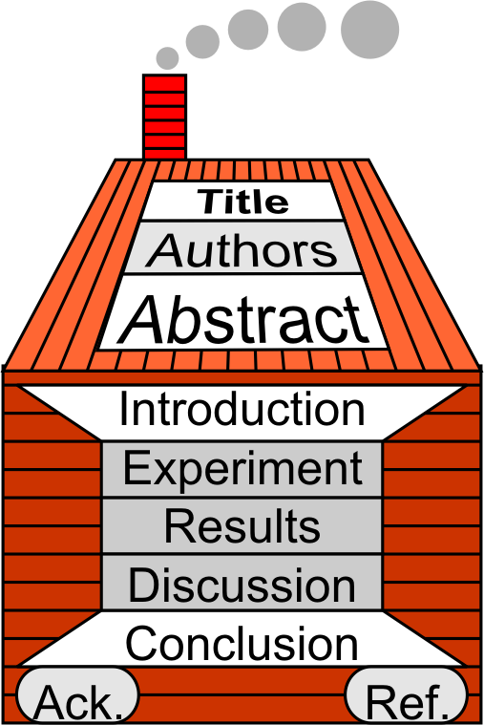

§7.6 Discussion Section
Keywords
https://uminntilt.files.wordpress.com/2013/09/discussion-wordle.png

Slide 2

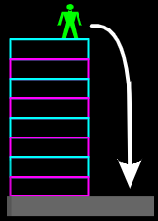

1 Journal Entry
Results Section
Write the results section of a paper.
Experiment: To test the theory of gravity, by dropping object from high building
Remember the components of the results section and who is the bride!

Slide 3

2 Key Elements
Listen to the Talk

Slide 4

2 Key Elements
Objective:
interpret results
support conclusions
Using…
  evidence from your experiment
  generally accepted knowledge
  other research results
Image generated using Co-pilot

Slide 5
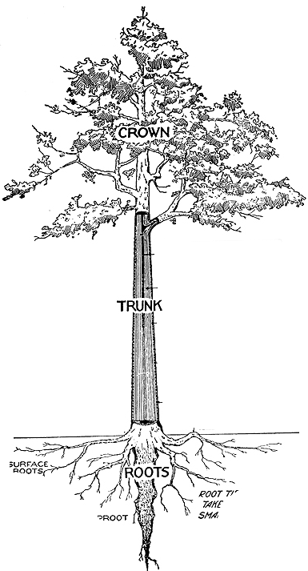
2 Key Elements
Overview (Macro)
Interpret results wrt your thesis
Interpret results wrt related studies.
Bring together everything → complete picture
Focus on Underlying Mechanisms
Limitations
Alt. Conclusions
Future Experiments

Slide 6





Jigsaw Puzzle Analogy
Results
+ References:
Missing
Piece

Slide 7
2 Key Elements
Verb Tense (Micro)
Whose work?
wrt your work: present
wrt others’ work: past
wrt accepted facts: present
?

Slide 8

2 Key Elements
: Group Project Discussion Section
Create cluster diagram or linear outline for discussion section:
Discuss your results as a whole.
Agree on some general statements
Argue for your conclusions
Write a short discussion section in your workbook based on the group discussion.

Slide 9

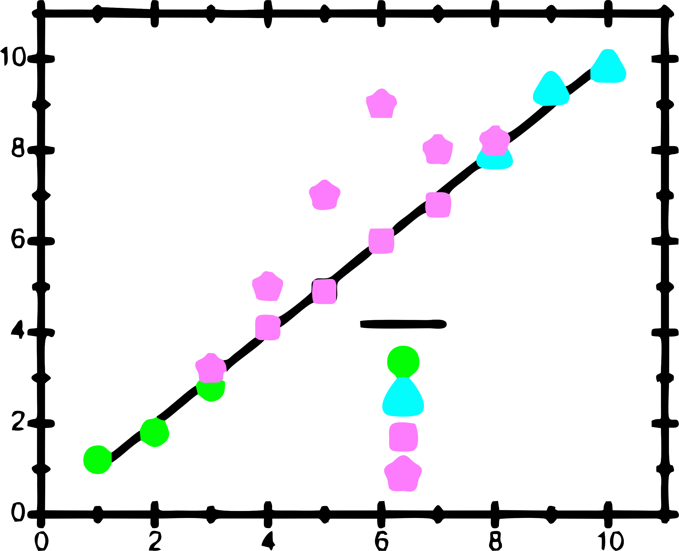
3 Six “Must Sees”
: Six Do’s
Interpret your results (mechanisms)
Emphasize new & unexpected results
Incorporate other’s results
Consider alternative explanations
Suggest future research directions
Be creative.
Velocity [m/s]
Theory
Ref. 1
Ref. 2
This work :(
This work :)
Electric Field [V/m]

Slide 10

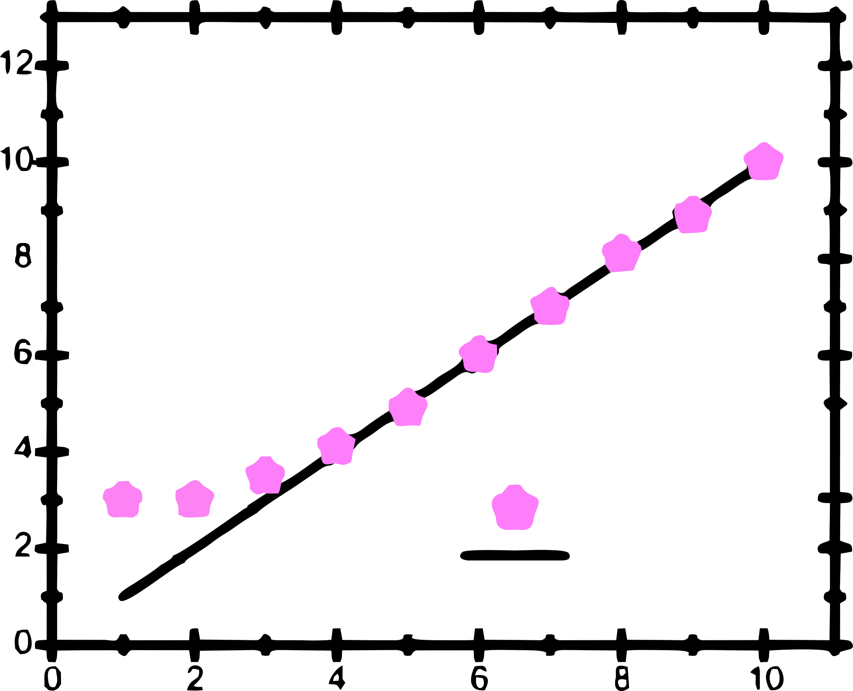
4 Four Common Errors
: Four Don’ts
Say “the data agreed with theory.”
Ignore results that don’t fit
Neglect areas your work confirms others
Repeat the results section.
Current [A]
Experiment
Ohm’s Law
Voltage [V]

Slide 11

4 Homework & Assignments
Continuing your Research Paper
(group) Complete Linear Outline of the discussion section
Do you need additional graphs?
(all) Bring a research paper in your field authored by a native English speaker to class next week.(i.e. not a paper by 白大明 or 白い小さな)

Slide 12









Blank Slide

