Slide 1
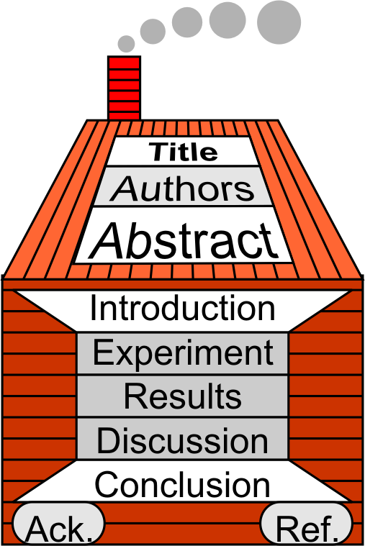

§7.7 Conclusion & Acknowledgments
Keywords
https://www.vecteezy.com/free-vector/the-end

Slide 2

1 Elements of the Conclusion
Sample Linear Outline
Summarize Results
Restate Thesis
Suggest Application
Summary
  Point A
  Point B
  Point C
Hypothesis
Application
  Idea A
  Idea B
Point A
Point B
Hypothesis
Summary
Conclusion
Point C
Idea B
Application
Idea A

Slide 3


1 Elements of the Conclusion
Project Conclusion
Point A
Point B
(macro) Decide on points to include in conclusions. (cluster diagram)
Order your points
(micro) Convert to Sentences
Hypothesis
Summary
Conclusion
Point C
Idea B
Application
Idea A

Slide 4

2 Mistakes in a Conclusion
New ideas
Citations
Summary
  Point A
  Point B (New Idea)
  Point C [Wang, 2024]
Hypothesis
Application
  Idea 1
  Idea 2

Slide 5
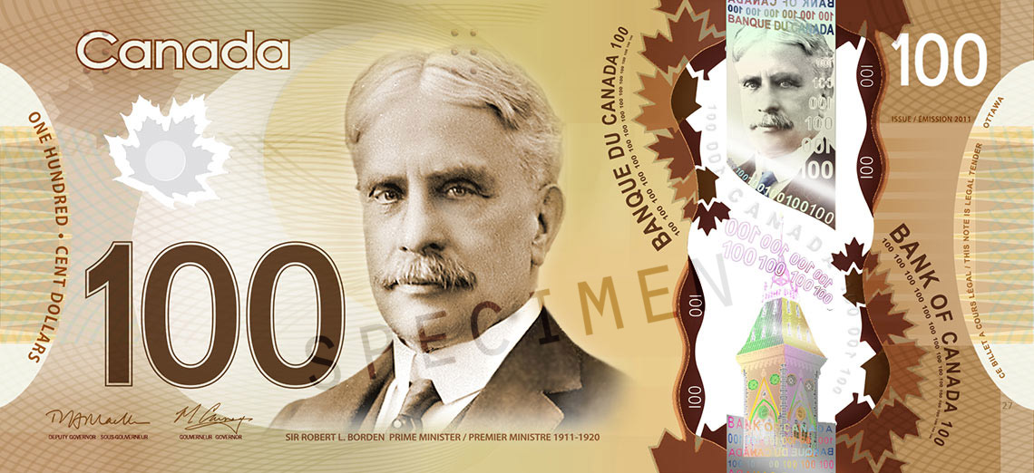
3 Acknowledgments
1. Sources of Funding
Ref: Bank of Canada

Slide 6

3 Acknowledgments
2. Colleagues who helped

Slide 7
3 Acknowledgments
3. Conflicts of Interest
If the conclusion is “Drinking one can of Taiwan Beer and Smoking six cigarettes daily reduces the chance of Parkinson’s disease.”
You must acknowledge that “The author owns shares in the Taiwan Tobacco and Liquor Corp.”
(It may bias your results.)

Slide 8
3 Acknowledgments
4. Division of Labor
Lestron provided the conceptual framework
Hank prepared the Survey Questions
Johnny analyzed the data and created all figures
Michael wrote the final draft
Donna provided overall supervision

Slide 9
3 Acknowledgments
Final Report: Decide on Division of Labor Statement
Agree on the Division of Labor for your Research Paper

Slide 10

4 Music & Culture Appreciation

Slide 11


5 Homework & Assignments
Complete an ordered cluster diagram for the conclusion and acknowledgments sections
Convert the discussion section into sentences
(all) Bring a research paper authored by a native English speaker to class next week. (i.e., not a paper by 白小明, or Hirohito Yamaguchi)
It should be related to your final project
Hint: Find paper on https://scholar.google.com

Slide 12

4 Homework & Assignments
Take Home Test / Assignment
The Final Due date for the Research Paper 7 days after the last exam.
This includes…
  Cluster Diagram
  Complete Linear Outline
  Complete Paper
  Cover Letter

