Slide 1
§7.8 Abstract

Slide 2







Activity_2Panes
For the case in which we need two sides
Tell me your ideas on improving this course for next year’s students.
What parts did you find most useful?

Slide 3

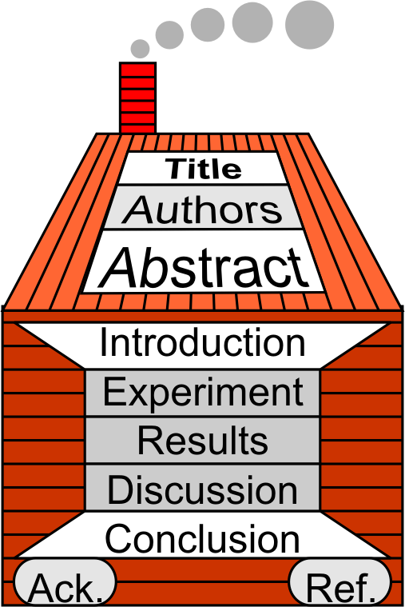
2 Its Role and Structure
Role and Importance
Objective: Gateway
  Point to Significant Results
  Provide a Gateway
Importance for Editor
  “Is it suitable for this journal?”
  “Is it worth sending to referees?’
  “Which referees?”
Importance for Readers
  Will they find your abstract?
  Will they look for your paper?
  Will they read your paper?

Slide 4

2 Its Role and Structure
Structure: Shaped Like a Pretty Girl

Slide 5
2 Its Role and Structure
Structure: Shaped Like a Pretty Girl
Draw the Reader In (1 sentence)
Why are you doing this? (1 sentence)
What did you do? (1 or 2 sentences)
What did your find out? (2 or 3)
What does this tell me? (1 or 2)
So what? (1)

Slide 6
2 Its Role and Structure
Verb Tenses
Present
Past or present perfect
Past
Past
Universal (Present)
Present tentative

Slide 7
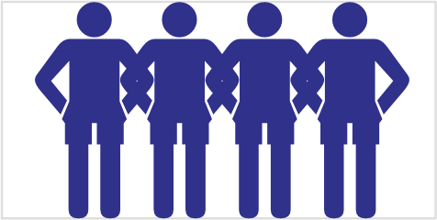
2 Its Role and Structure
Review a Published Abstract
Find another student with similar research interests.
Read a published paper’s abstract together.
Determine each sentence’s function
Prepare to introduce to class

Slide 8
3 Does & Don’ts
You must…
Demonstrate your findings are important.
Prove the study was carefully done.
State objectives clearly & concisely.
KISS
Include all key information.
Include terms to identify your work.
… in <150 words!

Slide 9
3 Does & Don’ts
You must not (Common Mistakes to Avoid)
Use the same sentences as the paper.
Include citations (i.e. Reference your points) [1]
Write: “In this paper”.
Provide a general motivation.
Use mathematical expressions.

Slide 10
4 Following a Recipe
Demonstration
Write down section names
Write sentences from your paper
Remove section names
Improve flow
Remove acronyms
Do something else

Slide 11
4 Following a Recipe
1. Write down section names
Background
Purpose
Method
Results
Conclusion
Implication

Slide 12
4 Following a Recipe
2. Write sentences from your paper
Background | It is generally accepted that the solvent used to spin a polymer thin film determines photoluminescence (PL) and that this PL is a good indicator of charge transport (CT) properties.
Purpose | To determine the relationship between photoluminescence (PL) and charge transport (CT) in MEH-PPV.
Method | Local PL, CT and topography of homogeneous, high optical quality films produced from MEH-PPV well dissolved in TL and CB were measured by means of TrEL, NSOM and SFM under vacuum conditions.
Results | Films exhibited identical, spatially invariant, far and near-field PL spectra without bright or dark spots. Topographically, films were featureless. CT; however, differed between films by an order of magnitude.
Conclusion | Morphologies dictating CT are different from those determining optical properties. It is proposed that differing orientation of small aggregated regions affects CT but not PL.
Implication | Optical and surface homogeneity are necessary but not sufficient conditions for good devices

Slide 13
4 Following a Recipe
3. Remove section names
It is generally accepted that the solvent used to spin a polymer thin film determines photoluminescence (PL) and that this PL is a good indicator of charge transport (CT) properties.
To determine the relationship between photoluminescence (PL) and charge transport (CT) in MEH-PPV.
Local PL, CT and topography of homogeneous, high optical quality films produced from MEH-PPV well dissolved in TL and CB were measured by means of TrEL, NSOM and SFM under vacuum conditions.
Films exhibited identical, spatially invariant, far and near-field PL spectra without bright or dark spots. Topographically, films were featureless. CT; however, differed between films by an order of magnitude.
Morphologies dictating CT are different from those determining optical properties. It is proposed that differing orientation of small aggregated regions affects CT but not PL.
Optical and surface homogeneity are necessary but not sufficient conditions for good devices

Slide 14
4 Following a Recipe
3. Remove section names
It is generally accepted that the solvent used to spin a polymer thin film
determines photoluminescence (PL) and that this PL is a good indicator
of charge transport (CT) properties. To determine the relationship
between photoluminescence (PL) and charge transport (CT) in
MEH-PPV. Local PL, CT and topography of homogeneous, high optical
quality films produced from MEH-PPV well dissolved in TL and CB
were measured by means of TrEL, NSOM and SFM under vacuum
conditions. Films exhibited identical, spatially invariant, far and
near-field PL spectra without bright or dark spots. Topographically,
films were featureless. CT; however, differed between films by an order
of magnitude. Morphologies dictating CT are different from those
determining optical properties. It is proposed that differing orientation
of small aggregated regions affects CT but not PL. Optical and surface
homogeneity are necessary but not sufficient conditions for good devices.

Slide 15
4 Following a Recipe
4. Improve flow
It is generally accepted that the solvent used to spin a polymer thin film
determines photoluminescence (PL) and that this PL is a good indicator of
charge transport (CT) properties. To determine the relationship between
photoluminescence (PL) and charge transport (CT) in MEH-PPV, local PL,
CT and topography of homogeneous, high optical quality films produced
from MEH-PPV well dissolved in TL and CB were measured by means of
TrEL, NSOM and SFM under vacuum conditions. Films exhibited
identical, spatially invariant, far and near-field PL spectra without bright or
dark spots. Topographically, films were featureless. CT; however, differed
between films by an order of magnitude suggesting that morphologies
dictating CT are different from those determining optical properties. It is
proposed that differing orientation of small aggregated regions affects CT
but not PL. This implies that optical and surface homogeneity are necessary
but not sufficient conditions for good devices.

Slide 16
4 Following a Recipe
5. Remove acronyms
It is generally accepted that the solvent used to spin a polymer thin film
determines photoluminescence (PL) and that this PL is a good indicator of
charge transport (CT) properties. To determine the relationship between
photoluminescence (PL) and charge transport (CT) in poly[2-methoxy-5-
(2'-ethyl-hexyloxy)-1,4-phenylene vinylene] (MEH-PPV), local PL, CT and
topography of homogeneous, high optical quality films produced from
MEH-PPV well dissolved in toluene TL and chlorobenzene CB were measured
by means of transient electroluminescence TrEL, near field optical microscopy
NSOM and shear force microscopy SFM under vacuum conditions. Films
exhibited identical, spatially invariant, far and near-field PL spectra without
bright or dark spots. Topographically, films were featureless. charge transport
CT; however, differed between films by an order of magnitude suggesting that
morphologies dictating charge transport CT are different from those
determining optical properties. It is proposed that differing orientation of small
aggregated regions affects CT but not PL. This implies that optical and surface
homogeneity are necessary but not sufficient conditions for good devices.

Slide 17
4 Following a Recipe
6. Do something else
It is generally accepted that the solvent used to spin a polymer thin film
determines photoluminescence (PL) and that this PL is a good indicator of
charge transport properties. To determine the relationship between (PL) and
charge transport in poly[2-methoxy-5-(2'-ethyl-hexyloxy)-1,4-phenylene
vinylene] (MEH-PPV), local PL, CT and topography of homogeneous, high
optical quality films produced from MEH-PPV well dissolved in toluene and
chlorobenzene were measured by means of transient electroluminescence, near
field optical microscopy and shear force microscopy under vacuum conditions
. Films exhibited identical, spatially invariant, far and near-field PL spectra
without bright or dark spots. Topographically, films were featureless. Charge
transport; however, differed between films by an order of magnitude
Suggesting that morphologies dictating charge transport are different from
Those determining optical properties. It is proposed that differing orientation
of small aggregated regions affects CT but not PL. This implies that optical
and surface homogeneity are necessary but not sufficient conditions for good
devices.

Slide 18
4 Following a Recipe
Write the Abstract for Your Paper
Design 1 sentence for each part of the abstract.
Improve the flow.
Remove acronyms

Slide 19

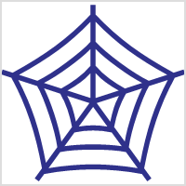
5 Homework & Assignments
Write the Abstract for Your Paper
Submit your completed research paper

Slide 20
1A_OnePane
Use for standard slides (not usually)

Slide 21

1B_OnePane_Icons
Vocabulary

Slide 22
2_TwoPanes_Compare

Slide 23
3_Title(NoPane)

Slide 24
Activity
Instruction for Activities

Slide 25

Activity
Homework

Slide 26
Activity
Assignments

Slide 27







Blank Slide

