Slide 1
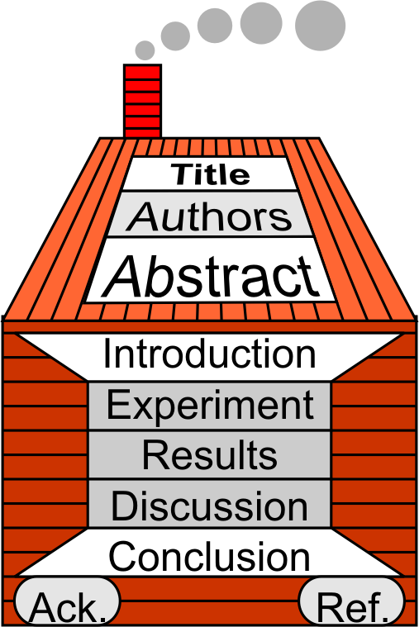
§7.9 Title, Cover, Final Edit
Keywords

Slide 2

1 Title
Choosing the Title
Taiwan Universities and STD
Concise
Understandable
Useful
Accurate
Descriptive
Eye catching
-Linux security tool?
-Sexually Transmitted
Disease (i.e. AIDS)?
-Sacred Theology
Doctorate?
-Short Term learning
Disability
Performance evaluation
of a new neural network
architecture

Slide 3



1 Title
Published Research Paper Title
Is the title…
  Concise
  Understandable
  Useful
  Descriptive
  Eye catching?
What is good?
How can it be improved?
Insights into the photo-physics of single luminescent conjugated polymers of PPV derivatives using single molecule techniques
Luminescent conjugated polymer photo-physics investigated using single molecule spectroscopy

Slide 4

1 Title
Look at your Published Research Paper
Is the title…
  Concise
  Understandable
  Useful
  Descriptive
  Eye catching?
What is good?
How can it be improved?

Slide 5

2 Homework
Homework
Choose a title for your research paper.

Slide 6
3 Cover letter
Writing the Cover Letter
Format: formal letter
Required contents
  Title of paper
  Author Names
  Journal
  Submission Type(letter || full length)
Journal dependent
  Suggested referees
  Suggested non-referees
  Reason submit to this journal
  Significance for this journal’s audience
  Author contributions: Who did what

Slide 7
2 Cover letter
Faculty of Engineering & Technology
Multimedia University
Jalan Ayer Keroh Lama
75450 Melaka University
Phone: +606-2523211
Fax:+606-2316552
E-mail: sychong@mmu.edu.my
Thursday, January 16, 2003
Xin Yao, Editor-in-Chief
IEEE Transactions on Evolutionary Computation
Dear Professor Yao:
Please find enclosed a copy of manuscript entitled “Observing the Evolution of Neural Networks Learning to Play the Game of Othello” by S.Y.Chong et al. that we would like to submit it for publication for IEEE Transactions on Evolutionary Computation. The work being submitted has not been published elsewhere nor is it currently under review by another publication.
Yours faithfully,
Siang Yew Chong
Enc
Sample

Slide 8
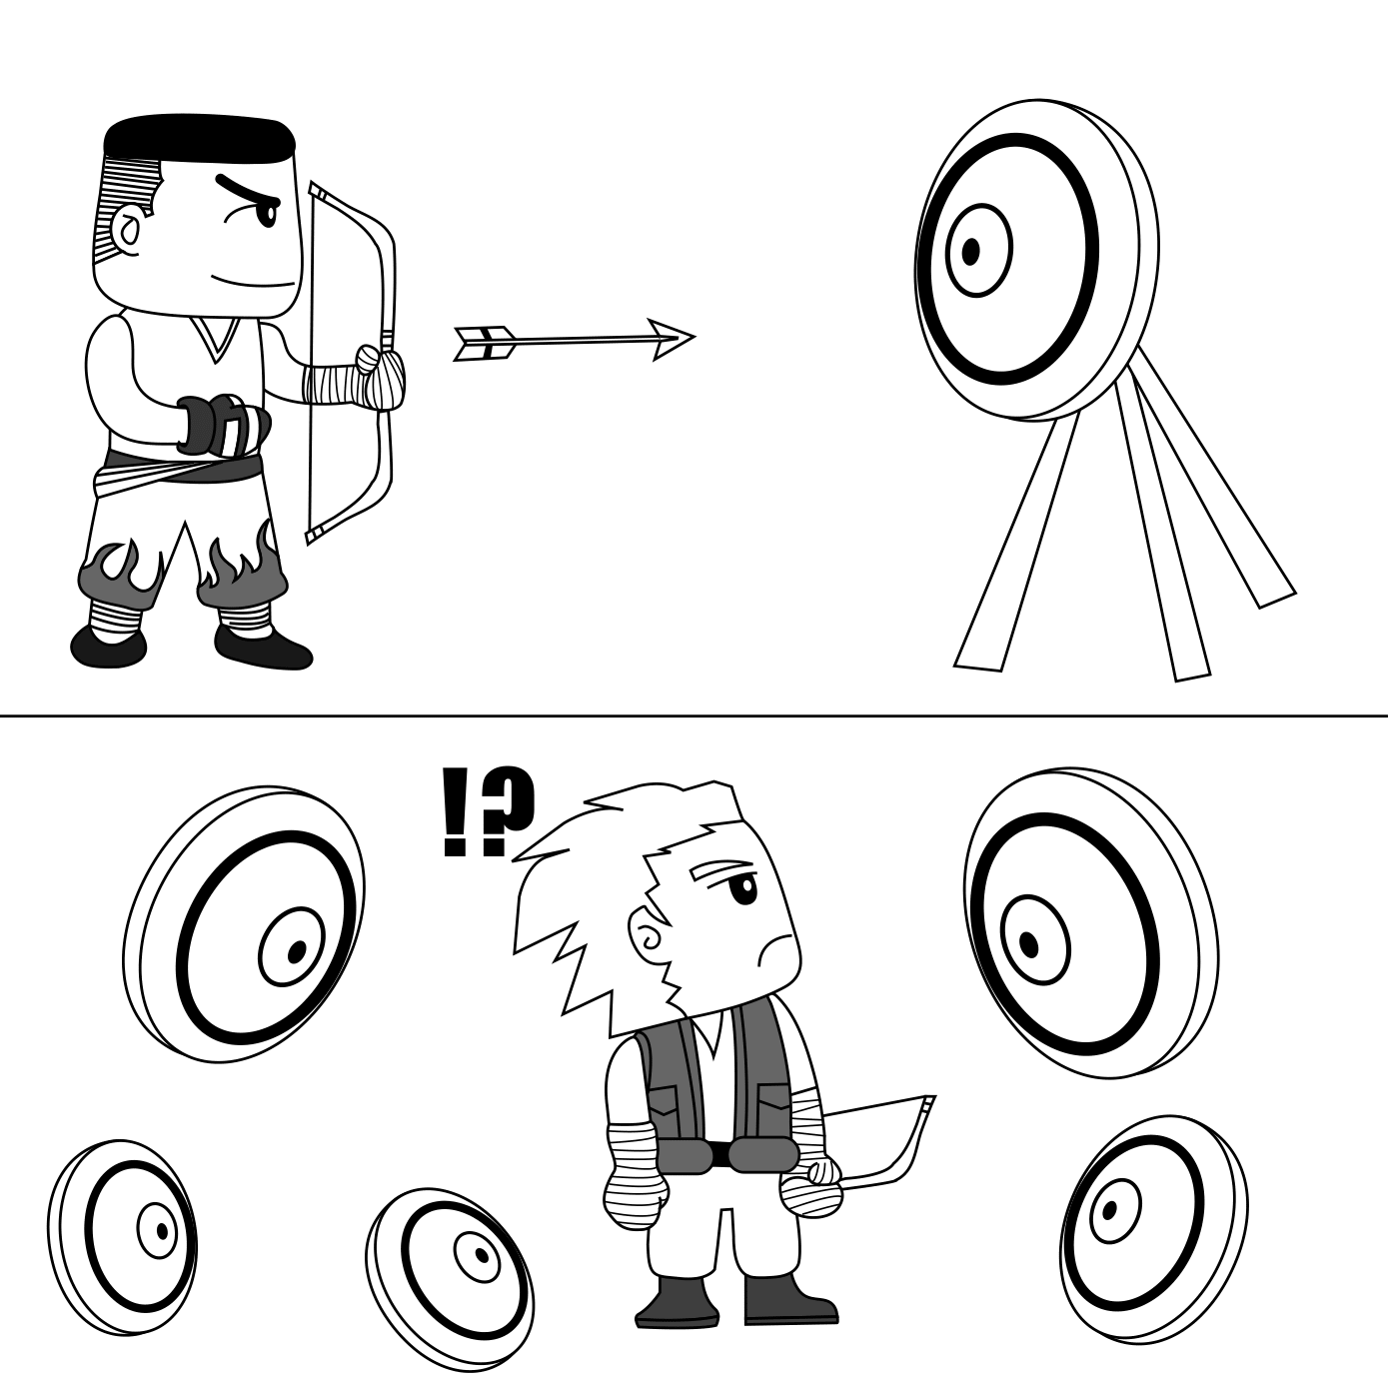
4 Final Editing
Questions for Research Papers (Macro)
Macro → Micro
Is the focus clear?
Is the paper focused?
Does it sound scientific?
Is the logic clear?
Is the evidence sufficient?

Slide 9
4 Final Editing
Questions for Research Papers (Micro)
Are there any undefined acronyms? → Define
Are any acronyms used only once? → Remove
Are the proper verb tenses used?
Universities in Taiwan have not been supportive of people with STD.
Universities in Taiwan have not been supportive of people with short term learning disabilities (STD).

Slide 10

4 Final Editing
Edit Your Research Paper
Use the Edit Checklist (§4.4)
Consider the additional concerns raised for scientific and engineering papers

Slide 11

5 Homework & Assignments
Homework
Finish editing your Research Paper

