Slide 1
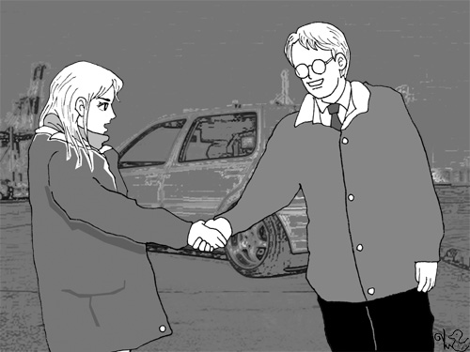
bo-§2.1 Overview
Basic Oral Skill Module

Slide 2


1. Objectives
To understand the teacher’s English
To carry on a short conversation (1:1) appropriate for a scientific conference reception
To learn how to
  Open conversations,
  Continue conversations,
  Invite
  Disagree
  Close conversations

Slide 3
2. Contents
Meeting People: Opening the communication channel
Continuing Conversations
Ending conversations
Conversation for Info
Invitations
Agreeing & Disagreeing
Logic & Debates
Brainstorming

Slide 4
3. Evaluation

Slide 5

4 Homework
Purchase and bring to class the textbook:
Bring Red, and Black Pens

