Slide 1
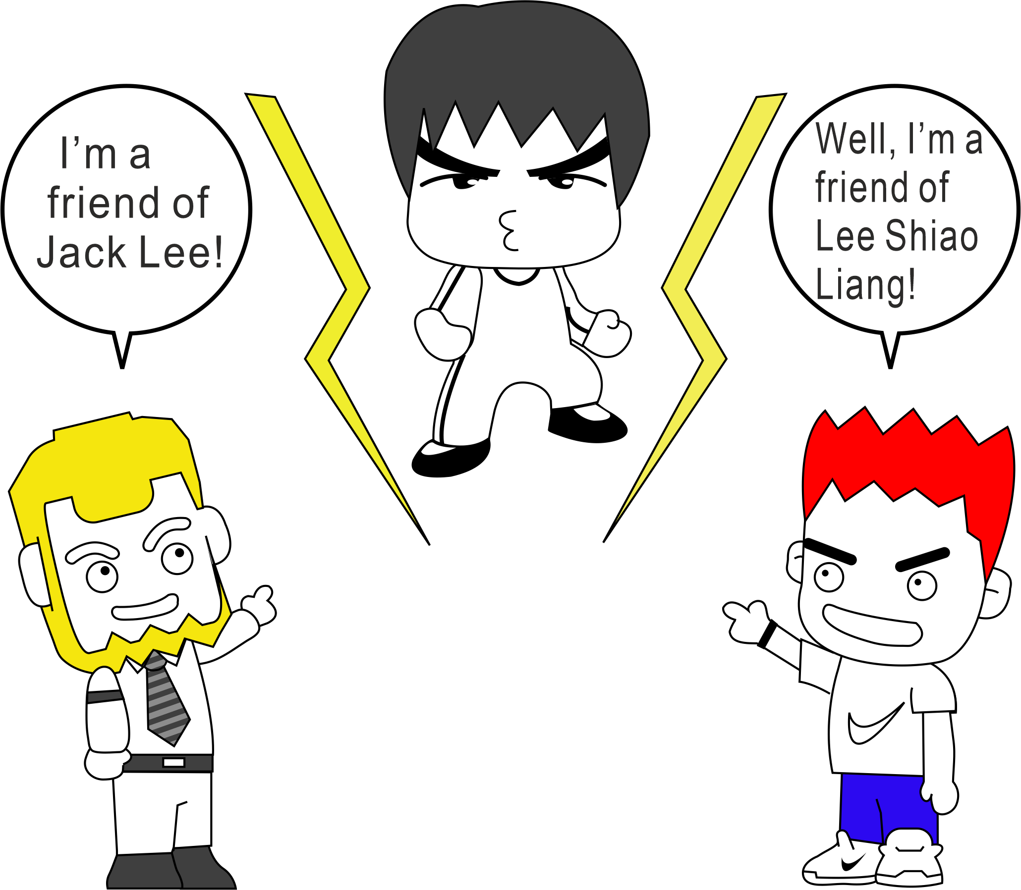
bo-§2.2 Opening Communication

Slide 2

1 Protocol
Protocol [proh-tuh-kawl]
  ftp: file transfer protocol
  http: hypertext transfer protocol
  https: hypertext transfer protocol secure
  ip: Internet protocol

Slide 3

1. Protocol
Protocols: Defined Way of Doing Something
E.g. ftp, http, https,
Opening
Information Transfer
Closing

Slide 4
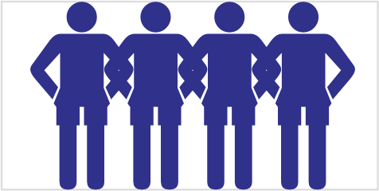
1. Protocol
Get up
Introduce yourself to 3 classmates (that you don’t know).
Sit down.

Slide 5
1. Protocol
Say your name
Repeat the 2 previous names.
Introduce the name of one of your new friends.

Slide 6

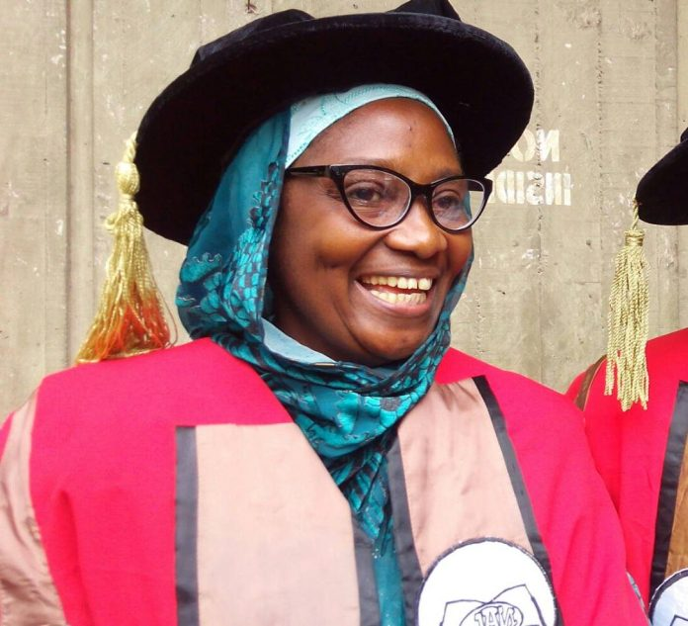
2. Addressing People in English
How would you address them?
Fill in the table in both your and your partner’s workbook.
I have a professor by the name of Musaddam Idrissa Musa. When I meet her on the road, I will address her as Professor Musa.
Musaddam Idrissa Musa, CC BY-SA 4.0 <https://creativecommons.org/licenses/by-sa/4.0>, via Wikimedia Commons

Slide 7
2. Addressing people in English
Using people’s names and titles
Listen to the teacher’s talk.
Check your answers.

Slide 8
2. Addressing people in English
Using people’s Names: Take Home Points
Relationship determines Formality
  Prof. Jonathon David White→ Prof. White, Jonathon, Jon, Sparky
  Mr. Lien Leon Joshua Donald White → Mr. White, Leon, LeeLee
Names not Relationship
  “Sharon thinks…” NOT “My wife thinks…”
  “Ask Deborah.” NOT “Ask your oldest sister.”
Role call: Given name 1st , Family name 2nd (no Middle)
  Meili Wang NOT Wang Meili
Titles
  Family name must include a title (with exceptions)
    Mr. Green NOT Green
    Ms. Wang NOT Wang
  Given name must NOT include a title
    Jonathon NOT Prof Jonathon
American vs British English

Slide 9
3. Opening with a Stranger
Acquaintance [uh-kweyn-tns]
Stranger
Stranger Acquaintance

Slide 10
3. Starting a Dialogue with a Stranger
Demonstration
Listen as the teacher roleplays opening a conversation with a stranger.
Opening
Information Transfer
Closing
J: Hello, my name is Jonathon David White
Could you please tell me your name?
P: Hi, I’m Chen Yong Guang, but just call me Peter.
J: Okay, Peter. Please call me Jon.
P: Nice to meet you, Jon.
J: Nice to meet you too, Peter.

Slide 11
3. Starting a Dialogue with a Stranger
Opening a Conversation
Choose a partner (someone you don’t know)
Fill in the blanks with your names.
Memorize the conversation opening.
A: Hello, my name is ____________________
Could you please tell me your name?
B: Hi, I’m __________, but just call me _____.
A: Okay, _______. Please call me _______.
B: Nice to meet you, _______.
A: Nice to meet you too, ________.

Slide 12
4 Opening with an Acquaintance
Demonstration
Listen as the teacher roleplays opening a conversation with an aquaintance.
Opening
Information Transfer
Closing
A: Hi Peter. How are you doing?
B: Fine, Jon. And you?
A: Okay, Peter.

Slide 13
4 Opening with an Acquaintance
Appropriate Greeting Phrases
Look at Table 2.2 “Greeting an Acquaintance”
Which expressions would you use to greet an acquaintance?
Discuss (in English) with your partner
Fill in the table in your books

Slide 14

4 Opening with an Acquaintance
Cultural Aspects of Greeting
Listen to the teacher’s talk.
Correct your answers.

Slide 15

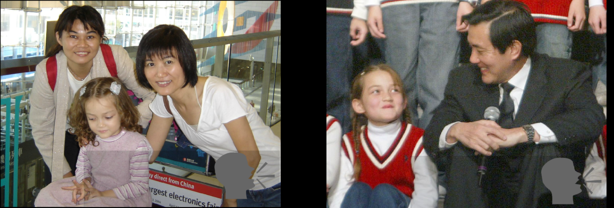
5 Introductions: Formal vs Informal
Compare 2 Conversations
Listen for keywords and phrases
Which is formal? Which is informal?
What are the differences?
Make notes in the table in your workbook.

Slide 16
5 Introductions: Formal vs Informal
Differences
Look at the Table in your book.
Follow along as the teacher explains.

Slide 17
5 Instructions: Formal vs Informal
Differences
When?
  Who?
  Where?
What?
How?
  Self
  A friend
  Responding

Slide 18
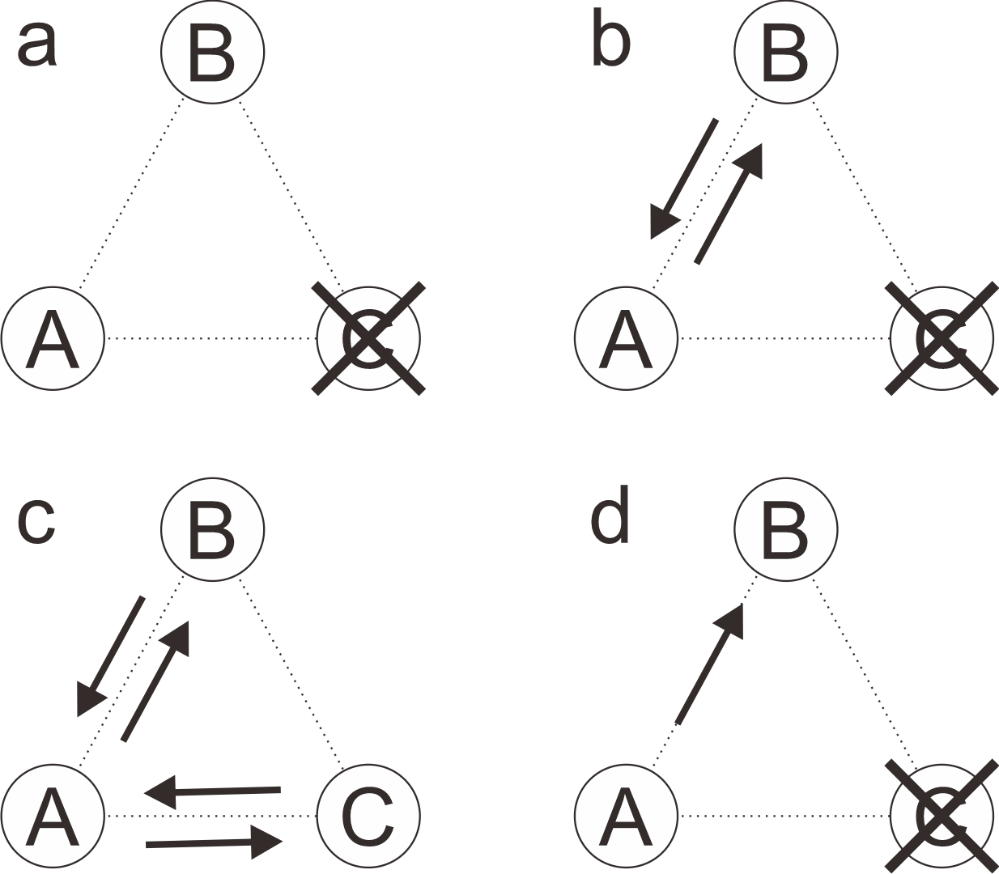
6 Different Types of Openings

Slide 19
7 Continuing: Appropriate Topics
Now What…
The communication channel has been opened
Now what?
Opening
Information Transfer
Closing

Slide 20
7 Continuing: Appropriate Topics
Which topics are appropriate?
Decide which topics are appropriate for a discussion with a scientist you have just met at a conference.
Fill in the table in your workbook after discussing with your partner/group.

Slide 21
7 Continuing: Appropriate Topics
Public and Private Words
Watch the Skit
Listen to the talk.
Fill in the blanks in your workbook.
Public
Private

Slide 22

7 Continuing: Appropriate Topics
Public and Private Words
Public
Private
100 kg
Marriage
Family
Life story
Name Location Job Position Research
$100
50 years

Slide 23
7 Continuing: Appropriate Topics
Learning about Others
Choose a conversation partner.
Open the conversation.
Continue to find out your partner’s:
  Name
  Hometown
  Languages spoken
  Research interests

Slide 24
7 Continuing: Appropriate Topics
Introducing a Friend
Find another pair of students.
Assume that you are friends with these students and they have never met your conversation partner.
Introduce your conversation partner

Slide 25

8 Homework
Opening Conversations
Write the opening of a dialogue where you meet a student in the class for the first time (~30 words).
Write a short conversation introducing your significant other* to a visiting scientist. This conversation will have three (3) people speaking. (30-50 words)
Take a picture of your book and upload to the portal 24 hours before the next class.
.

