Slide 1

bo-§2.3 Continuing…
opening
Information transfer
closing
https://www.groupia.com/party-on/yackety-yak-master-the-art-of-top-tier-chatter-with-100-conversation-starters-and-games-perfect-for-any-dinner-party/

Slide 2

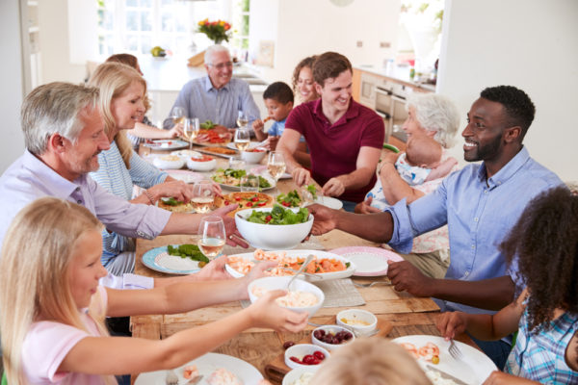
1. Small Talk
Easy Conversation
Name (uniqueness)
Location
  Current
  Place of birth (hometown/country)
  Length of time at present location
  Other places lived
Languages spoken
Job/Academic major
Research interests
Hobbies
https://www.jacquelynyoust.com/encourage-conversation/

Slide 3
1. Small Talk
Name
Location
Position
Research
Age (yr)
Cost ($)
Salary ($)
Weight (kg)
Politics
Religion

Slide 4

1. Small Talk
Find a student that you do not know.
Carry on a conversation
Write down their information in the table in your textbook.

Slide 5

1. Small Talk
Introduce your new friend to another pair of students.

Slide 6
2 Party Games: Yes- No Questions
Twenty (20) Questions
Listen to the teacher’s talk

Slide 7
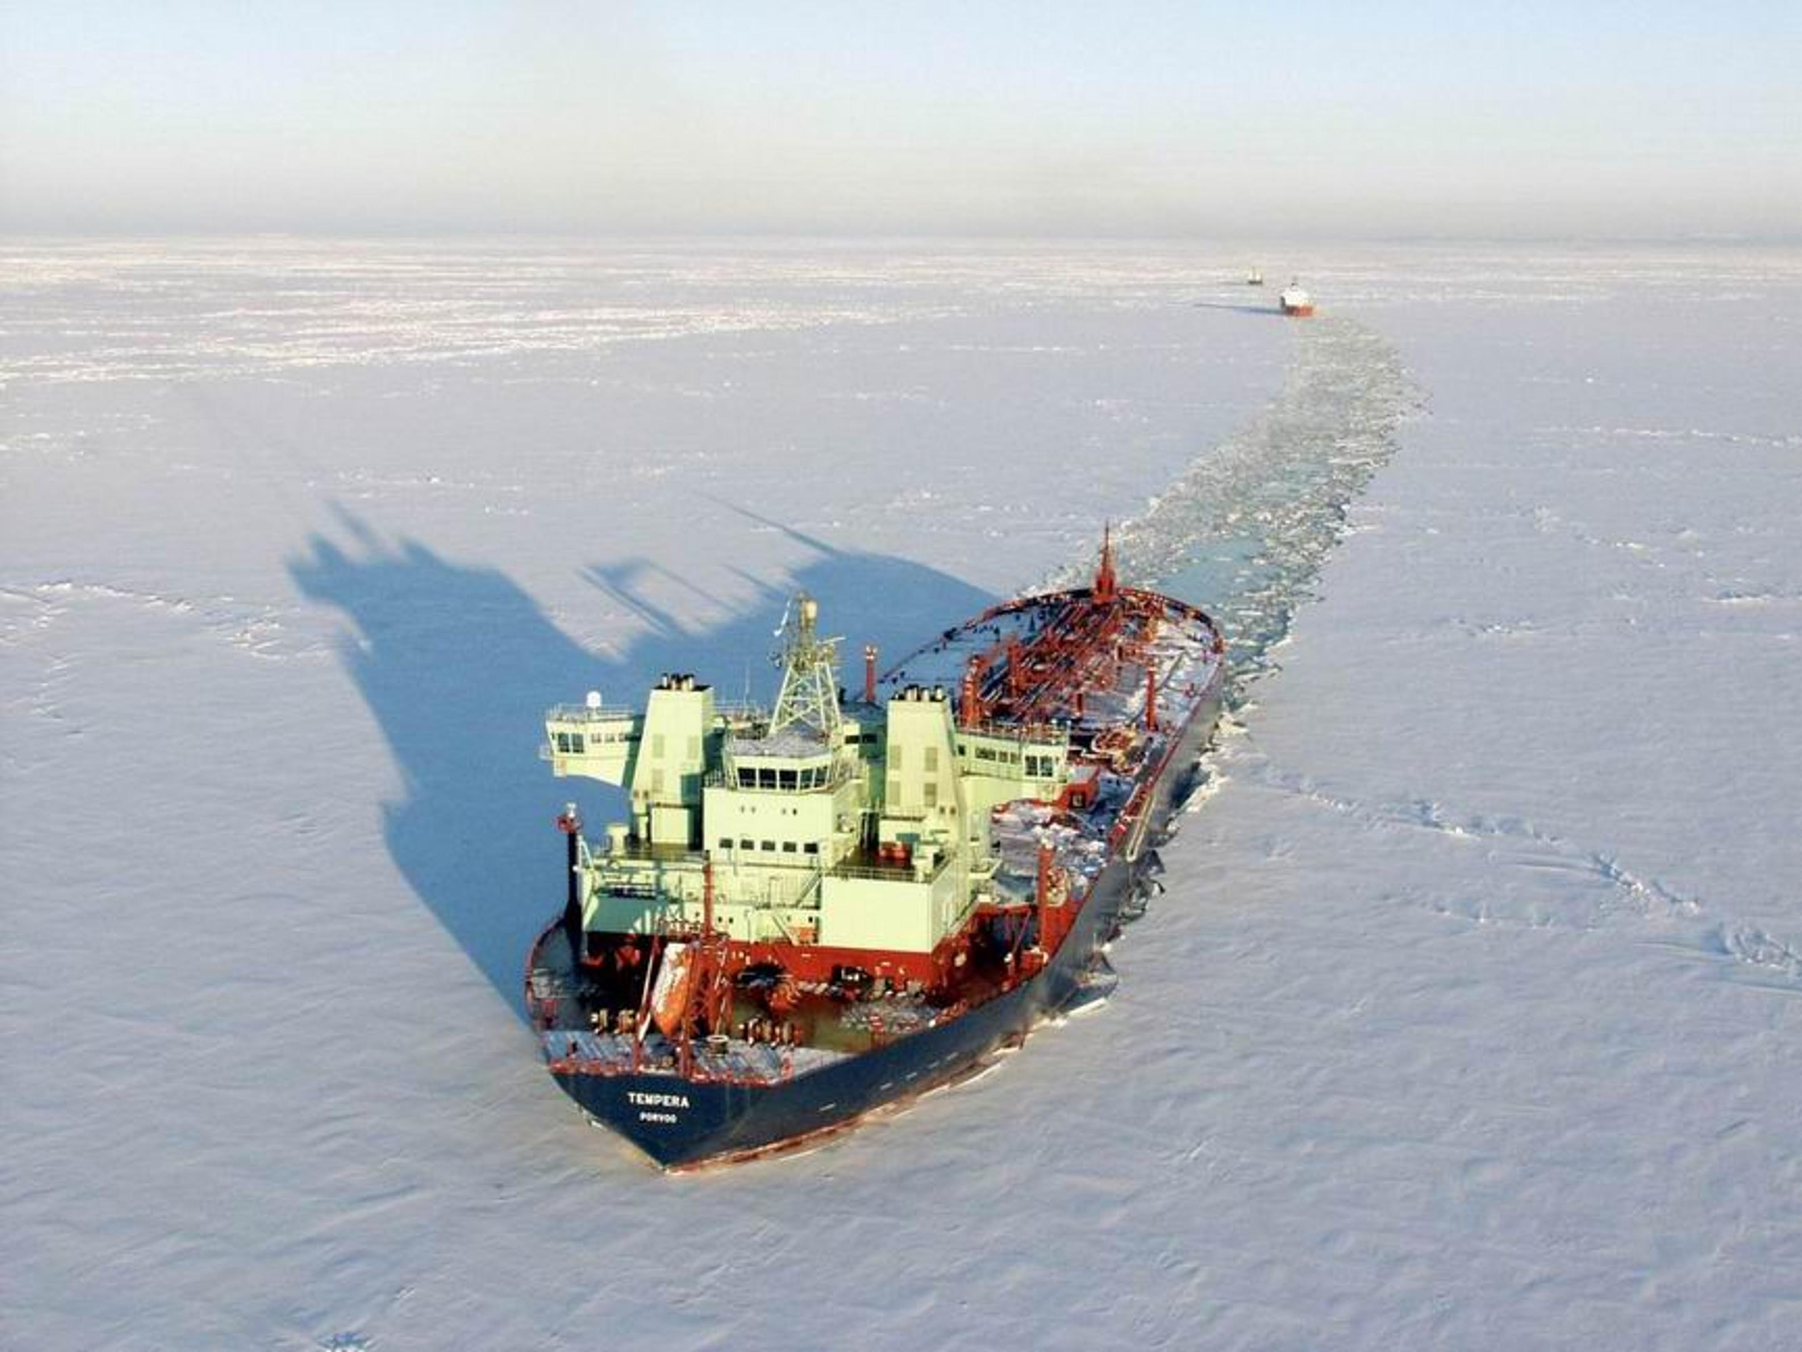
2 Party Games: Yes- No Questions
Parlor Games
Help people get to know each other.
Also called “ice breakers”
Played by a group of 6-10 people
A review of ship performance in level ice - Scientific Figure on ResearchGate. Available from: https://www.researchgate.net/figure/A-106-000-dwt-Masa-Yards-developed-DAT-crude-carriers-built-by-Sumitomo-Heavy-Industries_fig3_44069920 [accessed 24 Oct 2024]

Slide 8
2 Party Games: Yes- No Questions
Party Games example: Twenty (20) Questions
Goal: To determine who or what a person is
Rules
  One person (Amy) takes the identity of someone or something.
  Other group members ask ONLY yes-no questions
  Amy may only answer YES or NO.
  Round ends when either
    your identity is guess, or,
    20 questions asked
Winner: Person to whom was asked the most questions

Slide 9
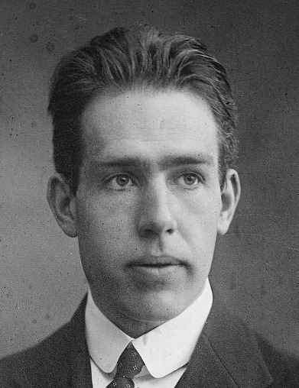
2 Party Games: Yes- No Questions
Twenty (20) Questions: Sample Game
Topic: Scientist/Engineers
Name: Niels Henrik David Bohr
Dates: Oct.7 1885 –Nov. 18, 1962
Nationality: Danish
Occupation: Physicist
Contributions: Bohr’s model of atomic structure, basis for quantum theory.
Award: Nobel Prize for Physics (1922)

Slide 10
2 Party Games: Yes- No Questions
Playing the Game
The teacher will number you off into groups.
One member of the group will come to the front to get a slip of paper.
Discuss briefly who this person is.
Go back to your group.
Let your group try to guess who you are.
REPEAT

Slide 11
3 Facilitating with WH Questions
Listen to the teacher’s talk

Slide 12

3 Facilitating with WH Questions
The Key to Information Transfer
opening
Information transfer
closing

Slide 13
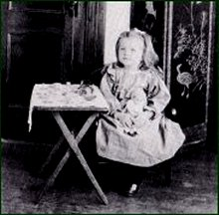
3 Facilitating with WH Questions
The Elephant’s Child
I keep six honest serving-men
(They taught me all I knew);
Their names are What and Why and When
And How and Where and Who.
I send them over land and sea,
I send them east and west;
But after they have worked for me,
I give them all a rest.
Rudyard Kipling

Slide 14

3 Facilitating with WH Questions
Echo and Memorizee
I keep six honest serving-men
(They taught me all I knew);
Their names are What and Why and When
And How and Where and Who.
I send them over land and sea,
I send them east and west;
But after they have worked for me,
I give them all a rest.
Rudyard Kipling

Slide 15

3 Facilitating with WH Questions
Listen to a Conversation at a Conference
Listen
Write Down “WH” questions used
Write Down the answers (Use Table in your textbooks)

Slide 16
4 Facilitating with “And you?”
The simplest way to continue…
Just 2 words added to your answer!
A: Are you enjoying the conference?
B: Yes, especially the invited talks.
And you?

Slide 17
4 Facilitating with “And you?”
Have a short conversation with a partner.
Practice using the phrase, “And You?” everytime you answer a question.
A: Are you enjoying the conference?
B: Yes, especially the invited talks.
And you?

Slide 18
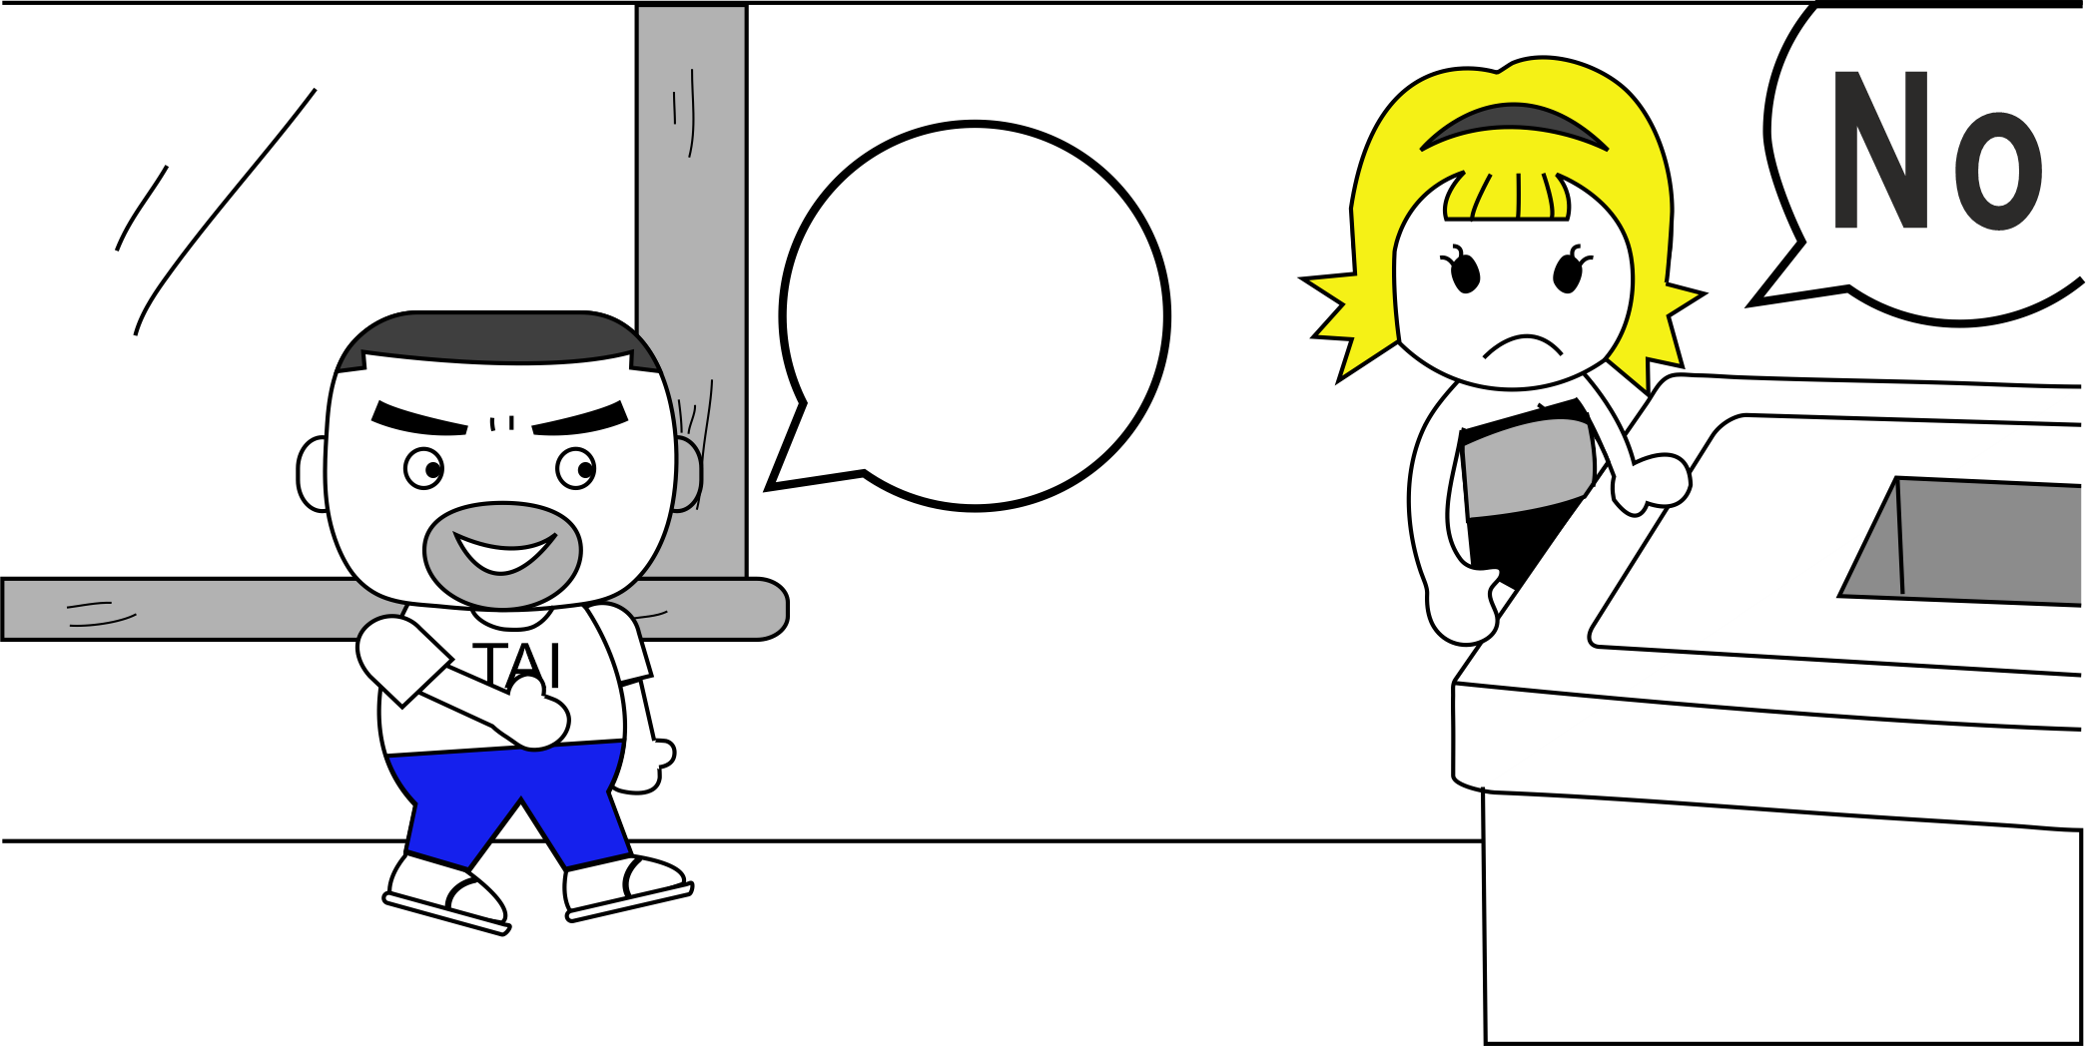
5 Facilitating with Long Answers
Listen to the conversation
Discuss with your partner:
  Does Susan want to continue the conversation?
  How do you think Timothy feels?

Slide 19
3 Facilitating with WH Questions
Keeping a Conversation Going
One Word Answers
WH Questions
And you?
Long Answers

Slide 20
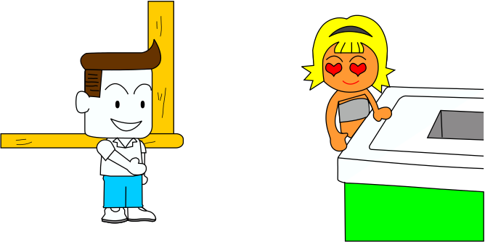
5 Facilitating with Long Answers
Giving Additional Information
Modify Susan’s answers to Tim’s questions to show she wants to continue the conversation

Slide 21
6 Ending Politely
Ways to End a Conversation
Listen to the teacher’s talk
Look at the table in your textbook.

Slide 22
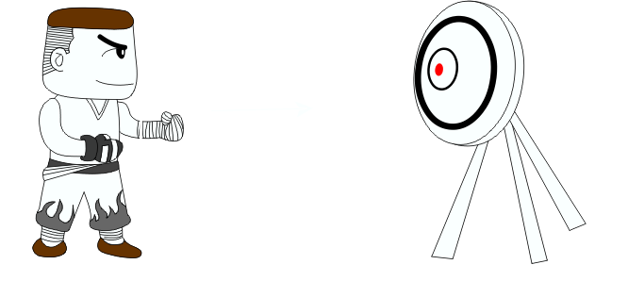
6 Ending Politely
To be moved to Section 2.2
opening
Information transfer
closing
Leave a “good taste”

Slide 23
6 Ending Politely
Practice Closing a Conversation
Practice reading the conversation closers from the textbook. If you have trouble with pronunciation, ask your teacher for help
Then take turns playing A or B

Slide 24

7 Homework & Assignments
Conference Reception Conversation
Write a short dialogue between yourself and an English-speaking graduate student (2 people)
Open the dialogue politely.
Continue by discussing research interests
End the conversation by closing the dialogue politely.
Write about 100 words

