Slide 1
2.4 Conversations (Other)
Above all and before all, do this:
Get Wisdom!
Write this at the top of your list:
Get Understanding!
Proverbs 4:7 MSG

Slide 2


1. Dialogues for Information
Getting Information
Listen to the Teacher’s talk
Look at the tables in your workbook when directed
https://upload.wikimedia.org/wikipedia/commons/6/63/The_book_of_Kells_library_interior_1.jpg

Slide 3


1. Dialogues for Information
Getting Information
Purpose:
  Previous → Relationship
  Here → Info
Examples:
  Directions to Train Station
  Finding Toilet (WC) in Hotel
  @ Library
https://upload.wikimedia.org/wikipedia/commons/6/63/The_book_of_Kells_library_interior_1.jpg
WC
TS

Slide 4

1. Dialogues for Information
Formal Requests
ECHO!
Excuse me, can you help me?
Pardon me, I am looking for…
Excuse me, would you help me to find….
Excuse me, could you guide me to the men’s room?
Excuse me, can you tell me the location of the powder room?
Pardon me, may I interrupt you for a moment to ask a question?

Slide 5
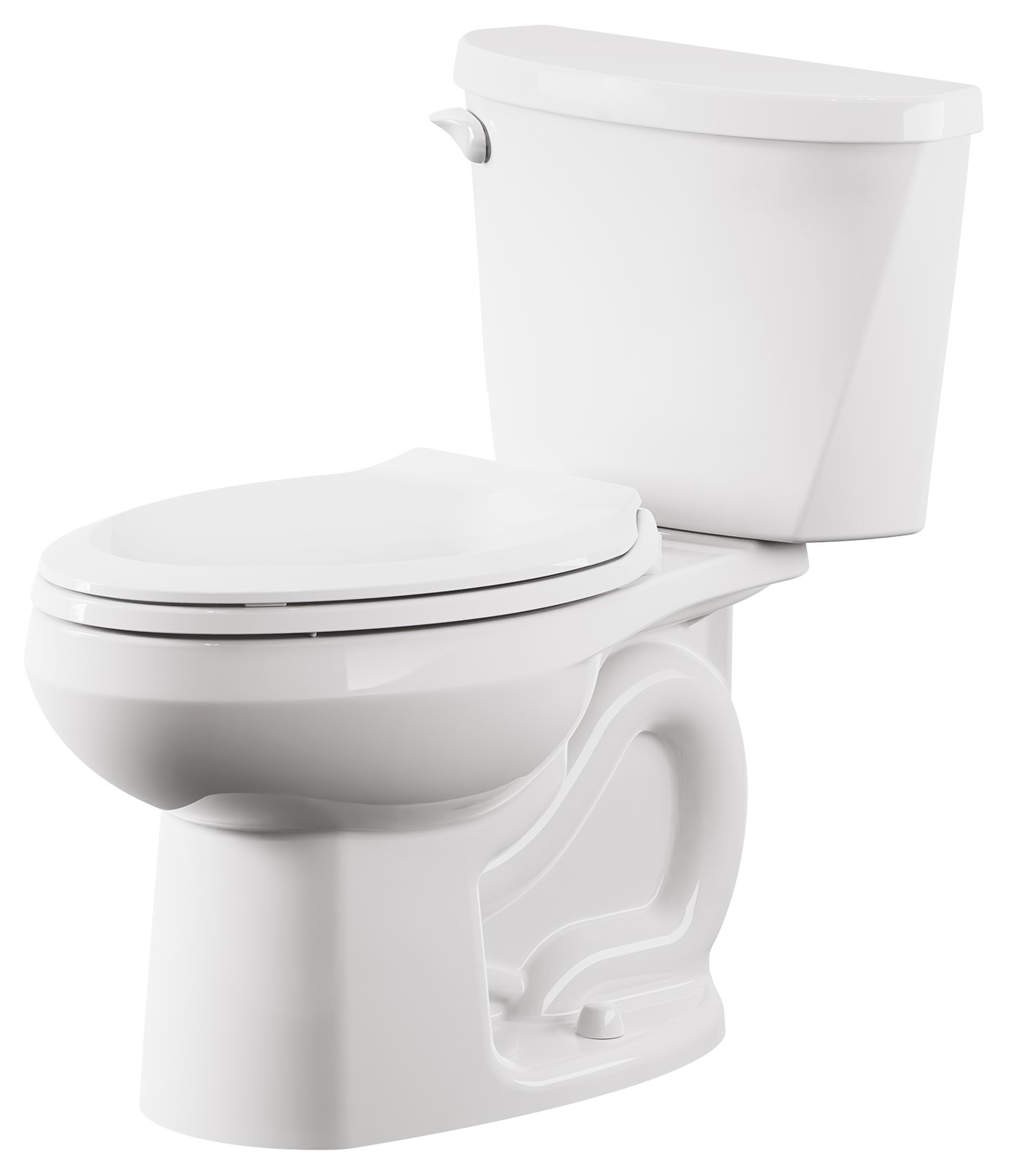
1. Dialogues for Information
Informal Requests
ECHO!
Can you help me?
Would you be able to tell me…?
I need to find…
Where is the toilet?

Slide 6

1. Dialogues for Information
Classifying Requests
Classify requests as informal (I), formal (F) or very formal (VF).
Explain why some requests are formal and some not.
May I borrow your calculator for a few minutes?
May I ask you a favor?
Would you please give this gift to my brother-in-law when you visit Toronto?
May I borrow your pencil?
Excuse me, I am lost. Would you please direct me to the train station?
May I please have an extra few days to complete my term paper?

Slide 7
1. Dialogues for Information
Determining Formality
Listen
Correct your Answers
https://upload.wikimedia.org/wikipedia/commons/6/63/The_book_of_Kells_library_interior_1.jpg

Slide 8
1. Dialogues for Information
Determining Formality: Nature of Request
Nature of the request
Relationship (e.g. student-professor)
Environment (e.g. work || home)
大
中
小

Slide 9
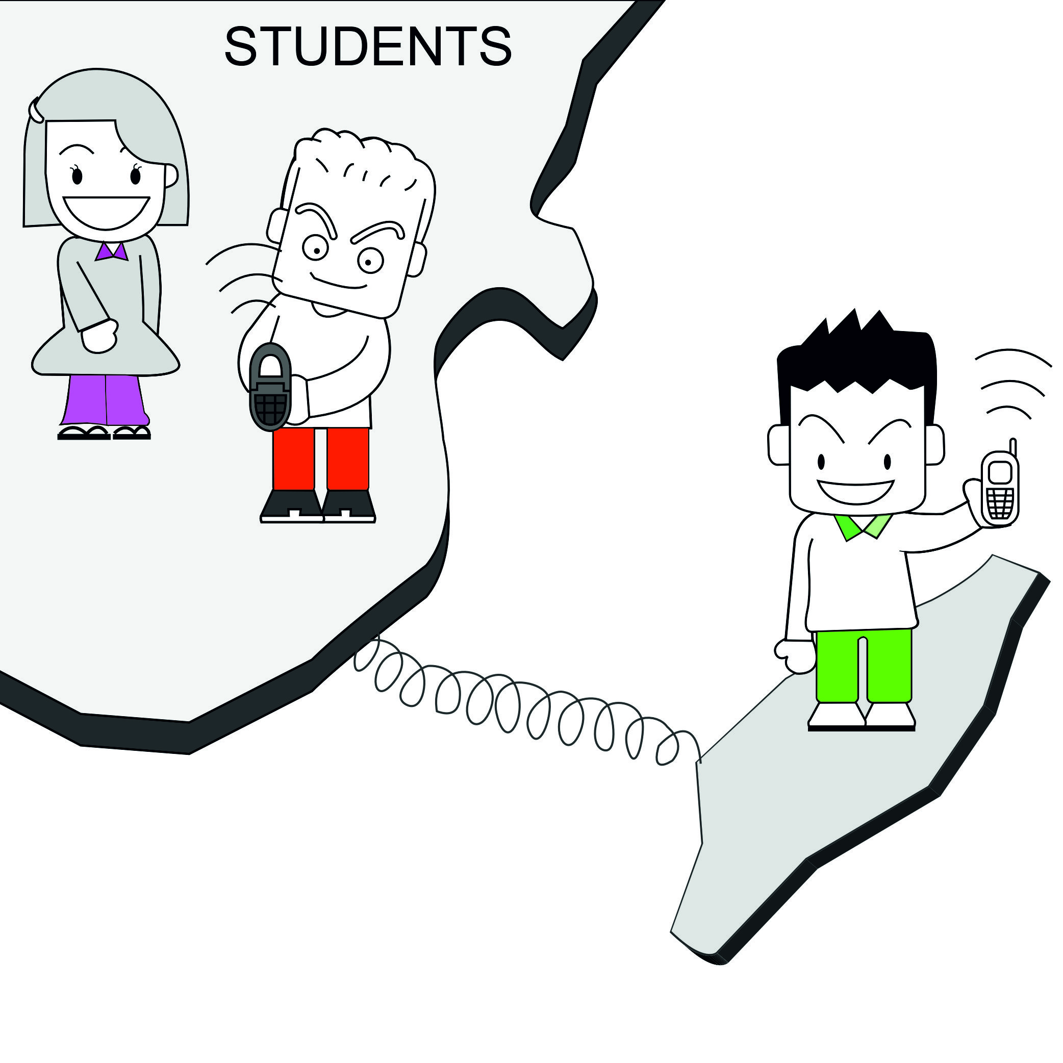
2. Dialogues over Phone
Nature
More difficult than face-to-face
Why?
  Only can hear (ears)
  No eye contact
  Can’t observe body language

Slide 10
2. Dialogues over Phone
Common Uses
Calling to set up an appointment (date)
Checking to see if a person is free before visiting
Clarifying the status of an order with a supplier.

Slide 11
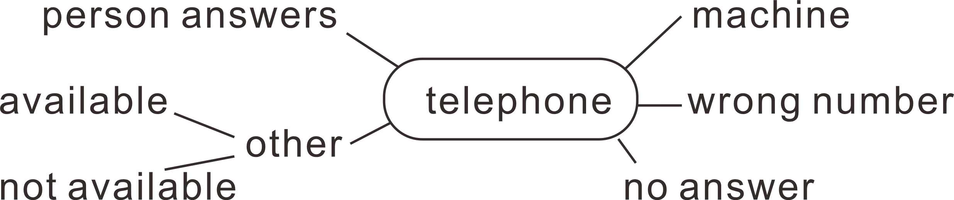

2. Dialogues over Phone
Types

Slide 12

2. Dialogues over Phone
Listening to Dialogues

Slide 13
2. Dialogues over Phone
Politeness
Consider the dialogues
Discover the rules of telephone politeness.

Slide 14
2. Dialogues over Phone
Politeness
First introduce yourself
“Please” at start
“Thank you” at end
End with “Good-bye”

Slide 15


3 Homework
Conversation for Information
Write a short conversation (in your textbook) between yourself and a shop assistant in a computer store.
Length: ~20 words
Telephone Politeness
Write a short dialogue (in your textbook) for a telephone call to the hotel of a visiting scientist. You need to tell him the time you will meet him to bring him to your university.
Length: ~25 words

Slide 16
1B_OnePane_Icons
Talk

Slide 17

1B_OnePane_Icons
Vocabulary

Slide 18
1C_TwoPane_Icons
Sub-section title will be here

Slide 19
2_TwoPanes_Compare

Slide 20
3_Title(NoPane)

Slide 21
Activity
Instruction for Activities

Slide 22
Activity
Homework

Slide 23

Activity
Assignments

Slide 24
Activity_2Panes
For the case in which we have two sides

Slide 25




Blank Slide

