Slide 1
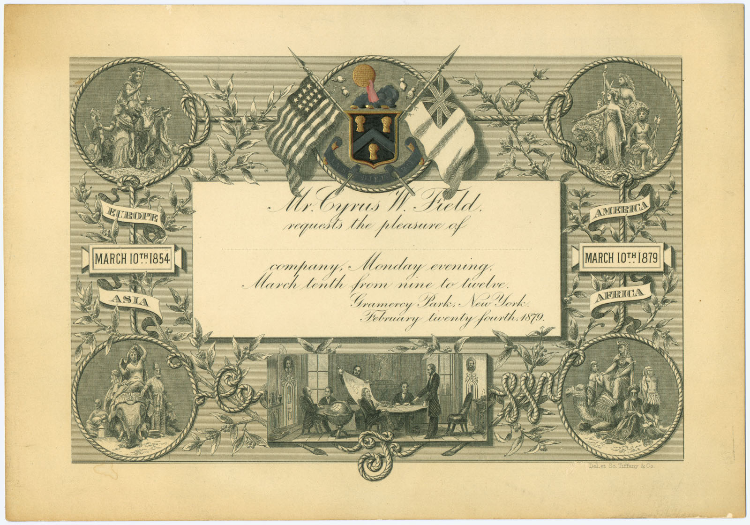
2.5 Invitations

Slide 2

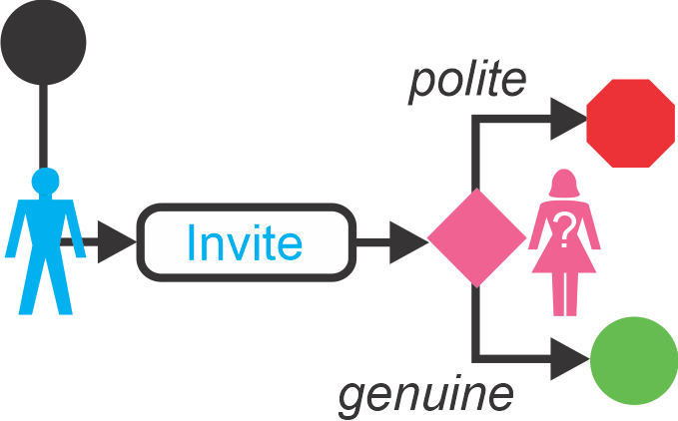
1 Misunderstandings
Genuine [gen-you-in]
Polite [puh-lahyt]
Distinguish [di-sting-gwish]

Slide 3

1 Misunderstandings
The Need to be Clear
Listen to the Teacher’s talk
Fill in the blanks in your workbook.

Slide 4

1 Misunderstandings
Reviewing Introductions
Find 1 person who shares the same…
  hometown
  favorite animal
  musical tastes
  Hobby/sports
You will need to:
  Open the conversation politely (cf. §2.2.3)
  Find out if you have anything in common. (cf. §2.3)
  Close the conversation politely. (cf. §2.3.6)
When you have found 3 people who have something in common with you…
  Sit down.
  Raise your hand
  Prepare to tell us

Slide 5



2 Distinguishing Genuine from Polite
Compare Steve’s two invitations
→ Fill in the table in your workbook.

Slide 6
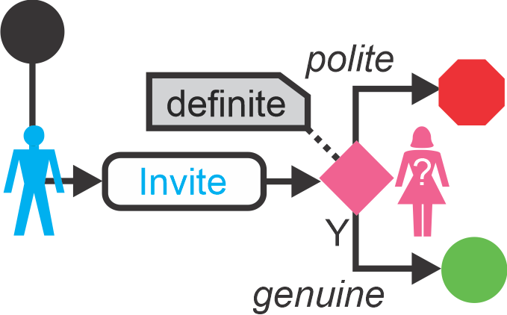
2 Distinguishing Genuine from Polite
Polite vs Genuine
Correct your answers as the teacher speaks.

Slide 7
2 Distinguishing Genuine from Polite
Polite vs Genuine
Definite
  Time
  Location
  Definite Activity
Yes/No question

Slide 8

2 Distinguishing Genuine from Polite
Listening to Typical Conversations
Listen to the dialogs (will play twice)
Fill in the sentences.
1 2 3

Slide 9

2 Distinguishing Genuine from Polite
Ranking Invitations
Listen to the dialogs (will play twice)
Rank each invitation from polite to genuine.
2 3 4 5 6 7 8

Slide 10
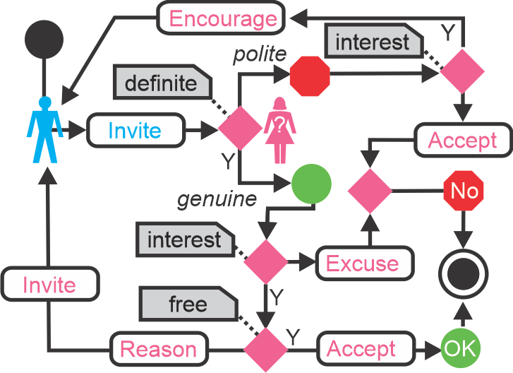
3 Accepting, Rejecting, Getting
The Technique of Response
Accept → “Yes, I’d love to…”
Reject: Gently!
  No interest → excuse
  Interested
    Real reason
    Counter invitation
To Get
  Use “Maybe”
  suggest a definite condition
Useful Phrases: Table 2.8

Slide 11

4 Homework
Write an Invitation Dialogue
With your chosen Partner
Choose 1 of the situations in the textbook.
Write an invitation dialog for that situation (may be either genuine or polite).
Respond to the invitation.
Be prepared to perform in front of the class.
Length: ~50 words
Due: Next Class

