Slide 1
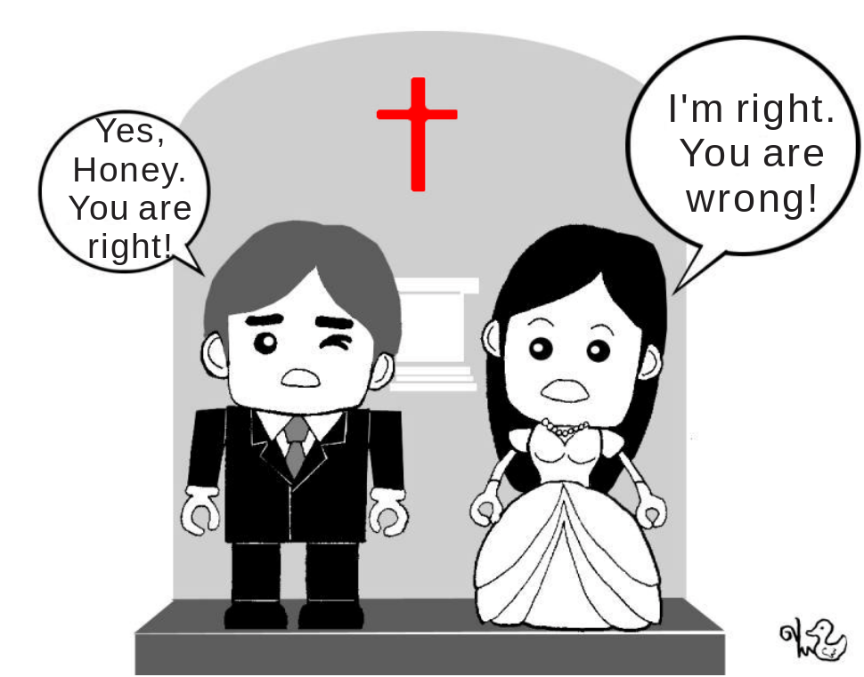
bo-§2.6 Agreeing & Disagreeing

Slide 2
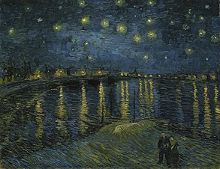
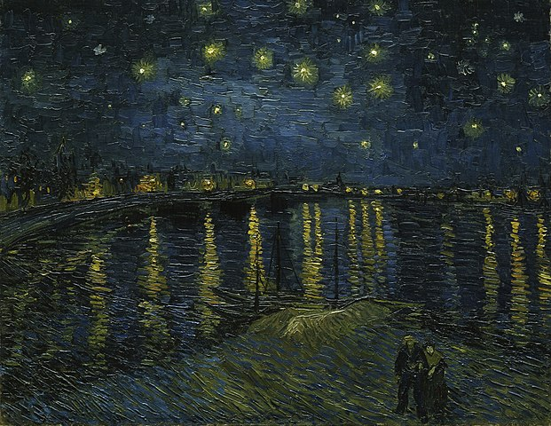
1 Expressing Degree of Belief/Certainty
For my part,
I know nothing with any certainty
But the sight of the stars
Make me dream.
Vincent Van Gogh
When I consider the heavens,
The work of your hands,
What is man that you are mindful of him,
Or the son of man that you care for him?
David (Bible, Psalm 8)
https://commons.wikimedia.org/wiki/File:Vincent_van_Gogh_-_Starry_Night_-_Google_Art_Project.jpg

Slide 3

1 Expressing Degree of Belief/Certainty
Belief vs Certainty: Not the Same
Degrees of Belief: “strength with which we believe the truth of various propositions.” (Franz Huber)
Degrees of Certainty: “how sure we are about what we think or what are the chances of-that something is true.”
E.g. gambling.
  The gambler believes he will hit it big “next time”.
  But he will not with a high degree of certainty

Slide 4
1 Expressing Degrees of Belief
How Sure are You?
Listen to the Teacher’s talk

Slide 5
1 Expressing Degree of Belief
How Sure are You?
⸪ It is important to accurately express one’s degree of certainty.
⸫ English has many words designed to allow one to express levels of certainty or uncertainty.

Slide 6
1 Expressing Degree of Belief
How Sure are You?
Taiwan has a low birthrate
...[A]…it is expensive to raise children.
Where [A] can be:
  because – 100%
  is likely because – 75%
  may be because – 50%
  might be because – 40%
  might possible be because – 20%
  is not because – 0%
Present (Continuous) Tense

Slide 7
1 Expressing Degree of Belief
How Sure are You?
Table 2.9: Expressing certainty in the future
  World oil supplies …
  [A]
  … be exhausted in 15 years.
Table 2.10: Expressing certainty something will not occur
  World oil supplies …
  [A]
  … not be exhausted in 15 years.
Future
Tense

Slide 8

1 Expressing Degree of Certainty
The Oldest Example (pre 1400BC)
וַיֹּ֥אמֶר הַנָּחָ֖שׁ אֶל־הָֽאִשָּׁ֑ה לֹֽא־מֹ֖ות תְּמֻתֽוּן׃
100% Die / 0% Safe
Yahweh God commanded the man, saying,
“Of every tree of the garden you may freely eat;
but of the tree of the knowledge of good and evil,
you shall not eat of it;
for in the day that you eat of it
you will surely die.”
(Genesis 2:16-17, WEB)
70% Die / 30% Safe
The serpent said to the woman,
“You will not surely die,
for God knows that in the day you eat it,
your eyes will be opened, and
you will be like God,
knowing good and evil.”
(Genesis 3:4-5, ESV/WEB)
魔→婪
devil covet
0% Die / 100% Safe
The serpent said to the woman,
“You surely will not die,
for God knows that in the day you eat it,
your eyes will be opened, and
you will be like God,
knowing good and evil.”
(Genesis 3:4-5, NASB/WEB)

Slide 9

1 Expressing Degree of Belief
Make up sentences
Write 3 sentences indicating degree of belief.
Sentences should be related to current news.
Write the same sentences in both of your books.
e.g.
The KMT candidate will win the presidential election (100%)
The KMT might possibly win the presidential election (20%)
The KMT candidate will not win the presidential election (100%)
Oakley will likely not date Derek (75%)

Slide 10

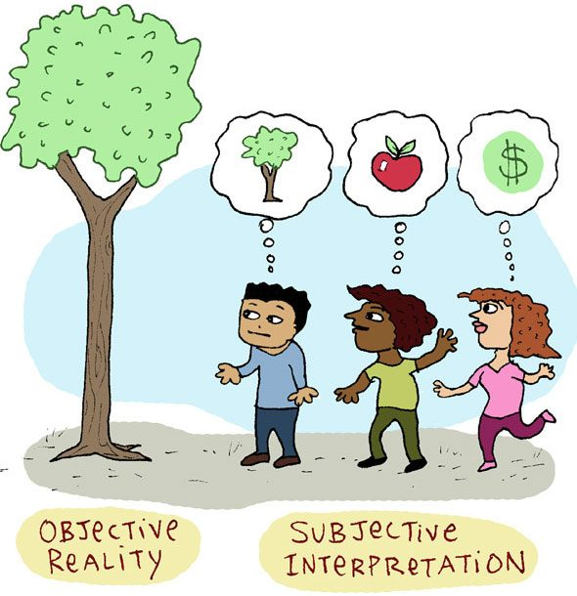
2 Expressing Disagreement Politely
Vocabulary
Ref:https://www.yesvedanta.com/objectivity-vs-subjectivity-in-light-of-vedanta/
Subjective
  [suhb-jek-tiv]
Objective
  [uhb-jek-tiv]

Slide 11
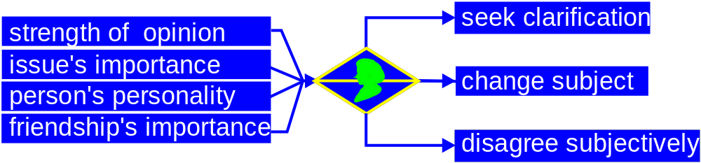
2 Expressing Disagreement Politely
♥
Think before speaking
  mitigating factors
  method of response
Respond Tentatively, Respond Subjectively
KEY: Avoid direct confrontation

Slide 12
2 Expressing Disagreement Politely
“Is it better to…
win the argument but lose the person
, or,
lose the argument but win the person
?

Slide 13
2 Expressing Disagreement Politely
Issues of Concern to Students
Decide on the five most important issues to students at your university.
Rank from most to least important.
Make use of statements expressing “Degrees of Belief” in your discussion.
Express disagreement politely.
You have 10 minutes to work.

Slide 14
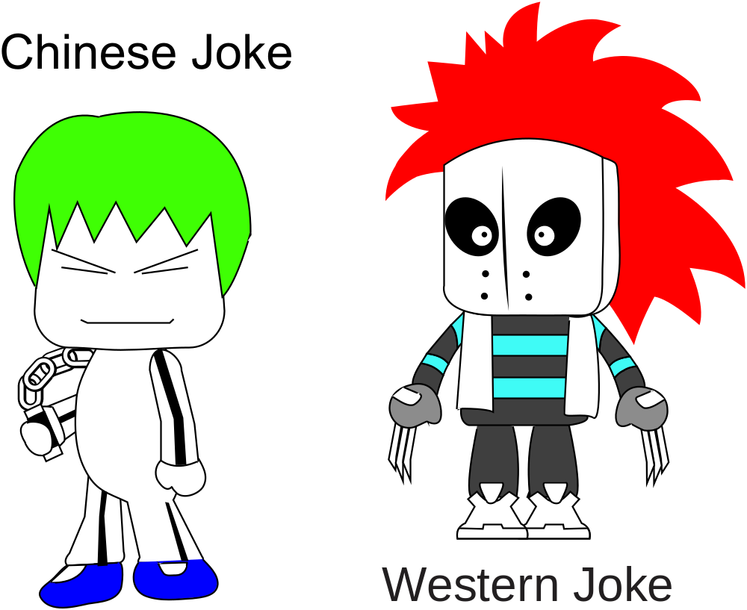
3 Jokes – Danger Area

Slide 15

4 Homework & Assignments
Preparing for a Debate
Do you think your country should have compulsory universal military service? (Yes/No)
Write down 3 reasons why it is important to have compulsory universal military service. (PRO)
Write down 3 reasons why there should not be compulsory universal military service. (CON)
Use point form

Slide 16

4 Homework & Assignments
Assignment: Two (2) Minute Dialogue
With a partner, prepare a 2-minute dialogue
Assume you have never met the person before.
Remember to: “Open → Transfer Info → Invite → Close” the conversation.
Be ready to present in class.
Evaluation criteria available at https://class.kejiyingwen.com
Assignments
are graded

