Slide 1
bo-§2.7 Logic, Reasoning & Debates
“Come now, let us reason together,”
says the LORD.
“Through your sins are like scarlet,
they shall be as white as snow;
though they are red as crimson,
They shall be like wool.”
Isaiah 1:18

Slide 2


1. Types of Logic
Logic [loj-ik] (noun)
Induction [in-duhk-shuhn] (noun)
Deduction [di-duhk-shuhn] (noun)
Generalize [jen-er-uh-lahyz] (verb)

Slide 3

1. Types of Logic
Logical Reasoning
Deductive
Theoretical Papers
Theory→ experiment
Inductive
Experimental Papers
Experiment → theory
All Chinese have black hair.
Amelia is Chinese.
⸫ Amelia has black hair.
Ohm’s Law: V=IR
V=10, R=5
⸫ I=2
All Chinese I have met have black hair.
Amelia is Chinese.
⸫ Amelia probably has black hair.

Slide 4
2 Over-Generalization
Stereotype [ster-ee-uh-tahyp] (noun)
Over-generalize (verb)

Slide 5
2 Over-Generalization
Example from Data Mining Example
Data
Result: one-to-one correspondence!
Conclusion: ⸫ All Chinese have homosexual tendencies
Wrong: But why?
Chinese Population
San Francisco, USA
New York, USA
Toronto, Canada
Vancouver, Canada
Homosexual Population
San Francisco, USA
New York, USA
Toronto, Canada
Vancouver, Canada

Slide 6
2 Over-Generalization
Electrical Engineering Example

Slide 7
2 Over-Generalization
Stereotypes
Examples
  Americans are…
  Blacks are…
  Moslems are…
Propagation
  Parent to child
  Media

Slide 8
2 Over-Generalization
Danger
Miss unique features in dataset
Prevent us from accepting new interpretations
Scientists are not exempt!

Slide 9

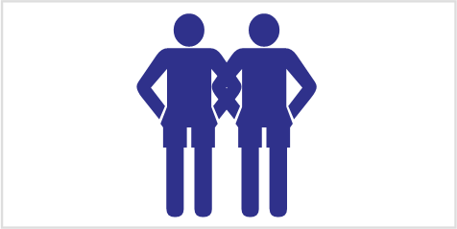
2 Over-Generalization
My Personal Stereotypes
Complete the sentences with the first idea that comes to your mind.
  Women are not…
  Politicians are…
  Hokka (客家人) are…
  Successful business people are…
  Farmers are…
  Taiwanese soldiers are…
From where do these ideas come?
good at engineering

Slide 10
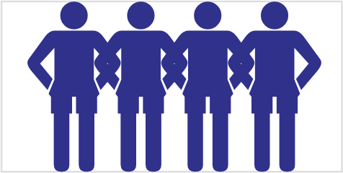
3 Responding to Stereotypes
The Eight (8) Ways
Agree with the statement
Say nothing
Look very angry
Deny them
Ask what they base their opinion on
Make a joke about it
Explain why it may not be true
Change the topic
    Discuss the stereotypes in the textbook.
    Decide how to respond.

Slide 11
4 Formal Debates
Listen to the teacher’s explanation about debates

Slide 12
4 Formal Debates
Moderator: control
Layout
PRO
CON
Arguing against
the idea
Arguing for
the idea
Audience: Voting to decide the Winner

Slide 13
4 Formal Debates
‘Rules of Thumb’
“Proof by Intimidation” is not scientific.
Use appropriate ‘degree of belief’. Don’t exaggerate.
Generalize… but don’t over-generalize.
Criticize ideas… not people.

Slide 14
4 Formal Debates
E.g. Application in a Formal Debate Setting
TOPIC: University students should not
receive grades, only Pass/Fail.
PRO: Students should not be graded but only
receive pass/fail marks as grading puts
unnecessary pressure on students.
CON: If students are not graded,
most students will not study hard.

Slide 15
4 Formal Debates
E.g. Application in a Formal Debate Setting
TOPIC: University students should not
receive grades, only Pass/Fail.
PRO: Don’t you think it would be better if students
were not graded but only received pass/fail
on courses? This would reduce competition
and unnecessary pressure on students.
CON: I see your point, but don’t you think that if
you eliminate pressure on students than they
won’t study as hard?

Slide 16
4 Formal Debates
Additional Useful Phrases
Isn’t it just possible that…
Possibly, but…
Surely you must admit that…
Sorry, I don’t quite agree with you on…
I see your point, but…

Slide 17
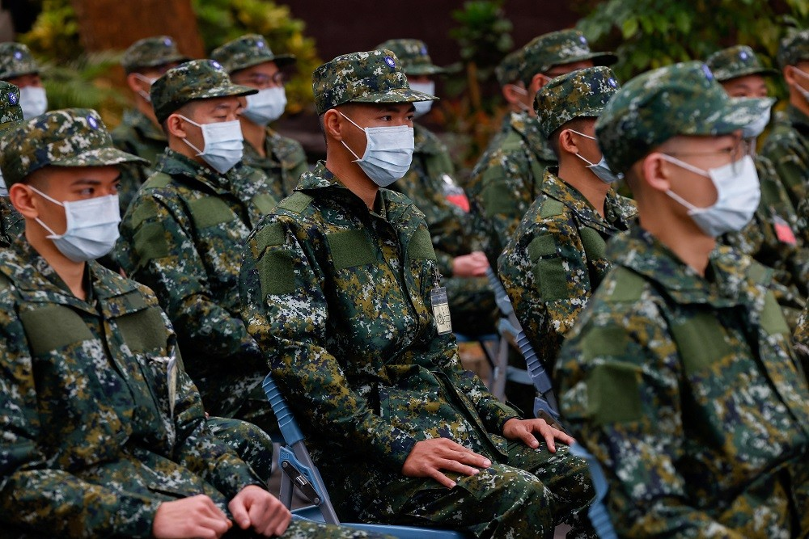
4 Formal Debates
Prepare to Debate
Understand the Question
PRO (3 reasons)
CON (3 reasons)
Rebuttal to each!
Compulsory Military Service
is both Necessary and Beneficial
https://www.taiwannews.com.tw/en/news/5085263#:~:text=TAICHUNG%2C%20Taiwan%2C%20Jan%2025%20(,about%20China's%20rising%20military%20threat.

Slide 18
4 Formal Debates
Debate
Pro
Con

