Slide 1
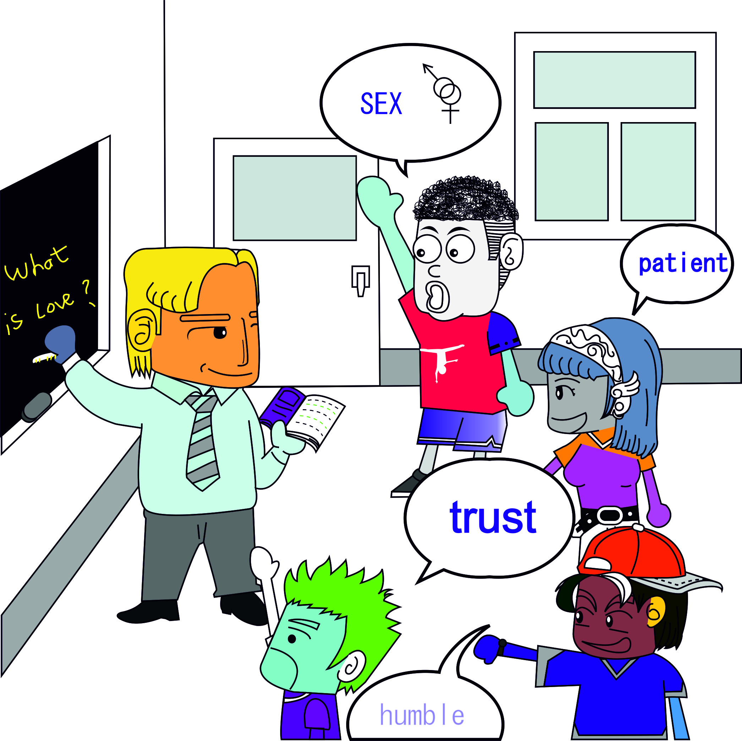
bo-§2.8 Brainstorming
When? Why? Who? How?

Slide 2

1. When & Why to Brainstorm
Facilitator [fuh-sil-i-tey-ter] (noun)
Secretary [sek-ri-ter-ee] (noun)
Participant (noun)
Perspective [per-spek-tiv] (noun)

Slide 3

1. When & Why to Brainstorm
Generate ideas when stuck
Lateral not vertical thinking process
Want Varied Group of People with different perspectives
Roles:
  1 facilitator (guide)
  1 secretary (write)
  6 participants (generate)

Slide 4
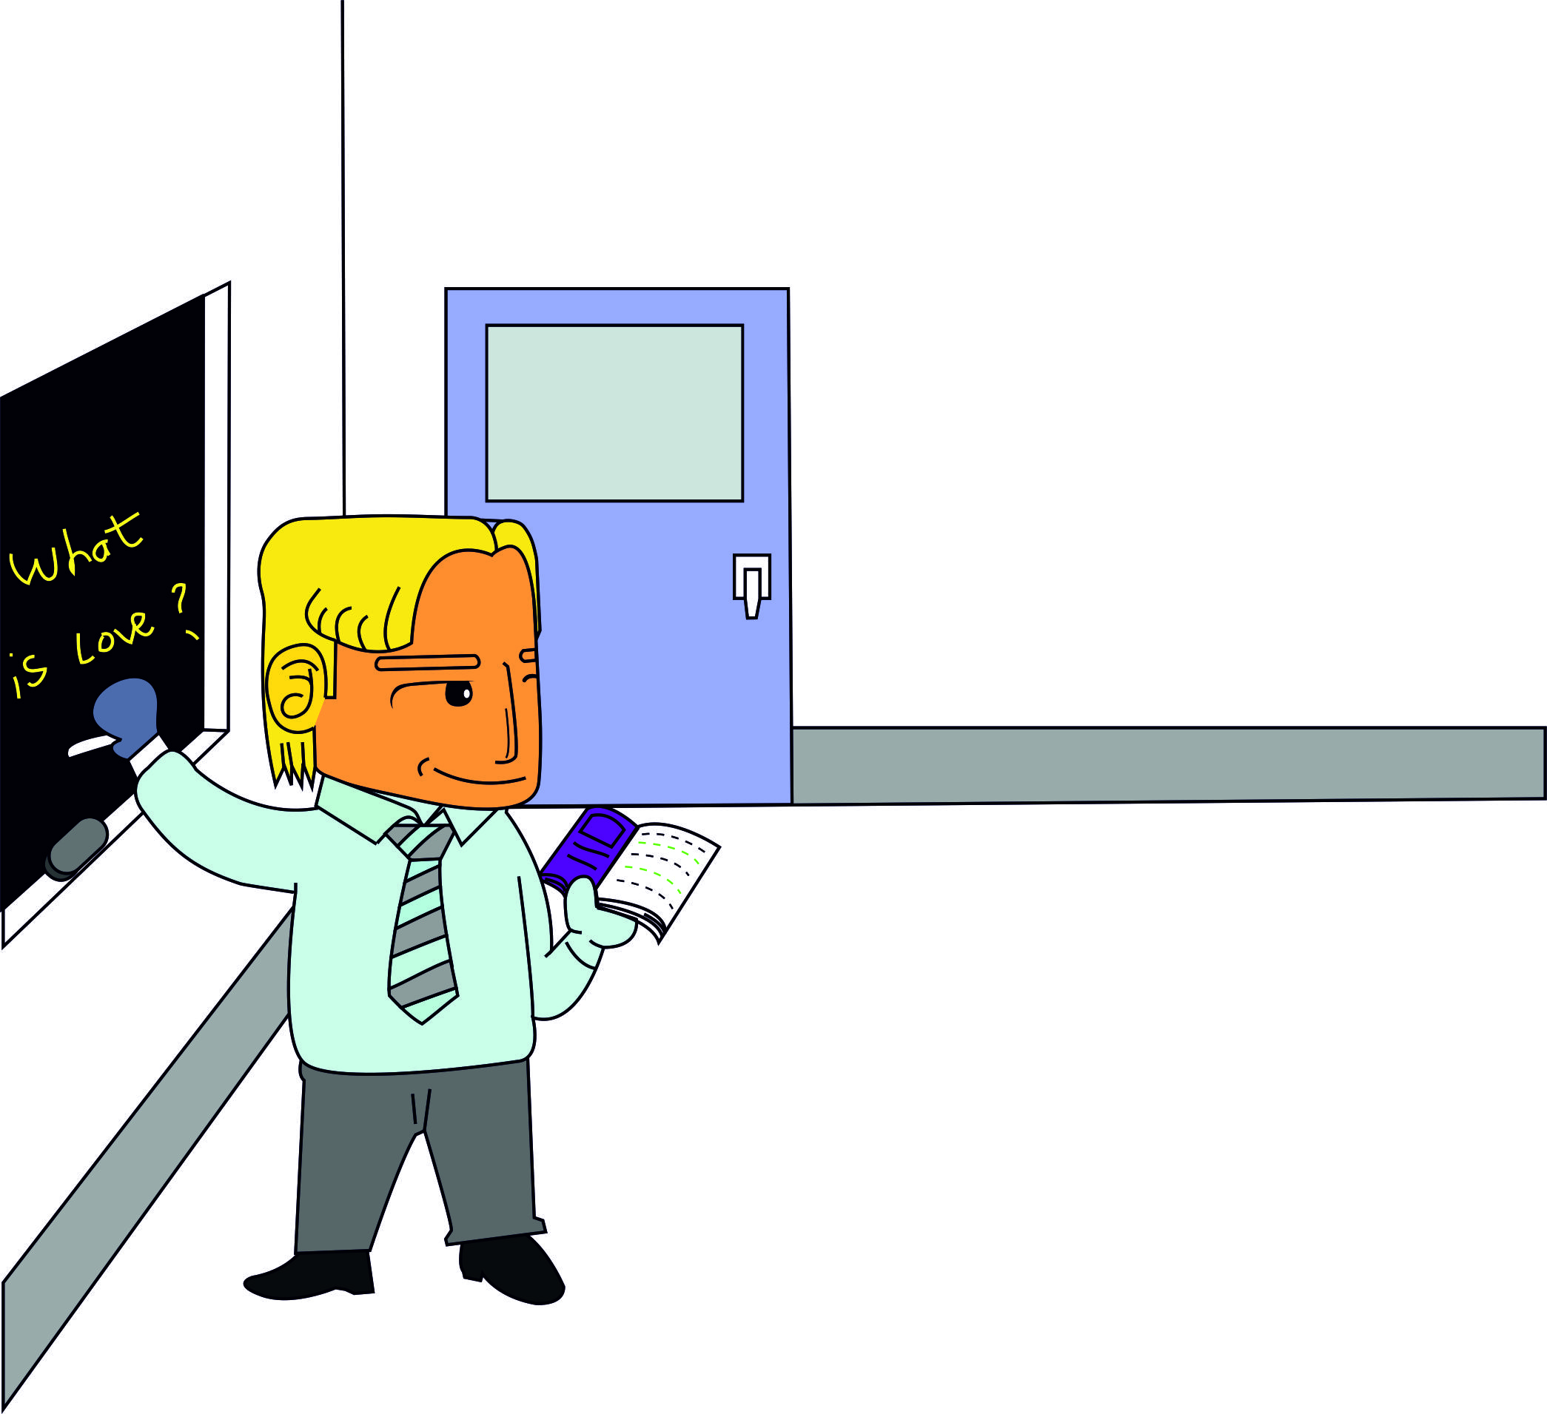
2. How to Brainstorm
Step-by-Step
Define problem (facilitator)

Slide 5
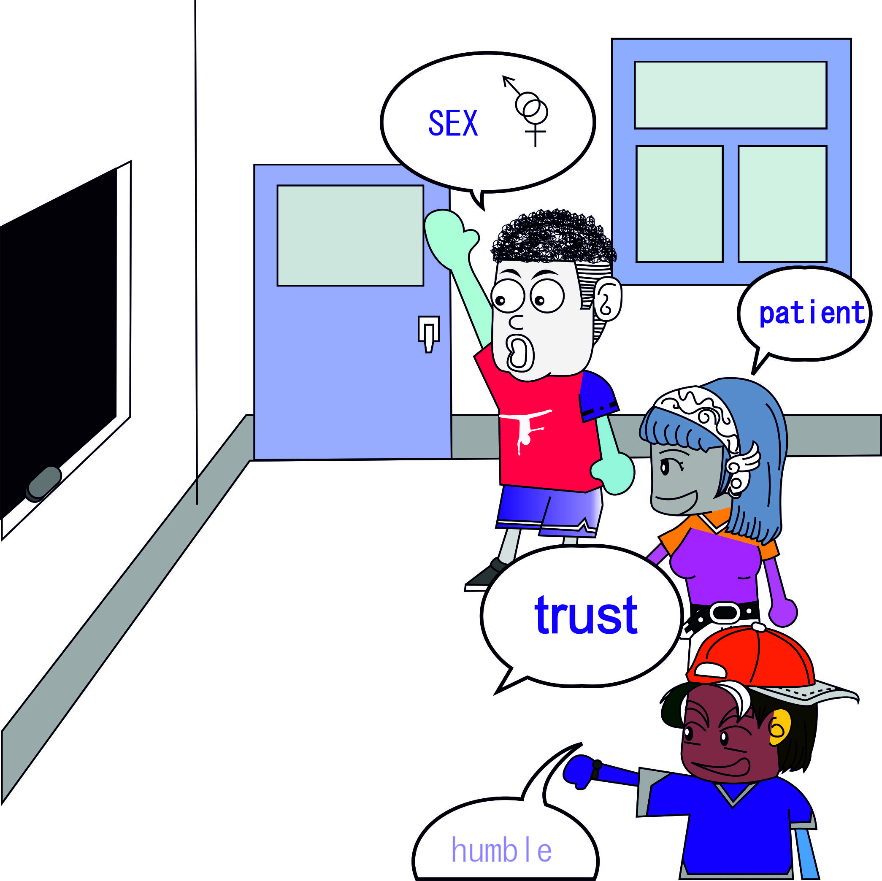
2. How to Brainstorm
Step-by-Step
Define problem (facilitator)
Generate ideas (group)

Slide 6

2. How to Brainstorm
Step-by-Step
Define problem (facilitator)
Generate ideas (group)
Select best ideas (group)
Switch to standard techniques to narrow selection
Kind
Patient
Sex
Does not envy
Does not boast
Endures all
Believes all
Hormones
Trusts
Insanity

Slide 7

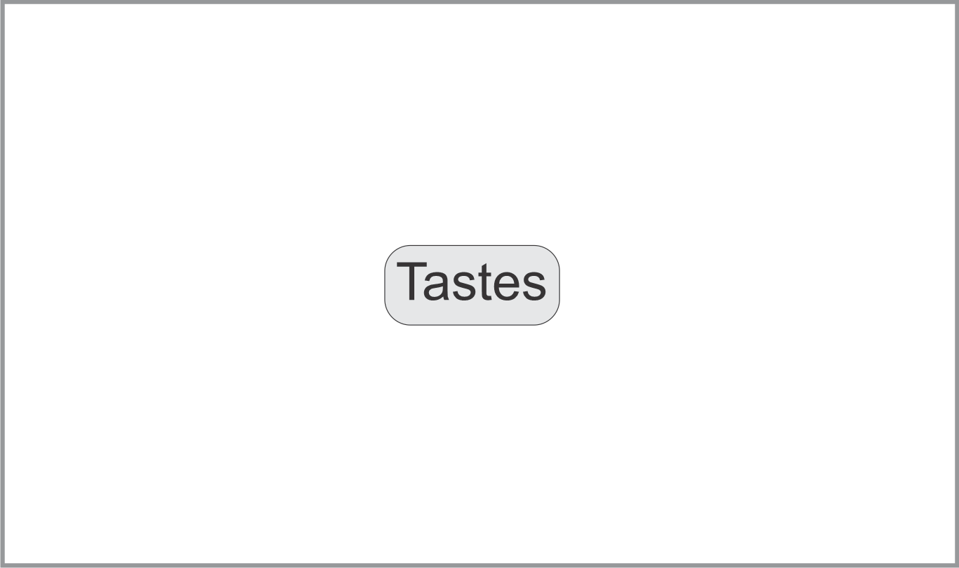
3. e.g. Describe Jon’s Tofu’s Taste
1. Define the Problem
Write (Draw) topic in
Middle of blackboard

Slide 8
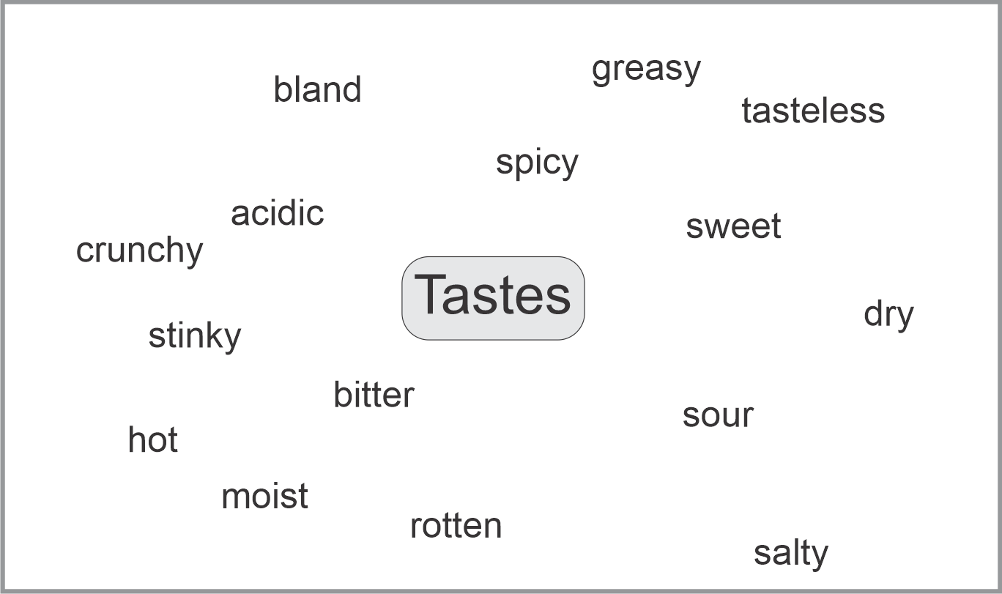
3. e.g. Describe Jon’s Tofu’s Taste
2. Generate Ideas (Brain Storm!)
Scatter ideas on blackboard.
Single words/pictures. Chaotic.

Slide 9
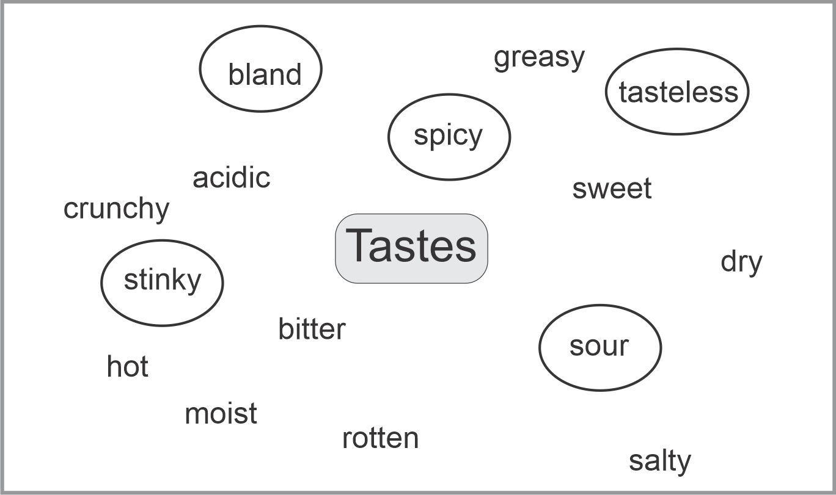
3. e.g. Describe Jon’s Tofu’s Taste
3. Select Best Ideas
Circle ideas for
Further research

Slide 10

2. e.g. Describe Jon’s Tofu’s Taste
4. Switch to Conventional Techniques

Slide 11


3. Brainstorm for Adjectives
Brainstorm for adjectives related to…
Break into groups of 6.
Form a circle
Choose a facilitator
Choose a secretary
Brainstorm:
  Facilitator defines the problem
  Participants generate ideas (10’); secretary writes them down on A3 paper – (~15 ideas)
  Group chooses the best 3 to share with the class
Relative Position
Dimension (size)
Colours
Patterns
Describe Taiwan
Smell
Directions
Texture
Describe a girl/boy
Describe a Cat
Don’t Criticize

Slide 12

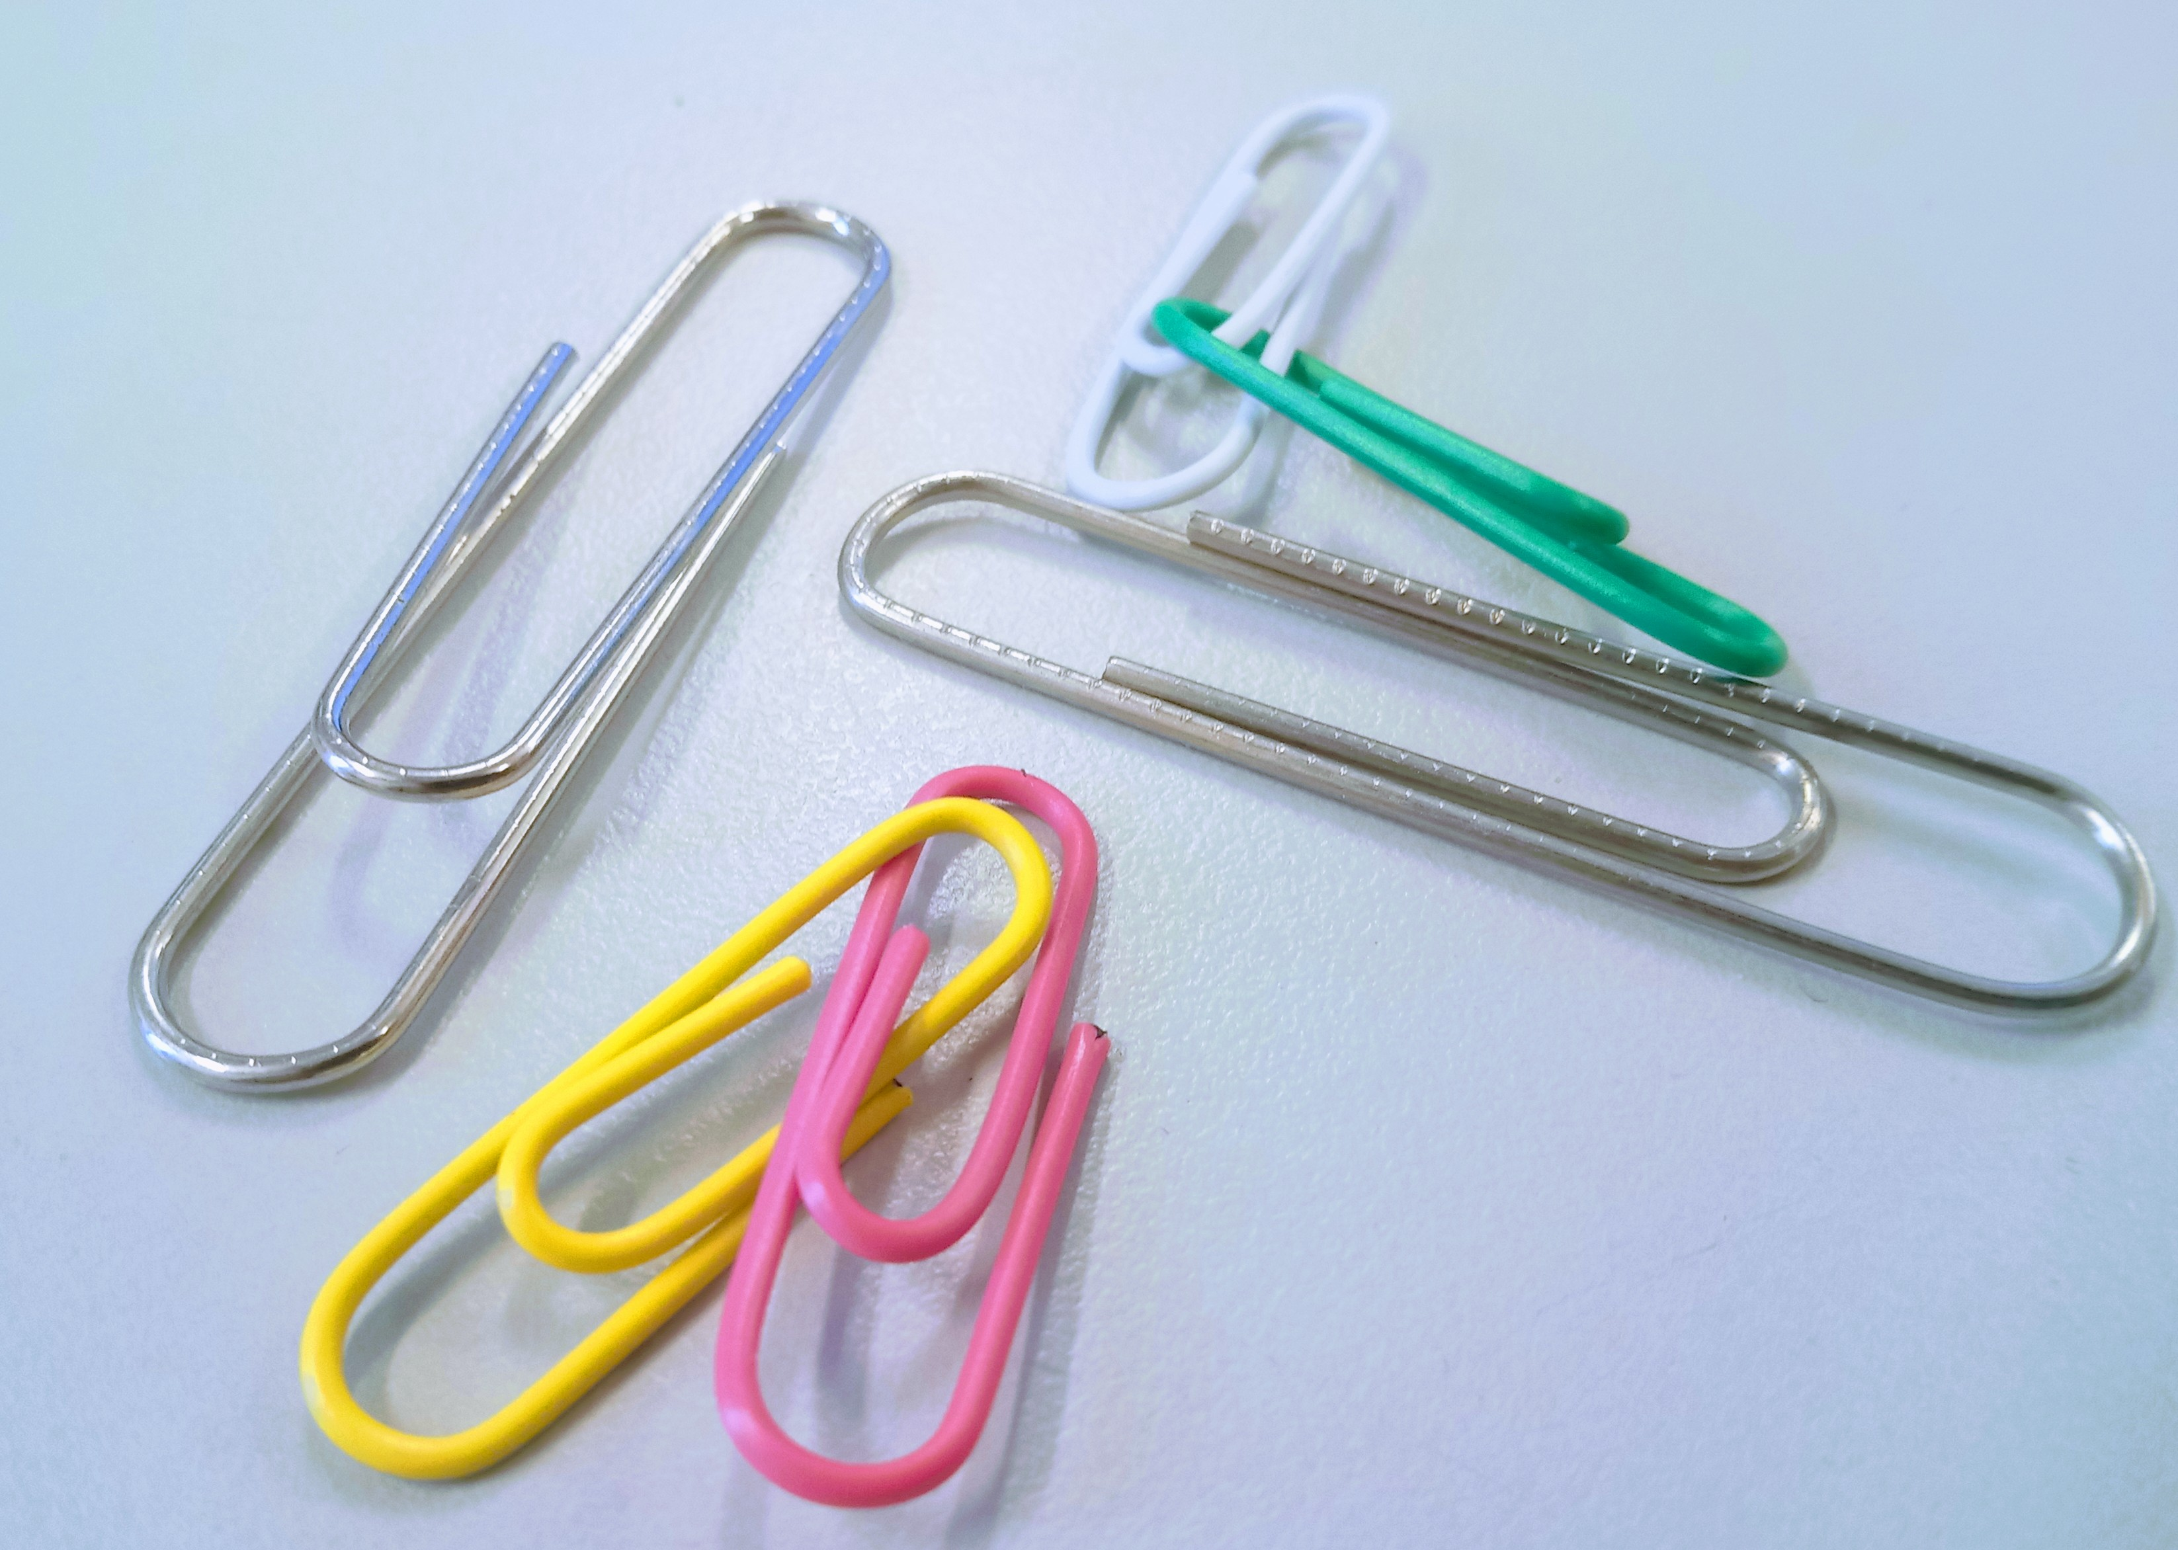
3. Brainstorm for Paper Clip Uses
Uses for paper clips
Your employer makes paper clips
You are assigned to think of new applications/markets.
Brainstorm for ~15 possible uses
Choose 3 or 4 uses that can be used as a basis for a new advertising campaign.
Share with the class

Slide 13
4. Summary of §2
Dialogue
Lecture

