Slide 1
bo-§3 Listening to Scientific Talks

Slide 2

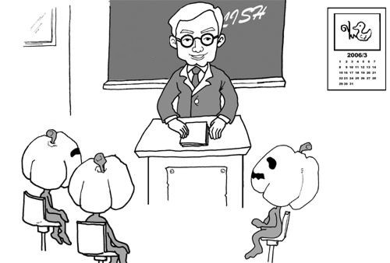
1 Overview
Objective → Scientific Lecture
To learn how to
  listen efficiently, and
  understand
To overcome one’s fear of
  speaking out and
  asking questions

Slide 3
1 Overview
Contents
Distinguishing Content from Filler
Short Talks & Communication Theory
Speak Up! Asking questions & Active Listening
Note Talking & Key Words
Putting it all together

Slide 4

1 Overview
Evaluation
Quizzes
  Contents (15 pts)
  Application (20 pts)
Continuous Grading (15 pts)

