Slide 1
§3.2 Separating Content from Filler

Slide 2
§3.2 Separate Content from Filler
“ Teacher, which is the greatest commandment
in the law?”
Jesus said to him,
“’You must love the Lord your God with all your heart, with all your soul, and with all your mind.’ This is the greatest and most important commandment.
The second is like it: ‘You must love your neighbor as yourself.’ All the Law and the Prophets depend on these two commandments.”
Ref: Matthew 22:36-40

Slide 3

1 Filtering Information
Five Steps for Information Processing
Listen carefully to the teacher’s talk.

Slide 4

1 Filtering Information
Five Steps for Information Processing
Not possible to process every word
Not necessary to process every word
listen to understand
the key information

Slide 5
1 Filtering Information
Five Steps for Information Processing
Input original signal
Cut filler words: low pass (noise) filter
Cut filter information: high pass filter
Apply Key Word Algorithm (§2.4)
Process and extract relevant information
low pass
(noise) filter
info
filler
info
key
noise
filler

Slide 6
1 Filtering Information
Five Steps for Information Processing
Input original signal
Cut filler words: low pass (noise) filter
Cut filter information: high pass filter
Apply Key Word Algorithm (§2.4)
Process and extract relevant information
high pass
filter

Slide 7
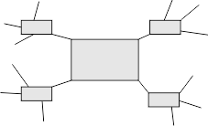
1 Filtering Information
Five Steps for Information Processing
Input original signal
Cut filler words: low pass (noise) filter
Cut filter information: high pass filter
Apply Key Word Algorithm (§2.4)
Process and extract relevant information

Slide 8
1 Filtering Information
Five Steps for Information Processing
Input original signal
Cut filler words: low pass (noise) filter
Cut filter information: high pass filter
Apply Key Word Algorithm (§2.4)
Process and extract relevant information

Slide 9
2 Filter out Filler Words
Follow the teacher’s talk in your textbook.
Echo the words in table when the teacher asks you.

Slide 10
2 Filter out Filler Words
Informal talk → filler words
Why? To give speaker time to think
Need to learn to ignore

Slide 11
2 Filter out Filler Words
Hmmm… Um…
OK You know
Well Now where was I?
Oh ya… ah
I guess what I really meant to ask is…
How should I say it?
Are you following me?
Now let me see…

Slide 12


2 Filter out Filler Words
Listen for Filler Words
Imagine: You are at a reception for a Canadian professor visiting your university.
Listen to professor’s talk.
Don’t try to understand the talk, just listen for the filler words.
Check off the filler words she uses in your textbook.

Slide 13
3 Listening for Content
Clues to Structure and Key Points
Follow the teacher’s talk in your textbook.
Echo the words in the table when the teacher asks you.

Slide 14
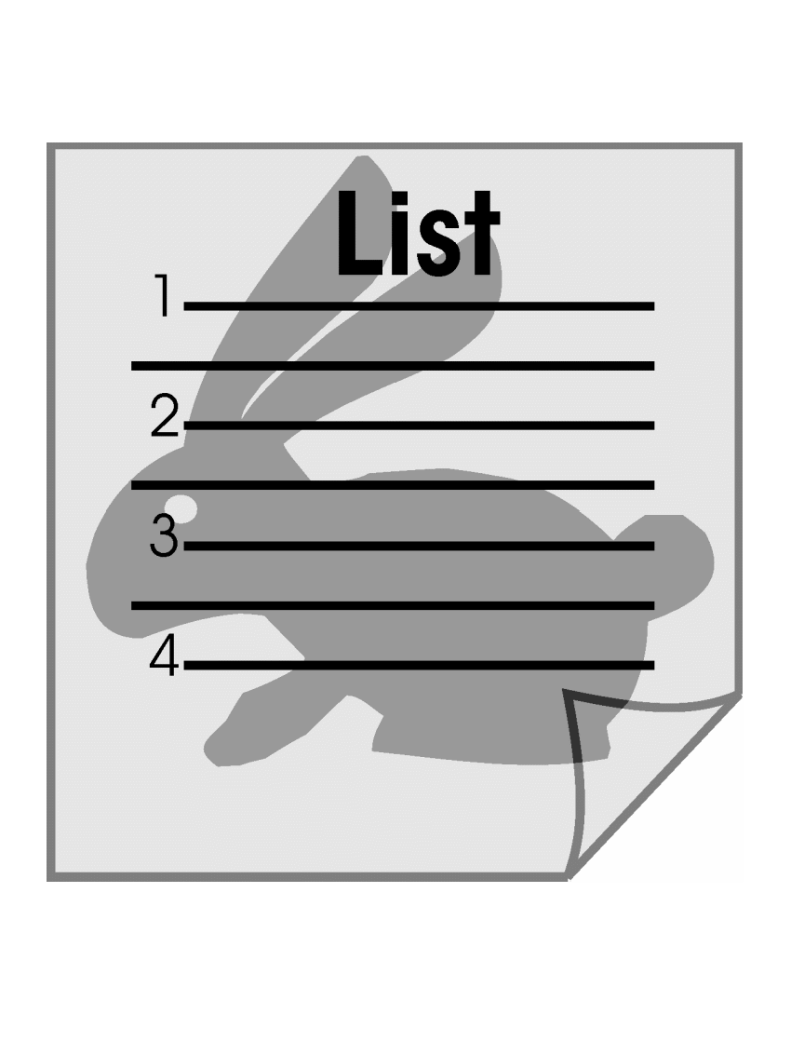
3 Listening for Content
Clues to Structure and Key Points
A couple of example are…
My talk today is divided into 2 sections…
The goals of this experiment were…
The data falls into one of
three categories…
There are three reasons for this behavior:
There were three major results…

Slide 15
3 Listening for Content
Listen to an informal talk
Listen to the professor’s self-introduction
Write down the answers to the questions in your textbook.
Convert your answer to a cluster diagram or mind map

Slide 16
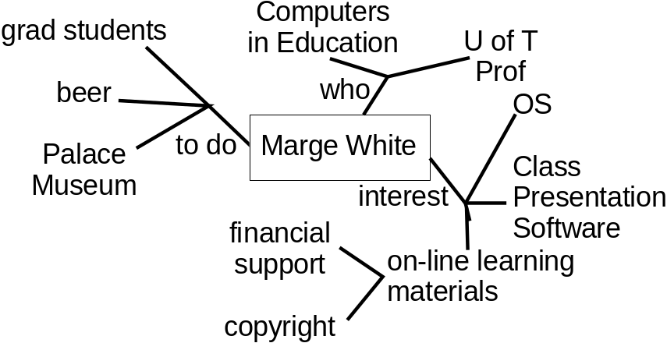
4 Summary Example
Listen to the conversation
Listen to the informal talk as we apply filters…
low pass
(noise) filter
input
After low pass
After bandpass
high pass
filter
info
filler
info
key
noise
filler

Slide 17












Blank Slide

