Slide 1
§3.3 Communication

Slide 2

§3.3 Communication
In Winter in the Woods Alone
(Robert Frost, 1874~1963)
In winter in the woods alone
Against the tree I go.
I mark a maple for my own
And lay the maple low.
At four o’clock I shoulder axe
And in the afterglow
I link a line of shadowy tracks
Across the tinted snow.
I see for Nature no defeat
In one tree’s overthrow
Or for myself in my retreat
For yet another below
Our Life’s Impact
Failure is not shameful
EN ZH

Slide 3


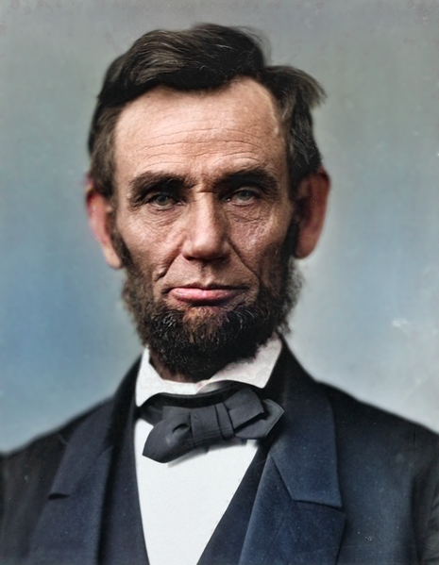
1 Speaker + Listener = Communication
Vocabulary
Communication [kuh-myoo-ni-key-shuhn]
Intellectual [in-t]-ek-choo-uh]
Obligation [ob-li-gey-shuhn]
Abraham Lincoln [ey-bruh-ham ling-kuhn]
https://www.protectrite.com/intellectual-property
https://commons.wikimedia.org/wiki/File:Abraham_Lincoln_In_Color.png

Slide 4

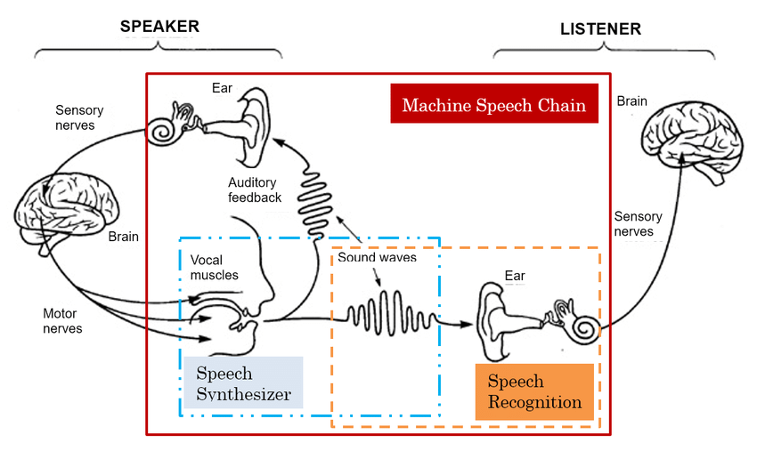
1 Speaker + Listener = Communication
Communication Theory
Listen to the teacher’s talk.
Fill in the blanks in your workbook
Ref: Tjandra A, Machine Speech Chain

Slide 5
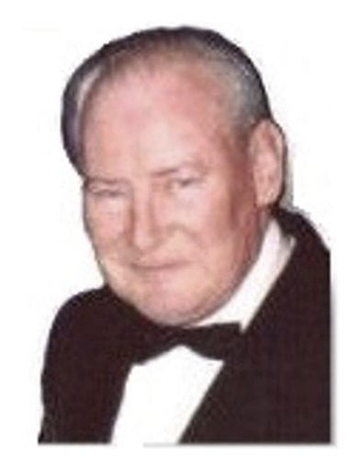
1 Speaker + Listener = Communication
Communication Theory
Communication requires both speaker & listener
The Listener’s Obligation: to try to understand
The Speaker’s Obligation: to help to understand
Examples
  Abraham Lincoln
  Don Singular
The Speaker’s Choice
https://commons.wikimedia.org/wiki/File:Abraham_Lincoln_In_Color.png

Slide 6

1 Speaker + Listener = Communication
One (1) minute talks (graded)
Speaker Role
1. Write down your name
2. Talk 1’
3. Pick up mark sheet
Listener Role
1. Take Notes
-topic
-Mind map (key points)
Together
Each Listener will summarize 1 speaker’s talk.
If correct, both gain 10%
If incorrect, both loose 10%

Slide 7

1 Speaker + Listener = Communication
Two (2) minute dialogues (graded)
When Your Name is Called…
Come to the Front.
Write your Name on the Board.
Speak for 1 Minute.
Sit Down.

Slide 9

2 The Meaning of Fluency
My greatest embarrassment…
Listen to the teacher’s talk
https://medium.com/the-ascent/what-i-find-most-difficult-about-writing-695e016b75b9

Slide 10
2 The Meaning of Fluency
My greatest embarrassment…
What I thought I said…
What I actually said…
Don’t Give up on English!
Failure is not shameful!
… o (pause) kashite kudasai”
→Please, may I borrow the…?
https://medium.com/the-ascent/what-i-find-most-difficult-about-writing-695e016b75b9
…(pause) okashite kudasai”
→ Please, I am going to rape you

Slide 11
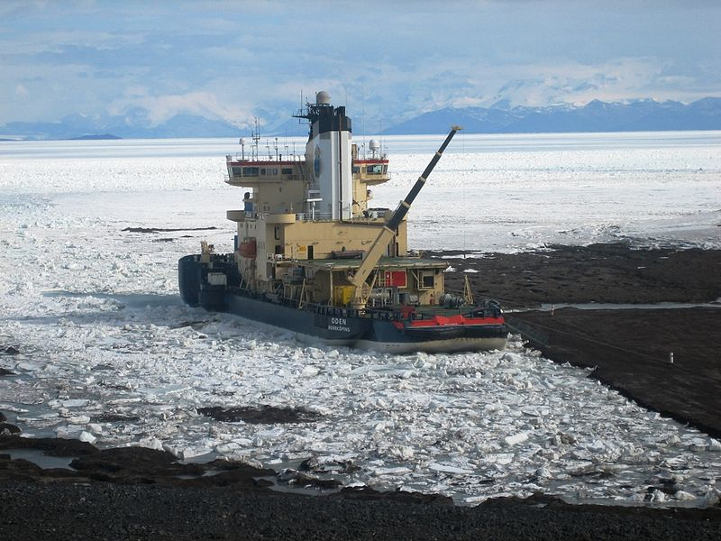
3 Small Groups & The Name Game
Small Groups in North America Culture
Meet weekly || Bi-weekly
Share Common Interest
Format
  “Ice-Breaker”
    10’
    Relax
  Activity (60’)
    Share
    Learn
  Closing (20’)
    Snacks
    Conversation
https://commons.wikimedia.org/wiki/File:The_Swedish_Ice_Breaker_Oden.JPG

Slide 12
3 Small Groups & The Name Game
Name Game (“Ice-Breaker”)
Repeat the names and likes/dislikes of the people speaking before you.
Then say your English name and something you either like or dislike

