Slide 1
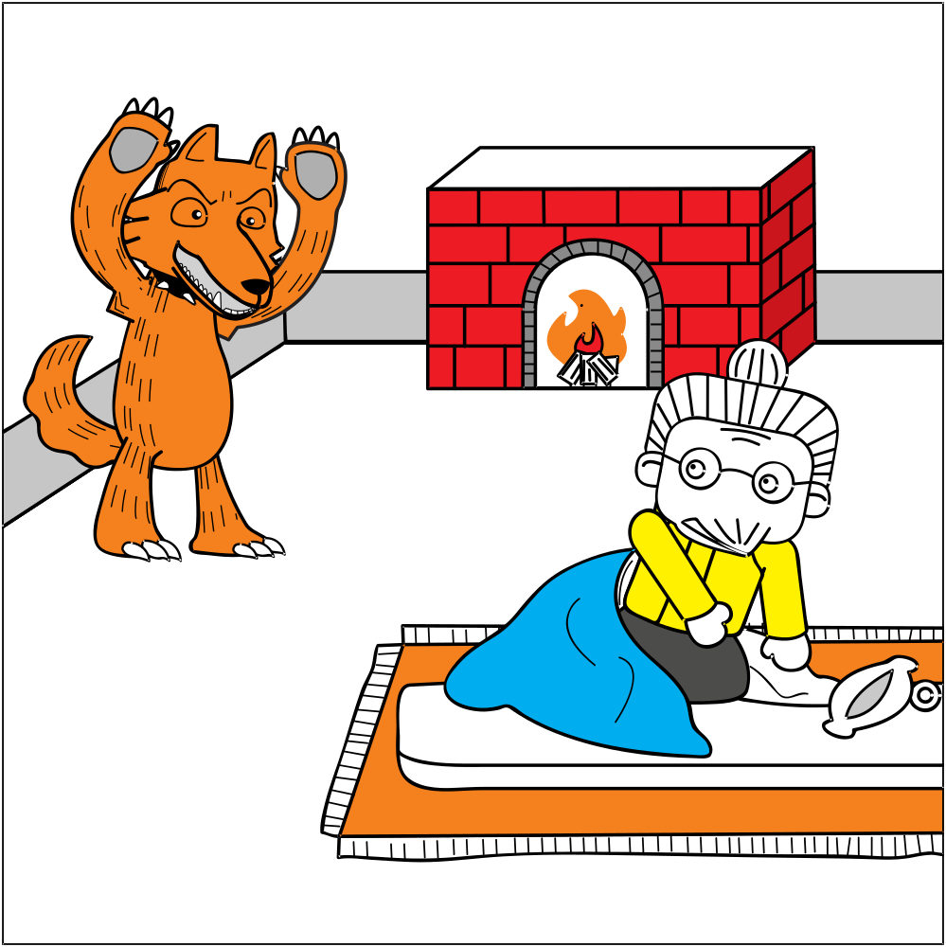
§3.4 Speak Up! Active Listening

Slide 2

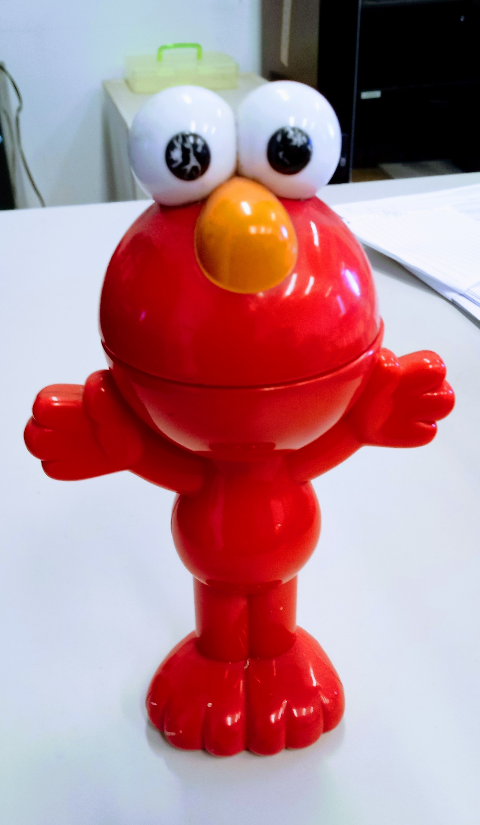
§3. Listener: Interrupting a Speaker
Interrupt [in-ter-rupt]
Clarification (noun) [clar-i-fi-ca-tion] verb: clar-i-fy

Slide 3

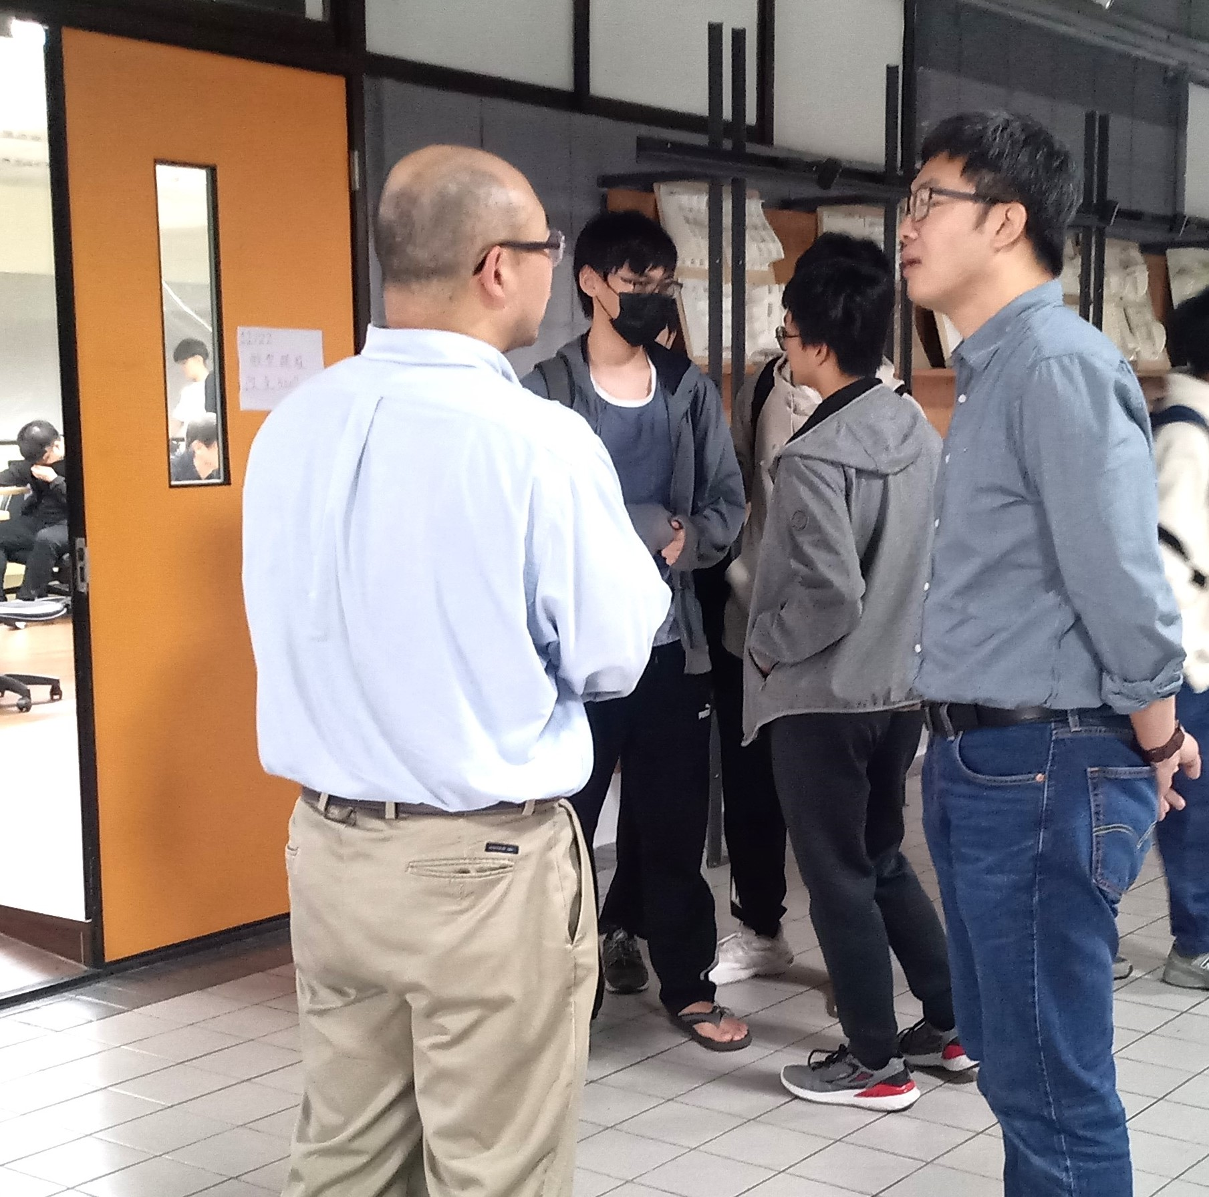
1 Listener: Interrupting a Speaker
Listen to the Teacher’s Talk
Visiting Professor Qiyin Fang (McMaster University) takes questions from Prof T X Lee (NTUST) after the lecture on December 2023. Yuan Ze University students in the background waiting for their turn to ask a question.

Slide 4
1 Listener: Interrupting a Speaker
The importance of Interrupting
Questions are Expected. If none?
  Everyone understands→ talk faster
  no one understands→ talk slower
  no one cares→ wasting his time
Influence of setting: When and How to Ask
  Formal → Raise hand
  Informal → Interrupt orally
  Short Talk → Wait
?
?

Slide 5

1 Listener: Interrupting a Speaker
Class Activity: Memorizing Interrupting phrases
Echo the phrases together with other classmates
Choose 1 or 2 to shout out loudly/repeatedly
-Excuse me…
-May I ask a question?
-Excuse me please…
-Sorry to interrupt but…
-Pardon me;
I’d like to ask a question.
-Question.

Slide 6
2 Speaker: Returning to Topic
Return-To-Topic Phrases
When? After speaker has answered the question
Why? To all the audience the speaker has finished answering the question.
In any case…
As I was saying…
Anyway…
Getting back to my story…
Now where was I? Oh yes…

Slide 7

2 Speaker: Returning to Topic
Looking for “Return-To-Topic” phrases
Underline the interrupting phrases in your book
Circle the return-to-topic phrases
In any case…
As I was saying…
Anyway…
Getting back to my story…
Now where was I? Oh yes…

Slide 8
2 Speaker: Returning to Topic
Memorizing “Return-To-Topic” Phrases
Echo the phrases together with other classmates
Choose a few phrases to memorize
Practice shouting them out.
In any case…
As I was saying…
Anyway…
Getting back to my story…
Now where was I? Oh yes…

Slide 9
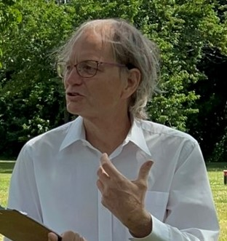
3 Informal Speeches
Prepare a Speech
Choose one (1) topic from the textbook.
Prepare a 1’ speech
Write down a few keywords to help you remember
Do not write in sentences!

Slide 10
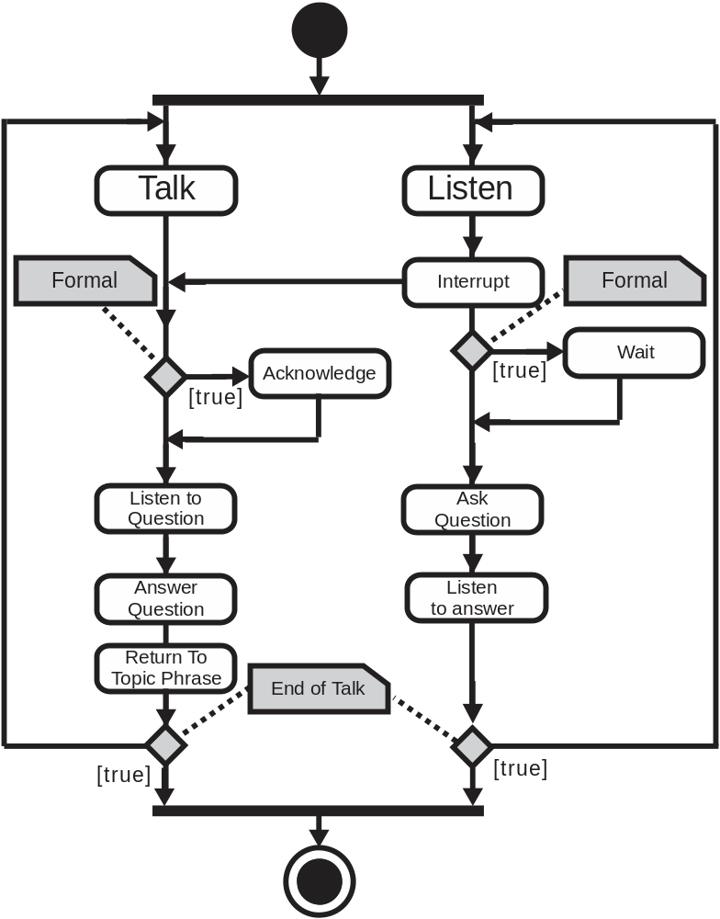
3 Informal Speeches
Demonstration

Slide 11
3 Informal Speeches
Interrupted Speech
1 Speaker:
  Give your talk
  Answer questions when interrupted
  Repeat talk until bell
3 Listeners:
  Interrupt
  Ask Clarification questions

Slide 12
4 Clarification Questions
Common Types of Questions

Slide 13

4 Clarification Questions
Common Types of Questions
Used after you speaker’s attention.
To request
  An Example
  A Point to be repeated
  Clarification of
    Terminology
    Logic
Further Study

Slide 14
4 Clarification Questions
Common Types of Questions
Could you please give us an illustration?
Could you give us an example of…?
Could you please explain your last point again?
I’m sorry, I’m not clear on the last point. Can you please give an example?
What does the word XXX mean?
What does XXX mean?
I don’t quite understand how YYY follows from XXX.
I’m sorry; I don’t quite understand the connection between XXX and YYY.
Could you please repeat your last point again?

Slide 15
4 Clarification Questions
Echo and Shout
Could you please give us an illustration?
Could you give us an example of…?
Could you please explain your last point again?
I’m sorry, I’m not clear on the last point. Can you please give an example?
What does the word XXX mean?
What does XXX mean?
I don’t quite understand how YYY follows from XXX.
I’m sorry; I don’t quite understand the connection between XXX and YYY.
Could you please repeat your last point again?

Slide 16
5 Interrupting: Formal Vs. Informal
Deciding how to interrupt
Listen to the talk
Complete the sentences in your textbook.

Slide 17
5 Interrupting: Formal Vs. Informal
Deciding how to Interrupt
Identical:
  Clarification questions
  Return-to-topic phrases
Different: Interrupting
  Informal: Speak out!
  Formal:
    How?
      Raise Hand
      Wait to be seen
      Identify self
      Ask question
    When?
      Long talk: Immediately
      Short Talk: Wait to End

Slide 18

6 Studying English w/comics
Ordering a Comic Strip
Find a partner
Member A come to front get correct order of the slides. Don’t show the order to your partner!
Member B: ask clarification questions in order to guess the order of the slides.

Slide 19
6 Studying English w/comics
Studying English using Comics
E.g.

Slide 20
6 Studying English w/comics
Class Activity
Listen
Interrupt when you don’t understand
Ask a clarification question.
Once you have asked one (1) question you may leave.

Slide 21

7 Homework
Writing a Short Speech
Write a short speech starting with the sentance:
“In working on a research project with a Canadian, the most difficult thing for me would be…”
Explain why you feel this would be a problem.
Be prepared to present your ideas in class.
Be prepared to answer questions about your ideas!

