Slide 1
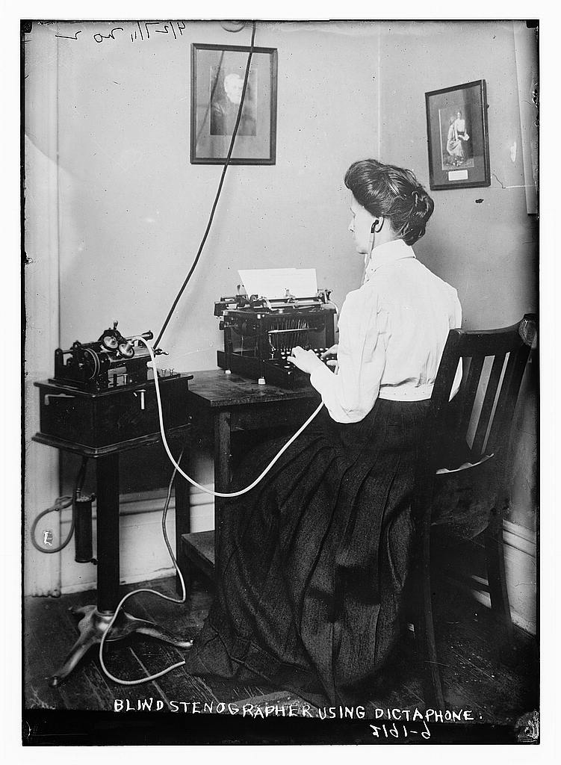
§3.5 Note Taking & Key Words
https://flickr.com/photos/library_of_congress/2163451008/in/photolist-4ibfBs-223KvSg-4ZJrbG-8eMY-2ggfKvi-e1uRs9-77HkQ8-653YFW-FKLj8S-2kH3RmR-9AqFgZ-2ivsggC-mdBLa6-HSbPj-2kvBbNG-2kdFv5L-7DTsfG-2UAmZm-6ZRAi4-2mm1RAd-2jYpeGM-3oyTig-2cf291B-2m4q7Xf-7fTaCk-2g8G2iX-gLmFxQ-2mMSmba-2kK1aYv-cUU8LC-2kJZ7iA-SSZxyQ-7ZYE56-2mLi4NX-2mvVe7F-npxJaz-2xhJXS-2jcaDo3-Yy9Fx1-6AW11j-2iGS76z-GpyQK-2iBry2Y-2jTcMw3-RMTTfN-6FkR7e-2kJVy3m-2mttcBC-XB5cMc-2iTbMg3

Slide 2

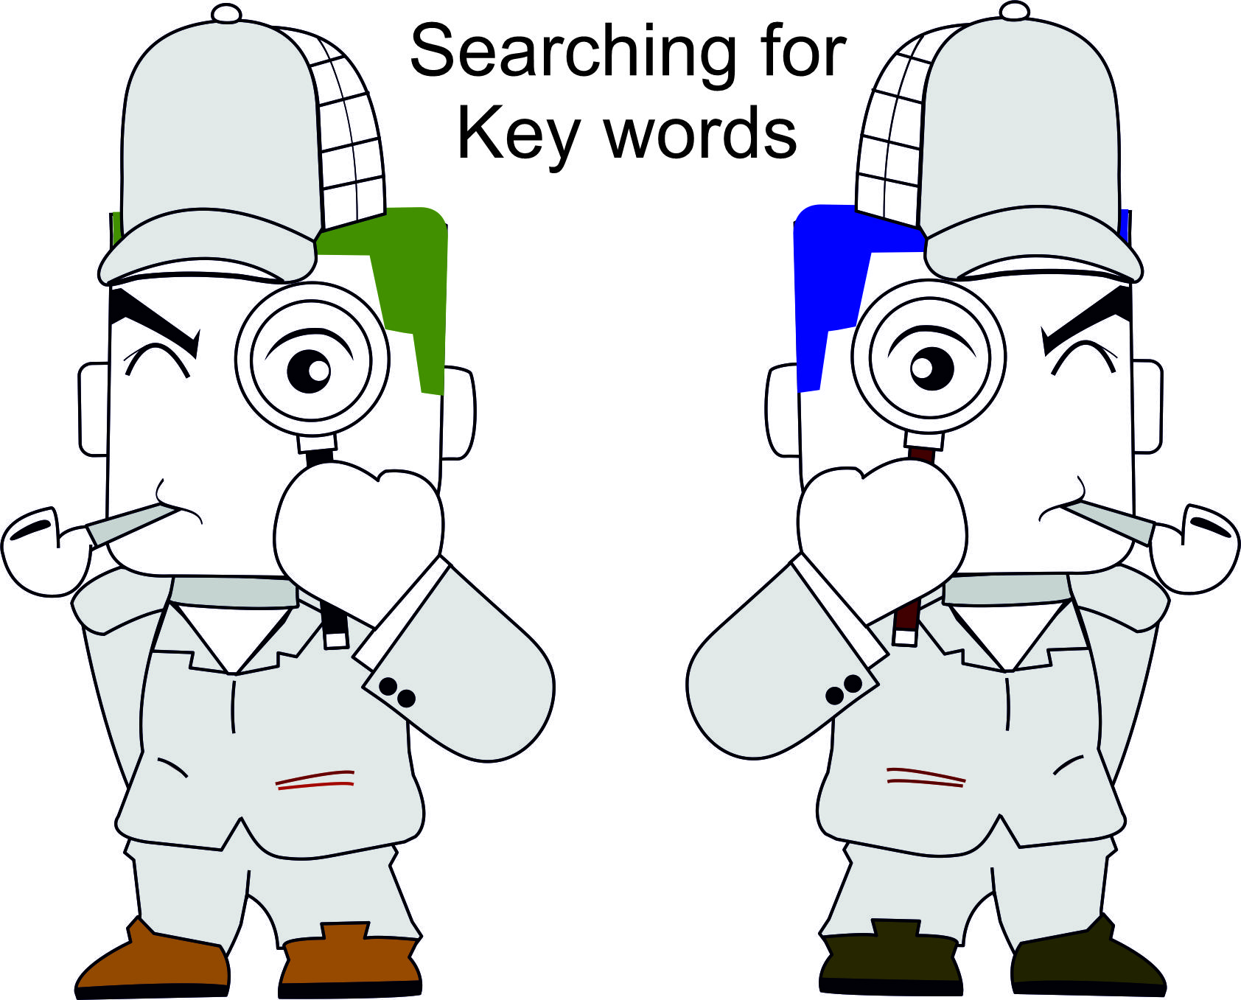
§3.5 Note Taking & Key Words
Find 5 differences!

Slide 3
§3.5 Note Taking & Key Words
1
5
3
2
6
4

Slide 4
§3.5 Note Taking & Key Words
Speaker: Present your homework
Listeners: Interrupt
Listeners: Ask a clarification question
Speaker: Return to topic
Interrupt: Excuse me…
  May I ask a question?
  Excuse me please…
  Sorry to interrupt but…
Return-to-topic phrases
  As I was saying…
  Anyway…
  Getting back to my story…
  Now where was I? Oh yes…

Slide 5


1 Identifying Key Words
Stenographer
https://flickr.com/photos/library_of_congress/2163451008/in/photolist-4ibfBs-223KvSg-4ZJrbG-8eMY-2ggfKvi-e1uRs9-77HkQ8-653YFW-FKLj8S-2kH3RmR-9AqFgZ-2ivsggC-mdBLa6-HSbPj-2kvBbNG-2kdFv5L-7DTsfG-2UAmZm-6ZRAi4-2mm1RAd-2jYpeGM-3oyTig-2cf291B-2m4q7Xf-7fTaCk-2g8G2iX-gLmFxQ-2mMSmba-2kK1aYv-cUU8LC-2kJZ7iA-SSZxyQ-7ZYE56-2mLi4NX-2mvVe7F-npxJaz-2xhJXS-2jcaDo3-Yy9Fx1-6AW11j-2iGS76z-GpyQK-2iBry2Y-2jTcMw3-RMTTfN-6FkR7e-2kJVy3m-2mttcBC-XB5cMc-2iTbMg3

Slide 6

1 Identifying Key Words
Using Key Words
Key words NOT all words
Guidelines in note taking/recording key words
  Begin with a general topic. What is the main point?
  Use a Mind Map (best) or informal outline
  Be selective.
    Ignore unimportant words.
    Omit “is”, “are” or use “=”
    Ignore “filler words”, “return-topic” phrases…
  Use an informal outline.
  Use abbreviations
  Note example
  Underline or star (*) key points

Slide 7
2 Reducing Sentences to Key Words
saying
Shakespeare
proverb
Bible
euphemism

Slide 8


2 Reducing Sentences to Key Words
Sentences → Key Words
Listen to the paragraph
Sentence by sentence
  Determine topic
  Write down 3-4 key words.
  Combine key words→ short note.
  (Each sentence will be played 4x)

Slide 9
2 Reducing Sentences to Key Words
Sentences → Key Words
1 (Example)
Topic: Sleep habits
early bed→ healthy
“Early to bed
and early to rise
makes a man healthy,
wealthy and wise.”
2 3 4 5 6 7

Slide 10
2 Reducing Sentences to Key Words
Sentences→ Key Words
Discuss your answers
Can you use less words, more symbols?

Slide 11
3 Combining Key Words → Paragraph
Key Words → Paragraph Outline
Topic: Sayings
  e.g. “Early to bed…”
  many from
    Shakespeare
    Bible
  Proverb:
    Simple, concrete
    common sense
    <7 words
  Euphemisms:
    harsh→ indirect
    E.g. Dear John Letter→ end friendship
1
2
3
4
5
6
7

Slide 12
3 Combining Key Words → Paragraph
Demo: Key Words → Paragraph Mind Map

Slide 13
3 Combining Key Words → Paragraph
Debating Popular Sayings
Choose a saying or proverb from the textbook
Divide into PRO (2 people) and CON (2 people) teams
Prepare your position (3 minutes)
Debate
  : PRO representative (90 s)
  : CON representative (90 s)
  : Q & A (120 s)

Slide 14
4 Short Talk: Key works →Mind Map
TEDS Talk: Mind Mapping
Listen to the lecture
We will play twice
Try to combine key words to understand

Slide 15
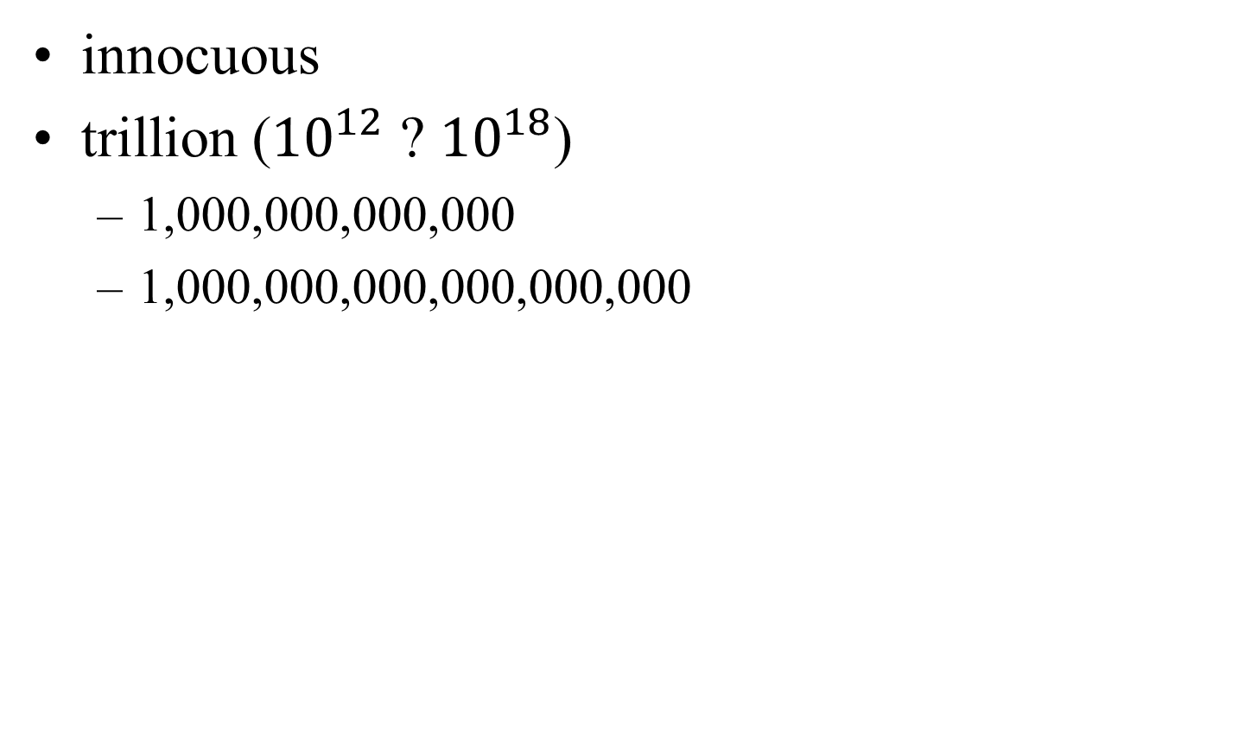
4 Short Talk: Key works →Mind Map
innocuous
trillion (${10}^{12}$ ? ${10}^{18}$)
  1,000,000,000,000
  1,000,000,000,000,000,000

Slide 16

4 Short Talk: Key works →Mind Map
1st Reading: Listen carefully to the talk
2nd Presentation: Ask clarification questions
3rd Time: Combine and optimize (~50 keywords) to capture the main ideas of the talk.
  Mind Map
  Linear Outline
4th Time: Compare with the Facilitator’s notes (next slide – not only correct way)

Slide 17
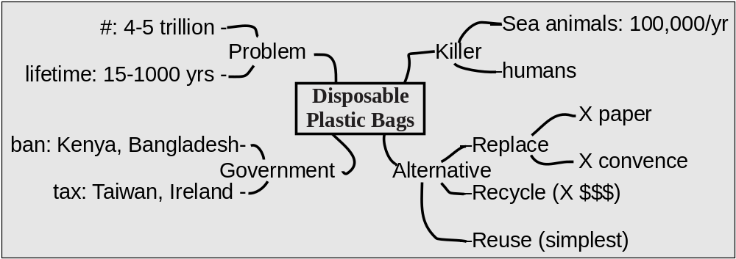
4 Short Talk: Key works → Mind Map
Disposable Plastic Bags (Mind Map)

Slide 18
4 Short Talk: Key works → Mind Map
Disposable Plastic Bags (Linear Outline)
Problem:
  #:4-5 trillion
  lifetime: 15 to 1000 yrs
Killer
  Sea animals: 100,000/yr
  humans
Government efforts to reduce use
  ban: Kenya, Bangladesh
  tax: Taiwan, Ireland
Alternatives
  Replace (X paper, X convenient)
  Recycle (X $$$)
  Reuse (simplest)

Slide 19



5 Homework & Assignments
Read the essay: “§11.4 Studying in the USA”
Review §3 for test (written)
Be prepared for a listening test

Slide 20






Blank Slide

