Slide 1
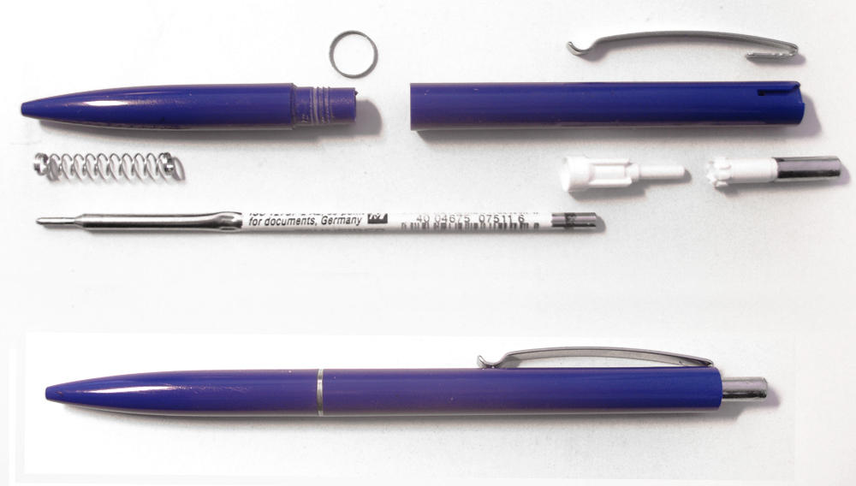
4 Correspondence
A Basic Written Skill
https://commons.wikimedia.org/wiki/File:Ballpoint-pen-parts.jpg
4. Correspondence: Basic Writing Skills
5. Reading Technical Literature

Slide 2


Objectives, Contents, Evaluation
Objectives
Contents
Evaluation

Slide 3

The Writing Process
Idea→
Cluster →
Linear Outline →
1st Draft →
Final Draft
https://www.gutenberg.org/cache/epub/13444/pg13444-images.html#page37

Slide 4

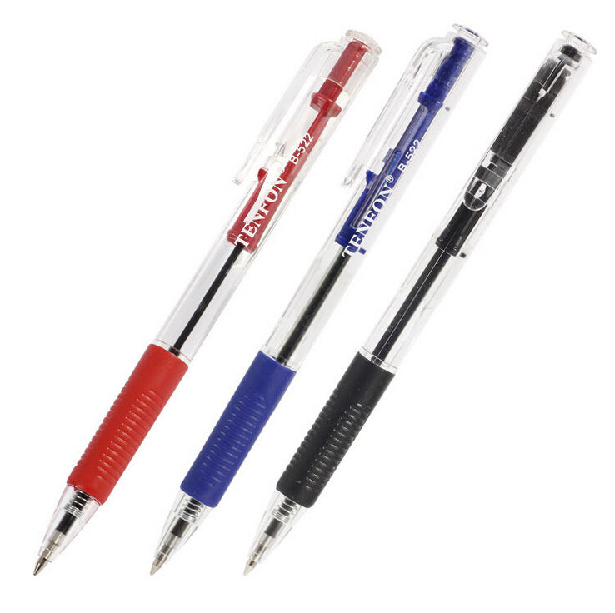
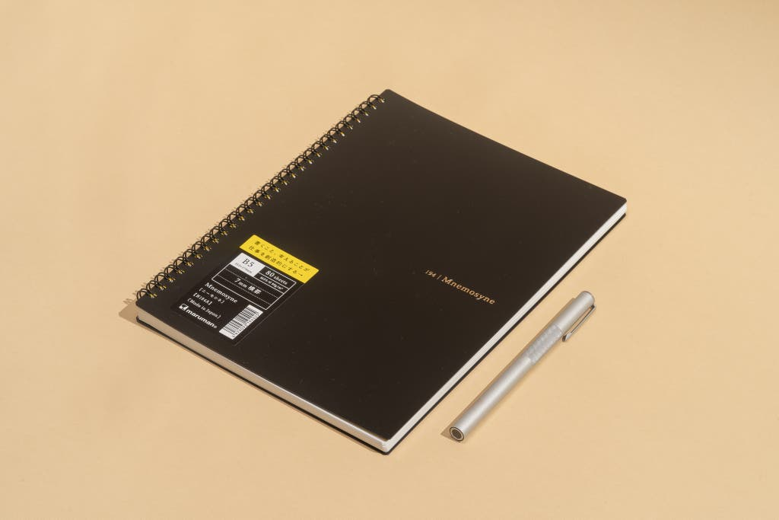
Supplies
For Next week...
Textbook
Notebook (B4)
  Use for Journal Entry (hand in weekly)
  write your English name and student number in the upper right-hand corner of the cover
  Place Sticker (next week) to indicate if want it marked.
Red, Blue, and black pens

