Slide 1
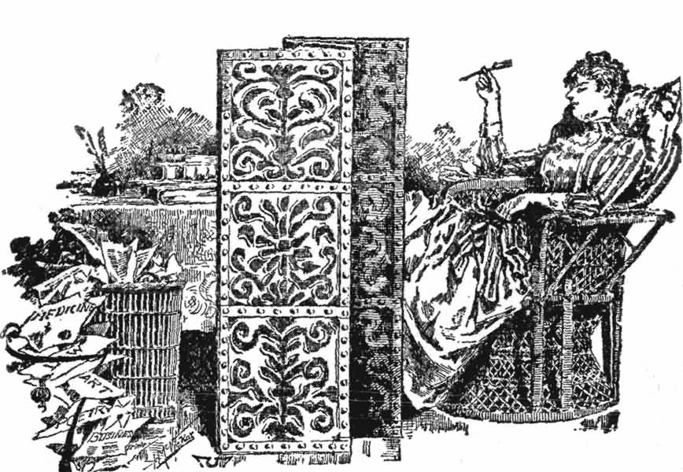
§4.2 Purpose & Types of Correspondence
https://www.gutenberg.org/cache/epub/13444/images/full034.jpg

Slide 2
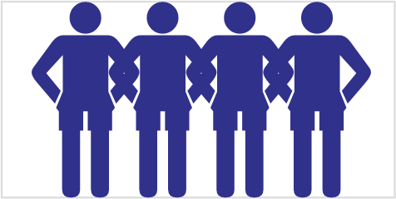
Class Activity: Learning and memorizing names
1st Round
  Repeat the names of students before you
  Add your name and give your hometown.
  Hello John, Jane. My name is Fred.
  I am from Tanshui.
2nd Round
  Recite the name of every third student.

Slide 3

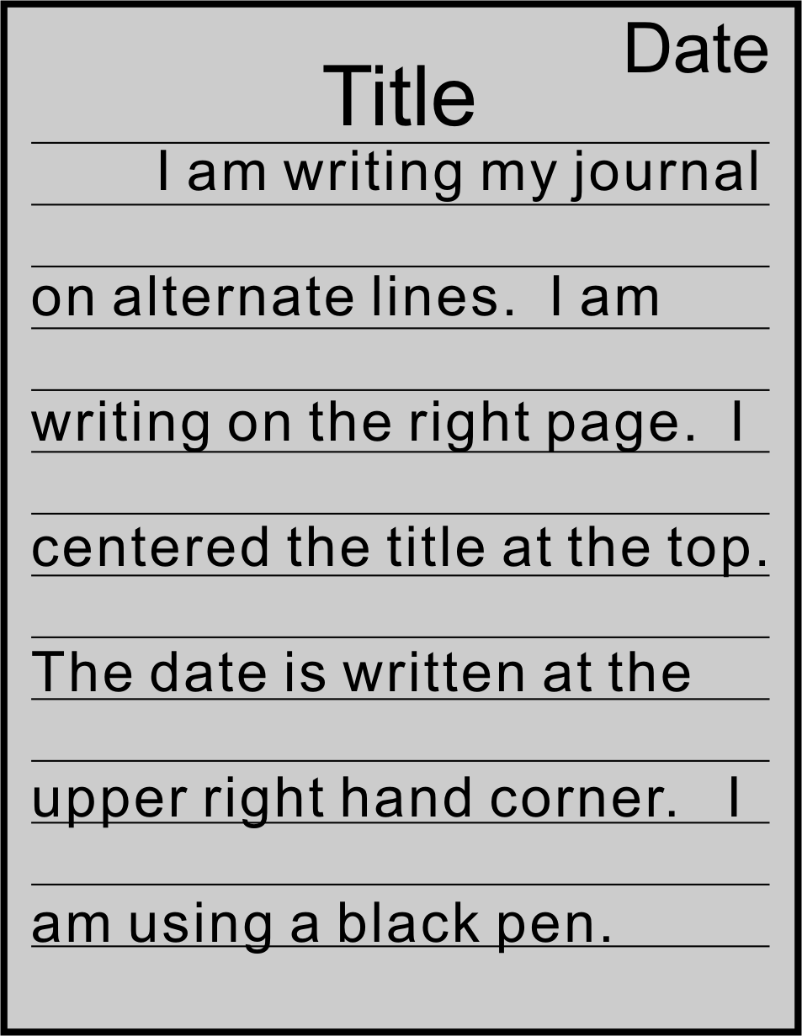
1 Journal Entry
Tell me what you hope to learn in this course.
You have 10 minutes

Slide 4

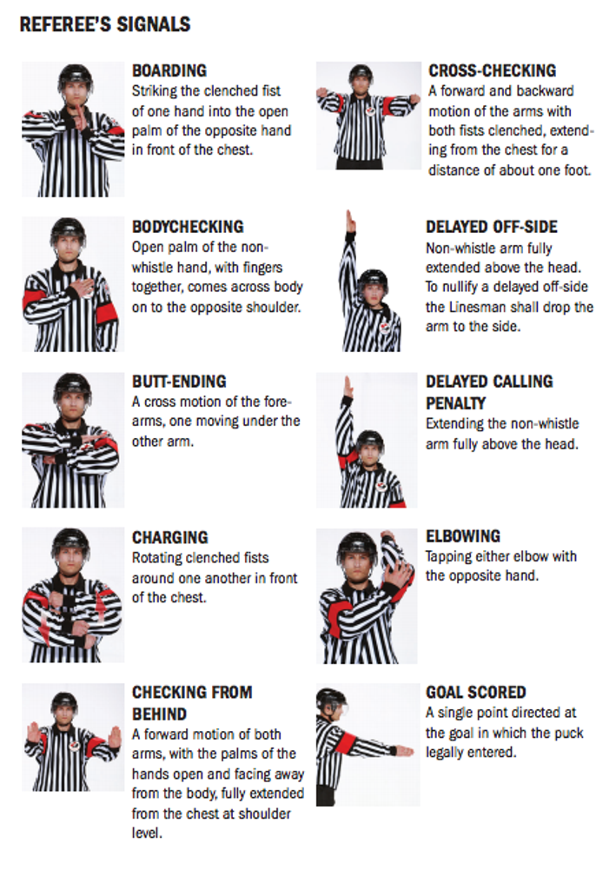
2 Purpose of Correspondence
https://www.jdfminorhockey.com/page/show/7289777-referee-signal-guide
Referee [re-fer-ee]

Slide 5

2 Purpose of Correspondence
Follow along in your workbooks.
Fill in the blanks.

Slide 6
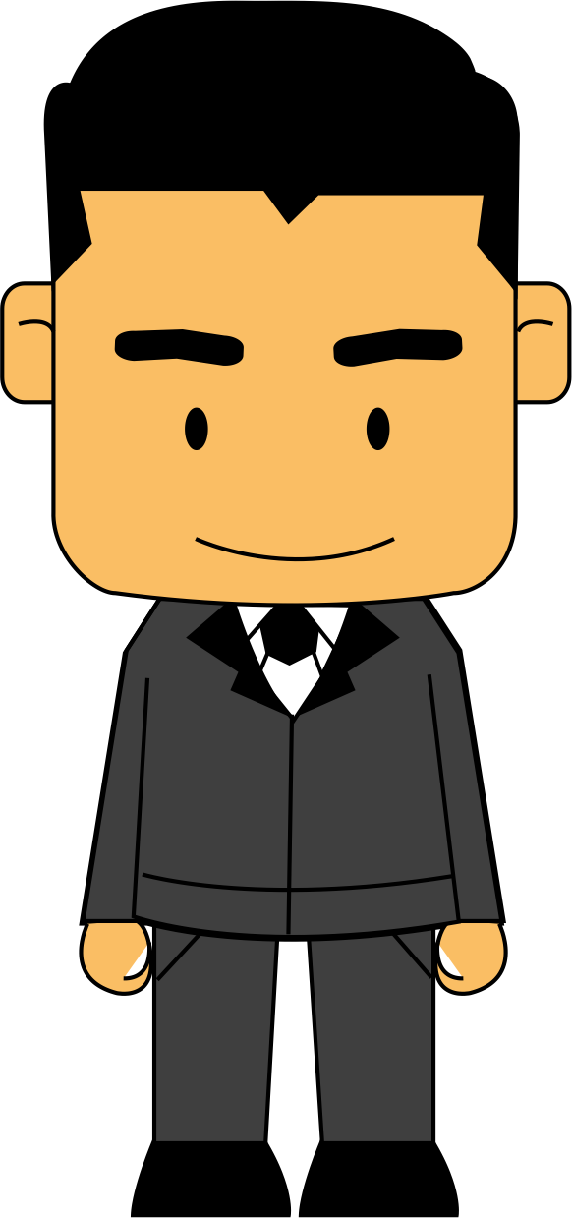
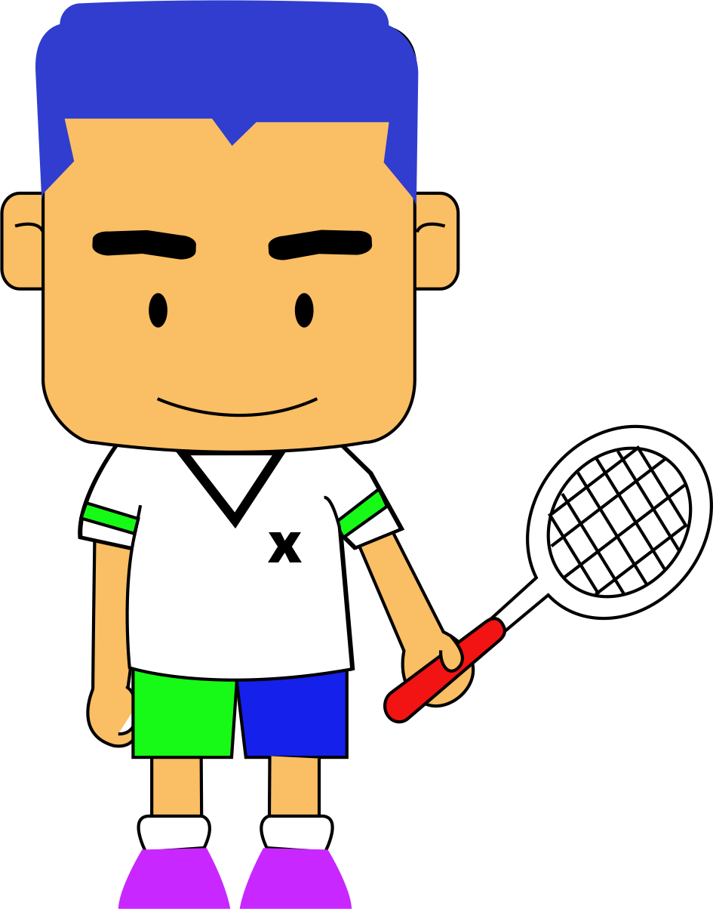

2 Purpose of Correspondence
Writing is used…
To greet
To introduce people
To express
To express sympathy
To describe experiments
To respond to
To
To apologize
To say
To greet co-workers
To introduce people
To express thanks
To express sympathy
To describe experiments
To respond to referees
To apply for a job
To apologize
To say farewell

Slide 7
2 Purpose of Correspondence
Writing is used…
Goals of the Units
To greet co-workers
To introduce people
To express thanks
To express sympathy
To describe experiments
To respond to referees
To apply for a job
To apologize
To say farewell
To distinguish between types of informal and formal correspondence
To identify what type of correspondence is appropriate in a given situation
To learn to write appropriately

Slide 8
3 Levels of Formality
Abbreviation
[ab-re-vi-a-tion]
  Example → e.g.
  Mister → Mr.
Con-trac-tion
  Do not → don’t
Acronym
  National Taiwan University → NTU

Slide 9
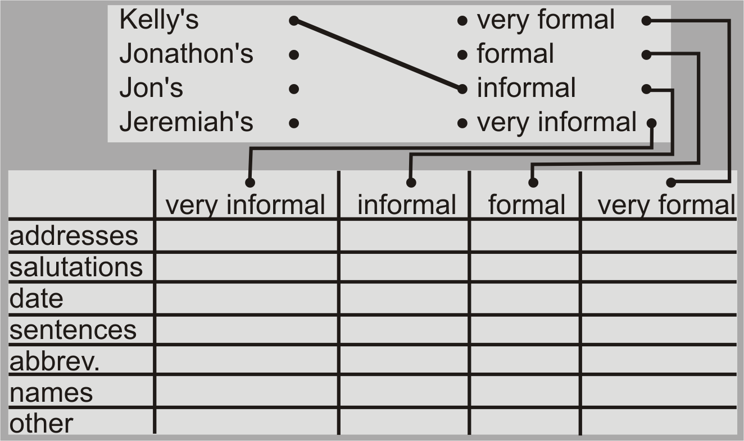
3 Levels of Formality
Categorizing Correspondence
1. Rank correspondence from least to most formal
2. Based on your ranking, fill in the table (Don’t try to understand contents)

Slide 10
3 Levels of Formality
Categorizing Correspondence

Slide 11
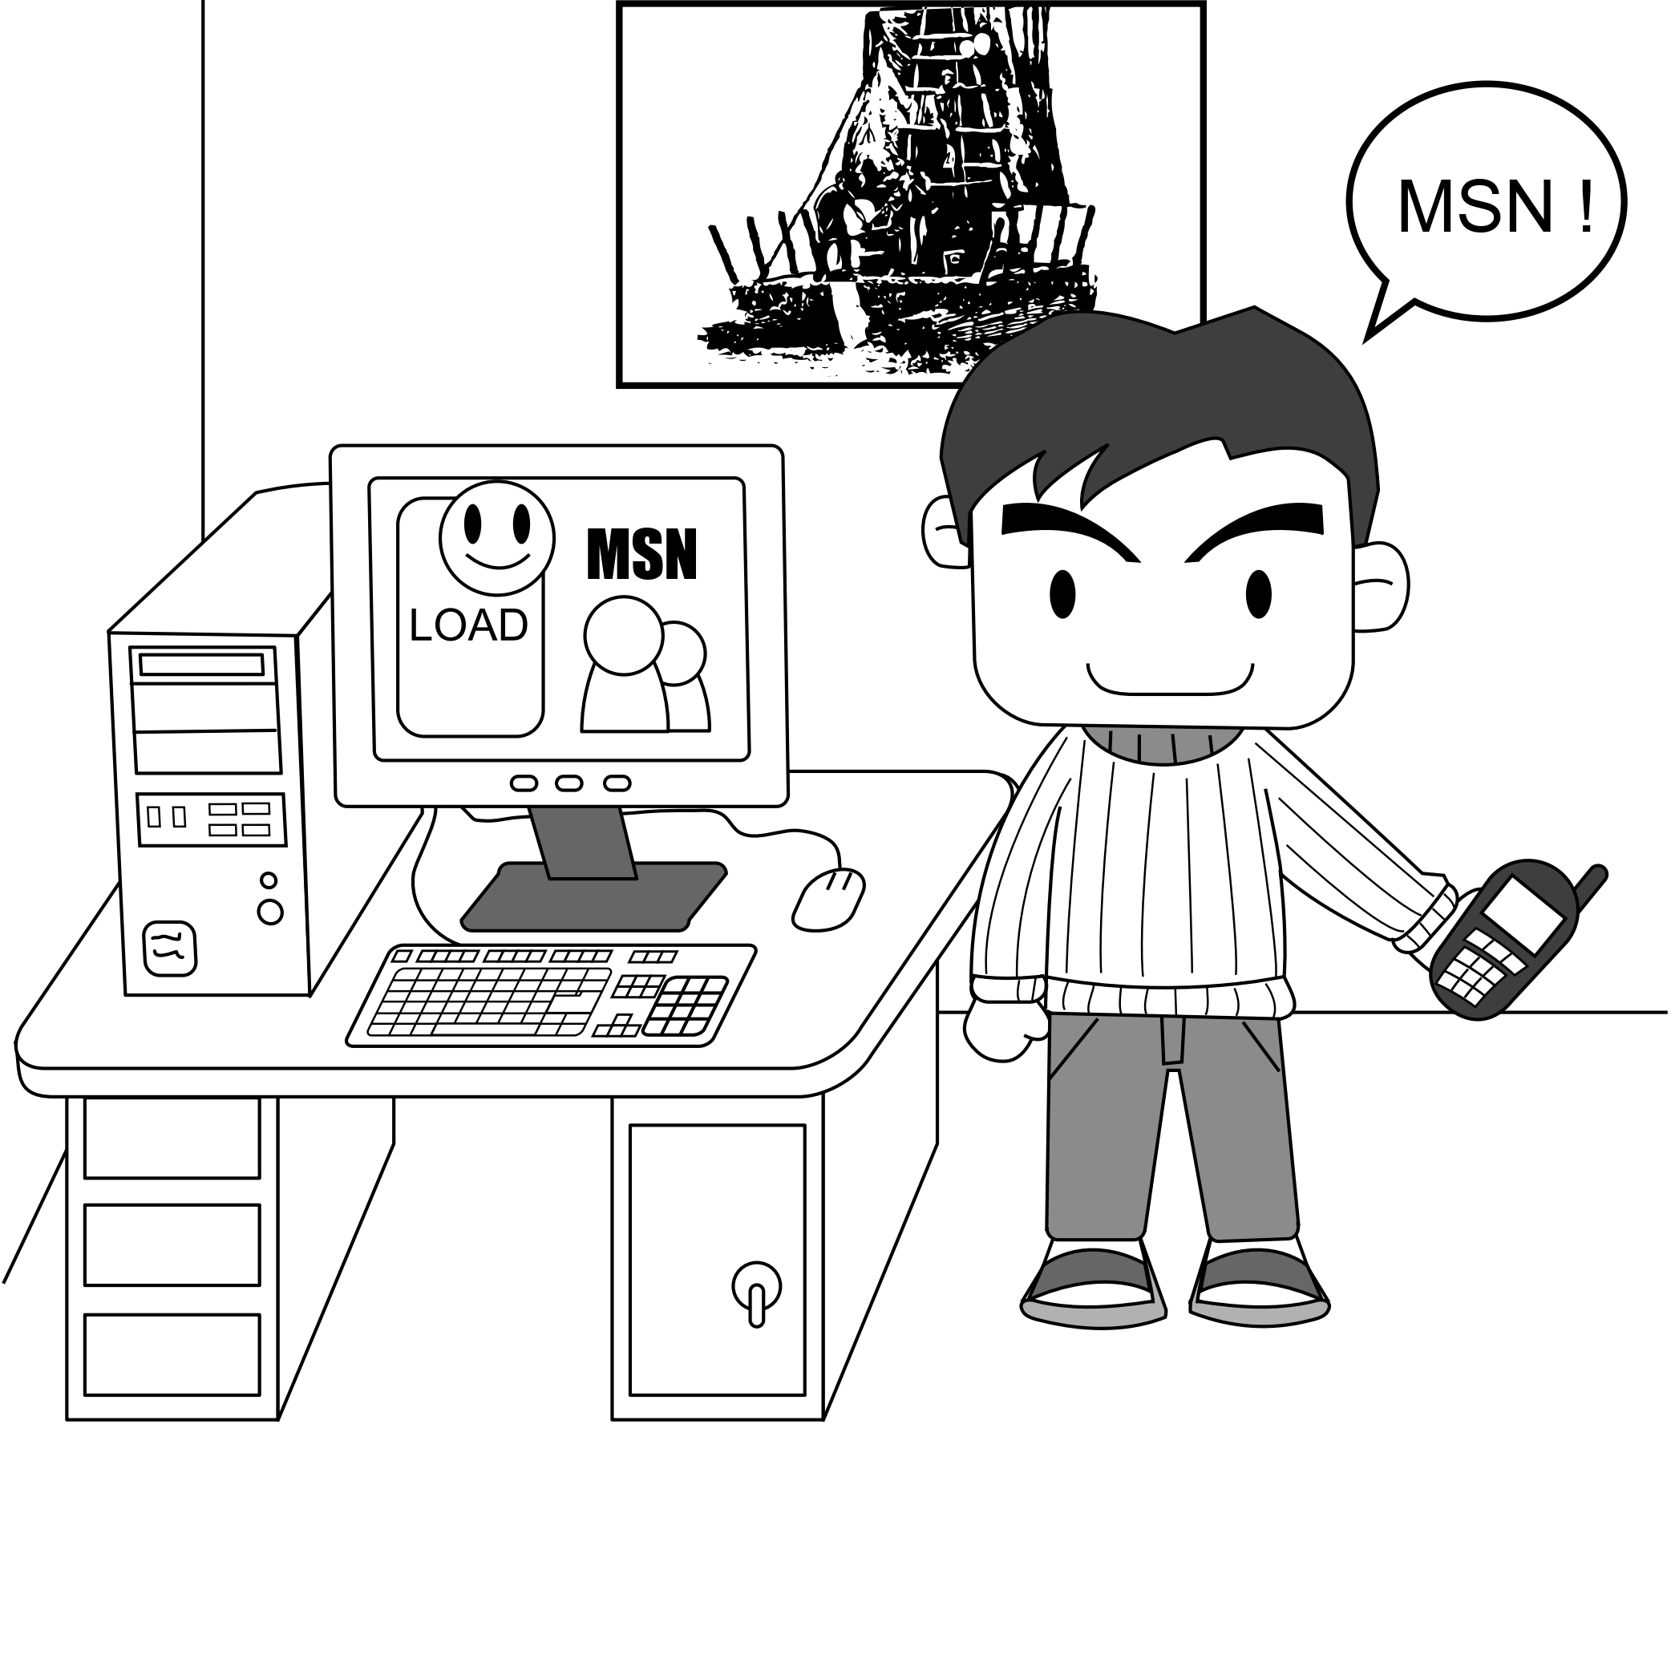
4 Informal Notes & Memos
The Simplest forms of Correspondence
Listen to the talk

Slide 12
4 Informal Notes & Memos
The Simplest forms of Correspondence
Who?
Self
Lab mates
family
Categories
  Lists
  Notes
  Memos
Attributes
  Phrases only
  No salutations
  Bullets, Symbol (☺)
  Leave out…

Slide 13
4 Informal Notes & Memos
Formalizing
Rewrite the memos and notes as formal correspondence. (i.e. make sentences complete, add missing words, and formal salutions.)

Slide 14
4 Informal Notes & Memos
Formalizing
Choose one (1) topic.
Write a short memo/note (1 line)
If additional time, choose a second.

Slide 15

Homework & Assignments
Complete the activities in this unit.

