Slide 1

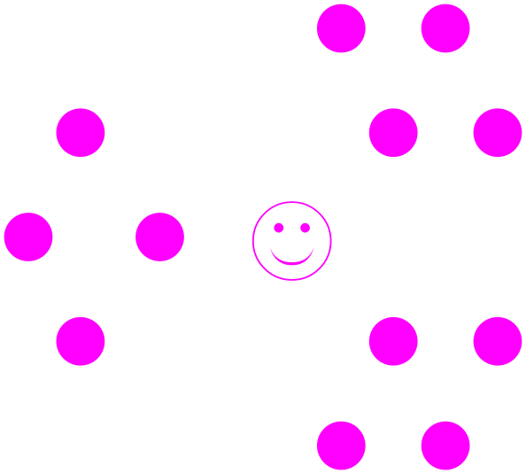
4.3 Personal Letters…
Pre-writing, Cluster Diagrams

Slide 2

0. Pre-writing, Cluster Diagrams
Alphabetic Name Game
if (classSize<20){
→1. In turn, Stand up and say your English name loudly;
→2. After all are standing up,
Sit down in alphabetical order;
}else{
1. Starting from the beginning of your column,
Stand up and say your English name loudly;
→2. Sit down in alphabetical order
(‘A’ closest to front, ‘Z’ closest to back);
}

Slide 3

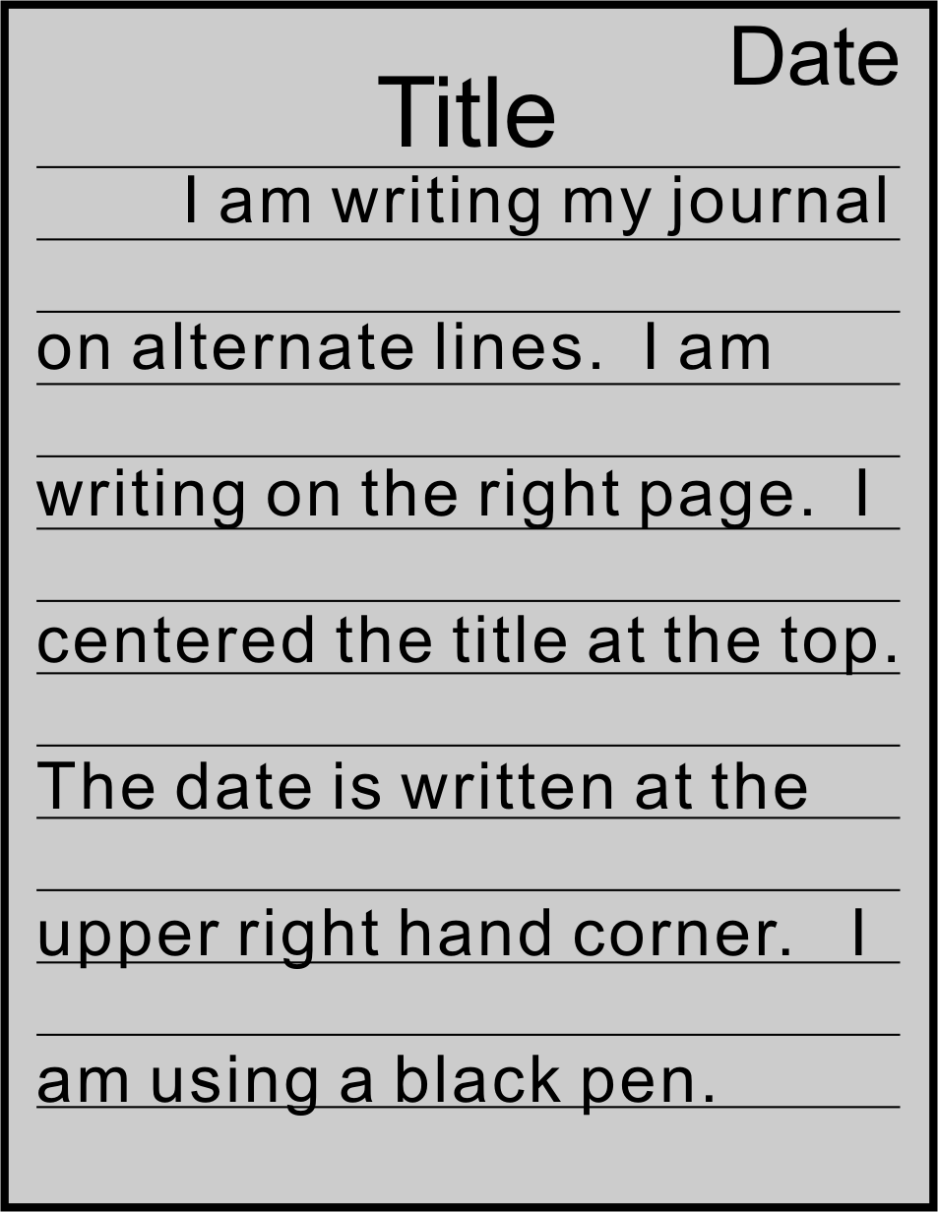
1 Journal Entry
if (you have taken a class with me previously){
Tell me how I can
improve my teaching.
}else{
Tell me how to improve English education in Taiwan.
}

Slide 4

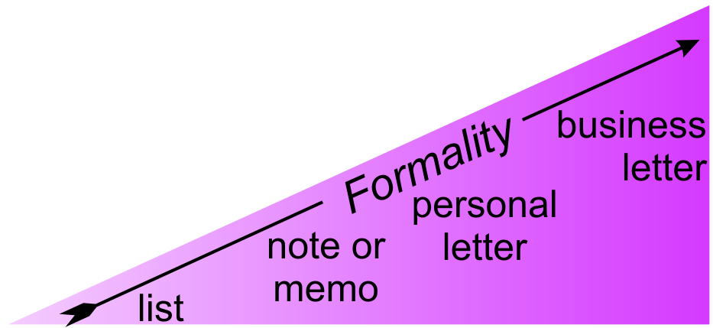

2 The Personal (Informal) Letter
Place in Correspondence Hierarchy

Slide 5

2 The Personal (Informal) Letter
Examine an Informal Letter of Introduction
What differences are there in format between this letter and a Chinese letter?
List characteristics that show this is an informal letter.

Slide 6
2 The Personal (Informal) Letter
: Format and Structure
Listen to the talk
Fill in the blanks in your workbook

Slide 7
2 The Personal (Informal) Letter
: Format and Structure
- indented to page center
- return address (maybe)
- date (last line)
heading
greeting
body
close
signature
post script (PS)
- Dear
- receiver’s name
- comma
- Your message
- Indent first line
1 line
Comma
2 blank lines follow
Handwritten name (blue)
Your name
1 blank line before
Begin P.S.
comma

Slide 8

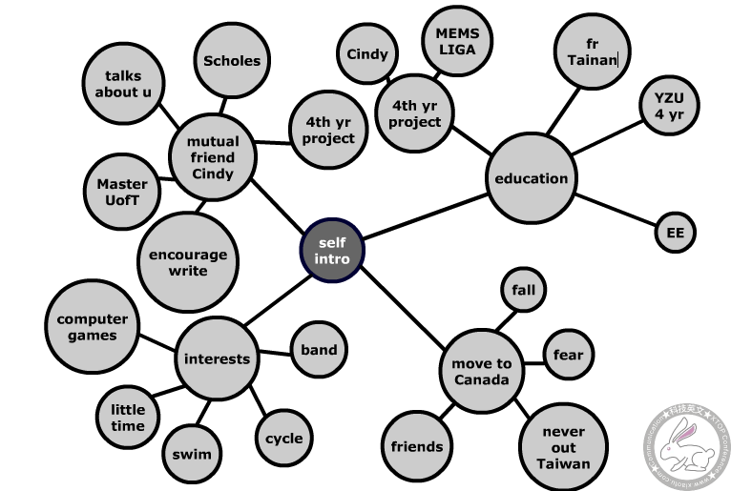
3 Pre-Writing
Cluster diagram
  = cloud diagram
  sub-set of mind maps
Mind map

Slide 9
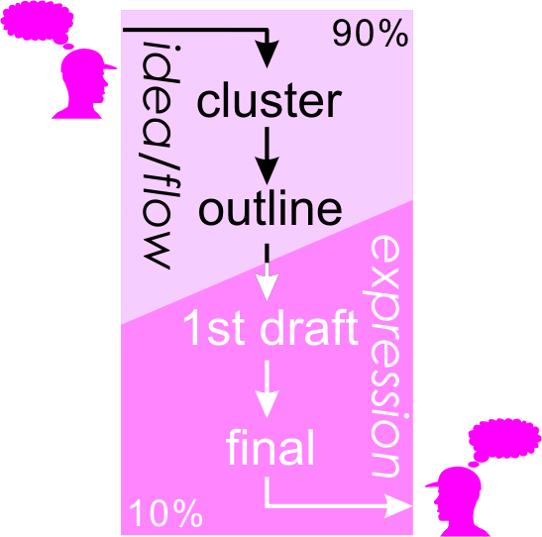
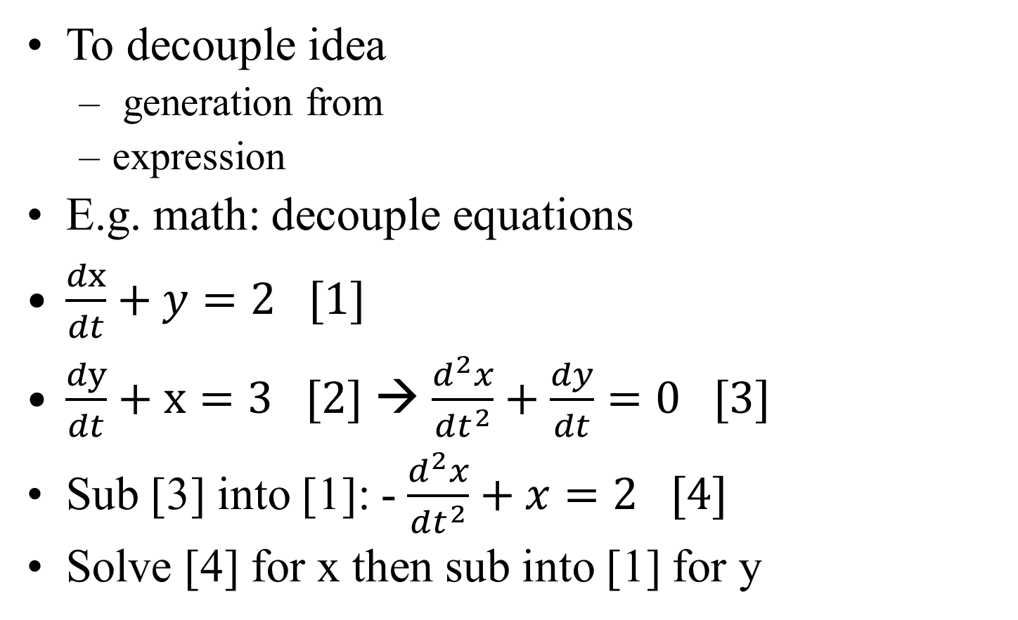
3 Pre-Writing
: Why?
To decouple idea
  generation from
  expression
E.g. math: decouple equations
$\frac{dx}{dt}+y=2 [1]$
$\frac{dy}{dt}+x=3 [2]$ → $\frac{d^{2}x}{dt^{2}}+\frac{dy}{dt}=0 [3]$
Sub [3] into [1]: - $\frac{d^{2}x}{dt^{2}}+x=2 [4]$
Solve [4] for x then sub into [1] for y

Slide 10

3 Pre-Writing
: Why?
To decouple idea
  generation from
  expression
E.g. math: decouple equations
Called “Pre-Writing”
Advantages
  Simplifies workflow
  Saves time
  Formalizes the process into simple steps

Slide 11
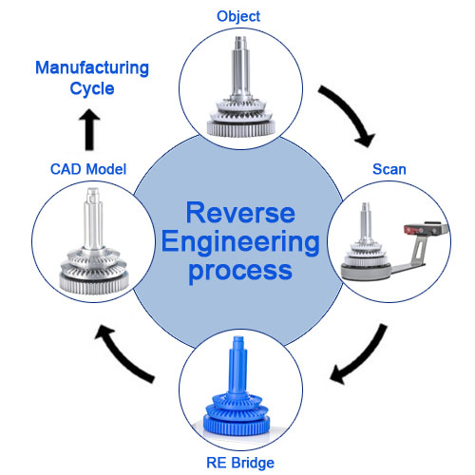
4 RE a Cluster Diagram
Reverse engineering [ri-vurs-en-juh-neer-ing] (noun)
Reverse engineer [ri-vurs-en-juh-neer] (verb)
https://www.pre-scient.com/offerings/engineering-services/reverse-engineering.html

Slide 12
4 RE a Cluster Diagram
Demonstration
Referring to the previous letter, fill in the cluster diagram with the teacher

Slide 13
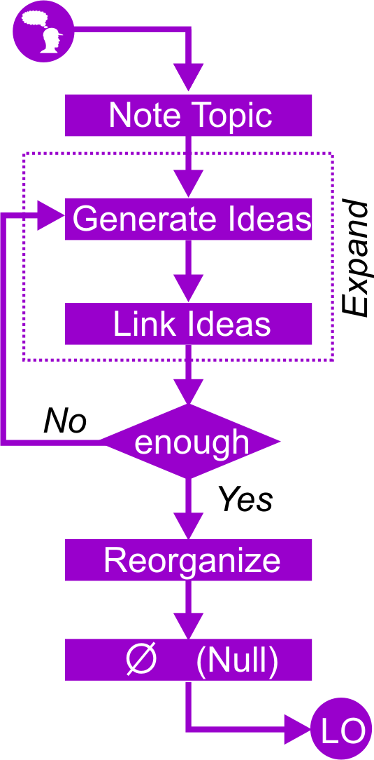
5 Cluster Diagrams
: Creating
0
0

Slide 14
5 Cluster Diagrams
: Cluster Diagram for a Personal Letter
Choose 1 situation…
Your friend is studying at the University of Chicago. Your classmate will be visiting Chicago this summer. Write a letter introducing your classmate to your friend.
A friend of yours is studying in North America. He does language exchange with James (an American). Next year, James will study Chinese at your university. Write a letter introducing yourself and welcoming him to Taiwan.
You have been accepted to the University of California for graduate studies. Your new girlfriend’s older brother is studying for his Ph.D. at the same institution. Write a letter introducing yourself.

Slide 15
5 Cluster Diagrams
: Cluster Diagram for a Personal Letter
Choose one situation
Introduce your classmate to your friend ||
Welcome a foreigner to your country ||
Introduce yourself and request help.

Slide 16
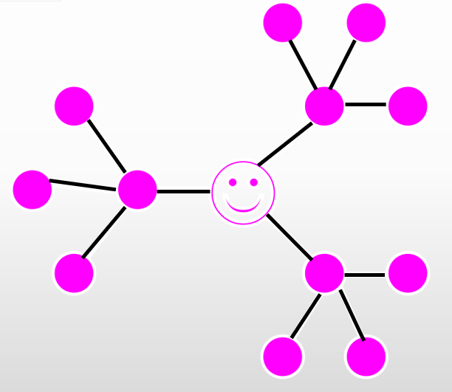
5 Cluster Diagrams
: Character of a Good cluster diagram

Slide 17
5 Cluster Diagrams
: Character of a Good cluster diagram

Slide 18
5 Cluster Diagrams
: Character of a Good cluster diagram

Slide 19
5 Cluster Diagram
Character of a Good Cluster Diagram
Check your cluster
  Linked Lists (one child node)?
  Graphs (only one route from node to node)?
  Unbalanced Tree?
Check your cluster
  Key Words Only
  Sufficient Depth

Slide 20
6 The Linear Outline
: Ordering
A
C
From center out
Recurs
1
B
3
2

Slide 21
6 The Linear Outline
: Order your Diagram
A
C
→ Order the ideas in your cluster diagram starting from the root.
1
B
3
2

Slide 22



7 The First Draft
:Its Purpose
Focus
  Sentences
  Paragraphs
NOT
  Spelling
  Grammar

Slide 23
7 The First Draft
Continue Your Personal Letter
Based on your ordered points
Write the first draft of your personal letter of introduction
Make sure your 1st draft is
  Double spaced
  Black or Blue Pen

Slide 24


8 Homework
: Personal Letter of Introduction
Complete your cluster diagram.
Order your cluster diagram (Linear Outline)
Complete the first draft.

Slide 25
8 Cluster Diagram (Review)
: Creating
A
C
1 Create
  Note topic
  Generate
  Connect
  Expand
2 Review
  Reorganize
  Order (Linear Outline)
  Null (0, cross-out)
0
1
B
3
2
0

Slide 26


9 Cluster Diagram (Review)
: Character of a good cluster diagram

