Slide 1
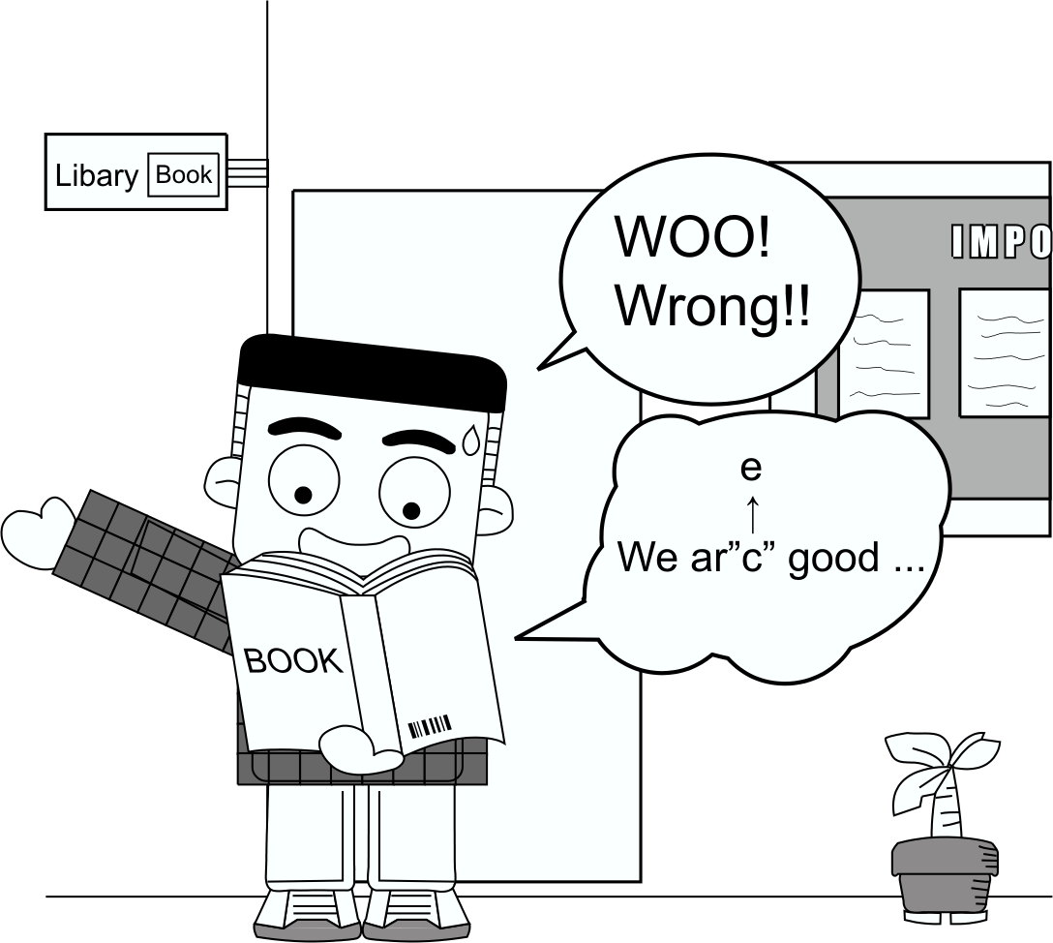
4.4 Editing & Revision

Slide 2
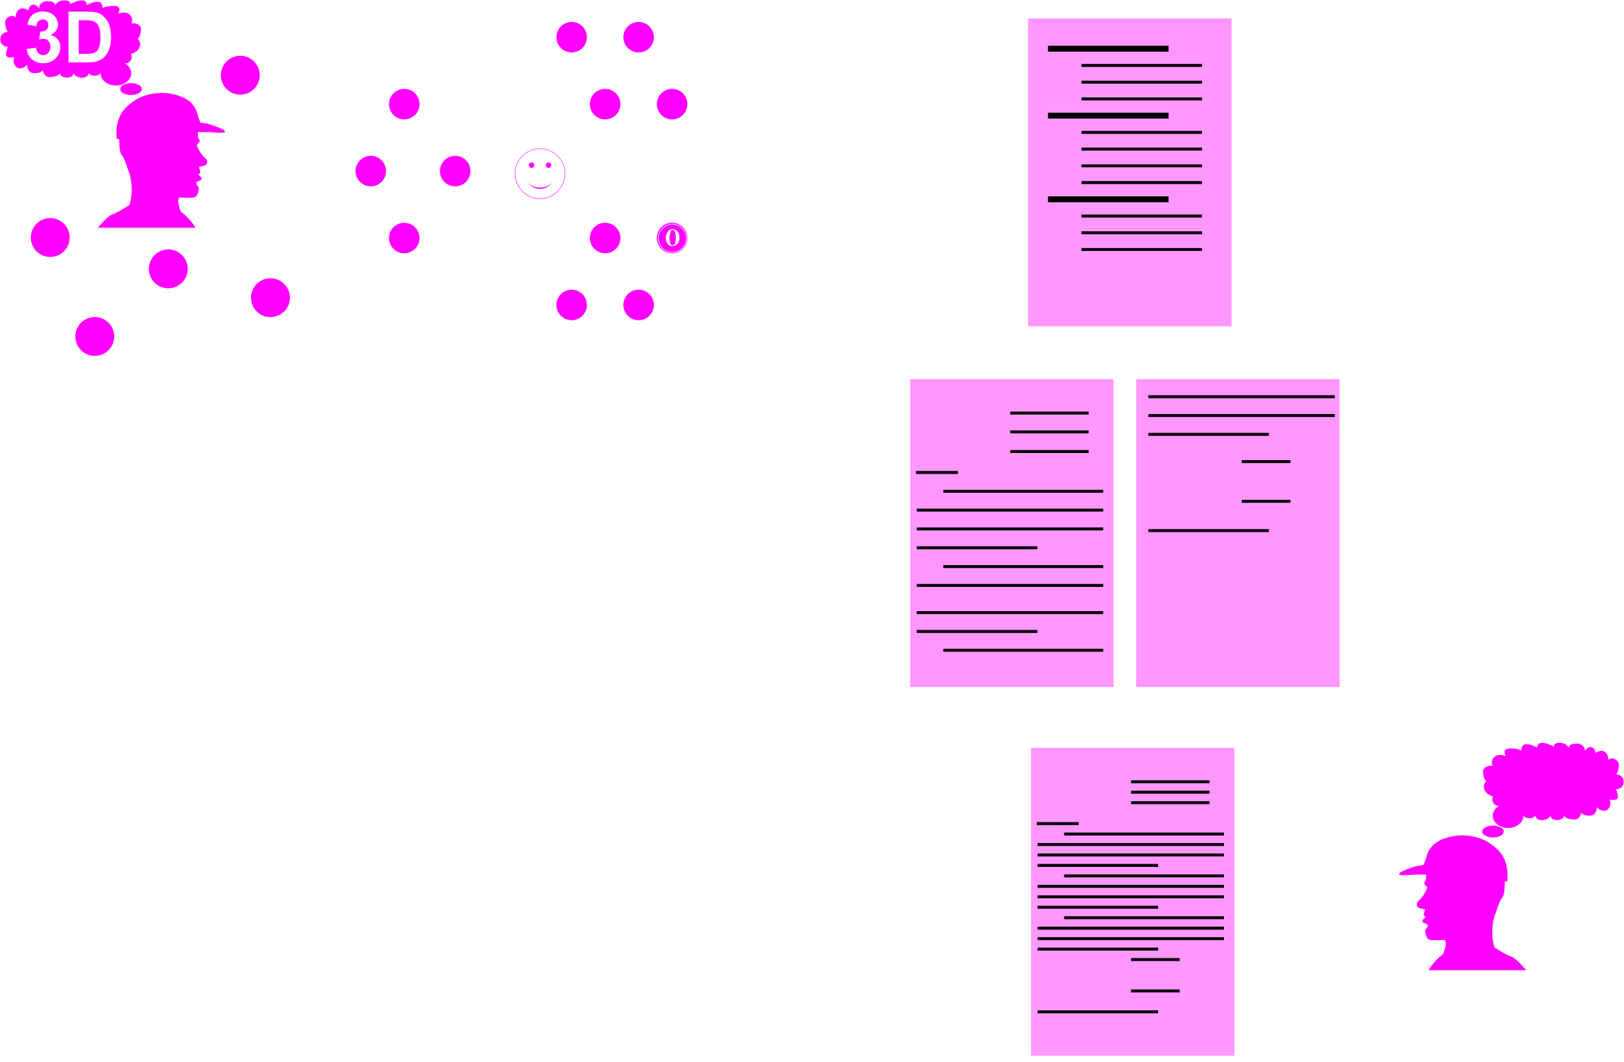
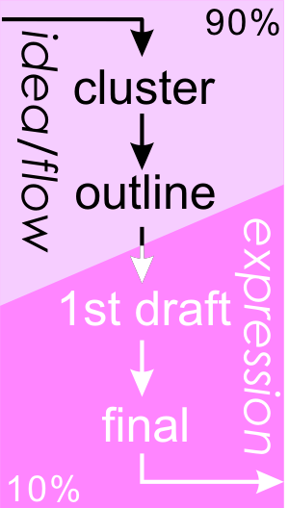
0. The Writing Process
2D
1D
Macro-
Micro-
Computer
Peer
Native Speaker

Slide 3

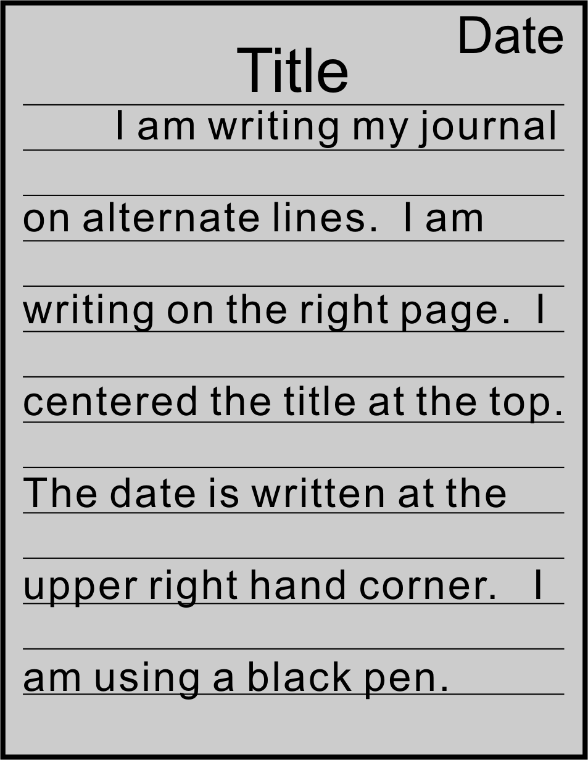
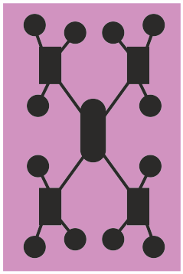
1 Journal Entry
An unidentified substance
Describe it!
  Look
  Feel
  Taste
  Smell
Hypothesize: What is it?

Slide 4
1 Journal Entry
My Favorite YouTube Channel
What is it?
When start liking?
Why you like?

Slide 5

2 Macro-level (The Big Picture)
Follow along in your textbook.

Slide 6

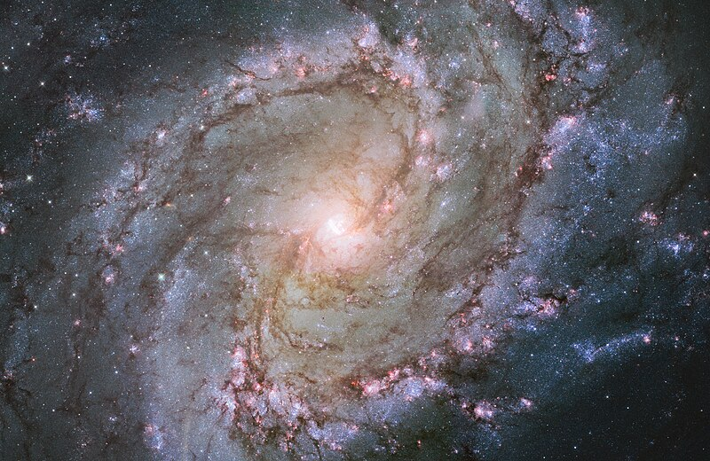
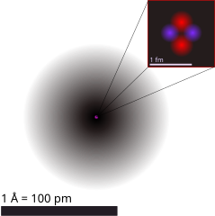
2 Macro-level (The Big Picture)
Macro 大
Micro小

Slide 7

2 Macro-level (The Big Picture)
Content /organization
  Logical
A B C D
A B C D
→ Improve linear outline

Slide 8
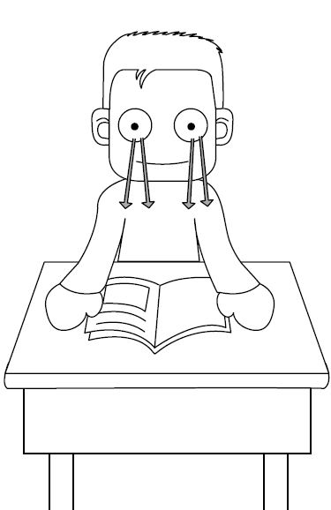

2 Macro-level (The Big Picture)
Content /organization
  Logical
  Interesting
→ Improve 1st Draft

Slide 9

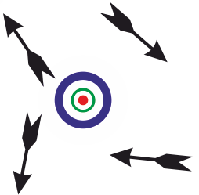
2 Macro-level (The Big Picture)
Content /organization
  Logical
  Interesting
  cohesive
→ Improve cluster diagram

Slide 10
2 Macro-level (The Big Picture)
Content /organization
Style
  Well developed
→ Improve cluster diagram

Slide 11
2 Macro-level (The Big Picture)
I like apples.
Bananas taste good.
Roger is my friend.
I love dogs.
Content /organization
Style
  Well developed
  variety
I like apples.
I like Bananas.
I like Roger
I like dogs.
I like ice cream
→ Improve 1st Draft

Slide 12
2 Macro-level (The Big Picture)
Content /organization
Style
Vocabulary
  variety
I like
I am fond of
I love
I like
I like
I like
→ Improve 1st Draft

Slide 13
2 Macro-level (The Big Picture)
Content /organization
Style
Vocabulary
  Variety
  accurate
A 50 µm hole was drilled.
A small hole was drilled.
→ Improve 1st Draft

Slide 14
2 Macro-level (The Big Picture)
MSN: got proof u cheated on test.
Content /organization
Style
Vocabulary
  Variety
  Accurate
  appropriate
MSN: I have irrefutable evidence that you made unauthorized usage of another person’s work during the examination.
→ Improve 1st Draft

Slide 15
2 Macro-level (The Big Picture)
Content /organization
Style
Vocabulary
Format
  All parts present
  No extra parts
E.g. NSC Report
Title (ZH & EN)
Abstract (ZH & EN)
Keywords (ZH& EN)
Background (ZH || EN)
Purpose (ZH || EN)
Methodology (ZH || EN)
Results (ZH || EN)
Self-criticism (ZH || EN)
→ Adjust cluster diagram

Slide 16
2 Macro-level (The Big Picture)
Content /organization
Style
Vocabulary
Format
Mechanics
  Clear handwriting
Clear
hand-writing is beautiful.
But this handwriting
is strange.
→ Improve Final Draft

Slide 17
2 Macro-level (The Big Picture)
Content /organization
Style
Vocabulary
Format
Mechanics
  Clear handwriting
  Font size/ type OK?
Times New Roman 12 pt is readable
Unreadable. You cannot see it clearly. Thus it is difficult to read this sentence. The person who receives this letter, won’t want to waste his time trying to read. Thus one can see that this is not a good font is not a good font to choose. I really don’t know why anyone would want to use this font. If you have an idea, please tell me so that I can share with other people.. There must be some reason to have this font!
→ Improve Final Draft

Slide 18


2 Macro-level (The Big Picture)
Content /organization
Style
Vocabulary
Format
Mechanics
  Clear handwriting
  Font size/ type OK?
  Page margins OK?
→ Improve Final Draft

Slide 19
2 Macro-level (The Big Picture)
Self-Editing
Content /organization
Style
Vocabulary
Format
Mechanics
Read through last lesson’s homework (§4.3.7) looking for Macro-level errors.
Indicate errors using circles, lines, arrows
Correct if possible
Use blue pen
Use Table 4.2 as a guide.

Slide 20
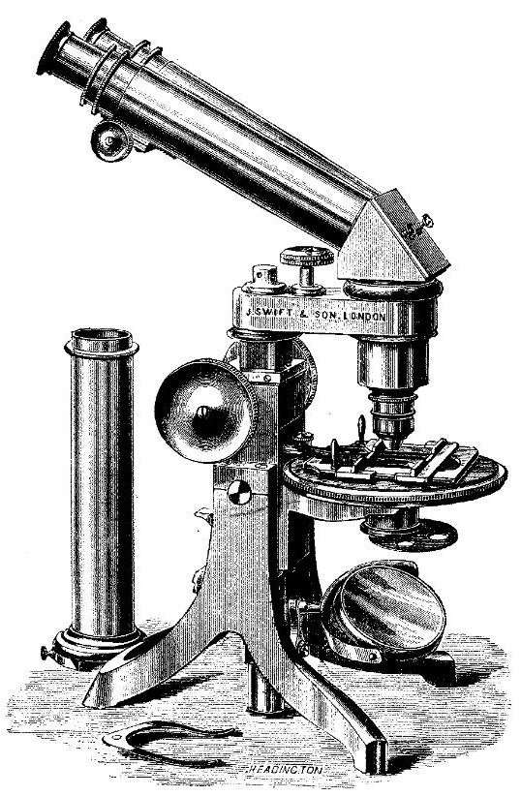
3 Micro-level (Grammar/Spelling)
Listen to the talk
Follow along in your textbook.
Micro小

Slide 21
3 Micro-level (Grammar/Spelling)
Subject-Verb Agreement
I am
a dog
She is
I am
a dog.
She is
Subject-Verb Agree?
Verb Tense
Singular/Plurals
Articles
Punctuation
Abbreviations
Spelling

Slide 22
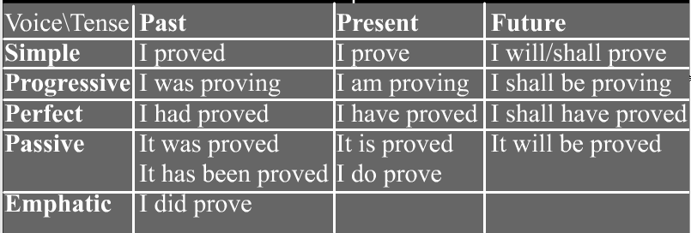
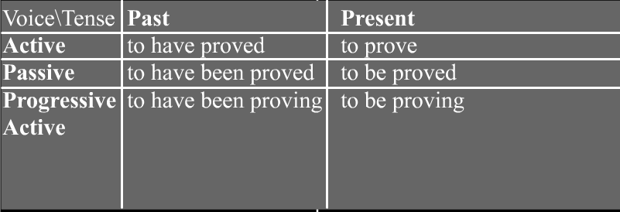
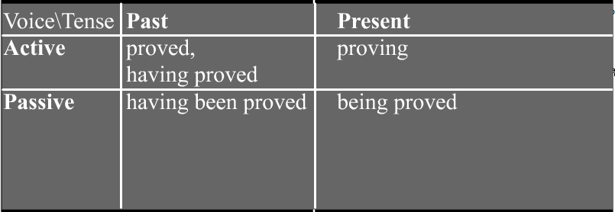
3 Micro-level (Grammar/Spelling)
Verb Tense
Basic Verb Tenses
Subject-Verb Agree?
Verb Tense
Singular/Plurals
Articles
Punctuation
Abbreviations
Spelling
Consistent use of past, present or future
Infinitive, gerunds and participles not mixed up
The Gerund
The Infinitive

Slide 23
3 Micro-level (Grammar/Spelling)
Singular/Plurals
Dog → dogs
oxen
Ox
oxes

Slide 24
3 Micro-level (Grammar/Spelling)
Articles
A
An
The
“ ”
I go to ___school.
I go to a school.
I go to the school.

Slide 25
3 Micro-level (Grammar/Spelling)
Punctuation
. ,
“ ”
。
【 】

Slide 26
3 Micro-level (Grammar/Spelling)
Abbreviations and Acronyms
YZU (acronym)
Can’t (abbreviation)
i.e. OR e.g.
  Choose a color (i.e, red, green)
  Choose a color (e.g. red, green)

Slide 27
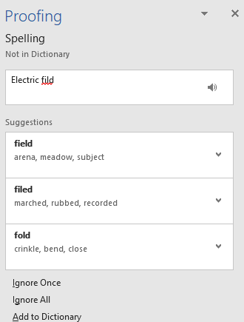
3 Micro-level (Grammar/Spelling)
Spelling

Slide 28

3 Micro-level (Grammar/Spelling)
Circle Mistakes
Write Down Type (e.g. 3)
Correct Mistake
  Use only 1 book!
  Use a red Pen..
Subject-Verb Agree?
Verb Tense
Singular/Plurals
Articles
Punctuation
Abbreviations
Spelling

Slide 29
3 Micro-level (Grammar/Spelling)
Example
People normally write in a linear progression with one word or thought following after another. Writers often use a linear outliner organizing their information and thoughts Studies; however, have shown that people don’t always think in such a manner. Usually creative thought pop into our minds sporadically. It may thus be better to use a 2-dimensional graphical outlining One popular method is writing down your topic and then put bubble or circle around it. Other ideas is written around the topic. These ideas are also circled. A line is then drawn to main topic or to another idea, is there seems to be a connection.
2
to organize

Slide 30
3 Micro-level (Grammar/Spelling)
Solution
People normally write in a linear progression with one word or thought following after another. Writers often use a linear outliner to organize their information and thoughts. Studies, however, have shown that people don’t always think in such a manner. Usually, creative thought pops into our minds sporadically. It may thus be better to use a 2-dimensional graphical outlining. One popular method is writing down your topic and then putting a bubble or circle around it. Other ideas are written around the topic. These ideas are also circled. A line is drawn to the main topic or another idea if there seems to be a connection.

Slide 31
3 Micro-level (Grammar/Spelling)
Modified by Grammarly
Usually, people write linearly, where one word or thought follows another. Writers often use a linear outline to organize their information and ideas. However, studies have shown that people do not always think in such a straightforward manner. Creative thoughts often come to mind sporadically, suggesting that a two-dimensional graphical outline might be more effective. One popular method involves writing down the main topic, encircling it, and then jotting down related ideas around it, also encircled. If there are connections between the main topic and these ideas, lines can be drawn to illustrate those relationships.

Slide 32
3 Micro-level (Grammar/Spelling)
Self-Editing
Read your personal letter of introduction
Check for Micro-level errors and indicate with proof-reading marks..
Use blue pen.
Subject-Verb Agree?
Verb Tense
Singular/Plurals
Articles
Punctuation
Abbreviations
Spelling

Slide 33

4 Computer Assisted Editing
Listen to the talk.
https://commons.wikimedia.org/wiki/File:Computer-cartoon.png

Slide 34

4 Computer Assisted Editing
Assisted!
Use built-in Spelling checkers
Use built-in grammar checkers
Use more than one (1),
  E.g., Microsoft Word && OpenOffice.org
Check default language setting:
  “English(USA)” or “English(UK)”
Not all errors caught, e.g. “We arc good together.”
Sometimes correction wrong, e.g.,
  “Electric field” → “Electric filed”
Free stand-alone grammar checkers helpful, e.g., Grammarly
Use AI systems, e.g., Copilot, ChatGPT, as a reference
https://commons.wikimedia.org/wiki/File:Computer-cartoon.png

Slide 35
4 Computer Assisted Editing
Type your letter into a computer
Use the spelling and grammar checkers
Observe the changes made
https://commons.wikimedia.org/wiki/File:Computer-cartoon.png

Slide 36
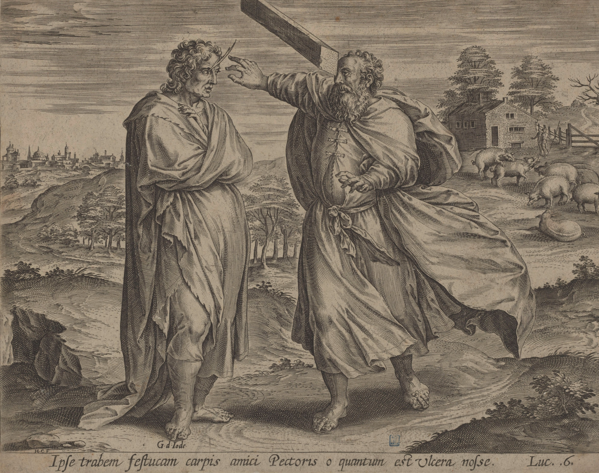
5 Peer Editing
→ Listen to the short talk.
You hypocrite, first take the plank out of your own eye, and then you will see clearly to remove the speck from your brother’s eye
(Bible Matthew 7:3-5).

Slide 37
5 Peer Editing
Cannot see our own faults
Problem may be obvious to others.
Useful for Micro, but more important for macro
You hypocrite, first take the plank out of your own eye, and then you will see clearly to remove the speck from your brother’s eye
(Bible Matthew 7:3-5).

Slide 38

5 Peer Editing
Use green pen
Exchange books with partner
Read twice (2x)..,
  1. Check Macro-
  2. Check Micro-
https://commons.wikimedia.org/wiki/File:Green_question_mark.svg

Slide 39
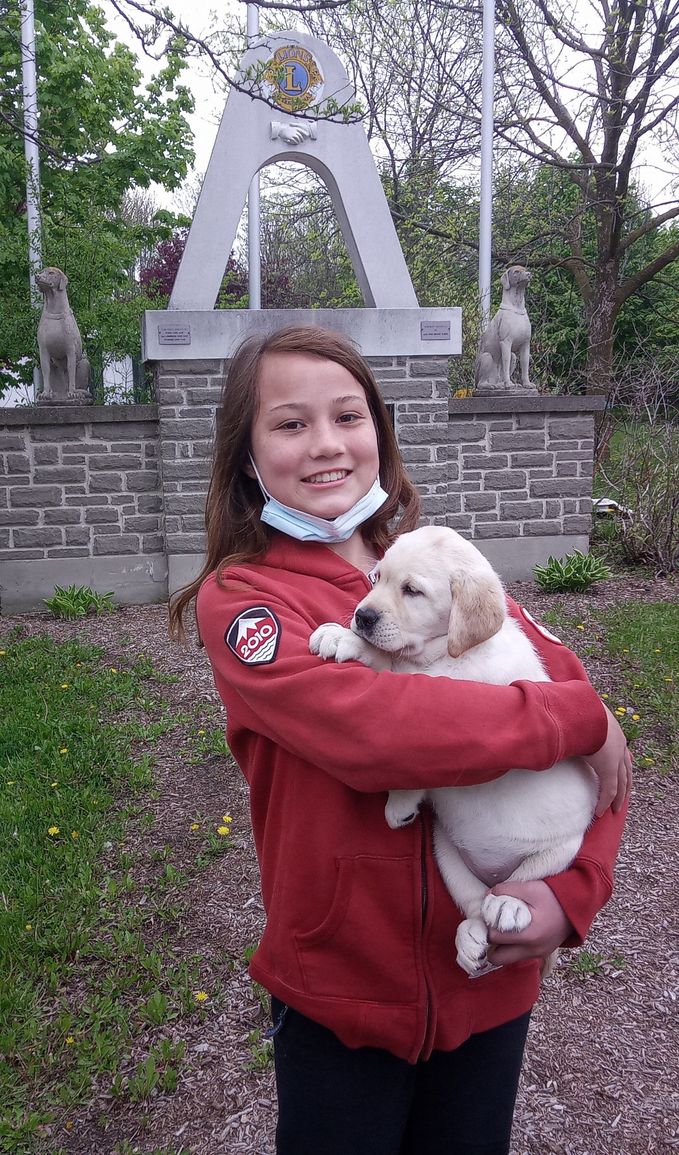
6 Using Native Speakers
Listen to the short talk.

Slide 40
6 Using Native Speakers
Some minor issues are very difficult for non-native speakers (e.g. “a”, “the” or “ ”)
AI doesn’t feel human to native speakers.

Slide 41


7 Homework & Assignments
Assignment (Letter of introduction)
Rewrite your informal letter of introduction (previous homework).
Use a single A4 sheet of paper.
Front: final draft
Back: Cluster diagram (drawn
by hand or using CLUSTER)
Hand in for grading next class.
See Website for mark allocation.
Front
Back

