Slide 1
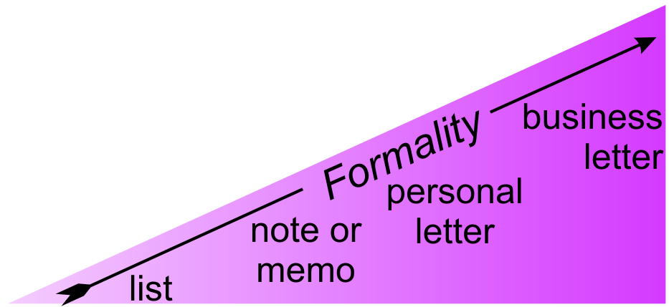
4.5 Business Letters

Slide 2

1 Resumes and Cover Letters
Follow the talk in your workbooks
Fill in the blanks

Slide 3
1 Resumes and Cover Letters
Resume
A document listing…
  Personal details
  Education
  Job experience
  Special skills and honours
usually for the purpose of obtaining an interview when seeking employment
Now that implies getting past computer vetting

Slide 4
1 Resumes and Cover Letters
Cover Letter
To indicate for what job you are applying
To explain why you are applying
To highlight how you are uniquely qualified for this position

Slide 5

2 Format and Structure
Inspecting a Cover Letter
Each group member work in one question
Fill in the blanks
Share your answers

Slide 6
2 Format and Structure
Listen to the talk
Correct your answers

Slide 7

2 Format and Structure
e.g. March 15, 2007
Return address
Date*
Receiver’s info
Salutation*
Body*
Closing
Signature line*
Enclosure line*
Full name
Position
address
“Dear”
+ title
+ surname
+”:”
No indent
Blank line between paragraphs
E.g. “Yours truly,”

Slide 8


2 Format and Structure
Informal
Formal

Slide 9

3 Analyzing a Cover Letter
Demonstration: RE Using CLUSTER

Slide 10
4 Reading Job Postings
Listen to the Talk

Slide 11

4 Reading Job Postings
Read the job descriptions in your book.
  ID=YE11: Software Engineer
  ID=YE21: Ph.D. in Engineering & Science
  ID=YE31: Post Doctoral Position in EE
  ID=YE41: Tenure-Track Position in EE
Consider job descriptions on course website

Slide 12
5 Cover Letters for Job App…
Drafting a Cover Letter: Some Tips
Follow the talk in your workbooks
Fill in the blanks

Slide 13
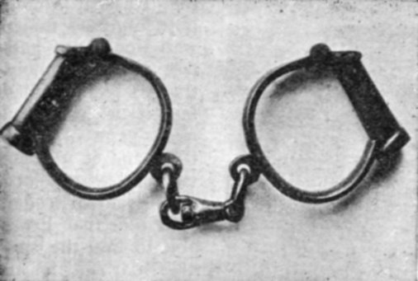
5 Cover Letters for Job App…
Drafting a Cover Letter: Some Tips
State applicable qualifications clearly, but don’t
Draw to relevant items in resume
Do not point out
In rare cases, your resume.
https://www.gutenberg.org/files/10020/10020-h/images/095-1.jpg

Slide 14
5 Cover Letters for Job App…
Drafting a Cover Letter: Some Tips
State applicable qualifications clearly, but don’t
boast
Draw attention to relevant items in resume
Do not point out weaknesses
In rare cases, explain your resume.

Slide 15
5 Cover Letter for Job Application
Imagine that you will soon graduate…
Read the job descriptions – text and online
Choose 1 position (book, website, online posting)
Understand the job requirements.
Draw a cluster diagram for your cover letter. (Use different colour pens to group ideas.)
Convert the cluster diagram → first draft.
  ID=YE11: Software Engineer
  ID=YE21: Ph.D. in Engineering & Science
  ID=YE31: Post Doctoral Position in EE
  ID=YE41: Tenure-Track Position in EE

Slide 16

6 Homework & Assignments
Cover Letter & Resume
For your cover letter
  Complete cluster diagram (use CLUSTER)
  Organize into a Linear Outline
  Write a first draft
Prepare your resume (use an online tool if you wish)

