Slide 1
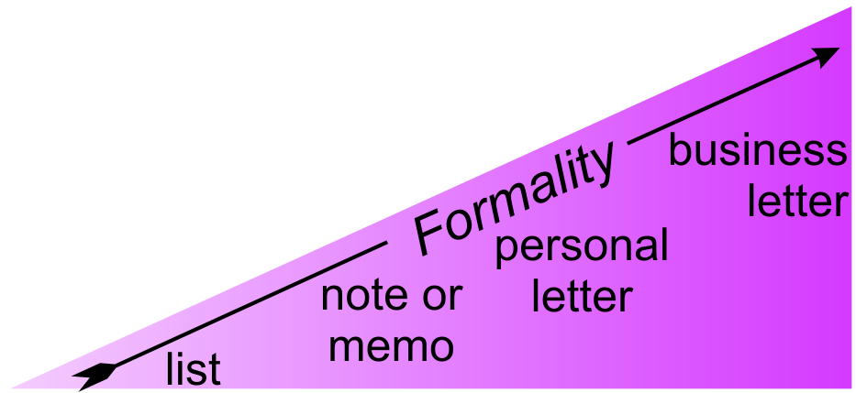
4.6 Summary
{
Types of Correspondence
Pre-Writing
  Importance
  Applicability
  Cluster Diagrams
  Linear Outlines
First Draft
Editing & Revision Techniques → Final Draft

Slide 2

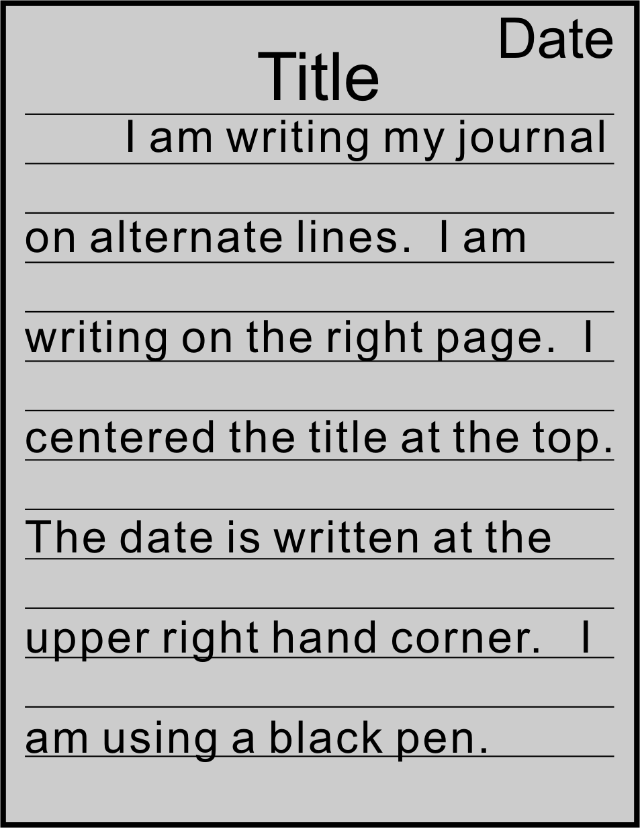
1 Journal Entry
The Most Important Scientific Discovery…
Your first sentence: “The most important scientific discovery was…”
Explain why you think this is the most important discovery
Don’t forget the Cluster diagram!

Slide 3

2 Listening for Macro-Level Errors
Three (3) questions to ask as you listen
Follow along in your textbook.

Slide 4

2 Listening for Macro-Level Errors
Three (3) questions to ask as you listen
What parts do I really like?
What parts are unclear or confusing?
How can I make it better?
Give your book to your partner.
Close your eyes.
Listen while your partner reads your cover letter.
Think about your answers to above questions
Revise (arrows, circles…) your cover letter.
Use a blue pen.

Slide 5
3 Recognizing Micro-Level Errors
Helping to Revise
Read your partner’s letter silently.
Circle (do not correct) with a green pen micro-level errors (c.f. §4.4.3) pg 116

Slide 6
3 Recognizing Micro-Level Errors
Give back your partner’s bool
Correct the errors in our own work using a red pen.
I will write
and

Slide 7

3 Recognizing Micro-Level Errors
Class Activity: Game Rules
Determine if there is a micro-error
  60 seconds
  For 2 points
Fix the micro-error
  60 seconds
  For 5 points
If fail, others groups can try.
  For 2 points

Slide 8
3 Recognizing Micro-Level Errors
There is the reasons for the experimental results.
Type: Subject-Verb Agreement
are

Slide 9
3 Recognizing Micro-Level Errors
To keep the birds from eating seeds, soak them in blue food coloring.
Type: Unclear Pronoun Reference
Repair: Soak the seeds in blue food coloring to keep the birds from eating them.

Slide 10
3 Recognizing Micro-Level Errors
There may be systematic errors in measurement. A possibility that results from the calibration of the equipment.
Type: Sentence fragment
Repair: …resulting ….

Slide 11
3 Recognizing Micro-Level Errors
After reading the original study, the paper remains unconvincing.
Type: Dangling / Misplaced Modifier
Repair: After reading the original study, this reviewer remains unconvinced by the paper.

Slide 12
3 Recognizing Micro-Level Errors
Whatever you think.
Type: Sentence fragment (incomplete thought)
I’ll do w
is right.

Slide 13
3 Recognizing Micro-Level Errors
Oil supplies are diminishing, an alternative fuel is hydrogen.
Type: Comma Fault (comma between 2 independent clauses)
Repair: → 2 Sentences
. A

Slide 14
3 Recognizing Micro-Level Errors
Because recycling is intended to conserve both energy and material resources.
Type: Sentence Fragment
R

Slide 15
3 Recognizing Micro-Level Errors
I like Christmas it is a good time to meet all my old friends.
Type: Run-on Sentence (two independent clauses not connected)
. It

Slide 16
3 Recognizing Micro-Level Errors
The experiment will have been running for three months.
Type: time Modifier Missing
Alt. Repair: The experiment has been running for three months.
…
by the end of next week.

Slide 17
3 Recognizing Micro-Level Errors
I am writing this letter to introducing myself.
Type: Infinitive, not participle required with “to”
e

Slide 18
3 Recognizing Micro-Level Errors
I had lived in Taipei for 1 year.
Type: Incorrect Use of Past Perfect
Alt. Repair: I have been living….

Slide 19
3 Recognizing Micro-Level Errors
Now I live in Taoyuan, a city lies in the north part of Taiwan.
Type: Omitted Relative Pronoun
which

Slide 20
3 Recognizing Micro-Level Errors
I am specialized in Opto-Electronics.
Type: Helper Verb Requires Present Progressive.
Alt. Repair: I am specializing in…

Slide 21
3 Recognizing Micro-Level Errors
My proposal was rejected, not having studied the application guidelines.
Type: Helper Dangling Modifier (The proposal did not study the application guidelines!)
as I had not

Slide 22
3 Recognizing Micro-Level Errors
Students who seek their advisor’s advice often can improve often can improve their papers.
Type: Squinting Modifier (unclear which verb id modified)
often
often

Slide 23


5 Summarizing the Writing Process

Slide 24
5 Summarizing the Writing Process

Slide 25
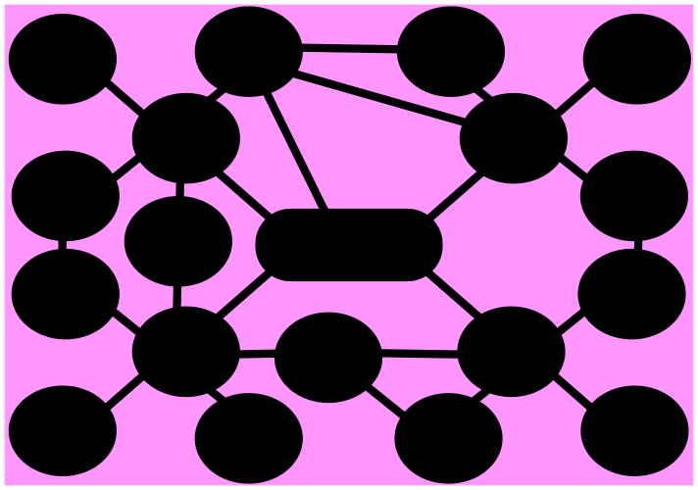
5 Summarizing the Writing Process

Slide 26
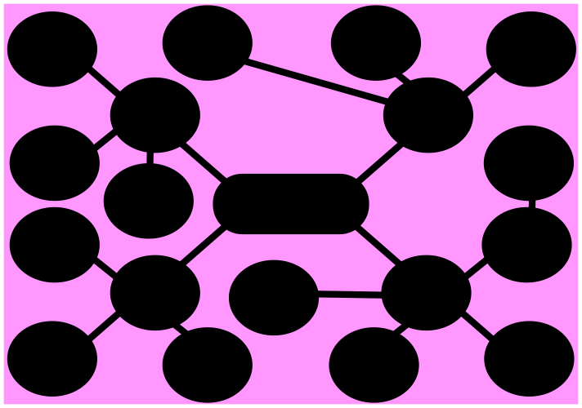
5 Summarizing the Writing Process

Slide 27
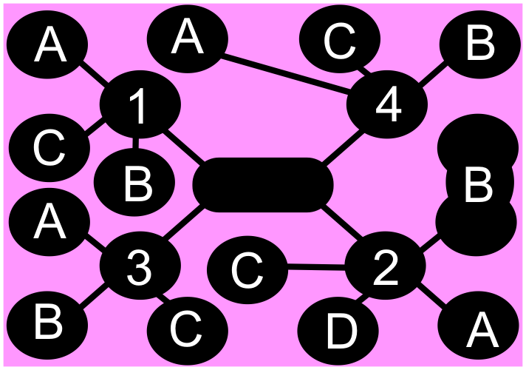
5 Summarizing the Writing Process

Slide 28

5 Summarizing the Writing Process

Slide 29
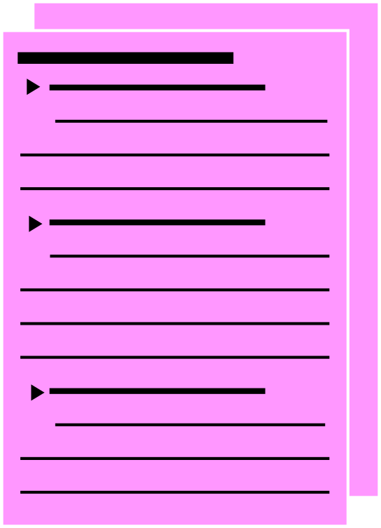
5 Summarizing the Writing Process

Slide 30

5 Summarizing the Writing Process

Slide 31

5 Summarizing the Writing Process

Slide 32
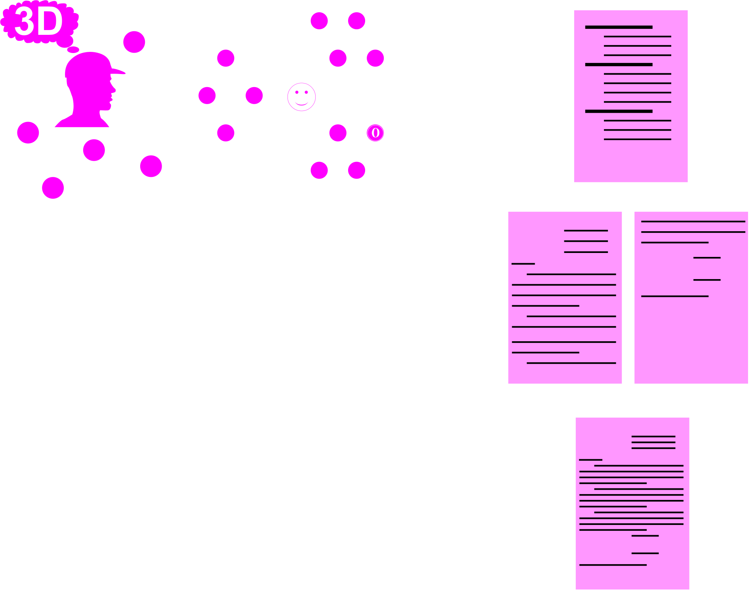
Editing & Revision
2D
1D

Slide 33


5 Homework & Assignments
Assignments
Complete your cover letter and resume.
Submit electronically
Due Next Week

Slide 34
1A_OnePane
Use for standard slides (not usually)

Slide 35
1B_OnePane_Icons
Talk

Slide 36

1B_OnePane_Icons
Vocabulary

Slide 37
1C_TwoPane_Icons
Sub-section title will be here

Slide 38
2_TwoPanes_Compare

Slide 39
3_Title(NoPane)

Slide 40
Activity
Instruction for Activities

Slide 41

Activity
Homework

Slide 42
Activity
Assignments

Slide 43
Activity_2Panes
For the case in which we have two sides

Slide 44






Blank Slide

