Slide 1
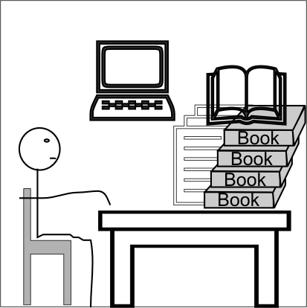
5 Reading Scientific Literature

Slide 2

5.1 Overview
Objectives
To learn how quickly gain a general understanding of a scientific article
To learn and apply the methods of skimming, and scanning to reading technical literature and scientific papers
To identify the key differences between scientific, regular writing, and oral communication.

Slide 3
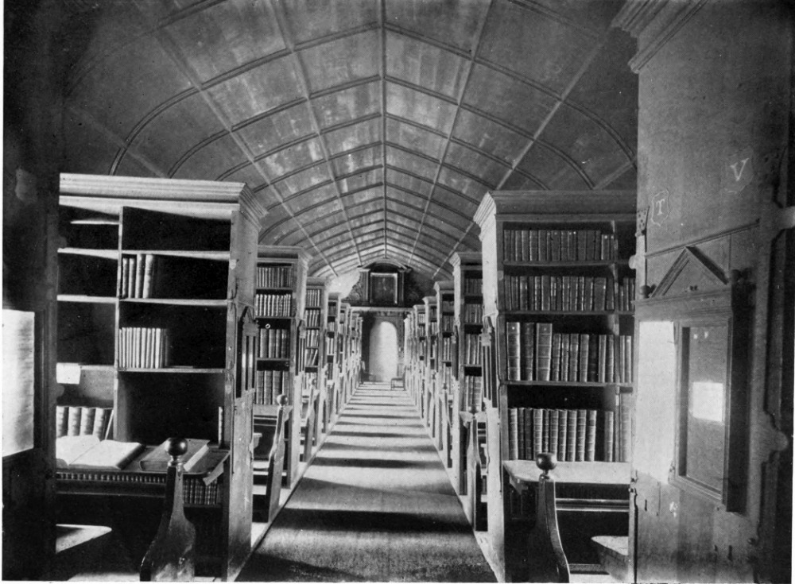
5.1 Overview
Types of Reading
Pleasure (Extensive)
Skimming
Scanning
Critical

Slide 4

5.1 Overview
Evaluation (50 pts total)
Reading Speed Test (20 pts)
  Before
  After
Journal Entry (15 pts)
Continuous Grading (15 pts)

Slide 5

5.1 Overview
Assignments
Complete Online Reading Speed Test (See §5.2 for details)

