Slide 1
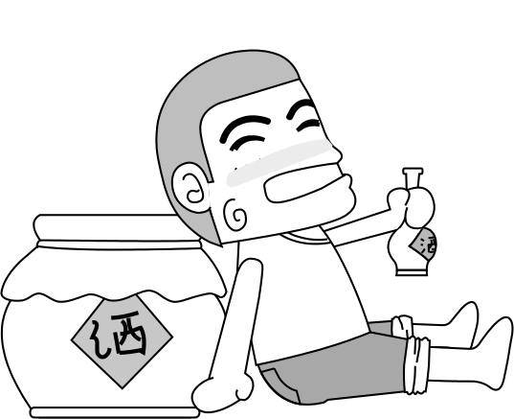
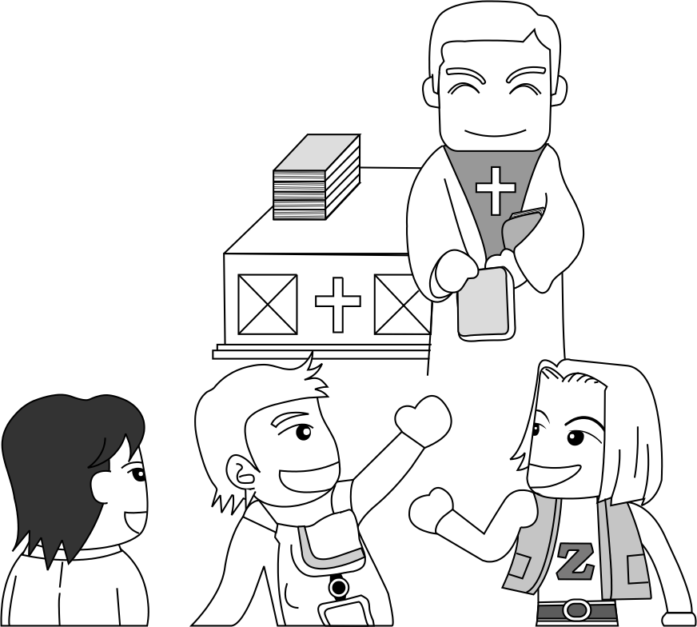
5.3 Verbs & Formality

Slide 2

1 The Meaning of Marks
Assignment 1
Actual mark is not key…
Relative mark is important…
  Macro (Cluster) - 50%
  Mechanics (Draft) - 30%
  Micro (English) - 20%
Where you lose marks is where you need to work
Note: Mark allocation is based on importance.

Slide 3


2 Phrasal vs Single-word verbs
Vocabulary
Idiom
Idiomatic
Phrasal verb

Slide 4
2 Phrasal vs Single-word verbs
Listen to the talk
Follow along in your books

Slide 5
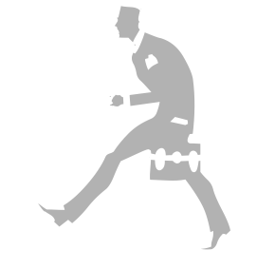
2 Phrasal vs Single-word verbs
Single
verbs
Phrasal

Slide 6
2 Phrasal vs Single-word verbs
Nature of phrasal verbs
Particle following verb changes meaning
If look up both words in the dictionary, you will not understand the meaning of the phrasal verb.
Example:
  Amelia [passed] by the house. (經過)
  At the sight of blood, Amelia [passed out].
  At the sight of blood, Amelia [fainted].
Pass + out = faint
經過 + 外面 = 昏倒

Slide 7
2 Phrasal vs Single-word verbs
Nature of phrasal verbs
Change particle → Change meaning completely
Example:
  At the sight of blood, Amelia [passed out].
  Amelia’s great-grandfather [passed away].
  Amelia’s great-grandfather [died].
Pass + out = faint
Pass + away = die
經過 + 離開 = 死了

Slide 8
2 Phrasal vs Single-word verbs
Nature of phrasal verbs
Contrast with verb and helper
Example:
  I [must win] the prize.
  I [may win] the prize.
  I [can win] the prize.
必須 + 贏得
可能 + 贏得
能 + 贏得

Slide 9
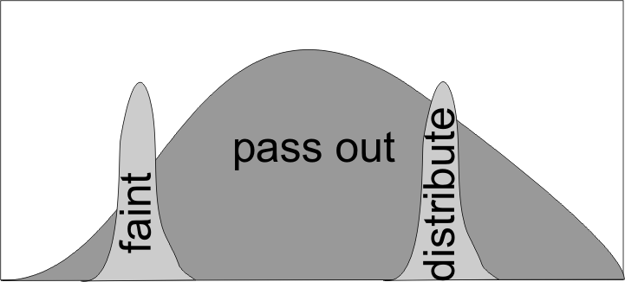
2 Phrasal vs Single-word verbs
Nature of phrasal verbs
Wide Range of Meaning
Example:
  At the sight of blood, Amelia [passed out].
  Amelia [passed out] the test papers.
  Amelia [distributed] the test papers.
Pass + Out = Faint
Pass + Out = Distribute (發)

Slide 10
2 Phrasal vs Single-word verbs
Nature of phrasal verbs → vague (inexact)
Pass out

Slide 11
2 Phrasal vs Single-word verbs
Summary
Nature → Inexact
Usage
  Single-word: specific → scientific writing
  Phrasal: vague
    notes, memos, lists, personal letters, novels
    Oral English
You need to know both types of verbs
  Single for writing
  Phrasal for talking

Slide 12
3 Using Phrasal Verbs
Common phrasal verbs
Ask out (invite)
Back off
Break off (end)
Butter up (flatter)
Chew out (criticize)
Drop out
Egg on (encourage)
Grow up
Kick out
Look over (inspect)
Make up
Stand up
Stand out
Rip off (cheat/steal)
Turn on (excite)
Turn off
Wear out (tire)
Write up
Write down

Slide 13

3 Using Phrasal Verbs
The Story of The Tramp
Fill in the Blanks
Choose a phrasal verb from the box on the right to fill in the blanks.
Decide on the correct tense.
Write single-word verb equivalents in ()
Get out
Lie down (recline)
Wake up (arouse)
Write down
Drop off (fall asleep)

Slide 14
3 Using Phrasal Verbs
The Story of The Tramp
A tramp was sitting on a park bench. He was very tired. So, he decided to A and go to sleep. He had been sleeping for about 5 minutes when a man stopped, B the tramp, and asked him, “Excuse me. Do you know what the time is?” The tramp replied, “I’m sorry – I don’t have a watch, so I don’t know the time.”
Get out
Lie down (recline)
Wake up (arouse)
Write down
Drop off (fall asleep)

Slide 15
3 Using Phrasal Verbs
The Story of The Tramp
The tramp C again. After a few minutes he went back to sleep. Just then, a woman, gently shook the tramp’s shoulder until he D again. She said, “I’m sorry to trouble you, but I’ve lost my watch – do you happen to know the time?” The tramp was a little annoyed at being E again, but he politely told the woman that he didn’t have a watch and didn’t know the time.
Get out
Lie down (recline)
Wake up (arouse)
Write down
Drop off (fall asleep)

Slide 16
3 Using Phrasal Verbs
The Story of The Tramp
After the woman had gone, the tramp had an idea. He opened the bag that contained all his possessions and F a pen, a piece of paper and some string. On the paper, he G, ‘I do not have a watch. I do not know the time’. He then hung the paper around his neck and eventually H again.
Get out
Lie down (recline)
Wake up (arouse)
Write down
Drop off (fall asleep)

Slide 17
3 Using Phrasal Verbs
The Story of The Tramp
After about 15 minutes, a policeman who was walking through the park noticed the tramp and the sign around his neck. He J (_) the tramp and said, “I read your sign, I thought you’d like to know that it’s 2:30 pm.”
Get out
Lie down (recline)
Wake up (arouse)
Write down
Drop off (fall asleep)

Slide 18

4 Journal Entry
A Funny Story
Tell me a funny story or a joke.
Write using as many phrasal verbs as possible.
Underline phrasal verbs
(Cluster Diagram Optional)

Slide 19

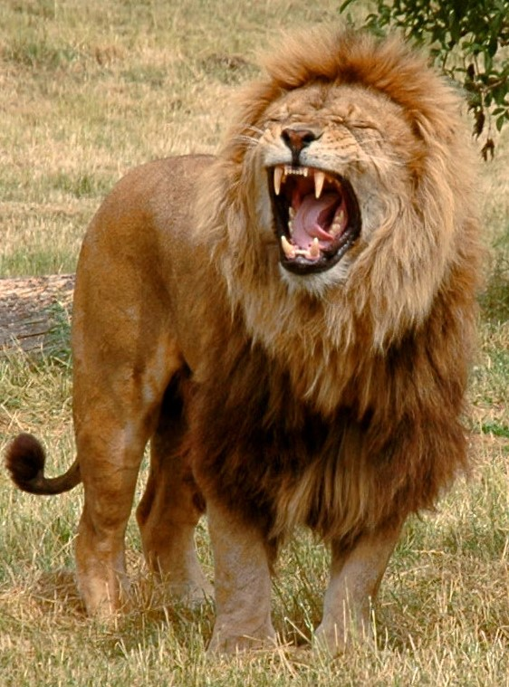

5 Homework & Assignments
Homework
Write a personal letter asking to borrow a copy of the book “The Lion, The Witch and the Wardrobe” by CS Lewis from a former teacher.
Write on a single sheet of A4 paper.

Slide 20

5 Homework & Assignments
Assignments
Submit your cover letter and resume electronically
Remember to attach a picture of your cluster diagram (mind map) to the submission
Bring a hardcopy next week.

Slide 21
Reading a Short Article
Read the short essay (handout).
Choose a Title for the article
Turn the page over and answer the multiple-choice questions
Do not look at the text when you are answering the questions

