Slide 1
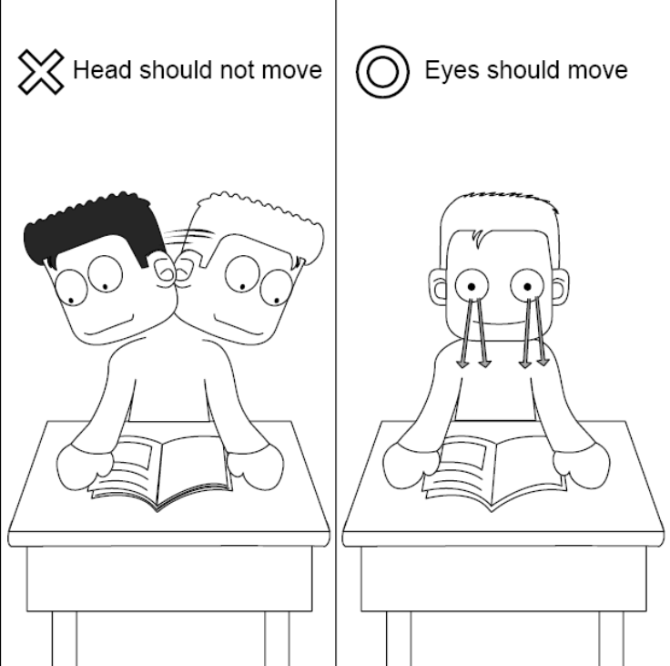
5.4 Skimming & Scanning
Use for the first slide in your presentation

Slide 2
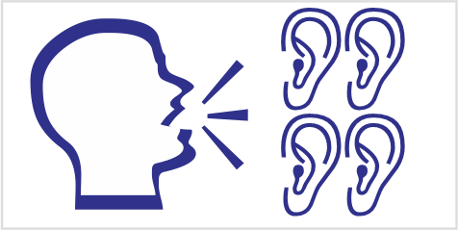
1 Introduction: When to Use
Listen to the teacher’s talk
Fill in the blanks in your workbook.

Slide 3
1 Introduction: When to Use
READING
Critical
Pleasure Scan
Skim

Slide 4

1 Introduction: When to Use
 | Scan | Skim
Definition | Look for specific facts | Search for main ideas
Use | Locate -new terms -specific info | Find main ideas Gain awareness Decide if to read Prepare to critical read

Slide 5
2 How to Skim
Listen to the talk
Follow along in your books

Slide 6
2 How to Skim
Steps to Skimming
Read title
First paragraph
  Read at regular speed.
  What is this all about?
Rest of article
  Read only a few words / paragraph.
  Look for words related to main idea.
Move your eyes not your head!

Slide 7

2 How to Skim
Assisted Skimming
Skim the article by looking only at highlighted phrases.
You have 3 (three) minutes.
Try to answer the questions without looking again at the article.

Slide 8
2 How to Skim
Skim a Long Article
You have 6 (six) minutes.
When you finish (or the time is up)’ immediately answer the questions.
Do not look back at the article once you start answering questions.
Do not start reading until you are told to start.

Slide 9
2 How to Skim
Skim a Scientific Article
You have 3 (three) minutes.
When you finish (or the time is up)’ immediately answer the questions.
Do not look back at the article once you start answering questions.
Do not start reading until you are told to start.

Slide 10
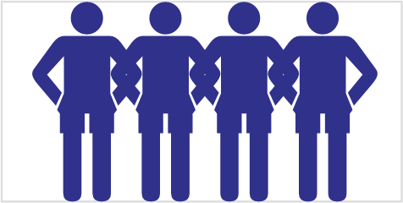
3 Skimming for the Main idea
Class Activity: Game of Competitive Skimming
Read over list of titles.
Skim the articles.
Match the title and the article.
Raise your hand when finished.
Do not start reading until you are told to start.

Slide 11
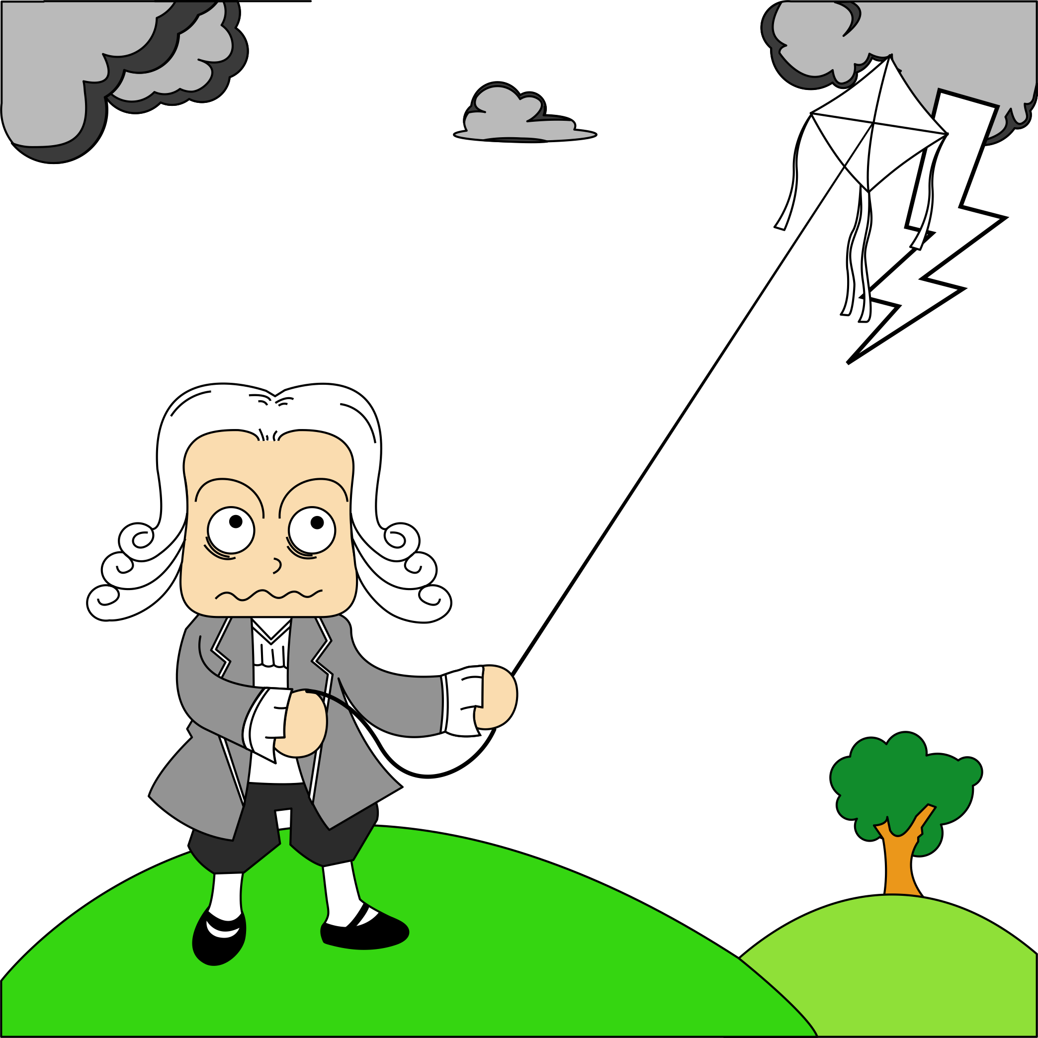
3 Skimming for the Main idea
Skim the Article
You have 3 (three) minutes.
When you finish (or the time is up)’ immediately answer the questions: “What is the main topic of this article?”
Do not look back at the article once you start answering questions.
Do not start reading until you are told to start.

Slide 12
3 Skimming for the Main idea
Demonstration
Observe the facilitator as they demonstrate skimming

Slide 13
3 Skimming for the Main idea
Read Title
Benjamin Franklin
and
Electricity
‘Franklin’ : ‘Electricity’

Slide 14
3 Skimming for the Main idea
Read 1st paragraph
Benjamin Franklin (January 17 [O.S. January 6] 1706 – April 17, 1790) was one of the most prominent of the Founders and early political figures and statesman of the United States. One of the earliest Founder, Franklin was noted for his curiosity, writings, ingenuity and diversity of interests. He shaped the American Revolution, despite never holding national elective office; a leader of the Enlightenment, he gained the recognition of scientists and intellectuals across Europe and the United States. As an agent in London before the Revolution, and Minister to France during, le mote than anything defined the new nation in the minds of Europe. His success in securing French military and financial aid was the turning point for American victory over Britain. But most important for us today is his investigations of electricity.
‘Franklin’ : ‘Electricity’

Slide 15
3 Skimming for the Main idea
Skim paragraph 2…
Franklin proposed that “vitreous” and “resinous” electricity were not different types of “electrical fluid” (as electricity was called then), but the same electrical fluid under different pressures (i.e. electrical charge). He was the first to label them as positive and negative respectively, and the first to discover the principle of conservation of charge.
‘Franklin’ : ‘Electricity’ ‘American Revolution’

Slide 16
3 Skimming for the Main idea
Skim paragraph 3…
His most famous experiment was proposed in 1750. In that year he published a proposal for an experiment to prove that lightning is electricity by flying a kite in a storm that appeared capable of becoming a lightning storm. On May 10, 1752, Thomas Francois d’Alibard of France conducted Franklin’s experiment (using a 40-foot-tall iron rod instead of a kite) and extracted electrical sparks from a cloud. On June 15, Franklin conducted his famous kite experiment and also successfully extracted sparks from a cloud (unaware that d’Alibard had already done so, 36 days earlies). Lightning was thus probed to be electrical in nature.
‘Franklin’ : ‘Electricity’ ←‘Lightning’

Slide 17
3 Skimming for the Main idea
Skim paragraph 4…
Incidentally, the next two people who attempted to repeat the experiment were killed in the effort. In his writings, Franklin indicates that he was aware of the dangers and offered alternative ways to demonstrate that lightning was electrical, as shown by his se of the concept of electrical ground. If Franklin did perform this experiment, he did not do it in the way that is often described, flying the kite and waiting to be struck by lightning, (as it could have been dramatic but fatal).
‘Franklin’ : ‘Electricity’ ←‘Lightning’

Slide 18
3 Skimming for the Main idea
Skim paragraph 5…
Franklin’s electrical experiments led to his invention of the lightning rod. He noted that conductors with a sharp rather than a smooth point were capable of discharging silently, and at a far greater distance, He surmised that this knowledge could be of use un protecting buildings from lightning, by attaching “upright Rods of Iron, made sharp as a Needle and gilt to prevent Rusting, and from the Foot of those Rods a Wire down the outside of the Building into the Ground…Would not these pointed Rods probably draw the Electrical Fire silently out of a Cloud before it came nigh enough to strike, and thereby secure us from that most sudden and terrible Mischief!” Following a series of experiments on Franklin’s own house, lightning rods were installed on the Academy of Philadelphia )later the University of Pennsylvania) and the Pennsylvania State House (later Independence hall) in 1752.
‘Franklin’ : ‘Electricity’ ←‘Lightning’→ ‘Rod’

Slide 19
3 Skimming for the Main idea
Read paragraph 6…
The importance of the lightning rod should not be underestimated, solving a very real problem – the destruction of tall buildings by lightning. Indeed, without such an invention, it is doubtful buildings greater than a few stories high would be feasible.
‘Franklin’ : ‘Electricity’ ←‘Lightning’→ ‘Rod’

Slide 20
3 Skimming for the Main idea
Summarize main idea
“Benjamin Franklin’s discovery that lightning is electrical in nature, allowed the development of lighting rods to protect buildings.”
‘Franklin’ : ‘Electricity’ ←‘Lightning’→ ‘Rod’

Slide 21
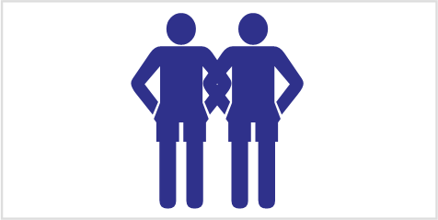
4 Skimming to Summarize
Skim the article.
You have 6 minutes.
Do not look at the questions,
Answer the questions following the article
Do not look at the article again.

Slide 22
5 Journal Entry
“Your biggest Challenge”
Tell me about a specific challenge that you have faced in university, graduate school, or work.
Tell me how you overcame it.

Slide 23
1A_OnePane
Use for standard slides (not usually)

Slide 24
1B_OnePane_Icons
Talk

Slide 25

1B_OnePane_Icons
Vocabulary

Slide 26
1C_TwoPane_Icons
Sub-section title will be here

Slide 27
2_TwoPanes_Compare

Slide 28
3_Title(NoPane)

Slide 29
Activity
Instruction for Activities

Slide 30

Activity
Homework

Slide 31

Activity
Assignments

Slide 32
Activity_2Panes
For the case in which we have two sides

Slide 33



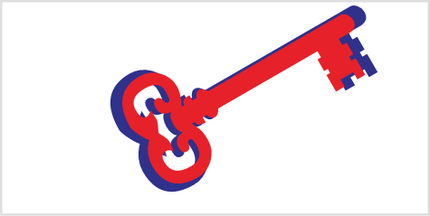
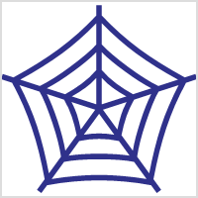

Blank Slide

