Slide 1
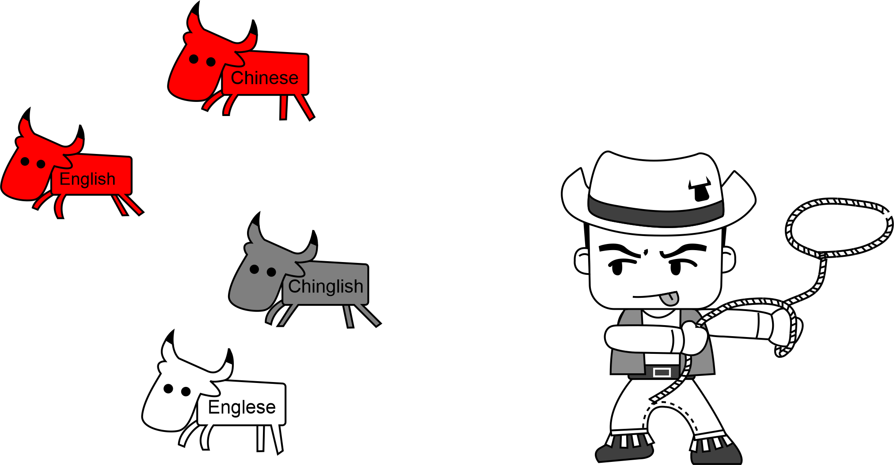
5.5 Chinglish & Englese

Slide 2

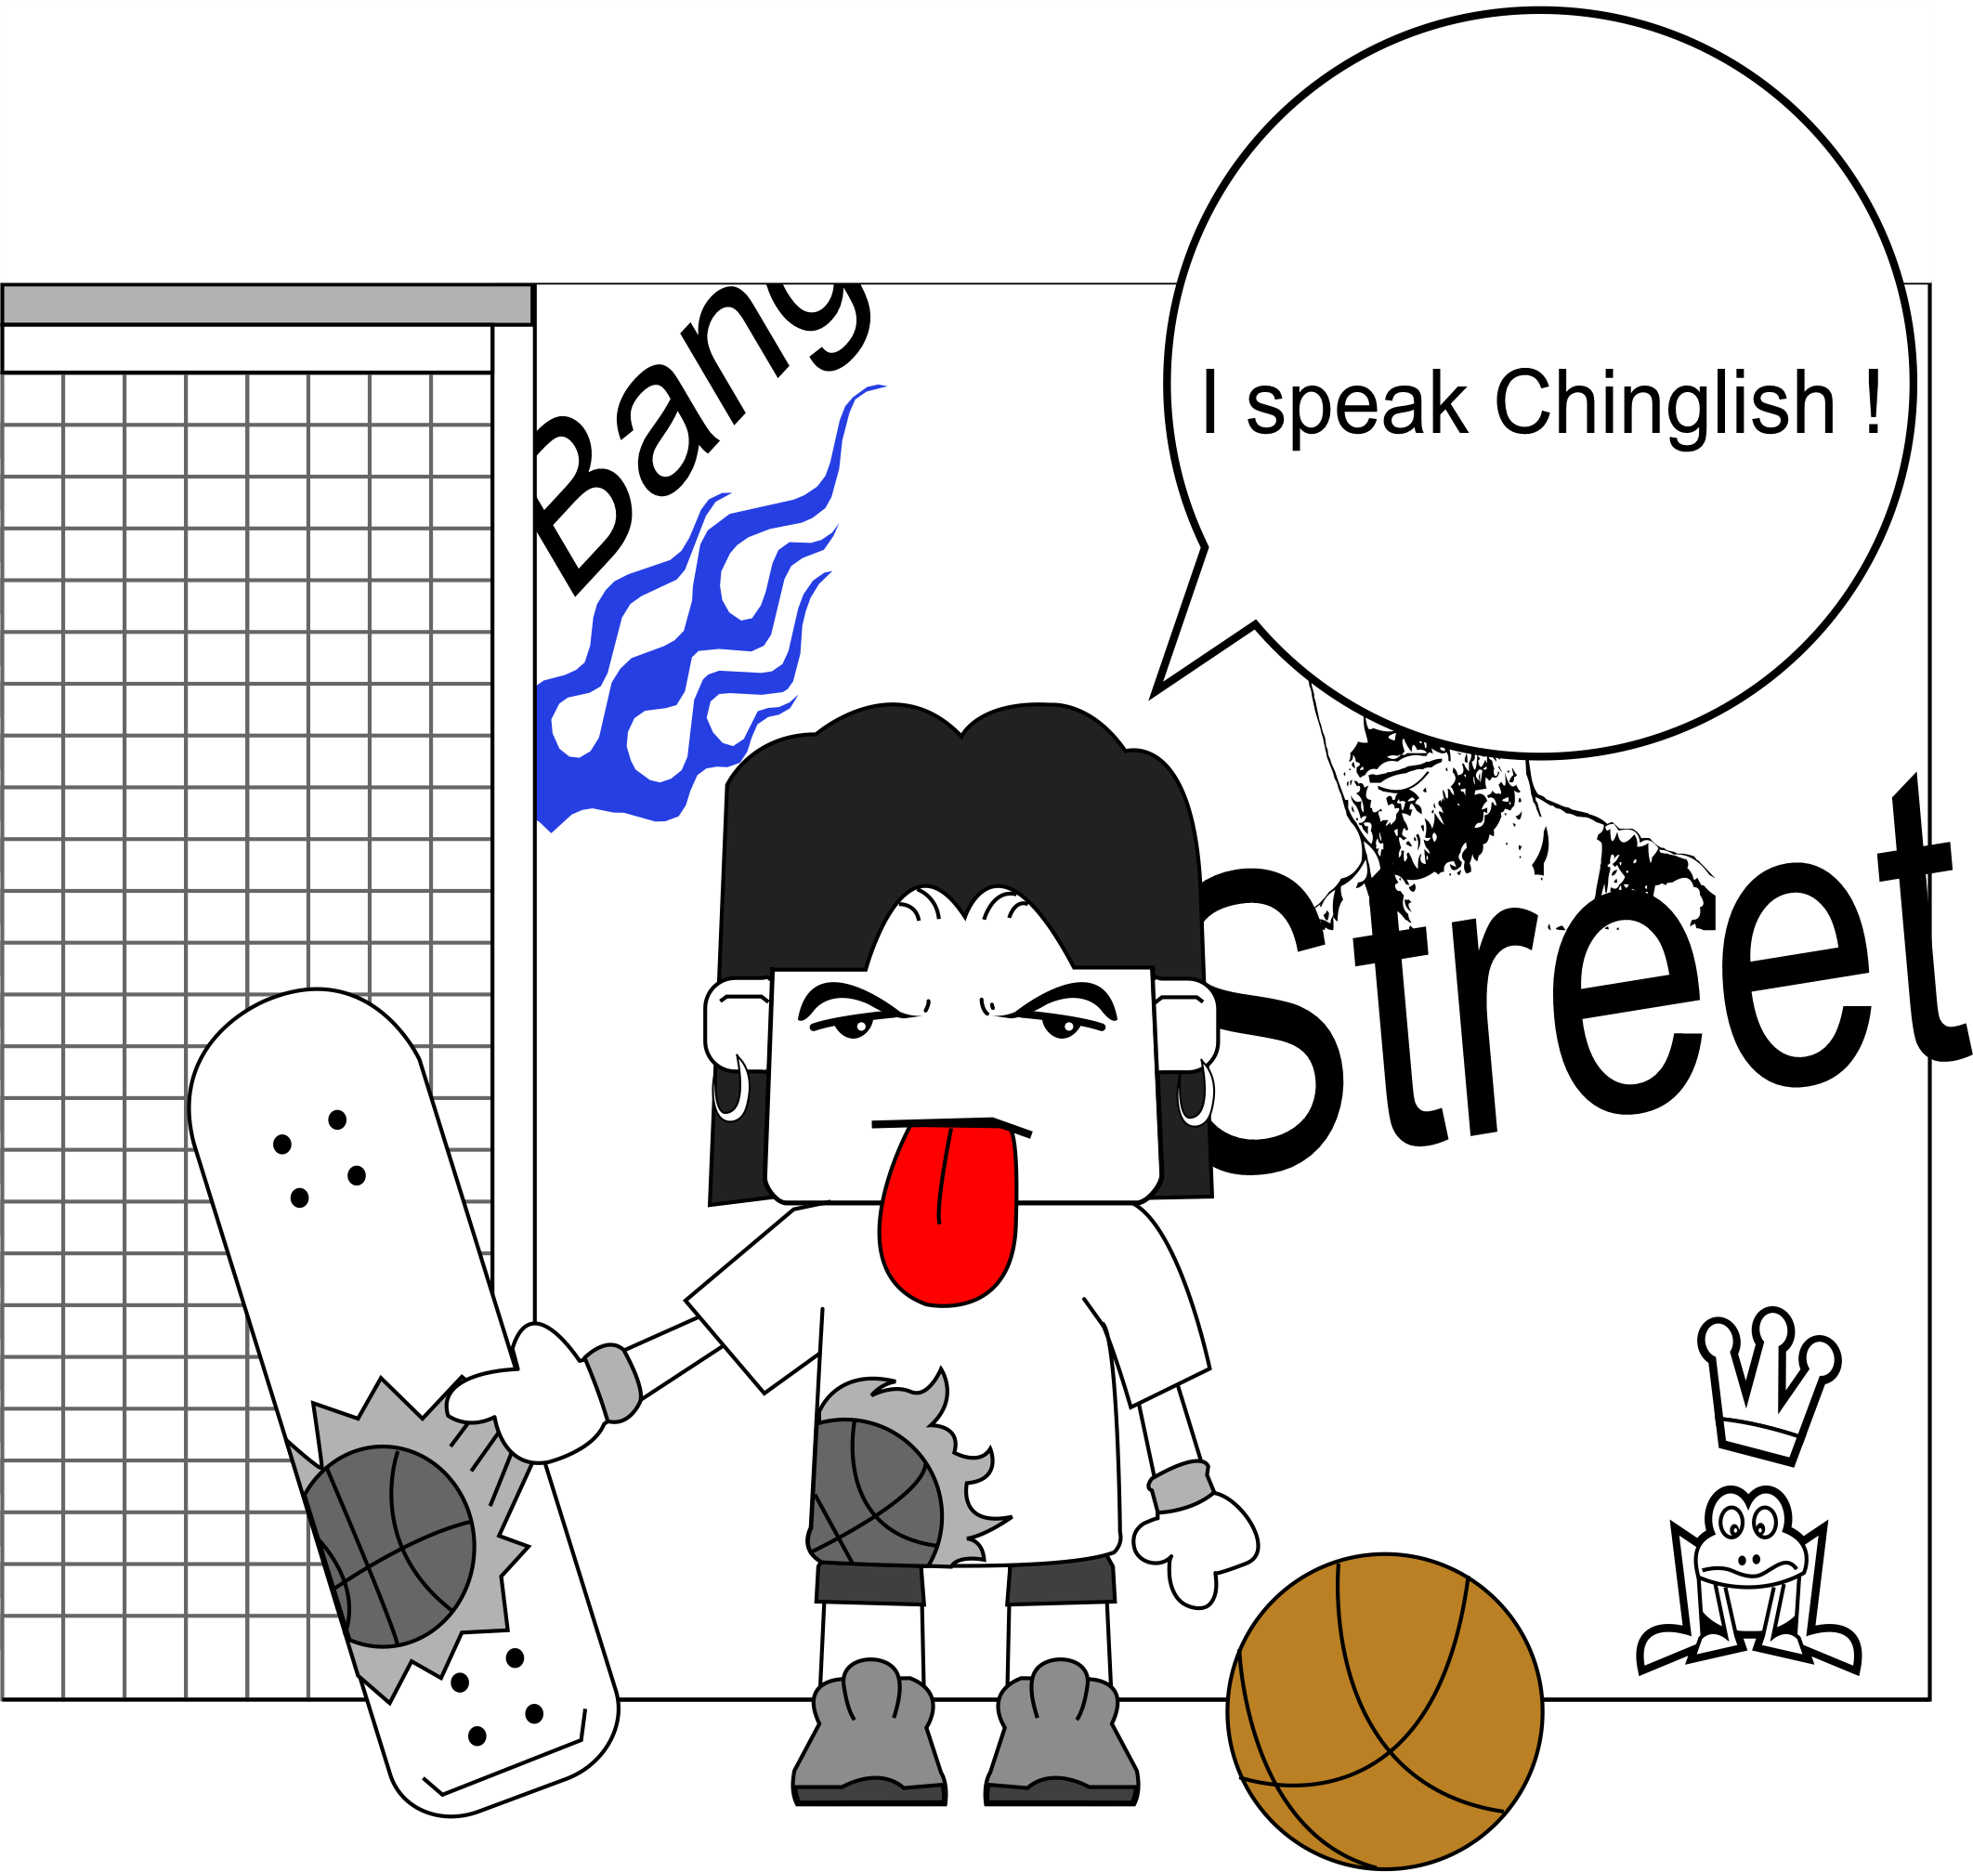

1 The Problem
Chinglish
Englese

Slide 3



1 The Problem
Understandable?
Natural?

Slide 4
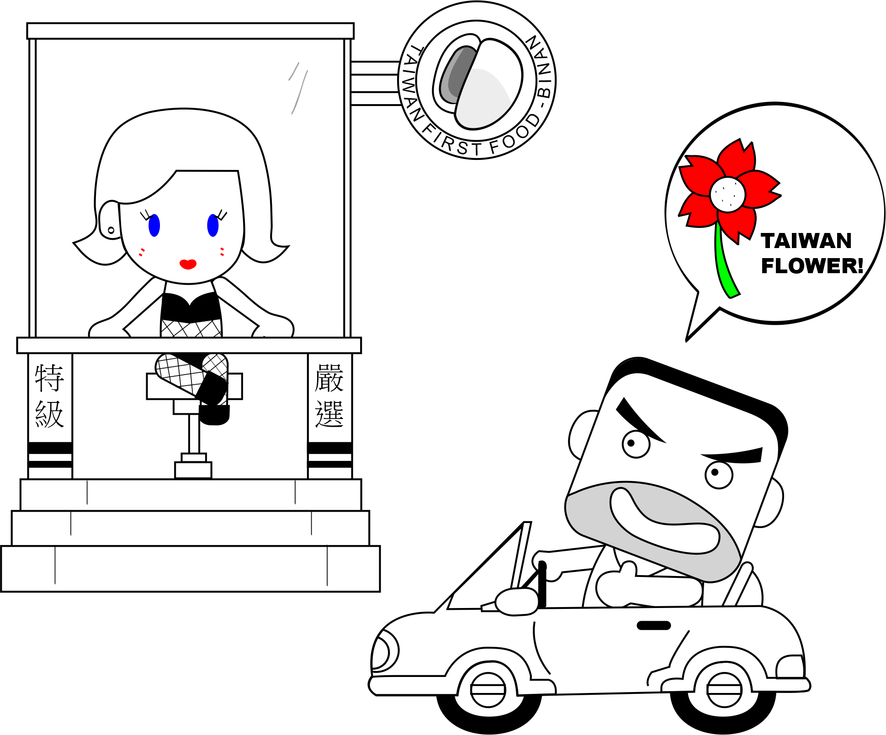
2 The Differences in Humour

Slide 5
3 Micro level Differences
Listen to the talk.
Observe the Viewgraphs

Slide 6
3 Micro level Differences
Overview
Item |  | Where | English | Chinglish | E.g.
Verbs |  | Oral | Phrasal | Single (rare)
Sentence length |  | Written | Short <2 commas | Long >3 commas
Sentence order |  | Both | By importance grammar: flexible | Fixed: logic, time cause-effect
Adverbial Sequence |  | Both | Manner-Place-Time | Time-Place-Manner

Slide 7
3 Micro level Differences (Verbs)
1. Verbs: Phrasal vs. Single
[中] 光子进入玻璃
[中En] The photon impregnated the cup.
[中En→中] 光子让杯子怀孕了
[En] The photon entered into the cup.

Slide 8
3 Micro level Differences (SL)
2. Sentence length: short vs long
I
Because English is the world language and in Taiwan, maybe situations must use that and when you speak or write need use English so may be in this class we can learn a lot of grammar, and new words, and in this class we can have conversations with every classmate.
(Ref: Steven chou, 2005, Starting Salary NT$80,000)
.
.
S
.
W

Slide 9
3 Micro level Differences (Adv)
4. Adverbial sequence: MPT vs TPM
[中] 昨天我们在他家吃中国菜。
[中EN] Yesterday, at her home we ate Chinese food.
[EN]We ate Chinese food
[EN中] 我们吃中国菜在他家昨天。
at her home
yesterday.

Slide 10
3 Micro level Differences (SO)
Sentence Order: Flexible vs Fixed
[中] 我们下午要访问老师。
[中En] We will this afternoon visit the teacher.
[En] Depends on question….
  We will visit the teacher this afternoon.
    (What are we going to do this afternoon?)
  This afternoon we will visit the teacher.
    (When are we going to visit the teacher?)
  The teacher is the person we will visit this afternoon.
    (Who are we going to visit this afternoon?)

Slide 11
3 Micro level Differences
Sentence Order: Flexible vs Fixed
[中]如果你亲她， 你就必須娶她
[中EN] If you kiss her, you must marry her.
[EN] You must marry her, if you kiss her.
[EN中] 你就必須娶她，如果你亲她

Slide 12

3 Micro level Differences
Chinglish
Understandable
Grammatically correct
but sounds strange
→Spoken English
好久不见=Long Time No see

Slide 13
3 Sequencing on Micro level
My English is very good, I have studied English at university for 4 years, doing well in Prof. White’s class, so I think I am qualified to work in your company as an translator.

Slide 14
3 Sequencing on Micro level
Long time no see

Slide 15
3 Sequencing on Micro level
Next week at Tsung Hua University we will have a party.

Slide 16
3 Sequencing on Micro level
On what topic is he pontificating?

Slide 17

3 Sequencing on Micro level
Jim: When will we work on this assignment?
Jane: We will this afternoon work on the assignment.

Slide 18
3 Sequencing on Micro level
My auntie, she heard some crying, and go outside to look for me, help me up, and ask me if I feel good.

Slide 19
3 Sequencing on Micro level
7. Recently, Air China offer 8008101111 free line which can book and send the ticket to the passenger in Beijing. In order to help Chinese and foreign passengers choose the flight of AIR CHINA, offer high-quality services to passenger, sales department of Beijing offer the free line to the passenger in Beijing and This is the first Airline which offer such free services. Free flight information, book the ticket at the earliest time, send the ticket to you hand reliable and free, join the Air China companion club to get the newest trends of Air China in time, get more favor of Travel. Just move your finger, ticket go to your hand, dial 8008101111, Air China offer you convenient services! (Courtesy of Air China)

Slide 20
4 Macro: Western vs Eastern Thought
Semitic [sum-mit-ik]
Greek [Greek]
Circular Thought
Linear Thought

Slide 21


4 Macro: Western vs Eastern Thought
Order of Importance

Slide 22
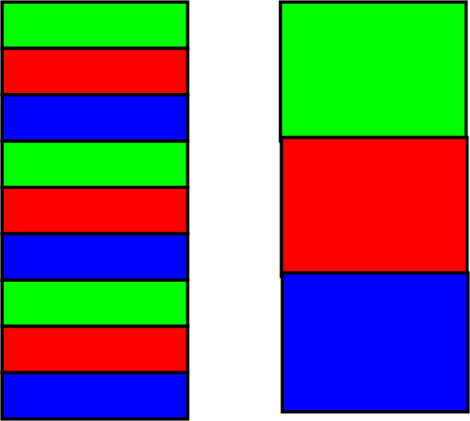
4 Macro: Western vs Eastern Thought
Circular vs Linear
Order of Importance
Circular vs. Linear

Slide 23
4 Macro: Western vs Eastern Thought
So What?
1:1 interactions
Writing Scientific Papers
Reading Scientific Paper

Slide 24
4 Macro: Western vs Eastern Thought
Order of Importance
Circular vs. Linear
Importance
Your thinking?
Main request: | Other | Beginning | Middle | End
#(%) students

Slide 25

4 Macro: Western vs Eastern Thought
Re-Read your letter of request (last homework)
Re-Sequence. Decide how it should be changed to reflect an English sequence of ideas.
Re-Move any Chinglish.
Re-Write the letter.

Slide 26


5 Homework & Assignments
Complete the re-sequencing of the sentences.
Complete rewriting your letter of request.
Next class please bring a photocopy of an English Paper in your field that you have not read. It should be ~2 pages long.

