Slide 1
Reading for Information

Slide 2


1 Approaching an Article
time
spent
Listen to the talk
Info
in

Slide 3

1Approaching an Article
Tricks of the Trade
What is the paper about?
What is new, interesting or important?
What parts do you need to focus on for your research?
Slim the article once: answer the 1st question (5’)
Skin again: answer question 2 (5’)
Skim a 3rd time: answer question 3 (5’)

Slide 4
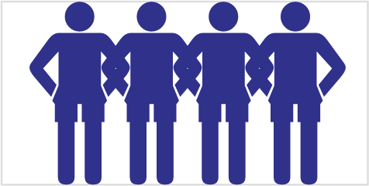
1Approaching an Article
Tricks of the Trade
What is the paper about?
What is new, interesting or important?
What parts do you need to focus on for your research?
Discuss your answers
Are the answers of all group members similar?
  Q#1 – Yes or No
  Q#1 – Yes or No
  Q#1 – Yes or No

Slide 5
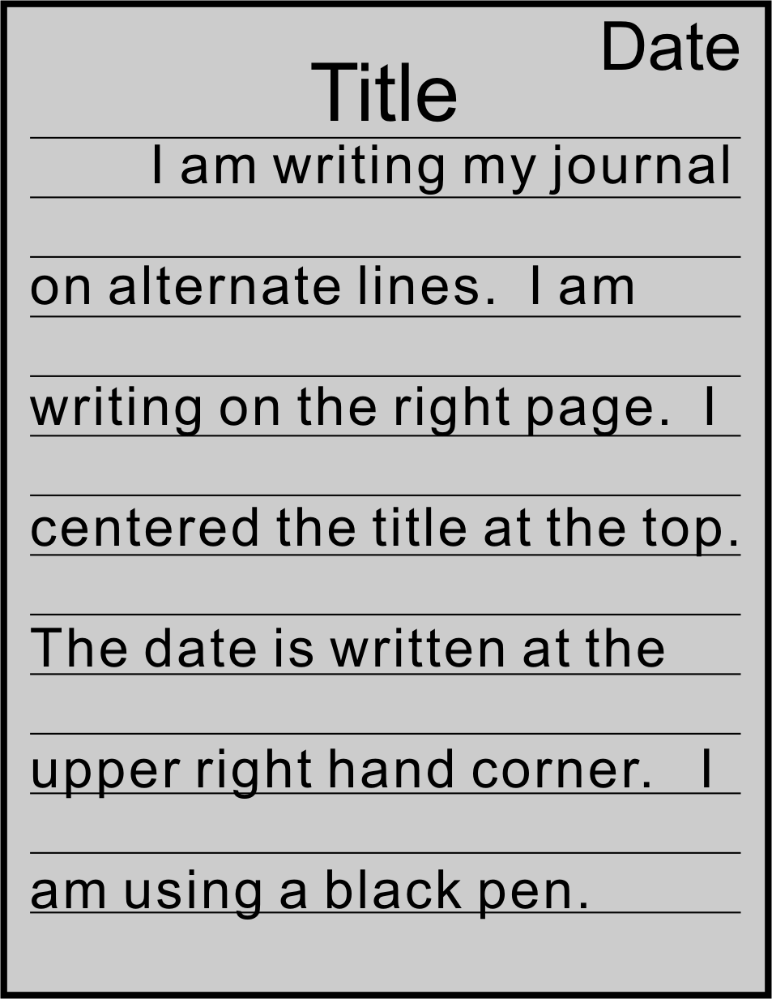
2 Journal Entry
“The Current Status of my Research”
Tell me about the current status of your studies.
Is it smooth sailing or have you become bogged down?
How do you feel about it?
Are you satisfied?
Are you frustrated?

Slide 6
3 Reading a Journal Article
Listen to the talk.
Follow along in your books.

Slide 7

3 Reading a Journal Article
1. Questions to keep in mind
What problem? Why important?
What did they do?
What is interesting or new?
What methods?
Do all the pieces of their work fit together?
What results? Did they do what they set out to do?
Value
Skimming
Validity
A + B → C → D → F!
Critical Reading

Slide 8
3 Reading a Journal Article
1. Questions to keep in mind
What problem? Why important?
What did they do?
What is interesting or new?
What methods?
Do all the pieces of their work fit together?
What results? Did they do what they set out to do?
Can a person reading your paper find answers to these questions easily?

Slide 9
3 Reading a Journal Article
2. Multi-Step Process
Read the Title & Abstract slowly. Use dictionary.
Study Figures and Captions carefully
Skim the text (3 passes) rapidly:
  What is the paper about?
  What is new, interesting, or important?
  What parts do you need to focus on for your research?
Read interesting sections critically.

Slide 10
3 Reading a Journal Article
2. Multi-Step Process
Read Title & Abstract slowly. Use dictionary.
Study Figures and Captions carefully
Skim the text (3 passes) rapidly:
  What is the paper about?
  What is new, interesting or important?
  What parts do you need to focus on for your research?
Read interesting sections critically.
→ Apply this multi-step approach to a paper in your field or the cone at the end of the book.
3’
3’
5’
5’
5’
x’

Slide 11
4 Sentence Trees
Listen as the teacher explains how to play the game.

Slide 12
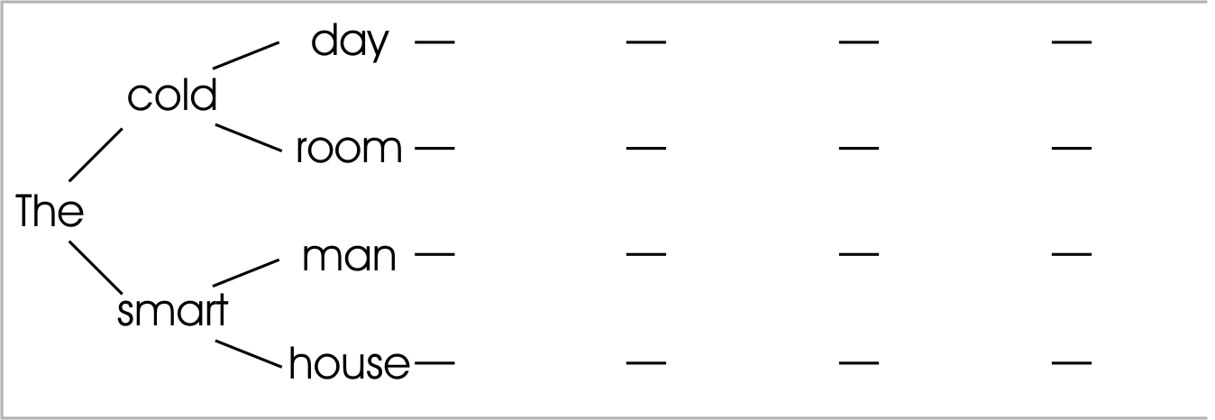
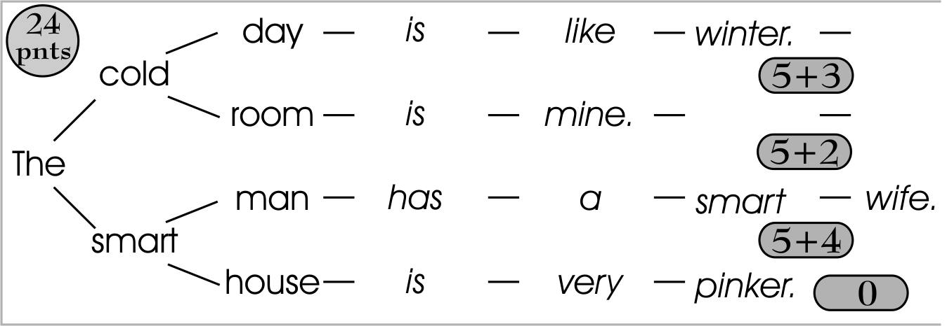
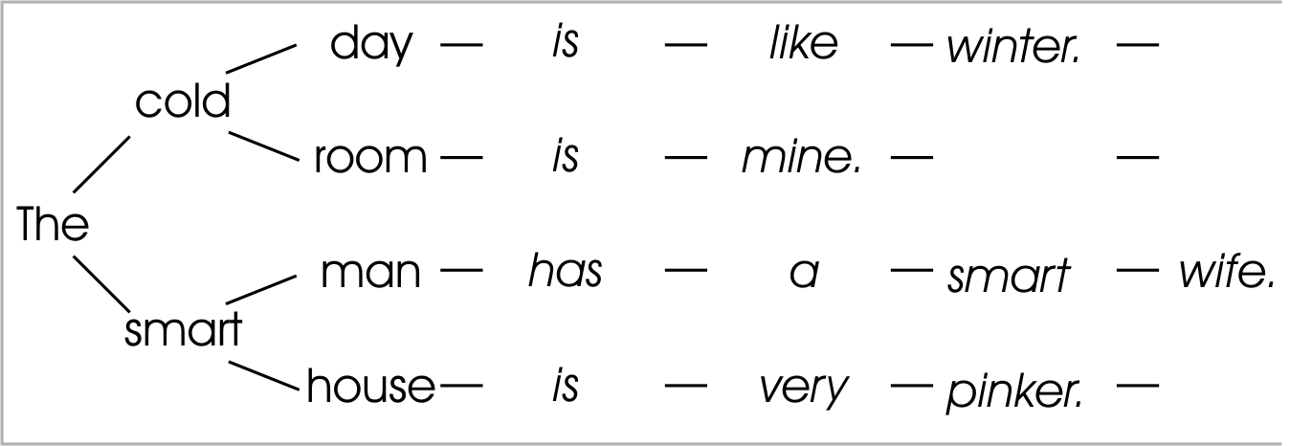


4 Sentence Trees
Task
→ Scoring
Task: write 4 sentences starting with the given words.
  5 points / correct sentence
  1 point/word in a correct sentence

Slide 13
4 Sentence Trees
Divide into teams of four.
Complete 4 grammatically correct, single phrase sentences based on the given question.
Total time = 10’
After 8’ I will start checking your sentences, after I check you may correct (until 10’ point)

Slide 14
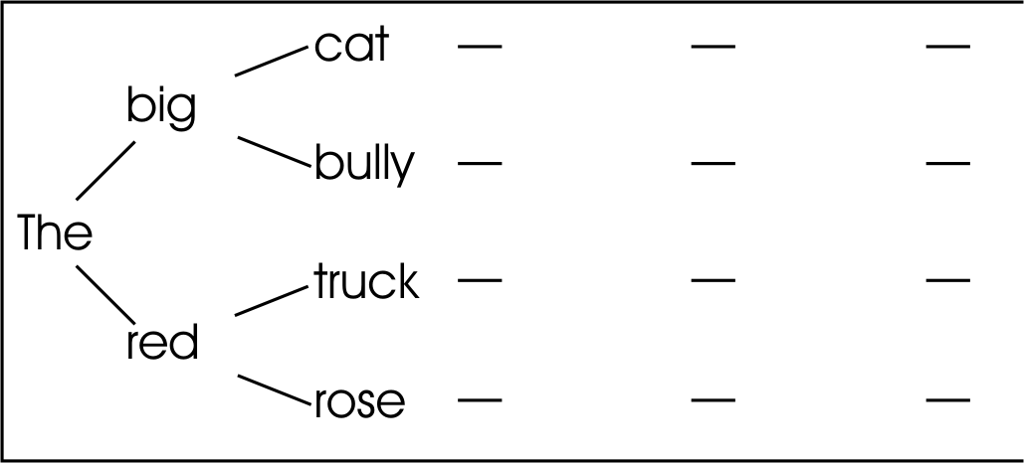
4 Sentence Trees

Slide 15
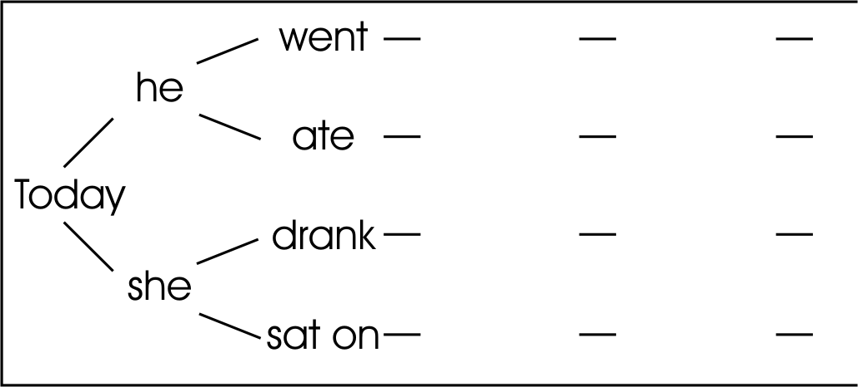
4 Sentence Trees

Slide 16


5 Homework & Assignments
Homework
Apply the reading techniques discussed in this lesson to a Journal Article in your field
(The article does not need to be written in English.)

Slide 17
1A_OnePane
Use for standard slides (not usually)

Slide 18
1B_OnePane_Icons
Talk

Slide 19

1B_OnePane_Icons
Vocabulary

Slide 20
1C_TwoPane_Icons
Sub-section title will be here

Slide 21
2_TwoPanes_Compare

Slide 22
3_Title(NoPane)

Slide 23
Activity
Instruction for Activities

Slide 24
Activity
Homework

Slide 25

Activity
Assignments

Slide 26

Activity_2Panes
For the case in which we have two sides

Slide 27



Blank Slide

