Slide 1
5.7 Learning from Mistakes

Slide 2

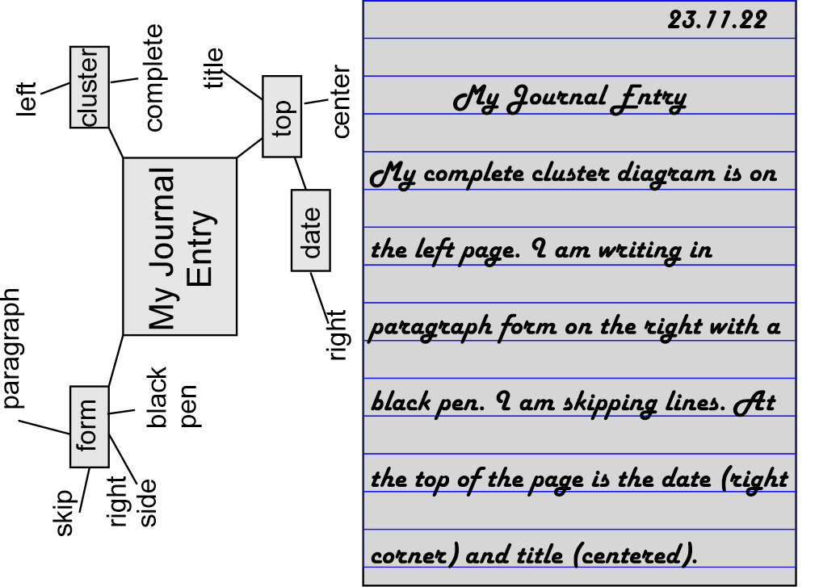
1 Journal Entry
Earliest Memory
Test me about your earliest childhood memory.
Was it happy? Was it sad?
Hypothesis: Why do you remember this?
Prove hypothesis

Slide 3


2 Cover Letters
So What? Inappropriate Content
Dear Mr. Tu:
Please consider me an application for the position you advertised on March 24. The position you described sounds exactly like the kind of job I am looking for.
I am 25 years of age and unmarried. I graduated from the Yuan Ze University of electrical engineering. Enclosed herewith is a copy of my resume for your reference. U have studied Fuzzy control, neural network, linear system.

Slide 4
2 Cover Letters
Chinglish
Dear Sir:
I read your advertisement and I am interested in the position of software engineer. Your company has a good reputation to exist between customers for designing software and producing high-quality products.
My department was electrical engineering when I studied in college. Afterwards, I studied electrical-optics at Yuan Ze University for institute. When I was in university, I was interesting in software design. So, I took some courses about software design, for example, C-programming, assembly language programming, and matlab.
I studied electrical engineering in college.
As I was interested in software,

Slide 5
2 Cover Letters
Acronyms
YZU → Yuan Ze University
Dear Sir:
First, I appreciate that you spend time reading this letter. I read the want-ad via YZU website, There is a position of professor occupation and that’s what I am interesting in.
YZU is my Alma school for my bachelor and master diploma, As you can see from the attached resume, I have excellent performance not only in academic but also in research ability. Life in YZU made my stronger and pushed me up to a higher level. It’s the reason that I feel like to apply for this job in return. YZU is co familiar to me that I believe I can adapt the environment as soon as I can.

Slide 6
2 Cover Letters
Acronyms
?
“In my second year at YZU, I switched from CIS to PE. Upon graduating I took a job at ITRI. After 2 years I switched to TIRI where I am now working.”

Slide 7
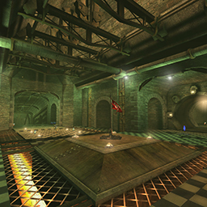
2 Cover Letters
English Romanization of Names
I graduated from the University of Yuan-Ze in electrical engineering. The university is located in Nali City, Taiwan.
Yuan Ze University
Ref: Nali City (Computer Game)
Neili

Slide 8
2 Cover Letters
Spelling Counts
…
I got the CIE Student Affiliation, 2004 Engineering Essay Competition Award in my B.S. period. And some journal and conference papers I wrote with my supervisor have been published. Those can certificate I have enough ability to serve this position. Moreover, teaching seems very important to me for next generation. Only having god education, we can improve our life both the physicality and spirit. Currently, I sometimes teach the university students in Engineering Circuit class. It’s seems inestering to me.

Slide 9
2 Cover Letters
Grammar: Use computer to check
Dear Sir.
I find your advertisement in 104 human resources bank for software engineer recently. Your company has good working and learn environment for employee that from my friends and co-work. Having fluently promotion ways for every working hard employee. Also having food relax environment for example golf practice plane, blowing, swimming pool…etc.
MS-WORD: “Fragment (Consider Revising)”

Slide 10

2 Cover Letters
Avoid…
Unrelated information
Chinglish
Acronyms: Use whole words.
Unique Romanizations: Check Internet
Spelling mistakes: Use a spell checker
Grammar mistakes: Use a grammar checker

Slide 11

3. The Resume: Your Strengths
→
Ignore the Negative
Emphasize the Positive
Education: B.S., Electrical Engineering, Yuan Ze Master.,
  Photonics, Yuan Ze University
Employment History: None
Language: Chinese, Taiwanese, English

Slide 12
3. The Resume: Your Strengths
Ignore the Negative
Emphasize the Positive
→
Awards: Yuan-Ze You Syang scholarship at YZU(2000, 2004) Kwo-Tai Life Insurance student scholarship Yuan-Ze, Best Engineering Institute Dissertation Award
Employment History: Study-work at OES, ITRI (2005-6)
Languages: A little bit English, Chinese, Taiwanese
Interests: President, YZU Dept. of Electrical Engineering, 2001-3 YZU volleyball team member, 2000-2004
Chinese (fluent), Taiwanese (fluent), English

Slide 13
4 Resume Supports Cover Letter
→
Resume agree with the cover letter
Resume supports the cover letter
I read with interest your advertisement in newspaper for the position of Software Engineer in Tamsui Technical Co. Inc. TTC programs and designs…
Address: Dept of Electrical Engineering, Yuan Ze University, 135 Far-East Rd., Chung-Li, Taiwan, 320. Tel: 886-3-463-8800#2414#33
Position Desired: Postgraduate of Control System
Education: M.S. Degree, University of YZU, Sep 2006

Slide 14
4 Resume Supports Cover Letter
Resume agree with the cover letter
Resume supports the cover letter
…2004 Engineering Essay Competition Award in my B.S. Some journal and conference papers I wrote with my supervisor have been published.
Position Desired: Tenure-Track Positions in EE
Related Skill: 1. Resonant Theory
2. Power Electronics
Education: M.S.(EE) at Yuan Ze University, in process
B.S. (EE), Yuan Ze University, 2004.
Interests: Movies, internet, fishing, baseball
→

Slide 15
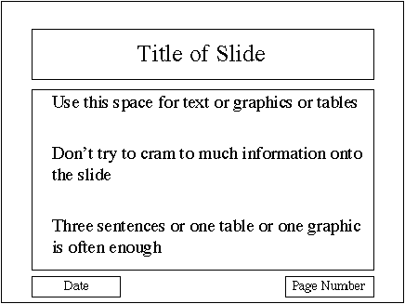
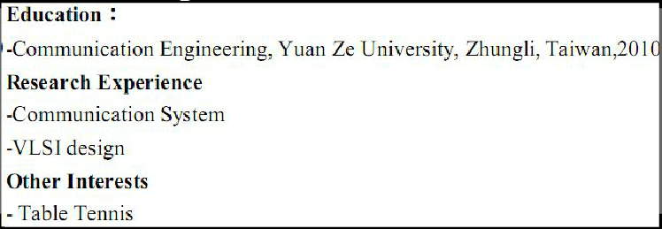
4 Resume Supports Cover Letter
Resume agree with the cover letter
Resume supports the cover letter
…focus on my major and practice English skills. Even though I have high score in TOEIC, I still think I should practice more conversation….
→

Slide 16
5 Meaning, Context and Culture
Nothing about her abilities
related to the job!
Dear Sir:
…My name is Shelly.
I am twenty-six years old and single.
I am a student at Yuan Ze University now.
I live in Hsinchu with my family. I have a sweet family. We love each other …
I still need to learn so many things…
Sincerely yours,
XXX
I am twenty-six years old
single
I still need to learn so many things

Slide 17
5 Meaning, Context and Culture
Western versus Japanese Corporate Culture
Listen as Teacher introduces

Slide 18

6 The Phrasal Verb “Put”
Remember…
Phrasal Verbs
  can be separated.
  may/must* have idiomatic meaning
Prepositional verb
  cannot be separated.
Phrasal
  I’ll put up Susan.
  I’ll put Susan up.
Prepositional
  I’ll jump on the computer.
  I’ll jump the computer on.
*terminology inconsistent
ESL: may
Linguistics: must

Slide 19

6 The Phrasal Verb “Put”
Write a short story.
Maximize the use of phrasal verbs starting with “put”.
Put off
Put on
Put out
Put up
Put up with
Put down
Put back
Put aside

Slide 20


7 Homework & Assignments
Assignments
Complete the reading speed test a second time.
Give your final score (after reading 4 articles) to the teacher

Slide 21
1A_OnePane
Use for standard slides (not usually)

Slide 22
1B_OnePane_Icons
Talk

Slide 23

1B_OnePane_Icons
Vocabulary

Slide 24
1C_TwoPane_Icons
Sub-section title will be here

Slide 25
2_TwoPanes_Compare

Slide 26
3_Title(NoPane)

Slide 27
Activity
Instruction for Activities

Slide 28

Activity
Homework

Slide 29
Activity
Assignments

Slide 30

Activity_2Panes
For the case in which we have two sides

Slide 31


Blank Slide

