Slide 1
Falling Objects
Generalizing the Solution → UML

Slide 2
Formalize → UML (Basic)

Slide 3
UML (Using Repetition)
Need a stop condition.
Choose to input negative time as it will not occur

Slide 4

UML (Use Repetition, Run Twice)
Read
v₁, t₁
Read
v₂, t₂
t₂ < 0.0
Read
v₂, t₂
[False]
t_{avg}=(t₁+t₂)/2
$$v=\frac{∆v}{∆t}=\frac{(v2−v1)}{(t2−t1)}$$
v₁ ₌ v₂
t₁₌ t₂
Save
a, t_{avg}
Acceleration
Input is v not h
Velocity

Slide 5
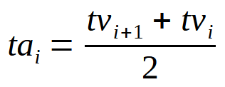
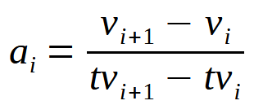
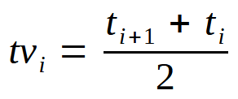
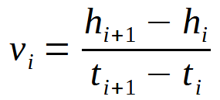
UML Arrays (Run Once)
i=0;
Input
Acceleration
i=0;
Read h_{i}, t_{i}
i++;
(Count entries)
i++;
More data?
i < ndata - 2
t_{i} < 0.0
Output
i=0;
Velocity
ndata=i;
i=0;
i++;
i < n
i < ndata - 1
Write
h, th, v, tv, a, ta
LOOPS #
do..while 1
for/while 3
i++;

Slide 6
UML Core Program

