Slide 1
Falling Objects
From Problem Definition to Solution

Slide 2
Falling Objects
Using Pointers
[Calling fscanf() from your function]

Slide 3
Create One’s Own Input Functions
Problem: Without pointers, one can only return one value from a function
Solution: Use two (2) pointers!
Replace jinlib.h /getFloatPrompt()
Create your own function to get x and t together in one function call
Hints: Your function should:
  Prompt the user for x then t using…
  Read the next values of x and t using…
Call your new function from the main program two times to get the variables.
void getXT(….);
fprintf (stdout,…);
fscanf(stdin,…);

Slide 4
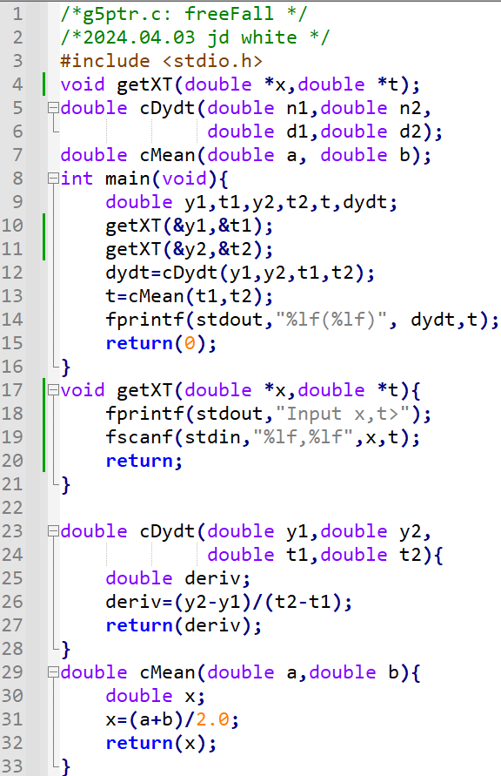
Create One’s Own Input Functions
The compiler only cares
about the types and
the number of parameters
— it ignores the names here.
→ Modify Code

Slide 5
Run the Code
gcc –c –Wall -g g7ptr.c
gcc –o g.exe g7ptr.o
g
→ Run Code (gdb?)

Slide 6
Pointer Code Analysis (Head)
Info for Human Reader: program name, purpose, author, version
To Pre-processor: Function prototypes: other files
Function prototypes (this file)
The prototype tells us the function
requires 2 addresses to be given
by the calling program.
The function will prepare 2 pointers
to receive the addresses.

Slide 7
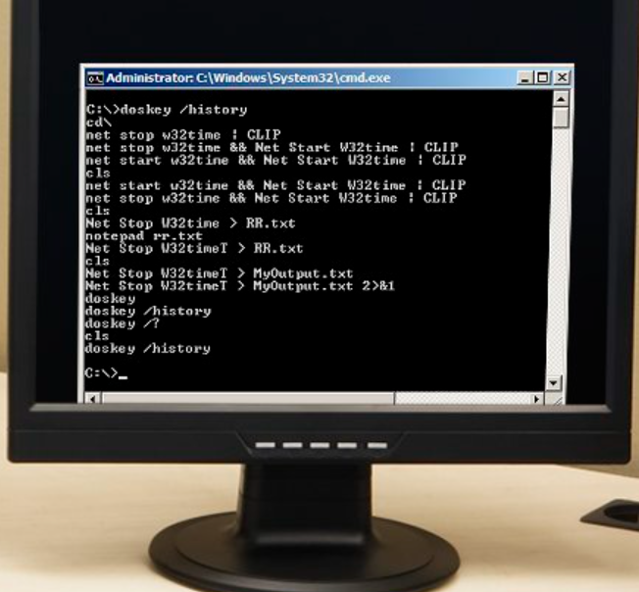
Pointer Code Analysis (Input)
getXT()
fprintf()
x
0.425e2
t
0.00e-9
Input x,t>
fscanf()
⌨
%lf,%lf
Input (x,t)> 42.5,0
Input (x,t)>

Slide 8
Pointer Code Analysis (Input)
getXT()
fprintf()
x
0.425e2
t
0.00e-9
Input x,t>
0.395e2
fscanf()
0.78e0
⌨
%lf,%lf
Input x,t> 42.5,0
Input x,t>
39.5,0.78

Slide 9
Pointer Code Analysis (Calculations)
0.425e2
0.00e-9
0.395e2
0.78e0
-0.385e1
cDydt()
cMean()
0.39e0
fprintf()
Input (x,t)> 39.5,0.78
-3.85000,0.390000,

Slide 10
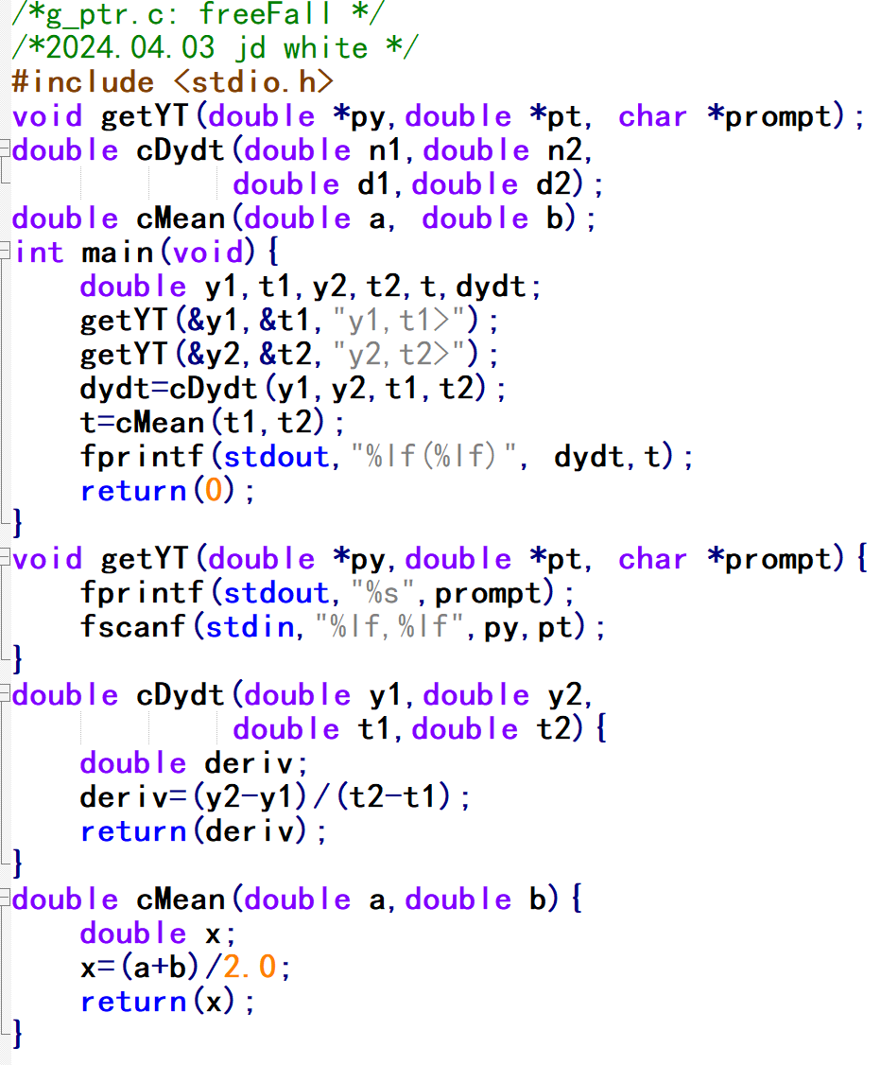
More Elegant Input Function
prompt
y
1
,
t
1
>
/0
Using an array
of type char
(called string)
Using an array
of type char
(called string)
Using an array
of type char
(called string)
Get the Code
g6ptr_prompt.c

